Slide 1
Monitoring Your Progress
Taking the TFI

Slide 2
Taking The TFI
To identify our perception of our current implementation status
To celebrate our success and plan for sustaining those efforts
To determine next steps of implementation
To communicate with staff
Purpose

Slide 3
Opening the Survey
www.pbisapps.org
Notes:
ACTIVITY: Pull up a SAS report (item analysis)
1. Fidelity (TFI or BoQ)
Perception (SAS)
Outcome (ODR, Attendance)
2. Precision statement, What, where, when, why, who

Slide 4
Opening the Survey
Notes:
ACTIVITY: Pull up a SAS report (item analysis)
1. Fidelity (TFI or BoQ)
Perception (SAS)
Outcome (ODR, Attendance)
2. Precision statement, What, where, when, why, who

Slide 5
Opening the Survey
Notes:
ACTIVITY: Pull up a SAS report (item analysis)
1. Fidelity (TFI or BoQ)
Perception (SAS)
Outcome (ODR, Attendance)
2. Precision statement, What, where, when, why, who

Slide 6
External Facilitators will guide your team
Opening the administration ppt.

Slide 7
Process for taking the TFI
The coach will have the survey open on pbisapps and record the vote of the team
A facilitator will have the survey open and read and show the questions and criteria for voting to the team
The team will briefly assess current status and vote using a visual signal response to as indicated by the scoring criteria
0=not implemented
1=partially implemented
2=fully implemented

Slide 8
Coach will Enter Your Team’s Score – keep paper copy too!
Notes:
Slides 27-31 are about entering TFI scores. These are included so the whole group can see how easy it is and because typically it is not the same person entering it from training to training.

Slide 9
Coach will Submit Your TFI
You are only required to Tier 1 of the TFI
After Tier I is done…..scroll down to the bottom of the page CLICK NEXT
Scroll down to the bottom of the page and CLICK SUBMIT

Slide 10
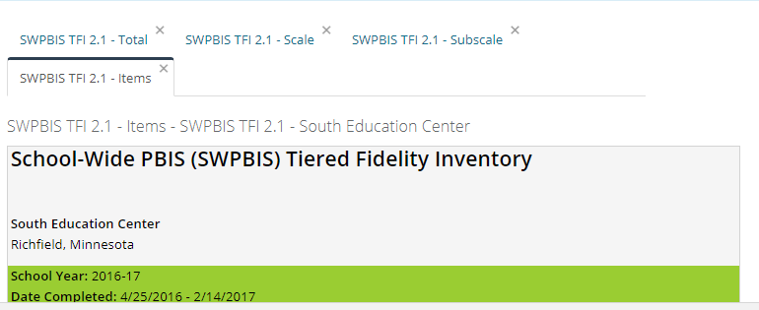
Pull All Reports and Review As a Team
Total
Scale
Subscale
Items

Slide 11
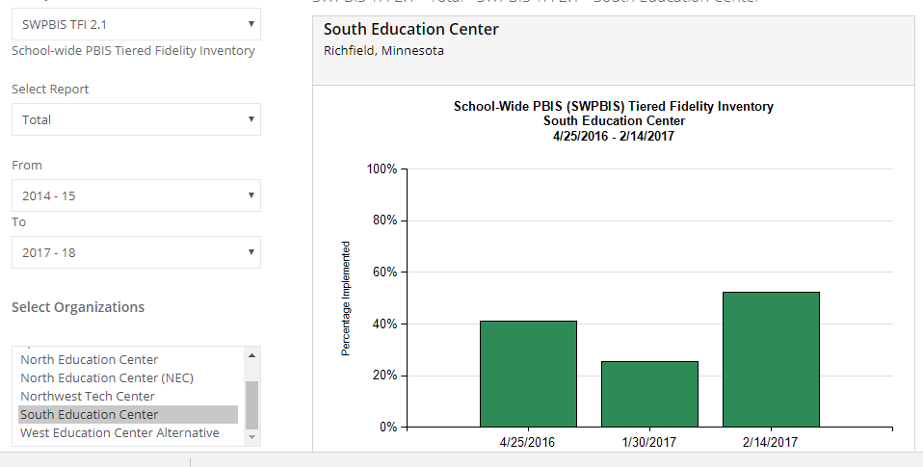
Total Report

Slide 12
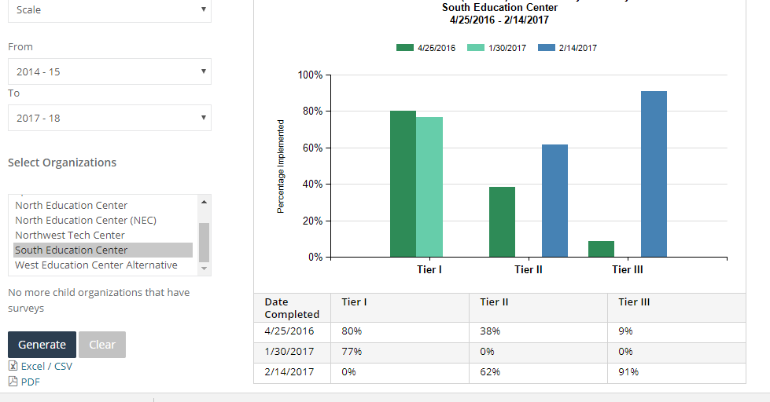
Scale Report

Slide 13
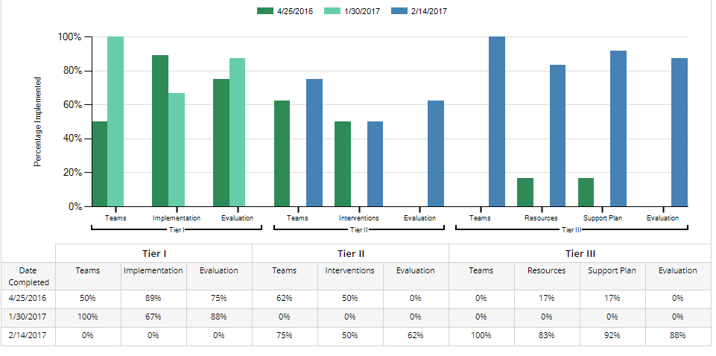
Subscale Report

Slide 14
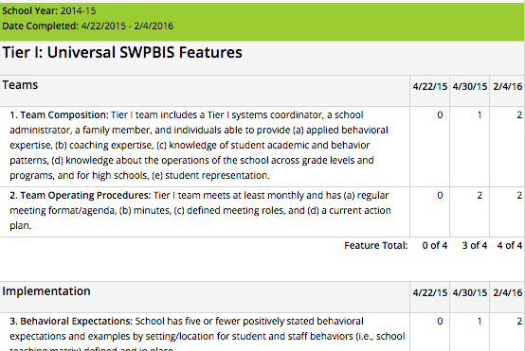
Action Planning: Items Report
Use the Action Planning Resources found at www.bit.ly/TFIResources
Copy & paste into your drive
U
Choose 1-3 items to take action on
Develop a plan to share with staff to increase their knowledge and willingness to participate
Your External Facilitator will help guide your action planning
Notes:
The items report is used to choose action steps.

Slide 15
Our Process for Taking the TFI
While you wait to take the TFI here are some suggested items to work on:
Effective Teaming
Team Roles & Responsibilities
Establishing 3-5 Expectations
Teaching Expectations
Lesson Plans
Schedule for Teaching
If you have not taken the TFI put your “We need help” sign over your team tent so facilitators know where to go next.

