Slide 1
PBIS Team Training 9B
Sustaining Tier 1

Slide 2
Learning Expectations
EXPECTATION | BEHAVIOR
Be Responsible | Make yourself comfortable Take care of your needs (water, food, restroom, etc.) Action plan to implement what you are learning Follow through on your action items
Be Respectful | Turn cell phones off or to “vibrate” Listen attentively while others are speaking Have only the training materials up on your computer/tablet/phone
Be Engaged | Ask what you need to know to understand and contribute Contribute to the group by sharing relevant information and ideas
Notes:
2

Slide 3
Tier 1: Professional Learning Roadmap Look how far you have come!
TFI Sub-Scale: Team
TFI 1.1 | Team Composition
TFI 1.2 | Team Operating Procedures
TFI Sub-Scale: Evaluation
TFI 1.12 | Discipline Data
TFI 1.13 | Data-based Decision Making
TFI 1.14 | Fidelity Data
TFI 1.15 | Annual Evaluation
TFI Sub-Scale: Implementation
TFI 1.3 | Behavioral Expectations
TFI 1.4 | Teaching Expectations
TFI 1.5 | Problem Behavior Definitions
TFI 1.6 | Discipline Policies
TFI 1.7 | Professional Development
TFI 1.8 | Classroom Procedures
TFI 1.9 | Feedback and Acknowledgement
TFI 1.10 | Faculty Involvement
TFI 1.11 | Student/Family/Community Involvement
8 Classroom Management Practices
1 | Arrange orderly physical environment
2 | Define, Teach, Acknowledge Rules and Expectations
3 | Define, Teach Classroom Routines
4 | Employ Active Supervision
5 | Provide Specific Praise for Behavior
6 | Continuum of Response Strategies for Inappropriate Behaviors
7 | Class-Wide Group Contingency
8 | Provide Multiple Opportunities to Respond

Slide 4
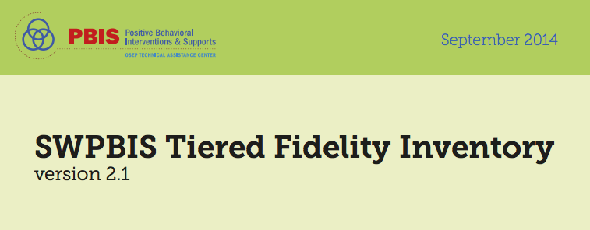
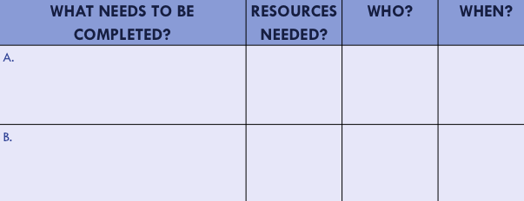
Organization of Modules
Content:
Aligned to TFI Items 1.1 – 1.15 and Classroom Management Practices
Activities/Team Time: Activities for Fluency
Self-Assessment:
Tiered Fidelity Inventory
Action Planning: Applying the core content to your school
Notes:
These are the icons that you will see throughout the training and will serve as a guide and a prompt to the content of each slide.

Slide 5
Purpose and Outcomes
Purpose:
Identify actions for a school-wide team to sustain the core practices of Tier 1 PBIS
Outcomes:
Create action plan to help sustain PBIS at your school.

Slide 6
Big Ideas of SW-PBIS
Identify & define behavior expectations
Teach behavior expectations
Monitor expected behavior
Encourage/acknowledge appropriate behavior
Correct behavior errors through a continuum of consequences that begins with teaching/re-teaching
Use data for decision making
Notes:
All about prevention
Creating predictable environments
Based on a model of teaching and re-teaching
Matching behavior supports to student need, based on data
All staff providing support to ALL students across ALL settings

Slide 7
60 Second Chat
At your table, discuss the core practices that have been the most successful at your school .

Slide 8
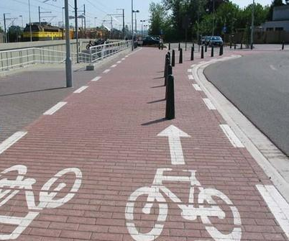
Avoid Obstacles
Identifying barriers (and plans to address them) is a critical step in systems-level change
(Curtis, Castillo, & Cohen, 2008)

Slide 9
Barriers to Sustainability:
The Three Cs
Antecedent
Behavior
Consequence
Ongoing
Challenge
Select Practices
& Implement
with Fidelity
Student
Outcomes
Changes in Context
- Lack of contextual fit
- New challenges exist
- Competing initiatives
Changes in Capacity
- Loss of funding
- Attrition of key personnel
Changes in Consequences
- Diminished effectiveness due to poor fidelity
- Outcomes no longer perceived as important
Notes:
Under the circles are the barriers to each area - spend a brief time explaining each

Slide 10
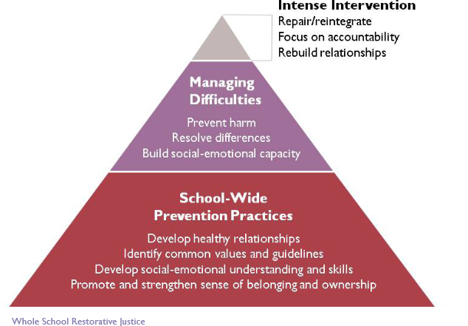
PBIS is a FRAMEWORK
Think about how new initiatives
fit into the framework.

Slide 11
SEL and PBIS
SEL
Provides explicit instruction to foster social and emotional development
Promotes emotionally safe environments
Focuses on core competencies:
Self-Awareness
Self-Management
Social Awareness
Relationship Skills
Responsible Decision-Making Skills
PBIS
Provides explicit instruction to foster effective conditions for learning
Promotes physically safe environments
Provides
Common purpose
Common Language
Common approach to discipline within the school setting
Positive approach to handling misbehavior
Supportive interventions for students who demonstrate need
BOTH
Focus on prevention
Build staff, school and system proficiency
Contribute to safe, welcoming, caring classroom
Caring/positive interactions between staff & students
Explicit skill instruction/curriculum integration
Modeling to teach and discussion
Practice, acknowledgement reinforcement
Notes:
Steve

Slide 12
Barriers to Sustainability Worksheet
 | Risk Factors/ Barriers | Plan to Address Barriers
Changes in Context
Changes in Capacity
Changes in Consequences
Notes:
Steve

Slide 13
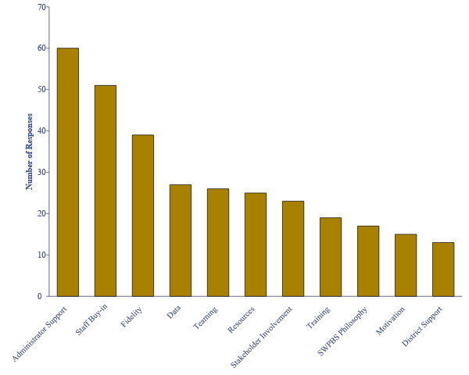
Enablers of Sustainability
Notes:
Charlie: Survey was done to see what people thought the biggest predictors of sustainability would be.

Slide 14
Most important single perceived factor in sustainability?
School Administrator Support
What do we do when…
A committed administrator moves on?
An administrator is opposed to PBIS?
Notes:
Charlie

Slide 15
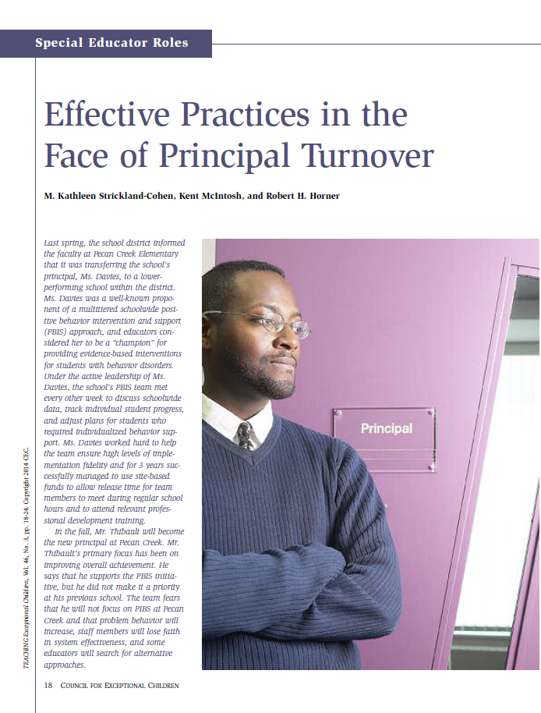
Sustaining PBIS through Administrator Turnover (Strickland-Cohen, McIntosh, & Horner, 2014)
School Team
Maintain the PBIS handbook
Document support among staff and stakeholders
Collect and share outcomes data n
Meet with the new administrator
District Team
Build PBIS into written policy
Build PBIS competencies into hiring criteria
Develop district coaching capacity
Notes:
Steve

Slide 16
Research Shows
PBIS is most sustainable with a supportive administrator and a strong team
If administrators take too much of a lead, sustainability can suffer
Notes:
Steve

Slide 17
Sustainability
Definition
Durable implementation of a practice at a level of fidelity that continues to produce valued outcomes
(McIntosh et al., 2009)
Notes:
Charlie

Slide 18
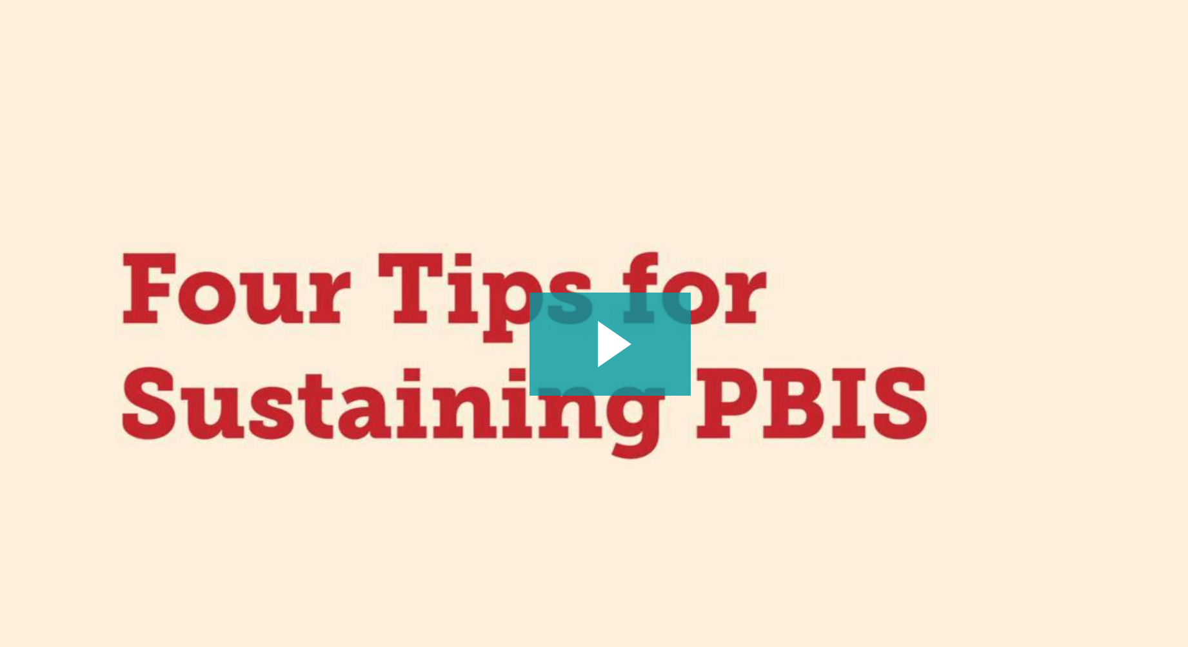
Four Tips for Sustaining PBIS
Four key tips that our research identified as most important to sustaining PBIS and 4 checks to see if you have them in place.
https://pbisapps.wistia.com/medias/uhkgj8pf29
Notes:
Charlie: Video is 4 minutes long – done by Kent McIntosh
https://pbisapps.wistia.com/medias/uhkgj8pf29
The following slides are a recap of the video.
You Choose:
Watch video only
Watch Video review slides
Review slides only

Slide 19
Strong Team
One superhero can’t sustain
Think roles, not people
Delegate
Incorporate new people on your team to get fresh ideas
TFI 1.1 and 1.2
Presentation 1B from Day 1 of training
Notes:
Steve

Slide 20
Fidelity Measures
The goal is not 100%- goal is to see what can be improved
Always know what next steps are (action plan)
TFI 1.14 & 1.15
Presentations on Day 1 of training
Notes:
Steve

Slide 21
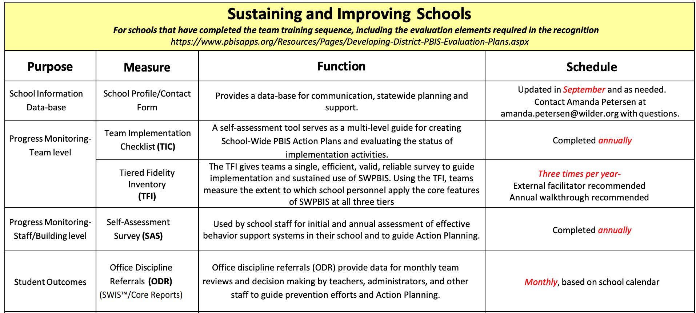
Data Calendar At A Glance
http://pbismn.org/documents/dataCalendarAtAGlance_Sustaining2015_16.pdf
Notes:
Steve

Slide 22
Use School Discipline Data
Can’t just collect it, you need to use it for decision-making
Share data with staff- goal is MONTHLY
TFI 1.5, 1.6, 1.12, 1.13
Presentations on Day 4 & 8 of training
Notes:
Steve

Slide 23
Don’t forget it is important…
to have
both non-classroom
and classroom systems
in place in order
to support
all students
Notes:
Charlie

Slide 24
PBIS in the Classroom
Think of how much time in a day students spend in the classroom.
Even if your SWPBIS is strong, you are not a PBIS school if you don’t do PBIS in the classroom.
TFI 1.8
Presentations on Day 5 and 6 of training
Notes:
Charlie

Slide 25
Answers to Some Common Questions - pbsimn.org
Most of the team that went through training is no longer working here. Do we have to go through training again?
We have a new principal. What’s the best way to transition?
Our building needs a PBIS booster. How do we do that?
We don’t have current data. How do we start getting a system back in place?
Do we have to continue to get staff buy-in during or after training?
http://pbismn.org/school-teams/index.php
Notes:
Charlie

Slide 26
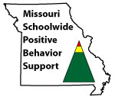
Appreciation is given to the following for their contributions to this Professional Learning:

Slide 27
Team Time
Action Plan Ideas on how sustain your Tier 1
 | Team | Fidelity Measures | School Data | PBIS in the Classroom
Task
Timeline

