Slide 1
PBIS Team Training 9A
Introducing Tier 2 Systems
Notes:
Updated Jan 2020

Slide 2
Learning Expectations
EXPECTATION | BEHAVIOR
Be Responsible | Make yourself comfortable Take care of your needs (water, food, restroom, etc.) Action plan to implement what you are learning Follow through on your action items
Be Respectful | Turn cell phones off or to “vibrate” Listen attentively while others are speaking Have only the training materials up on your computer/tablet/phone
Be Engaged | Ask what you need to know to understand and contribute Contribute to the group by sharing relevant information and ideas
Notes:
2

Slide 3
Tier 2: Professional Learning Roadmap
TFI Sub-Scale: Teams
TFI 2.1 | Team Composition
TFI 2.2 | Team Operating Procedures
TFI Sub-Scale: Evaluation
TFI 2.10 | Level of Use
TFI 2.11 | Student Performance Data
TFI 2.12 | Fidelity Data
TFI 2.13 | Annual Evaluation
TFI 2.3 | Screening
TFI 2.4 | Request for Assistance
TFI Sub-Scale: Interventions
TFI 2.5 | Options for Tier 2 Interventions
TFI 2.6 | Tier 2 Critical Features
TFI 2.7 | Practices Matched to Student Need
TFI 2.8 | Access to Tier 1 Supports
TFI 2.9 | Professional Development

Slide 4
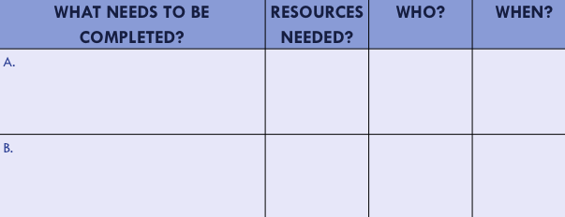
Organization of Modules
Content:
Aligned to TFI Items 1.1 – 1.15 and Classroom Management Practices
Activities/Team Time: Activities for Fluency
Self-Assessment:
Tiered Fidelity Inventory
Action Planning: Applying the core content to your school
Notes:
These are the icons that you will see throughout the training and will serve as a guide and a prompt to the content of each slide.

Slide 5
Purpose and Outcomes
Review continuum of support
Understand Tier 2 interventions/supports
Discuss essential components of effective Tier 2 systems
Tier 2 team
Establish criteria to access Tier 2
Determine/identify collection of Tier 2 interventions
Intervention evaluation process (review data)

Slide 6
Continuum of Support
Tier 3
Individualized
Intense Intervention
Tier 2
Some Students
Targeted Intervention
Tier 1
All Students
All Staff
All Settings
Notes:
Efficient process for students to move along continuum of support
Fluid system -

Slide 7
Build a Solid Tier 1
Tier 1 will reduce the need for Tier 2
There is so much power in Tier 1 to:
Prevent problems from happening
Reduce current problems
Build connections and form relationships
Establish systems and practices that are efficient and effective for your school
Use data to determine what your school community needs and decide how to meet that need as a school staff
Is what we are doing working?

Slide 8
Tier 2 is…
Students not responding to tier 1 supports
Students that share a common need
Interventions remain constant - not tailored to individual student
Low effort for teachers/staff
Can be implemented by any/all school staff

Slide 9
Table Talk Reflection
Is Tier 2 what you thought it was?
What components do you have at your site?
What are you missing?

Slide 10
Tier 2 Team
Responsible for meeting regularly:
Review data to identify new Tier 2 referrals
Evaluate intervention effectiveness for students currently accessing Tier 2
Disseminate information / provide PD training to school staff
Consider staff availability
Do not need to be on the team to implement intervention(s)

Slide 11
Table Talk
Who is on the Tier 2 team at your school?
What is that team called and how do they function?

Slide 12
Criteria for Accessing Tier 2 Support
Develop a process for identifying students
Train Teachers on this process
Make it accessible by all
Consistent and clear processes
strengthen the system

Slide 13
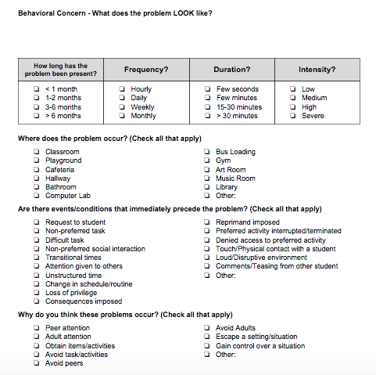
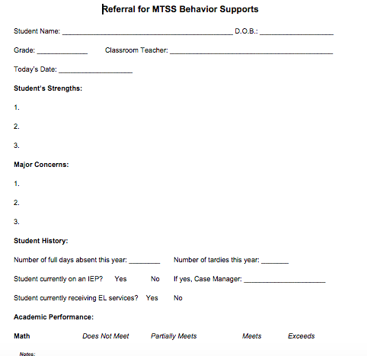
Example Criteria to Access
Academic performance (performing below grade level)
ODR data (2-5 office discipline referrals)
Attendance (frequently absent, tardy or truant)
Setting events (life outside of school)
Universal Screening Data
Performing at grade level
Office referrals are down
Life outside of school has stabilized

Slide 14
Determine Tier 2 Interventions
Based on common student need
Avoid including too many intervention options
Interventions must include:
Additional time for instruction and skill development
Increased structure/predictability
Increased opportunities for feedback

Slide 15
Training-Professional Development Considerations
Is everyone trained on the interventions you selected?
Does everyone know their role in the intervention?
Is there time built into the professional development calendar?

Slide 16
It is Not About….
The number of interventions,
it is about quality of the interventions

Slide 17
Tier 2 Intervention: Check In – Check Out
Involves a daily routine where the student:
Checks in each morning with a designated adult to review daily behavioral goals aligned with school wide expectations
Throughout day teachers provide rating and behavioral feedback regarding expectations and observed behavior
Review points and receive feedback (and reward if met goal) at end of day with designated adult

Slide 18
Tier 2 Intervention: Social Skills Groups
Build this intervention into Tier 2 system proactively
Avoid attempting to create and schedule groups reactively during school year
Requires time, resources, and is typically poorly implemented = NOT EFFICIENT
Identify several staff (e.g., social worker, guidance counselor..etc.) that will implement social skills groups
Schedule blocks of time into staff schedules at beginning of school year
No need to identify group focus at this time - can be determined when student need is observed
Efficiency is key!

Slide 19
Tier 2 Intervention: Behavior Contract
MUST be the same for each student if used as tier 2 intervention
Avoid creating individualized contracts
Implemented similar to CICO - without scheduled check in(s)/out(s)
Use point sheet (can be same as CICO sheet) to provide feedback on behavior throughout day
Contract Details:
Outlines school wide expectations
Explains point system and contingency
E.g., earn 80% of points = 10 minutes of free time at end of day

Slide 20
Group Talk
What interventions do you have at your site? Consider mapping out your interventions:

Slide 21
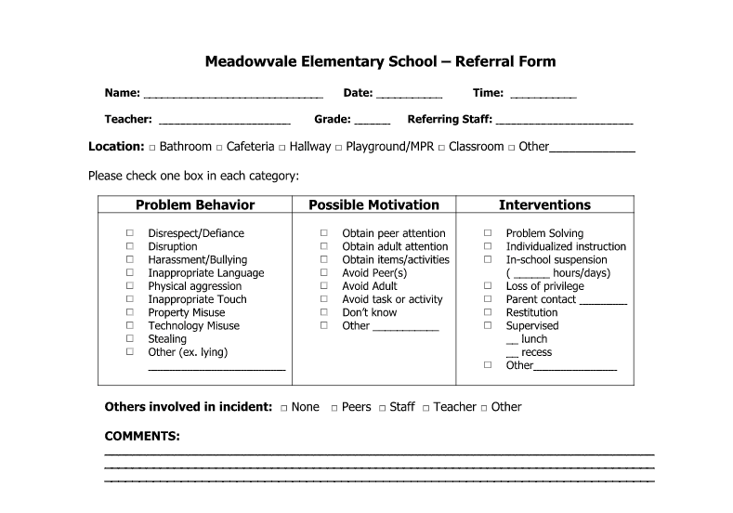
Student Intervention Selection
Process for selecting intervention
TEAM decision
Use data
Perceived motivation on referral form
Avoid guessing
Be purposeful when selecting an intervention - this sets the student up for success!

Slide 22
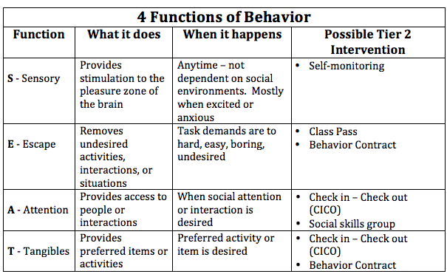
Why Behavior Happens

Slide 23
Intervention Evaluation
DATA is required to determine if intervention is working or not
Data Based Decision Making
Fade out intervention?
or
Provide additional supports?
**Data collection is necessary for each Tier 2 intervention**
Notes:
Data is necessary for students to move along the continuum - without data to evaluate intervention effectiveness there is no continuum

Slide 24
Intervention Evaluation Process
Determine process for fading out each intervention and “graduation”
TEAM decision
Examples:
8/10 days met percentage goal Reduce check ins
8/10 days met percentage goal with reduced check ins - exit intervention
Determine process if progress not made
TEAM decision
Move to Tier 3 or continue intervention
How/where is intervention data collected and analyzed
Determine who will compile student data sheets
Is data easily accessible?
Stack of point sheets vs spreadsheet generated graph
Review student data at least monthly to measure progress

Slide 25
What to do when:
a student does not make progress
with Tier 2 intervention?
OR
challenging behavior worsens?

Slide 26
Individualize Tier 2 Intervention

Slide 27
Tier 2 Modification Examples
Tier 2
CICO
Change CICO contact person
Change reward/incentive options
Behavior Contract
Change reward/incentive options
Switch from paper point sheet to electronic
Tier 3
CICO
Adjust goal percentage
Identify specific behaviors (instead of general school-wide expectations)
E.g., Keep hands to self, raise hand before speaking in class...etc.
Additional check-ins
Behavior Contract
Adjust goal percentage
Modify general contract
E.g, specific individualized behaviors

Slide 28
Team Time: Tier 2 Next Steps
Confirm who is on your team and share the Tier 2 Products & Measures
Have your Tier 2 team complete the TFI Tier 2 by the end of the year.
Use the Tier 2 Checklist when developing your interventions.
Map out the interventions you use - remember quality versus quantity.
Train your Tier 2 team on this work and let them run with it!

Slide 29
Appreciation is given to the following for their contributions to this Professional Learning:

