Slide 1
Minnesota PBIS
PBIS Team Training 8B
Managing the Cycle of Escalating Behavior:
Understanding and Responding
Notes:
UPDATED October 2019

Slide 2
Learning Expectations
EXPECTATION | BEHAVIOR
Be Responsible | Make yourself comfortable Take care of your needs (water, food, restroom, etc.) Action plan to implement what you are learning Follow through on your action items
Be Respectful | Turn cell phones off or to “vibrate” Listen attentively while others are speaking Have only the training materials up on your computer/tablet/phone
Be Engaged | Ask what you need to know to understand and contribute Contribute to the group by sharing relevant information and ideas
Notes:
2

Slide 3
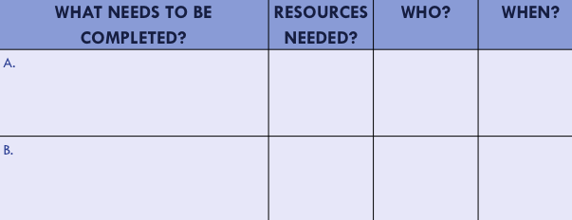
Organization of Modules
Content:
Aligned to TFI Items 1.1 – 1.15 and Classroom Management Practices
Activities/Team Time: Activities for Fluency
Self-Assessment:
Tiered Fidelity Inventory
Action Planning: Applying the core content to your school
Notes:
These are the icons that you will see throughout the training and will serve as a guide and a prompt to the content of each slide.

Slide 4
Tier 1: Professional Learning Roadmap
TFI Sub-Scale: Team
TFI 1.1 | Team Composition
TFI 1.2 | Team Operating Procedures
TFI Sub-Scale: Evaluation
TFI 1.12 | Discipline Data
TFI 1.13 | Data-based Decision Making
TFI 1.14 | Fidelity Data
TFI 1.15 | Annual Evaluation
TFI Sub-Scale: Implementation
TFI 1.3 | Behavioral Expectations
TFI 1.4 | Teaching Expectations
TFI 1.5 | Problem Behavior Definitions
TFI 1.6 | Discipline Policies
TFI 1.7 | Professional Development
TFI 1.8 | Classroom Procedures
TFI 1.9 | Feedback and Acknowledgement
TFI 1.10 | Faculty Involvement
TFI 1.11 | Student/Family/Community Involvement
Notes:
Point Out that this topic is not a piece of the TFI, but it has an important part in PBIS implementation

Slide 5
Purposes
To gain an understanding of how to better respond to student behavior.
Information shared can be used with all staff at your school.
Notes:
Point out the key feature of improving student behavior in non-classroom settings is to involve all school personnel in Active Supervision, emphasizing ALL school staff.
*

Slide 6
Outcomes
Teams will update their action plan to include a method, materials, personnel etc. needed to train staff on the use of Managing the Cycle of Escalating Behaviors.

Slide 7
Outline
Brain Basics
What is happening in the brain
Review Escalation Cycle
Different for each individual
Behavior Basics
ABCs of behavior
Determine environmental patterns surrounding display of behavior
Identify Strategies to Manage and Respond to Behavior
Notes:
Goals of the session

Slide 8
Brain Basics-The Thinking Brain
Functions of the Cortex
Impulse control
Self control
Empathy
Working memory
Sustained attention
Planning, prioritization, initiation
Organization
Time management
Goal persistence
Notes:
This is the part of the brain that becomes disabled as behavior escalates. During the peak phase these functions are offline.

Slide 9
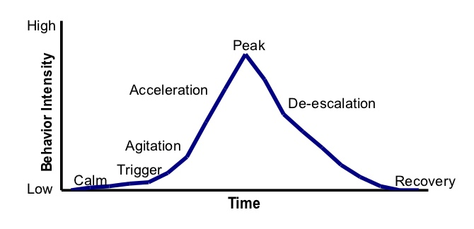
The Basic Model
Notes:
The basic model of Geoff Colvin.

Slide 10
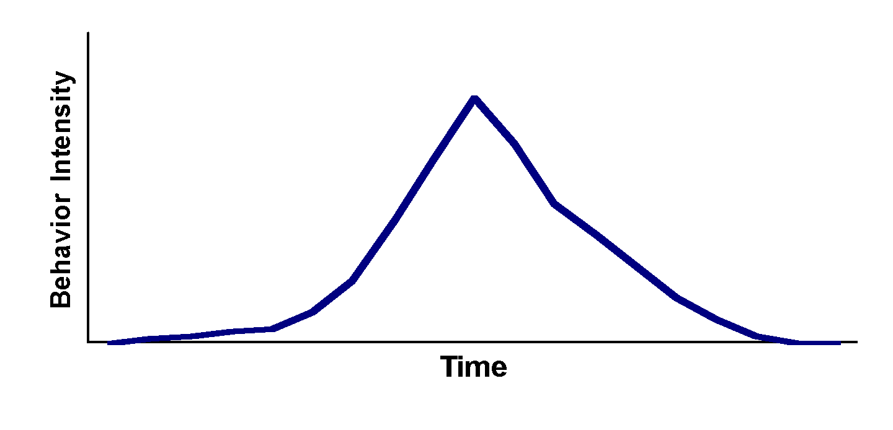
The Escalation Cycle…
can happen to anyone-but is unique for each individual
High
Low
Notes:
Each person’s escalation cycle is follows the phases but uniquely.
Have participants reflect and draw how escalation happens for them on a sticky note.

Slide 11
Why different for every individual?
Learning history
Past experiences
Motivation
Environmental factors

Slide 12
Behavior Basics
To efficiently and effectively change behavior we need to know WHY it is occurring
ABCs of behavior
Identify patterns of events before, during, and after display of behavior
Behavior is learned

Slide 13
ABCs of Behavior
Antecedent
Behavior
Consequence
A
B
C

Slide 14
Table Talk
Who are your school knows this information?
What kind of training have they received on it?
Have they ever been coached on how to use the information?

Slide 15
Antecedent
Anything that precedes a behavior
May make it more likely that the behavior will occur
When and where did the behavior occurred
What happened immediately before the behavior occurred
Who was present when the behavior occurred
*Use office referral form to identify patterns*

Slide 16
Behavior
Almost all human behavior is learned
All behaviors occur for a reason.
Behaviors do not occur “out of the blue.”
Behaviors continue to occur because they are effective.
Behaviors stop occurring because they are ineffective.

Slide 17
Consequence
Events occurring after the behavior
Can be positive or negative
Examples:
Get what you want
Get away from you don’t like
People leave you alone
Get a scolding from others
Lose something valuable

Slide 18
Consequence Patterns
Determine effective reactive strategies
Limit access to reinforcing/maintaining variables
E.g., Hypothesized that student displays disruptive behavior during class to get reaction/attention from teacher – When student blurts out inappropriate comment during class, the teacher maintains neutral expression waits 30 seconds (withhold immediate attention/reaction) and then redirects the student
Determine effective proactive strategies
Provide reinforcing/maintaining variables for other appropriate behavior(s)
E.g., Hypothesized that student displays disruptive behavior during class to get reaction/attention from teacher – Teacher increases frequency of praise statements/animated reactions for appropriate/on-task behavior

Slide 19
Identify Patterns Using Data on Referral Forms

Slide 20
Table Talk
Do staff at your school have difficulty filling out this portion of the ODR?
What can you do to ensure this section is filled out correctly?

Slide 21
Why ABCs?
Antecedent patterns:
Determine effective preventative strategies
E.g., identify difficult transition = may use visuals to initiate transition as proactive approach
Consequences maintain behavior
Analysis of consequent events aid in identifying function of behavior
“We do what we do because of what happens to us.”

Slide 22
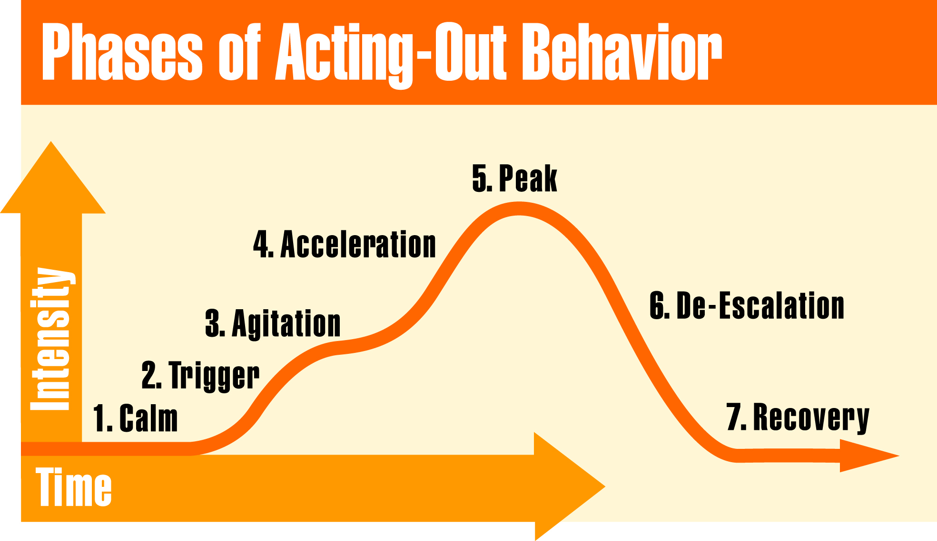
Model for Escalating Behavior
Phases of the Escalation Cycle
Notes:
Section Introduction Slide

Slide 23
Calm Behaviors
Student is cooperative.
Accepts corrective feedback
Follows directives
Ignores distractions
Accepts praise
On-task
Notes:
Observable behaviors to help adults identify the calm phase.

Slide 24
Calm Strategies
Focus is on prevention.
Arrange for high rates of successful academic & social engagements
Use positive interaction to establish and maintain relationship with students
Teach skills
Communicate positive expectations
Notes:
Strategies to use when the individual is in the calm phase.

Slide 25
Preventative Examples
Four Strategies:
Classroom Structure (safe and connected)
Quality Instruction (culturally relevant & engaging)
Managing Attention (relationships)
Teaching Behavior (SWExpectations within routines)
Discuss examples & non-examples, model, practice, provide consistent feedback on correct and incorrect displays of behavior
Do not rely on discussion alone when teaching
Notes:
Strategies to use when the individual is in the calm phase.

Slide 26
Model for Escalating Behavior
Phases of the Escalation Cycle
Notes:
Section Introduction Slide

Slide 27
Pre-Cursor Behaviors (Trigger & Agitation)
Low-level disruption
Off-task
Verbal protesting
Attempts to negotiate
“Junk” behavior
Not harmful or dangerous but inappropriate
Notes:
Observable behaviors to help adults identify the agitation phase.

Slide 28
Pre-Cursor Strategies
Focus on escalation prevention and redirection.
Increase opportunities for success
Specifically identify alternative behavior that will receive the same outcome as challenging behavior
E.g., If attention is hypothesized function – Say, “I will come over to talk with you when you start working on your assignment.”
Reinforce the student’s first on task response
Intermittently reinforce subsequent on-task behavior

Slide 29
What to do before escalation
Achieve eye contact
Use person’s name
Non-verbal signal
Proximity & praise
Reduce distance
Give time to think & decide
Teacher proximity
Pre-arranged signal
Independent activities
Give more “start” requests instead of “stop” requests.
Make non-emotional instead of emotional requests
Teacher empathy
Movement activities
Space (jobs)
Options/Choices
Preferred activities
Relaxation techniques
Notes:
Strategies to use when the individual is in the agitation phase.

Slide 30
AVOID These Responses
Raising your voice
Insisting on having the last word
Sarcasm
Nagging
Comparing to others
Touching or grabbing the student
Preaching
Assumptions
Non related events
Holding a grudge
Engaging in power struggles
Moving into the student’s space
Notes:
Avoid these strategies during the agitation phase

Slide 31
Model for Escalating Behavior
Phases of the Escalation Cycle
Notes:
Section Introduction Slide

Slide 32
Continuous/Escalated Behaviors
Acceleration and Peak
Behaviors that are unsafe and/or occur for an extended period of time
Physical Aggression
Property Destruction (e.g throwing dangerous items)
Leaving school grounds
Notes:
Observable behaviors to help adults identify the acceleration phase.

Slide 33
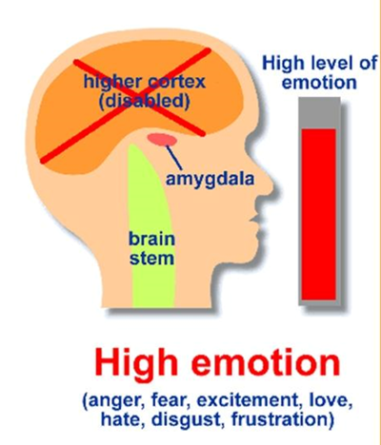
Managing and Responding to Escalated Behaviors
Focus is on safety
Do not attempt to problem solve now
Develop and implement a crisis response plan
Identify and define target behaviors
E.g., Property Destruction: tearing math worksheet versus throwing chair
Describe responding staff roles
E.g., 1st responding staff clears room of potentially dangerous items, 2nd responding staff initiate data collection…etc.
Establish process of communication

Slide 34
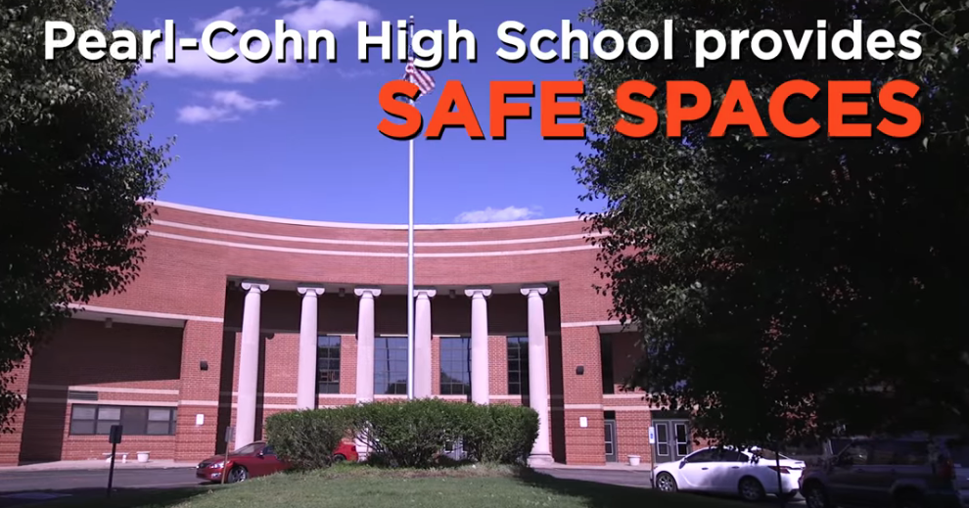
Example of De-Escalation
https://www.youtube.com/watch?v=YxC_Q8zE0SU
Notes:
https://www.youtube.com/watch?v=YxC_Q8zE0SU

Slide 35
Model for Escalating Behavior
Phases of the Escalation Cycle
Notes:
Section Introduction Slide

Slide 36
Recovery Strategies
Focus on returning to normal activities and prevention
Follow through with initial expectations if possible
Debrief/problem solve how to handle situation next time – identify alternative skill
Provide opportunity to practice alternative skill
Notes:
Strategies to use when the individual is in the recovery phase.

Slide 37
Recovery Strategies
Effective Consequences
Does the consequence…
Model, instruct or teach a more appropriate behavior?
Give the learner opportunities to practice replacement behavior?
Give the learner the opportunity to learn how to restore relationship and/or repair harm?
Notes:
Strategies to use when the individual is in the recovery phase.

Slide 38
Debriefing Session
Occurs when the thinking brain is back online
Facilitates transition back to class… not further negative consequence.
Pinpoint events that contributed to the incident - ABCs
Teach replacement behaviors
Goal is to increase appropriate behavior
Notes:
Debriefing occurs when the thinking brain is back online.

Slide 39
When We Know Better…We Can Do Better!
Notes:
This is an ending slide to encourage adults to move away from traditional reactions to escalating behavior and shift to safer, more proactive positive strategies for managing escalating behavior.

Slide 40
What we know helps….
Intervene early in an escalation
All adults remain calm
Understand that Teacher behavior sets the stage for the next student behavior
Identify environmental factors that can be changed
Teach replacement behaviors
Notes:
Summary Slide for how we can do better

Slide 41
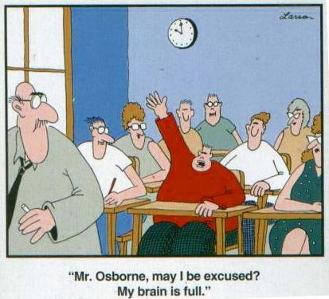
Time for planning!

Slide 42
Action Plan:
Managing the Cycle of Escalating Behavior
Who needs training?
How and when will this be done?
How will you provide coaching to those that need it?

Slide 43
Appreciation is given to the following for their contributions to this Professional Learning:

