Slide 1
PBIS Day 7 Professional Development
Notes:
Updated July 2019

Slide 2
Learning Expectations
EXPECTATION | BEHAVIOR
Be Responsible | Make yourself comfortable Take care of your needs (water, food, restroom, etc.) Action plan to implement what you are learning Follow through on your action items
Be Respectful | Turn cell phones off or to “vibrate” Listen attentively while others are speaking Have only the training materials up on your computer/tablet/phone
Be Engaged | Ask what you need to know to understand and contribute Contribute to the group by sharing relevant information and ideas
Notes:
2

Slide 3
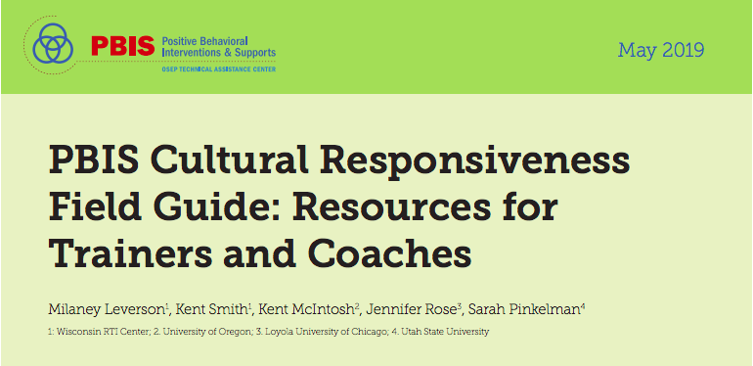
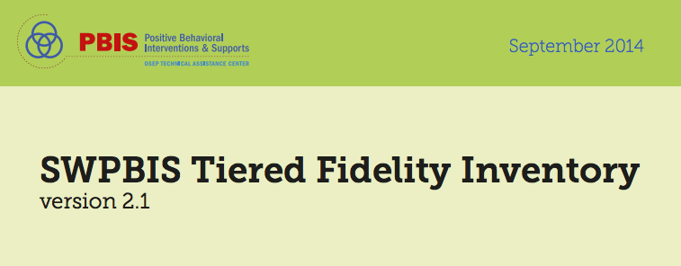
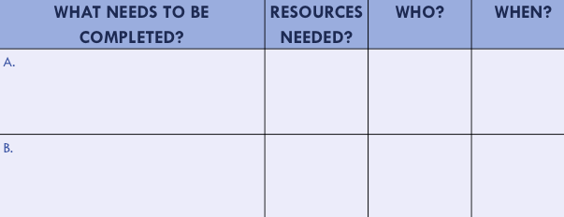
Organization of Modules
Content:
Aligned to TFI Items 1.1 – 1.15
Activities/Team Time: Activities for Fluency
Culturally Responsive:
Aligning culturally responsive practices to the core components of SWPBIS
Self-Assessment:
Tiered Fidelity Inventory
Action Planning: Applying the core content to your school
Notes:
MOVE UP
These are the icons that you will see throughout the training and will serve as a guide and a prompt to the content of each slide.
Change

Slide 4
Tier 1: Professional Learning Roadmap
TFI Sub-Scale: Team
TFI 1.1 | Team Composition
TFI 1.2 | Team Operating Procedures
TFI Sub-Scale: Evaluation
TFI 1.12 | Discipline Data
TFI 1.13 | Data-based Decision Making
TFI 1.14 | Fidelity Data
TFI 1.15 | Annual Evaluation
TFI Sub-Scale: Implementation
TFI 1.3 | Behavioral Expectations
TFI 1.4 | Teaching Expectations
TFI 1.5 | Problem Behavior Definitions
TFI 1.6 | Discipline Policies
TFI 1.7 | Professional Development
TFI 1.8 | Classroom Procedures
TFI 1.9 | Feedback and Acknowledgement
TFI 1.10 | Faculty Involvement
TFI 1.11 | Student/Family/Community Involvement

Slide 5
TFI Self-Assessment
Features | Possible Sources | Criteria
1.7 Professional Development: A written process is used for orienting all faculty/staff on 4 core Tier I SWPBIS practices: teaching school-wide expectations, Acknowledging appropriate behavior correcting errors, and requesting assistance. | • Professional development calendar • Staff handbook | 0 = No process for teaching staff is in place 1 = Process is informal/unwritten, not part of professional development calendar, and/or does not include all staff or all 4 core Tier I practices 2 = Formal process for teaching all staff all aspects of Tier I system, including all 4 core Tier I practices
Notes:
Teams should complete this self assessment and use the results to determine action planning steps on Workbook

Slide 6
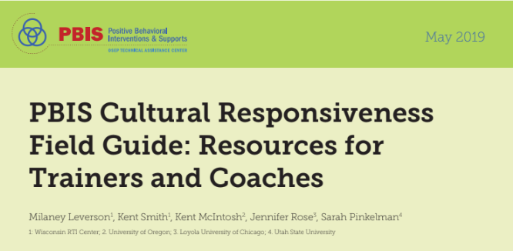
TFI & Cultural Responsiveness
Features | Cultural Responsiveness
1.7 Professional Development: A written process is used for orienting all faculty/staff on 4 core Tier I SWPBIS practices: teaching school-wide expectations, Acknowledging appropriate behavior correcting errors, and requesting assistance. | Teams adopt or revise expectations that are reflective of the cultural values of the surrounding community. Expectations and specific rules are identified based on a legitimate purpose within the setting, as opposed to simply school tradition or maintaining the status quo. Within a culturally responsive framework, behavior expectations should focus on high standards for all students, be able to be taught and learned, and be respectful of the students’ cultures.
Notes:
Teams should complete this self assessment and use the results to determine action planning steps on Workbook

Slide 7
Considerations
TFI | Action Item (Not In Place; Partially; Fully In Place ->) | NI | PI | FI
1.7 | A curriculum to teach the components of the discipline system (e.g flow chart and related processes) to all staff is developed and used
1.7 | Plans for training staff how to teach expectations/rules/acknowledgments are developed, scheduled and delivered
1.7 | A plan for teaching students expectations/rules/acknowledgments is developed, scheduled, and delivered
1.7 | A system for orienting substitutes, volunteers, and guests on expectations, rules, and acknowledgements is in place
1.7 | Booster sessions for students and staff are planned, scheduled, and delivered
1.7 | Schedule for acknowledgments for the year is planned
1.7 | Plans for orienting new staff and students are developed and implemented
1.7 | Plans for introducing families/communities to your PBIS system are developed and implemented
1.7 | Dates for professional training of all school staff, and ongoing support are on the school’s calendar
1.7 | A communication system is established to share information regularly (at least monthly) with staff

Slide 8
Considerations
TFI | Action Item (Not In Place; Partially; Fully In Place ->) | NI | PI | FI
1.7 CR | The district has a long-term professional development plan that includes SWPBIS and enhancing equity.
1.7 CR | Professional development opportunities are identified based on system and student outcome data.
1.7 CR | Teams partner with local community supports and families to provide professional development that orients staff to the community cultures, values, and historical perspectives (e.g., marginalization from schooling).
1.7 CR | Teams have procedures to provide staff with explicit training and practice in specific skills for enhancing equity and examining implicit bias.
1.7 CR | Teams have procedures to provide staff with explicit training and practice in de-escalation skills.

Slide 9
TFI 1.7 Purpose & Outcomes
Purpose:
Organize the PBIS features into a cohesive plan
Outcome:
TFI 1. 7 Professional Development: A written process is used for orienting all faculty/staff on 4 core Tier I PBIS practices:
(a) teaching school-wide expectations,
(b) acknowledging appropriate behavior,
(c) correcting errors, and
(d) requesting assistance.

Slide 10
Definition
Professional Development Plan is the scope of all implementation activities including timelines.
The Professional Development Plan is developed by the team and coach. It incorporates all of the school-wide and classroom components.
It is flexible and is informed by the measures we have discussed to date: SWIS, SAS, and the TFI
Notes:
I would have each sub section start in a familiar format as well:
Define
Rationale
Example

Slide 11
Rationale
It provides the road map to Tier I implementation, and supports us thinking about professional development as an ongoing process.
As we accomplish our professional development goals, we celebrate and then create new ones, all for the improvement of outcomes for our students and staff.

Slide 12
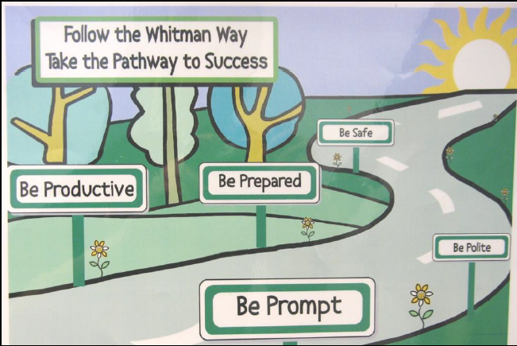
Roll-out
Notes:
Our roll out is how we bring what we have learned to our entire school. We begin teaching and reinforcing expectations, data review surveys.

Slide 13
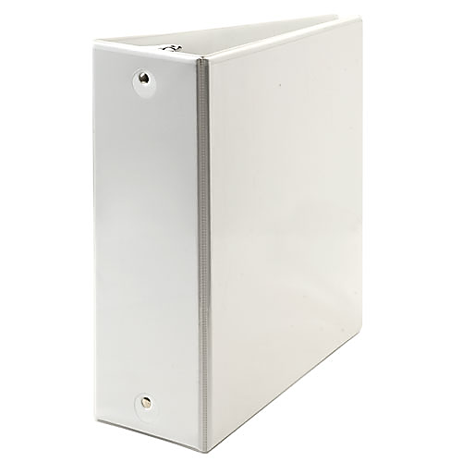
Documentation
Team Composition
Team Operating Procedures
Behavioral Expectations
Teaching Expectations
Problem Behavior Def.
Discipline Policies
Professional Dev.
Classroom Procedures
Feedback & Acknow.
Faculty Involvement
Student/Family Involvement
Data-based Decision
PBIS BINDER
Notes:
It is very important for the plan to:
1- be clear
2- be up to date
3- live somewhere accessible

Slide 14
Orienting Guest Teachers and Substitutes
New adults in the school and classroom need to know how they participate in PBIS.
Most relevant for expectations, acknowledgements and discipline.
Part of the binder, part of the PD, part of substitute / guest teacher information for EVERY class.
Notes:
We want the plan to live beyond teachers, and a notebook, but also pull in families and make sure they understand what we are doing, and over time provide input into the process. Your staff need to be fluent in the process first.
Here are ways to engage families and let them know what is going on with PBIS.

Slide 15
How do you orient people new to your school community?
How will you share your School-wide PBIS plan with:
Short-term and long-term substitutes?
Staff starting after your school’s kick-off?
Students starting after your school’s kick-off?
Guest teachers or presenters?
Volunteers?

Slide 16
Introducing PBIS to Families
Methods of communication:
Written
Letters, newsletters, marques
Face-to-Faces
School and/or community events
Other:
Hold message when they call into the office
Video demonstrations
Website blurbs
Notes:
We want the plan to live beyond teachers, and a notebook, but also pull in families and make sure they understand what we are doing, and over time provide input into the process. Your staff need to be fluent in the process first.
Here are ways to engage families and let them know what is going on with PBIS.

Slide 17
Components of the Plan
We are going to talk about Professional Development in relation to the other components of PBIS.

Slide 18
Professional Development Plan Activities
A curriculum to teach the components of the discipline system to all staff is developed and used
Plans for training staff how to teach expectations/rules/acknowledgments are developed, scheduled and delivered
A plan for teaching students expectations/rules/acknowledgments is developed, scheduled, and delivered
Notes:
Read these, stress that they have learned about these in the other modules. This module will function as a review as well as the important features of an implementation plan.

Slide 19
Professional Development Plan Activities
Booster sessions for students and staff are planned, scheduled, and delivered
Schedule for acknowledgments for the year is planned
Plans for orienting incoming staff and students are developed and implemented
Plans for involving families/communities are developed and implemented

Slide 20
Expectations and Acknowledgements
What are expectations?
What do they do for us?
What are acknowledgements?
What do they do for us?
How frequently should we be teaching / reminding and reinforcing expectations?
Workbook: TFI 1.7 Activity 1

Slide 21
Discipline Systems PD Plan
Go back to your notes on the discipline system.
Read them over and check in with your team:
Are there outstanding questions?
Do you know how to “sell” this to your staff?
Ask those questions now.
Summarize the main components of the discipline system and be prepared to share as if you are presenting to your staff members.
Workbook: TFI 1.7 Activity 2

Slide 22
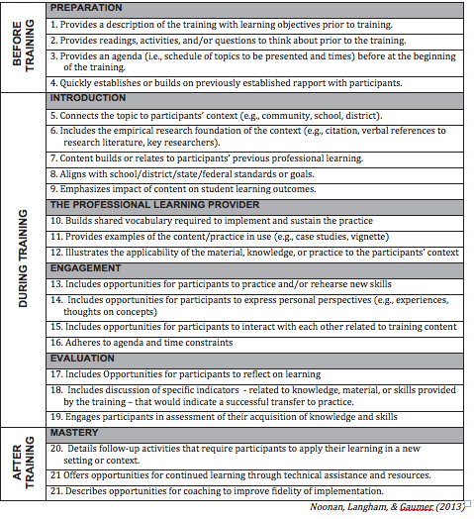
High Quality PD Checklist
Notes:
This is also in the workbook

Slide 23
Prof. Development Calendar
Notes:
This is also in the workbook

Slide 24
Professional Development/
Training Timelines
Brainstorm!
We need a timeline that is reasonable and allows us to teach and train all staff and students on the core features (expectations, acknowledgements, discipline and data).
What are all the components in our PD Plan?
Who do we train first?
When do we hold “boosters”?
Workbook:

Slide 25
TFI 1.7: Professional Development
SELF-ASSESSMENT
Complete TFI item(s)
Assess additional action items at end of module
ACTION PLANNING
Add action items to Action plan
Plan for PD
Add to your Staff Presentation PPT

Slide 26
TFI Self-Assessment
Features | Possible Sources | Criteria
1.7 Professional Development: A written process is used for orienting all faculty/staff on 4 core Tier I SWPBIS practices: teaching school-wide expectations, Acknowledging appropriate behavior correcting errors, and requesting assistance. | • Professional development calendar • Staff handbook | 0 = No process for teaching staff is in place 1 = Process is informal/unwritten, not part of professional development calendar, and/or does not include all staff or all 4 core Tier I practices 2 = Formal process for teaching all staff all aspects of Tier I system, including all 4 core Tier I practices
Notes:
Teams should complete this self assessment and use the results to determine action planning steps on Workbook

Slide 27
TFI & Cultural Responsiveness
Features | Cultural Responsiveness
1.7 Professional Development: A written process is used for orienting all faculty/staff on 4 core Tier I SWPBIS practices: teaching school-wide expectations, Acknowledging appropriate behavior correcting errors, and requesting assistance. | Teams adopt or revise expectations that are reflective of the cultural values of the surrounding community. Expectations and specific rules are identified based on a legitimate purpose within the setting, as opposed to simply school tradition or maintaining the status quo. Within a culturally responsive framework, behavior expectations should focus on high standards for all students, be able to be taught and learned, and be respectful of the students’ cultures.
Notes:
Teams should complete this self assessment and use the results to determine action planning steps on Workbook

Slide 28
Considerations
TFI | Action Item (Not In Place; Partially; Fully In Place ->) | NI | PI | FI
1.7 | A curriculum to teach the components of the discipline system (e.g flow chart and related processes) to all staff is developed and used
1.7 | Plans for training staff how to teach expectations/rules/acknowledgments are developed, scheduled and delivered
1.7 | A plan for teaching students expectations/rules/acknowledgments is developed, scheduled, and delivered
1.7 | A system for orienting substitutes, volunteers, and guests on expectations, rules, and acknowledgements is in place
1.7 | Booster sessions for students and staff are planned, scheduled, and delivered
1.7 | Schedule for acknowledgments for the year is planned
1.7 | Plans for orienting new staff and students are developed and implemented
1.7 | Plans for introducing families/communities to your PBIS system are developed and implemented
1.7 | Dates for professional training of all school staff, and ongoing support are on the school’s calendar
1.7 | A communication system is established to share information regularly (at least monthly) with staff

Slide 29
Considerations
TFI | Action Item (Not In Place; Partially; Fully In Place ->) | NI | PI | FI
1.7 CR | The district has a long-term professional development plan that includes SWPBIS and enhancing equity.
1.7 CR | Professional development opportunities are identified based on system and student outcome data.
1.7 CR | Teams partner with local community supports and families to provide professional development that orients staff to the community cultures, values, and historical perspectives (e.g., marginalization from schooling).
1.7 CR | Teams have procedures to provide staff with explicit training and practice in specific skills for enhancing equity and examining implicit bias.
1.7 CR | Teams have procedures to provide staff with explicit training and practice in de-escalation skills.

Slide 30
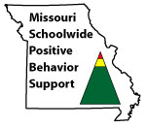
Appreciation is given to the following
for their contributions to this Professional Learning:

