Slide 1
PBIS Day 7 Morning Session
Notes:
Updated July 2019

Slide 2
Tier 1 New Team Training Review Big Ideas
Plan Professional Development
Monitor Your Progress
Action Planning

Slide 3
Learning Expectations
EXPECTATION | BEHAVIOR
Be Responsible | Make yourself comfortable Take care of your needs (water, food, restroom, etc.) Action plan to implement what you are learning Follow through on your action items
Be Respectful | Turn cell phones off or to “vibrate” Listen attentively while others are speaking Have only the training materials up on your computer/tablet/phone
Be Engaged | Ask what you need to know to understand and contribute Contribute to the group by sharing relevant information and ideas
Notes:
3

Slide 4
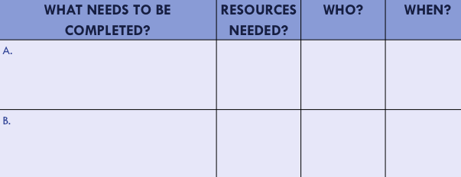
Organization of Modules
Content:
Aligned to TFI Items 1.1 – 1.15 and Classroom Management Practices
Activities/Team Time: Activities for Fluency
Self-Assessment:
Tiered Fidelity Inventory
Action Planning: Applying the core content to your school
Notes:
These are the icons that you will see throughout the training and will serve as a guide and a prompt to the content of each slide.

Slide 5
Review Big Ideas
Section 1
Notes:
This section will reorient teams to the Big Ideas of school-wide PBIS

Slide 6
PBIS is a framework that helps adults…
Increase school safety and improve school and classroom climate
Integrate academic & behavioral initiatives
Decrease reactive management
Improve
support for students with EBD
Maximize academic achievement
Notes:
Teams need to ensure that all staff back home understand what PBIS is about.

Slide 7
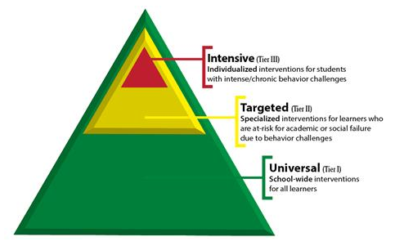
The framework is flexibly designed so you can meet the needs of the students you serve
You will design your systems of support.
Notes:
The framework is multi-tiered and flexible to meet the needs of your school, your learners, and your families.

Slide 8
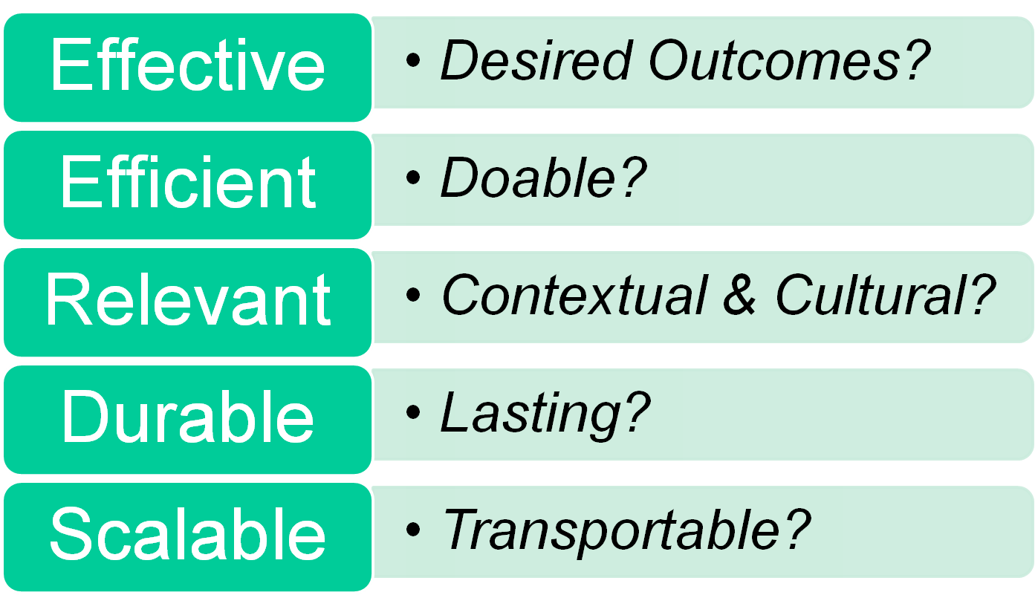
PBIS Logic Helps Adult Plan Effectively
Successful individual student behavior support is linked to host environments or school climates that are effective, efficient, relevant, & durable
(Zins & Ponti, 1990)
Notes:
Review Big Ideas Cohort 6 Secondary 9 am
*
*
As teams implement all the tiers of PBIS they can use this as a guide to building PBIS that will be sustainability.

Slide 9
Integrated Framework Elements Guide All Actions
Culturally Equitable Academic & Social Behavior Expectations
OUTCOMES
Culturally Knowledgeable
Staff
Culturally Valid Information for Decisions
SYSTEMS
DATA
PRACTICES
Culturally Relevant & Effective Instruction
Vincent, Randall, Cartledge, Tobin, & Swain-Bradway 2011; Sugai,
O’Keeffe, & Fallon, 2012ab
Notes:
Review the integrated elements of PBIS. Implementation of SWPBS is based on a balance of four interactive elements:
OUTCOMES – What do we want to see? Clearly specified outcomes related to academic achievement and social competence.
CULTURE is one our major considerations, and CULTURAL INFLUENCE is reflected in high attention toward CULTURAL EQUITY of outcomes CULTURAL VALIDITY of data CULTURAL RELEVANCE of practices CULTURAL KNOWLEDGE of systems about data, outcomes, practices, and students/families.

Slide 10
Tier 1 Primary Prevention
STEP 8
STEP 1
Establish procedures for on-going data-based monitoring & evaluation
Establish staff commitment leadership team
8
1
STEP 7
7
STEP 2
Establish procedures for corrective/crisis response
Establish team roles, responsibilities and effective team operations
Tier 1
Primary Prevention
2
6
STEP 6
STEP 3
Establish procedures for encouraging expected behavior
Establish school wide expectations
3
5
STEP 5
4
STEP 4
Establish procedures for embedding school wide expectations into the classroom
Establish procedures for teaching school wide expectations
Notes:
Review of the work they have done using the old 8 steps format.

Slide 11
TFI 1.7: Professional Development
Section 2
Notes:
This section will take teams through a review of Tier 1 and focus on how they will train staff on the core features of Tier 1.

Slide 12
Tier 1: Professional Learning Roadmap
TFI Sub-Scale: Team
TFI 1.1 | Team Composition
TFI 1.2 | Team Operating Procedures
TFI Sub-Scale: Evaluation
TFI 1.12 | Discipline Data
TFI 1.13 | Data-based Decision Making
TFI 1.14 | Fidelity Data
TFI 1.15 | Annual Evaluation
TFI Sub-Scale: Implementation
TFI 1.3 | Behavioral Expectations
TFI 1.4 | Teaching Expectations
TFI 1.5 | Problem Behavior Definitions
TFI 1.6 | Discipline Policies
TFI 1.7 | Professional Development
TFI 1.8 | Classroom Procedures
TFI 1.9 | Feedback and Acknowledgement
TFI 1.10 | Faculty Involvement
TFI 1.11 | Student/Family/Community Involvement
8 Classroom Management Practices
1 | Arrange orderly physical environment
2 | Define, Teach, Acknowledge Rules and Expectations
3 | Define, Teach Classroom Routines
4 | Employ Active Supervision
5 | Provide Specific Praise for Behavior
6 | Continuum of Response Strategies for Inappropriate Behaviors
7 | Class-Wide Group Contingency
8 | Provide Multiple Opportunities to Respond

Slide 13
TFI 1.7 Purpose & Outcomes
Purpose:
Organize the PBIS features into a cohesive plan
Outcome:
TFI 1. 7 Professional Development: A written process is used for orienting all faculty/staff on 4 core Tier I PBIS practices:
(a) teaching school-wide expectations,
(b) acknowledging appropriate behavior,
(c) correcting errors, and
(d) requesting assistance.

Slide 14
Definition
Professional Development Plan is the scope of all implementation activities including timelines.
The Professional Development Plan is developed by the team and coach. It incorporates all of the school-wide and classroom components.
It is flexible and is informed by the measures we have discussed to date: SWIS, SAS, and the TFI
Notes:
I would have each sub section start in a familiar format as well:
Define
Rationale
Example

Slide 15
Rationale
It provides the road map to Tier I implementation, and supports us thinking about professional development as an ongoing process.
As we accomplish our professional development goals, we celebrate and then create new ones, all for the improvement of outcomes for our students and staff.

Slide 16
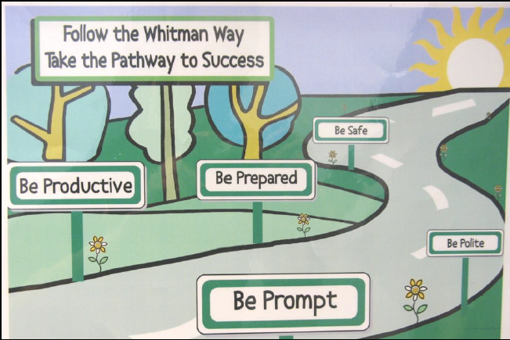
Roll-out
Notes:
Our roll out is how we bring what we have learned to our entire school. We begin teaching and reinforcing expectations, data review surveys.

Slide 17
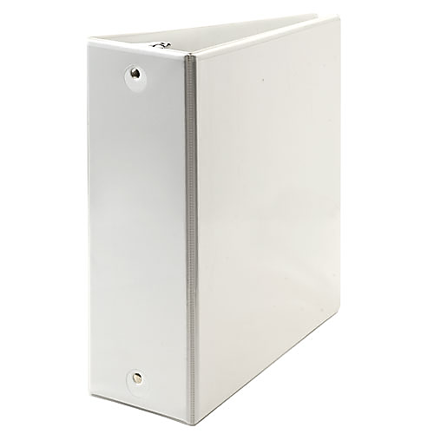
Documentation
Team Composition
Team Operating Procedures
Behavioral Expectations
Teaching Expectations
Problem Behavior Def.
Discipline Policies
Professional Dev.
Classroom Procedures
Feedback & Acknow.
Faculty Involvement
Student/Family Involv.
Data-based Decision
PBIS BINDER
Notes:
It is very important for the plan to:
1- be clear
2- be up to date
3- live somewhere accessible

Slide 18
Orienting Guest Teachers and Substitutes
New adults in the school and classroom need to know how they participate in PBIS.
Most relevant for expectations, acknowledgements and discipline.
Part of the binder, part of the PD, part of substitute / guest teacher information for EVERY class.
Notes:
We want the plan to live beyond teachers, and a notebook, but also pull in families and make sure they understand what we are doing, and over time provide input into the process. Your staff need to be fluent in the process first.
Here are ways to engage families and let them know what is going on with PBIS.

Slide 19
How do you orient people new to your school community?
How will you share your School-wide PBIS plan with:
Short-term and long-term substitutes?
Staff starting after your school’s kick-off?
Students starting after your school’s kick-off?
Guest teachers or presenters?
Volunteers?

Slide 20
Introducing PBIS to Families
Methods of communication:
Written
Letters, newsletters, marques
Face-to-Faces
School and/or community events
Other:
Hold message when they call into the office
Video demonstrations
Website blurbs
Notes:
We want the plan to live beyond teachers, and a notebook, but also pull in families and make sure they understand what we are doing, and over time provide input into the process. Your staff need to be fluent in the process first.
Here are ways to engage families and let them know what is going on with PBIS.

Slide 21
Components of the Plan
We are going to talk about Professional Development in relation to the other components of PBIS.

Slide 22
Professional Development Plan Activities
A curriculum to teach the components of the discipline system to all staff is developed and used
Plans for training staff how to teach expectations/rules/acknowledgments are developed, scheduled and delivered
A plan for teaching students expectations/rules/acknowledgments is developed, scheduled, and delivered
Notes:
Read these, stress that they have learned about these in the other modules. This module will function as a review as well as the important features of an implementation plan.

Slide 23
Professional Development Plan Activities
Booster sessions for students and staff are planned, scheduled, and delivered
Schedule for acknowledgments for the year is planned
Plans for orienting incoming staff and students are developed and implemented
Plans for involving families/communities are developed and implemented

Slide 24
Expectations and Acknowledgements
What are expectations?
What do they do for us?
What are acknowledgements?
What do they do for us?
How frequently should we be teaching / reminding and reinforcing expectations?
Workbook: TFI 1.7 Activity 1

Slide 25
Discipline Systems PD Plan
Go back to your notes on the discipline system.
Read them over and check in with your team:
Are there outstanding questions?
Do you know how to “sell” this to your staff?
Ask those questions now.
Summarize the main components of the discipline system and be prepared to share as if you are presenting to your staff members.
Workbook: TFI 1.7 Activity 2

Slide 26
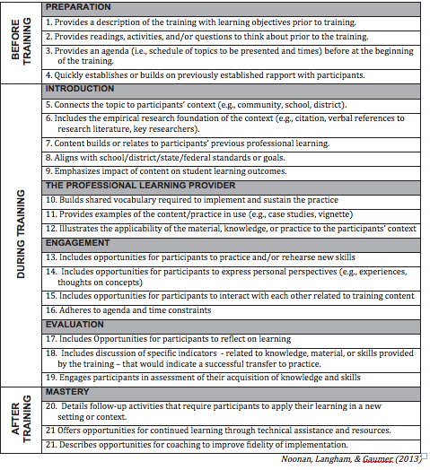
High Quality PD Checklist
Notes:
This is also in the workbook

Slide 27
Prof. Development Calendar
Notes:
This is also in the workbook

Slide 28
Professional Development/
Training Timelines
Brainstorm!
We need a timeline that is reasonable and allows us to teach and train all staff and students on the core features (expectations, acknowledgements, discipline and data).
What are all the components in our PD Plan?
Who do we train first?
When do we hold “boosters”?
Workbook:

Slide 29
TFI 1.7: Professional Development
SELF-ASSESSMENT
Complete TFI item(s)
Assess additional action items at end of module
ACTION PLANNING
Add action items to Action plan
Plan for PD
Add to your Staff Presentation PPT

Slide 30
TFI Self-Assessment
Self-Assess on the TFI
Enter your score on the TFI Tool in the front of the workbook
Features | Possible Sources | Criteria
1.7 Professional Development: A written process is used for orienting all faculty/staff on 4 core Tier I SWPBIS practices: teaching school-wide expectations, Acknowledging appropriate behavior correcting errors, and requesting assistance. | • Professional development calendar • Staff handbook | 0 = No process for teaching staff is in place 1 = Process is informal/unwritten, not part of professional development calendar, and/or does not include all staff or all 4 core Tier I practices 2 = Formal process for teaching all staff all aspects of Tier I system, including all 4 core Tier I practices
Notes:
Teams should complete this self assessment and use the results to determine action planning steps on Workbook page 11.

Slide 31
Monitor Your Progress
Section 3
Notes:
Teams will take the TFI to monitor their Tier 1 Progress

Slide 32
Opening the survey
www.pbisapps.org

Slide 33
Opening the survey

Slide 34
Opening the survey

Slide 35
If you get stuck an External Facilitator to help you
Opening the administration ppt.

Slide 36
Process for taking the TFI
The coach will have the survey open on pbisapps and record the vote of the team
A facilitator will have the ppt. open and read and show the questions and criteria for voting to the team
The team will briefly assess current status and vote using a visual signal response to as indicated by the scoring criteria
0=not implemented
1=partially implemented
2=fully implemented

Slide 37
Coach will enter your team’s score

Slide 38
Coach will Submit Your TFI
You are only required to Tier 1 of the TFI
After Tier I is done…..scroll down to the bottom of the page CLICK NEXT
Scroll down to the bottom of the page and CLICK SUBMIT
You should get a confirmation of your submission

Slide 39
Action Planning
Section 4
Notes:
Teams will engage in action planning.

Slide 40
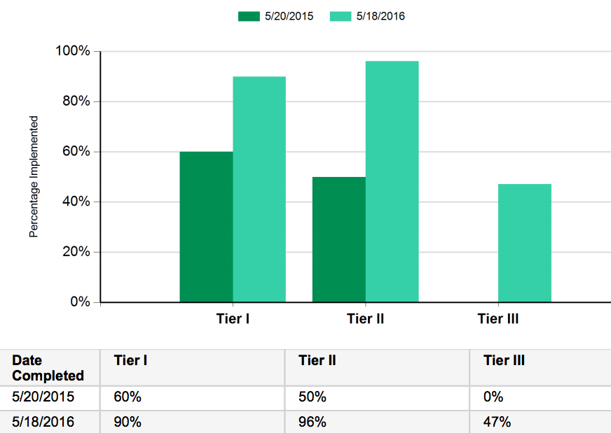
Sample TFI Report - Scale
Look for growth overtime.
Washington School
TFI Tip:
Fidelity Cut Scores:
Tier 1 ≥70%
Tiers 2/3 ≥80%
Notes:
Coach pulls up ad reviews report with their team. With the scale report look for progress over time.

Slide 41
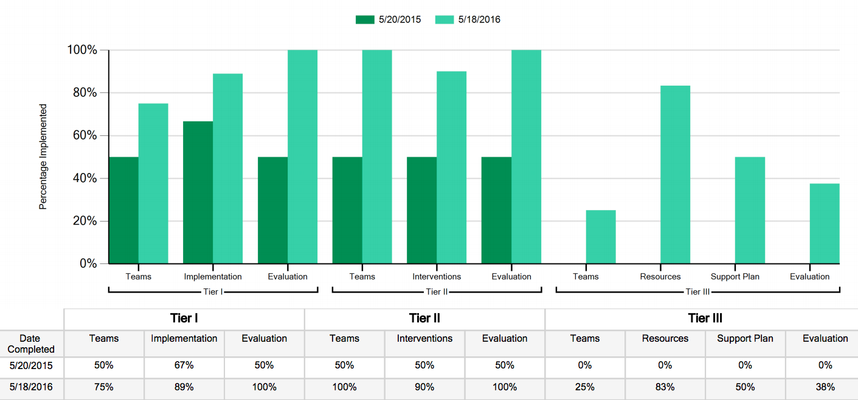
Sample TFI Report - SubScale
Look for your focus area.
Washington School
Notes:
With the subscale report look for a focus area.

Slide 42
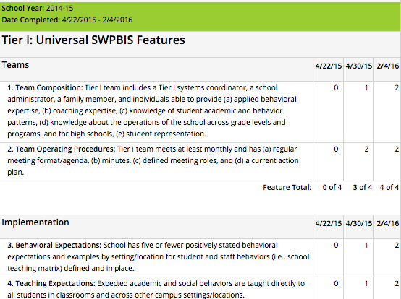
Action Planning Using the Items Report
Choose 1-3 items to take action on
Develop a plan to share with staff to increase their knowledge and willingness to participate
Your External Facilitator will help guide your action planning
Notes:
The items report is used to choose action steps within your focus area.

Slide 43
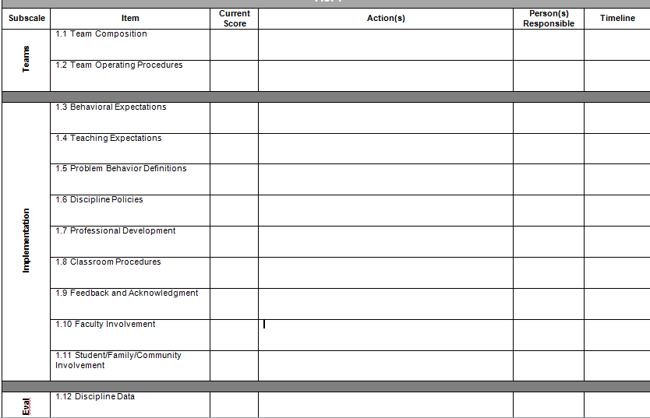
TFI Action Plan
Notes:
Teams complete their action plan.

Slide 44
Appreciation is given to the following
for their contributions to this Professional Learning:

