Slide 1
PBIS Team Training 6B
Faculty Involvement (TFI 1.10) Student, Family, Community Involvement (TFI 1.11)

Slide 2
Learning Expectations
EXPECTATION | BEHAVIOR
Be Responsible | Make yourself comfortable Take care of your needs (water, food, restroom, etc.) Action plan to implement what you are learning Follow through on your action items
Be Respectful | Turn cell phones off or to “vibrate” Listen attentively while others are speaking Have only the training materials up on your computer/tablet/phone
Be Engaged | Ask what you need to know to understand and contribute Contribute to the group by sharing relevant information and ideas
Notes:
2

Slide 3
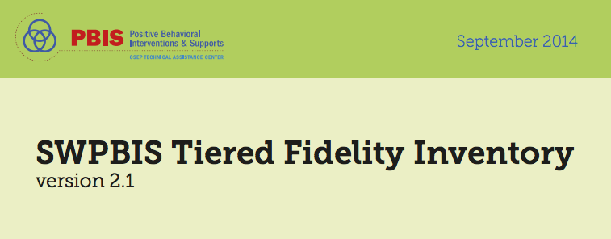
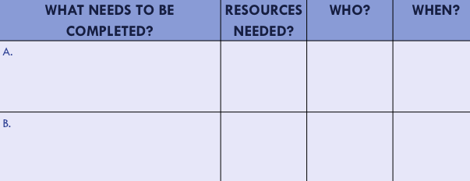
Organization of Modules
Content:
Aligned to TFI Items 1.1 – 1.15 and Classroom Management Practices
Activities/Team Time: Activities for Fluency
Self-Assessment:
Tiered Fidelity Inventory
Action Planning: Applying the core content to your school
Notes:
These are the icons that you will see throughout the training and will serve as a guide and a prompt to the content of each slide.

Slide 4
Tier 1: Professional Learning Roadmap
TFI Sub-Scale: Team
TFI 1.1 | Team Composition
TFI 1.2 | Team Operating Procedures
TFI Sub-Scale: Evaluation
TFI 1.12 | Discipline Data
TFI 1.13 | Data-based Decision Making
TFI 1.14 | Fidelity Data
TFI 1.15 | Annual Evaluation
TFI Sub-Scale: Implementation
TFI 1.3 | Behavioral Expectations
TFI 1.4 | Teaching Expectations
TFI 1.5 | Problem Behavior Definitions
TFI 1.6 | Discipline Policies
TFI 1.7 | Professional Development
TFI 1.8 | Classroom Procedures
TFI 1.9 | Feedback and Acknowledgement
TFI 1.10 | Faculty Involvement
TFI 1.11 | Student/Family/Community Involvement
8 Classroom Management Practices
1 | Arrange orderly physical environment
2 | Define, Teach, Acknowledge Rules and Expectations
3 | Define, Teach Classroom Routines
4 | Employ Active Supervision
5 | Provide Specific Praise for Behavior
6 | Continuum of Response Strategies for Inappropriate Behaviors
7 | Class-Wide Group Contingency
8 | Provide Multiple Opportunities to Respond

Slide 5
TFI 1.10 Purpose & Outcomes
Purpose:
Prepare and plan for involving all stake holders in decision-making and implementation
Objectives:
1.10 Faculty Involvement: Faculty are shown school-wide data regularly and provide input on universal foundations (e.g., expectations, acknowledgements, definitions, consequences) at least every 12 months.
1.11 Student/Family/Community Involvement: Stakeholders (students, families, and community members) provide input on universal foundations (e.g., expectations, consequences, acknowledgements) at least every 12 months.
Notes:
Trainer Notes:
Module 2 is all about faculty/staff commitment and participation. Your team should be working towards:
Sharing behavior data with the faculty at least monthly
Most faculty participate in establishing PBIS goals on at least an annual basis
Faculty given opportunities to provide feedback, to offer suggestions, and to make choices in every step of the PBIS process (via staff surveys, voting process, suggestion box, etc.) Nothing is implemented without the majority of faculty approval

Slide 6
TFI 1.10: Faculty Involvement
CORE CONTENT: Definition, Rationale & Examples

Slide 7
Definition
Open and honest communication is established among stakeholders to secure buy-in and commitment to change
Is it good to have cognitive conflict?
Do you have an honest critic in your group?
Notes:
Those involved must share :
a common dissatisfaction with the processes and outcomes of the current system
a vision of what they would like to see replace it
Problems occur when the system lacks the knowledge of how to initiate

Slide 8
Faculty Involvement Involves at least 80% buy-in
Turn and Talk: Why do we need faculty involvement?
Collectively, staff will:
identify focus
identify ways to monitor progress
identify goals
Identify ways to evaluate outcomes
Identify how to engage resistant staff

Slide 9
Rationale
… and Implementation of PBIS involves all faculty and staff

Slide 10
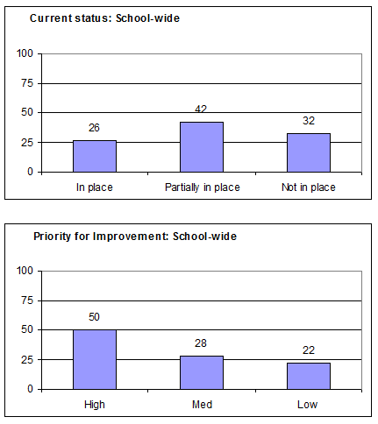
What data will you share?
Self-Assessment Survey (SAS)
Self-Assessment Survey?
Informal surveys?
TFI results?
Climate Surveys?
Discipline Data?
Cost Benefit Analysis
Notes:
Determine date to share info with faculty- this could be part of kick off event for staff

Slide 11
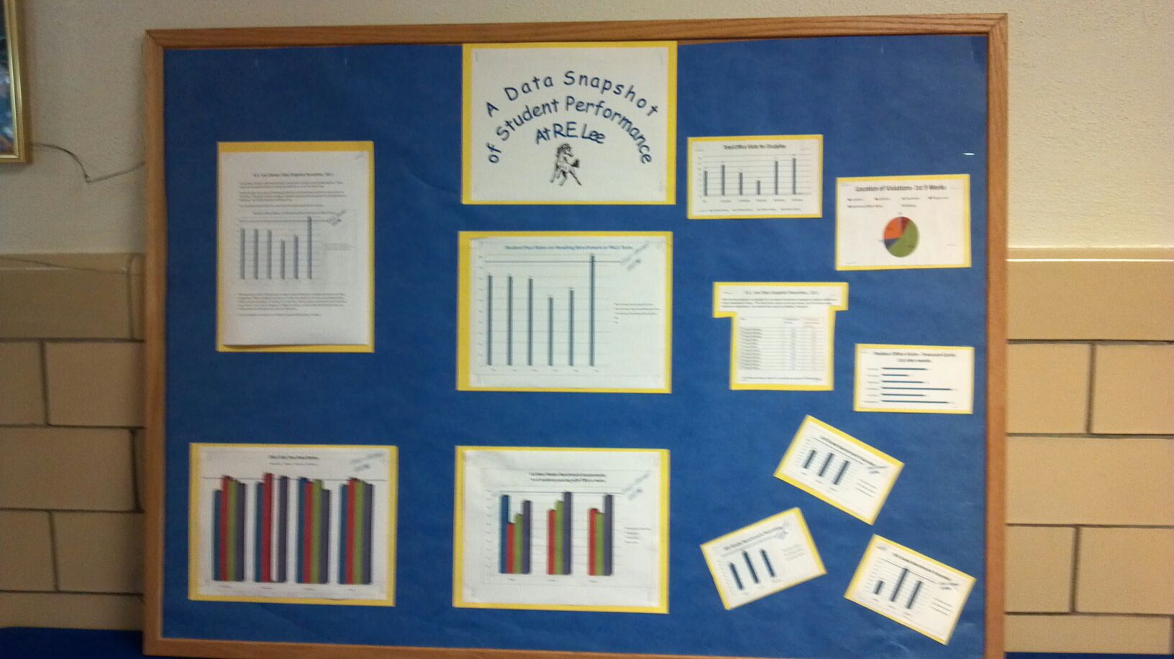
How and when will you share data?
Share visuals with staff monthly
What’s working?
What needs more focus?
Emphasize staff involvement
Notes:
Share visuals with staff monthly.
Show
What’s working?
What needs more focus?
Emphasize staff involvement!

Slide 12
Staff Ppoint Templates

Slide 13
Input and Feedback: Communication and Feedback Loops
Grade level/core/department meetings
Vertical team meetings
Staff/Faculty Meetings
Google Docs, SharePoint, or other virtual sharing mechanisms
Newsletters
Professional development days
Communities of Learners (shared learning)
Notes:
You see a common theme running through the Faculty Commitment element: COMMUNICATE for understanding / trust/ safety/ transparency/ ownership
Look at the flow of your meetings
Systems wide…does the meeting structure flow in order i.e. grade level mtg then PBIS mtg, staff mtg, parent advisory---What flow works for your school
Think about the best time to share information, then collect info, push out to the whole, etc. Admin, look for this structure.
Guiding questions for each planned mtg that requires faculty reflection, data analysis, feedback.

Slide 14
How will you engage staff in the implementation of PBIS?
Building a shared vision
Rethinking Discipline
Sharing data
Encouraging input and feedback
Implementation prompts/reminders for staff
Workbook: p. 74 Activity 1A

Slide 15
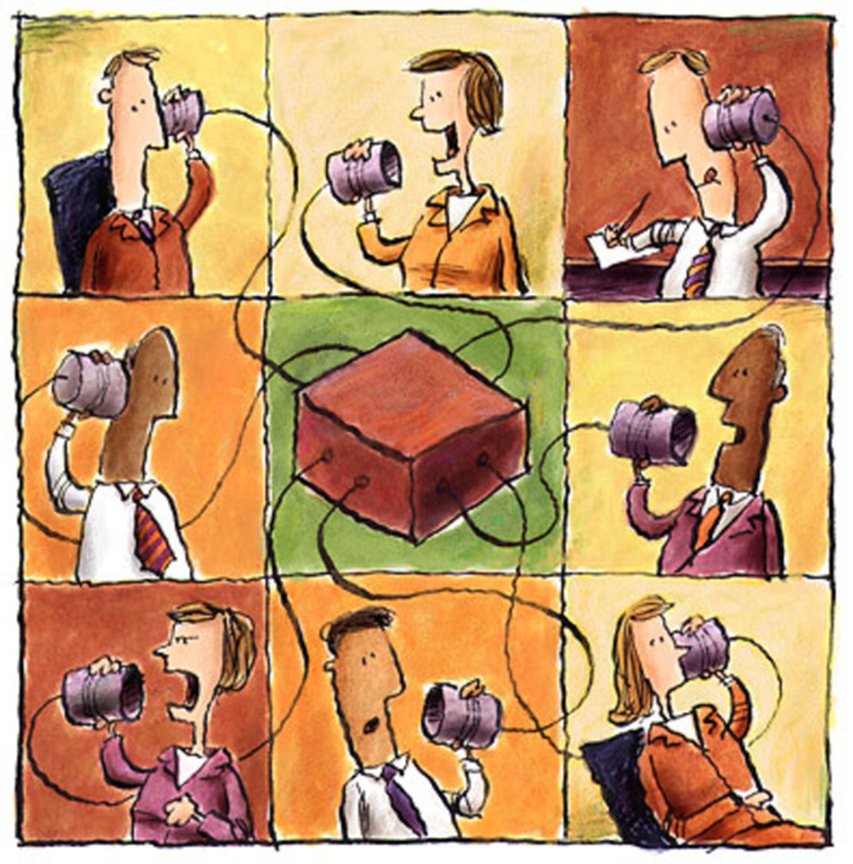
Input and Feedback: Create a Communication System
Sharing ongoing information
Presenting data
Obtaining feedback from stakeholders
Reviewing goals and action plans

Slide 16
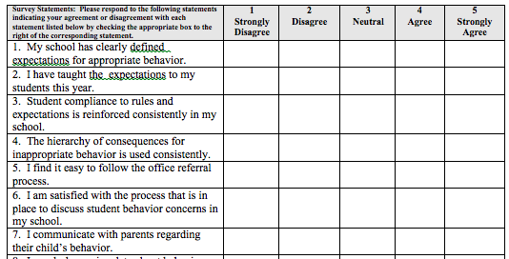
School Created Staff Survey
https://www.pbis.org/resource/423/pbs-staff-satisfaction-survey
Notes:
The SAS is a great tool, but sometimes you want to ask some quick questions or more school specific questions.

Slide 17
Communication Systems
Directions:
Starting with the facilitator, and moving clockwise, each person share out a time/opportunity your school could share important school data/PBIS information.
(Think about what structure you have in place now and “outside” the box thinking of what may be opportunities you haven’t explored yet)
Recorder, document the team’s discussions.
Communicator, share out after the activity.
Workbook p. 74 Activity 1B
Notes:
ACTIVITY:

Slide 18
TFI 1.11: Student/Family/Community Involvement
CORE CONTENT:
Definition, Rationale & Examples

Slide 19
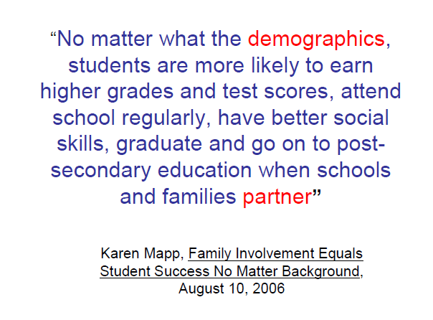
School-Family Partnership
Dual Capacity-Building Framework for Family-School Partnerships, USDOE download
Notes:
Additional trainer notes for background:
Secretary of Education Arne Duncan visited the Harvard Graduate School of Education in February 2010, Senior Lecturer Karen Mapp asked him about federal support for family and community engagement. She came away with a new assignment: Help the U.S. Department of Education find a new approach that would do a better job.
For the next several years, Mapp and colleagues consulted with USDOE to develop what came to be called the Dual Capacity-Building Framework for Family-School Partnerships, now released by the government as a downloadable, shareable model that schools and districts can use to build the kind of effective, mutually rewarding engagement that will make schools the center of their communities.
Dual Capacity-Building Framework for Family-School Partnerships - https://www2.ed.gov/documents/family-community/frameworks-resources.pdf

Slide 20
Families and teachers engage in meaningful communication
Involves two way communication.
Uses language that both parties are comfortable with.
Avoids jargon and acronyms.
Sets communication standard that is open, honest, and continuous.

Slide 21
Outcome …
Stakeholders
(students, families, and community members)
provide input on universal foundations (e.g., expectations, consequences, acknowledgements)
at least every 12 months

Slide 22
Question
What is already happening at your school that gets families in the door?
Workbook p. 75 Activity 2

Slide 23
Families and Students
Encourage families to share information with the school about culture, background, children's talents and needs
Plan for data-informed decisions through feedback from families and students (e.g. formal and informal surveys, focus groups)
Student ambassador and leadership opportunities
Student engagement opportunities (e.g., student PBIS team, clubs)

Slide 24
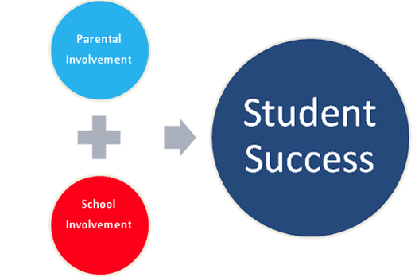
Family Kick Off
Letter to families
PBIS overview
Explanation of school expectations
Explanation of acknowledgement system
Brochure
Back to school activities
Sports Meetings
Utilize down time when you have a captive audience (waiting for something to start or intermission…)
(Didier, J. & Udry, V 2007 Unity West Elementary)

Slide 25
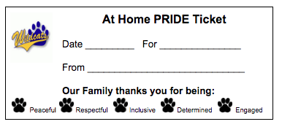
Family Examples

Slide 26
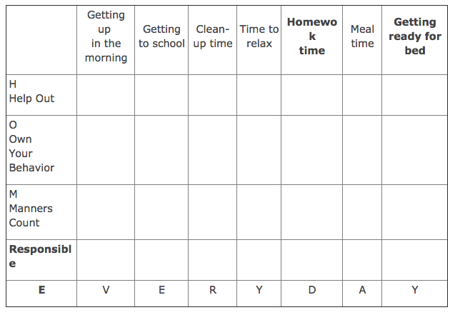
Available Templates-pbismn.org
Notes:
Available from pbismn.org>Families and Community

Slide 27
Help Wanted
Notes:
Help Wanted Poster to bring in volunteers to help with PBIS activities

Slide 28
Include in Celebrations
Spartan Pride Celebrations
On late start days (the second Tuesday of every month), staff and students of the school gather school-wide to celebrate all of the successes of one another. This celebration is a part of our “Spartan Pride” program, increasing the positive school climate in the building.
In order to celebrate the great things about our students, we need your help to find out about them! If you have something special you would like us to recognize about your child please detach the form below and send it to the school office, so that we may include it in our next celebration.
Spartan Pride Celebration Form
I would like my child to be recognized at a school-wide celebration.
Student’s name: Date:
Reason:

Slide 29
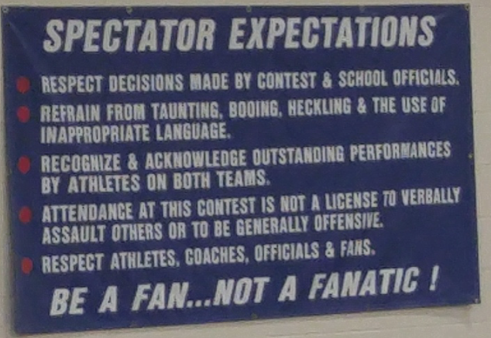
Secondary Level
Concerts, plays, sporting events…
Add expectations to program
Have expectations posted
Speak about expectations
Specifically THANK audience for following expectations at some point

Slide 30
Student Voice
What do students offer that is unique and helps the school?
How do students benefit from being involved?

Slide 31
“SW-PBIS is something we do WITH students not to them.” -Tim Lewis
Benefits:
Students feel more ownership of the SW-PBIS initiative
Students want a direct impact on their school
Builds social skills for life
Bridges the gap between student and teacher
Builds unity within a school
Make sure students of all demographics are represented
St. James Student Video

Slide 32
Perception
Students have a different perception of school than adults.

Slide 33
Student Survey

Slide 34
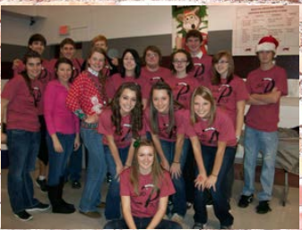
Ways to “Hear” Students
Student Surveys
Student reps from each grade
Use existing groups
Give leadership role to higher level students
Have a student on your teams

Slide 35
Communities
Local resources are crucial
Media Coverage
Alumni
Business Awareness
Notes:
Invite politicians to school events.
Have student PBIS team leaders walk the politician around the school pointing out the 3-5 behavioral expectations, the matrix of behavioral teaching examples, the gotcha program, and discuss how each behavior was taught to the entire school.
Have the students talk about what a difference PBIS has meant to them.
Keeping politicians informed assists with legislature like the "Positive Behavior for Effective Schools Act" in the US Senate (S.2111), which is companion legislation to H.R.3407. S.2111 Title: A bill to amend the Elementary and Secondary Education Act of 1965 to allow State educational agencies, local educational agencies, and schools to increase implementation of early intervention services, particularly school-wide positive behavior supports.

Slide 36
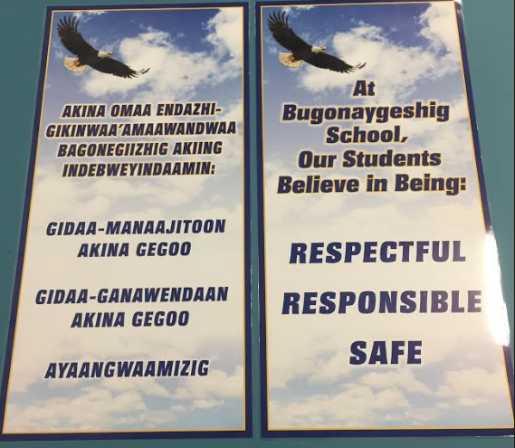
Connecting with Culture

Slide 37
Community-wide PBIS Implementation Who is involved?
Police Department
Park District
Community Center
Parents
Library
Schools/District
Chamber of Commerce
Community Organizations
Notes:
LC

Slide 38
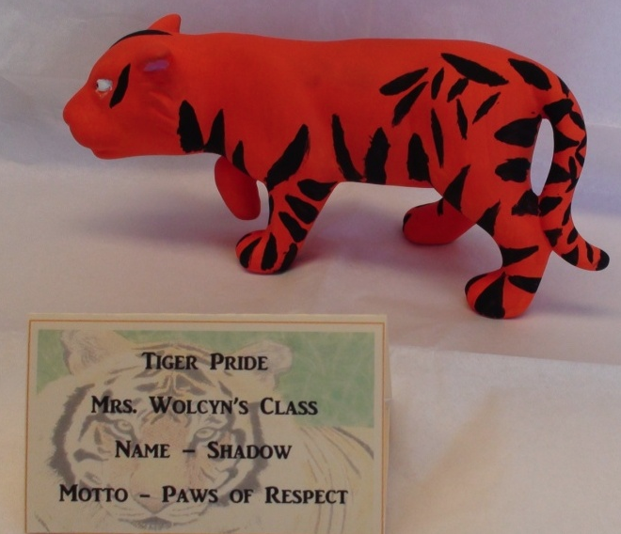
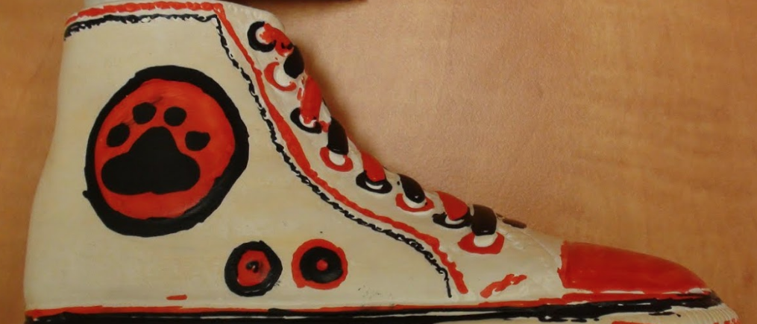
Business Awareness
Presentation at Chamber of Commerce meeting
Posters hung up in town – connection to universal language
Opportunity to display student work
Brochure to businesses to give basic understanding
Notes:
How can schools procure business support? Invite business owners to visit the schools, visit the Rotary Club and talk about success stories in the schools, invite businesses to the PBIS stakeholder group, and when visiting the business mention the program and ask for support.
One school has a theme each year. Each classroom paints a ceramic figurine to match theme. Figurines are placed in local businesses and over 6 weeks students are encouraged to find the figures around town. Only expectation from business is to keep figures displayed and safe. After 6 weeks items are collected and auctioned off. Businesses look forward to this each year.

Slide 39
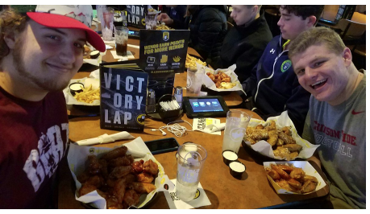
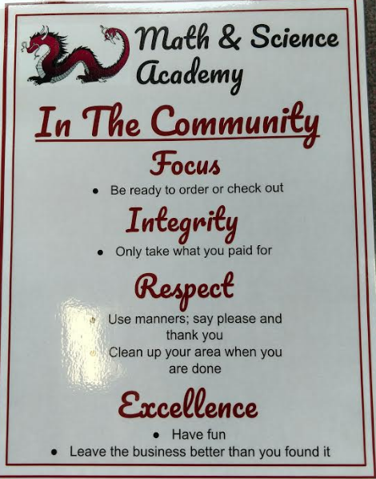
Community Examples
Students at a local restaurant that donated 30 wings to each student who had their name drawn.
Notes:
Poster Example for Community
Chanhassen High School does a "PRIDE Ride" every Friday as part of their student incentives. Administration drives the "short bus" to a local restaurant that has donated lunch for students (and 1 friend) whose names have been drawn. Here, students were at Buffalo Wild Wings, who donated 30 wings to each student!

Slide 40
Resource on Family and Community Engagement
https://www.pbis.org/Common/Cms/files/pbisresources/Family%20Engagement%20in%20PBIS.pdf

Slide 41
More Resources on Family and Community Engagement
National PTA Standards for Family-School Partnerships, http://www.pta.org/nationalstandards
Connecting Family and Community Engagement to Student Learning and Educator Effectiveness, Mass. Department of Elementary and Secondary Education http://www.doe.mass.edu/boe/sac/parent/PracticeGuide.html
Harvard Family Research Project http://www.hfrp.org/

Slide 42
Plan for Stakeholder Input …
Universal Foundations and Stakeholders | Expectations and Rules (Teaching Matrices) | Initial and on-going instruction on expectations | Acknowledgment Program | Discipline (problem behavior definitions, policies, procedures)
Students
Families
Communities
Workbook:
Workbook p. 75 Activity 3
Notes:
Identify how your team will involve all your stakeholders in developing the Universal Foundations. How will you receive their input, as well as their continued feedback?

Slide 43
TFI 1. 10 & 1.11: Faculty Involvement and Student/Family/Community Involvement
SELF-ASSESSMENT
Complete TFI item(s)
Assess additional action items at end of module
ACTION PLANNING
Add action items to Action plan
Plan for PD
Add to your Staff Presentation PPT

Slide 44
TFI Self-Assessment
Features | Possible Sources | Criteria
1.10 Faculty Involvement: Faculty are shown school-wide data regularly and provide input on universal foundations (e.g., expectations, acknowledgements, definitions, consequences) at least every 12 months. | • PBIS Self-Assessment Survey • Informal surveys • Staff meeting minutes • Team meeting minutes | 0 = Faculty are not shown data at least yearly and do not provide input 1 = Faculty have been shown data more than yearly OR have provided feedback on Tier I foundations within the past 12 months but not both 2 = Faculty are shown data at least 4 times per year AND have provided feedback on Tier I practices within the past 12 months
1.11 Student/Family/Community Involvement: Stakeholders (students, families, and community members) provide input on universal foundations (e.g., expectations, consequences, acknowledgements) at least every 12 months. | • Surveys • Voting results from parent/ family meeting • Team meeting minutes | 0 = No documentation (or no opportunities) for stakeholder feedback on Tier I foundations 1 = Documentation of input on Tier I foundations, but not within the past 12 months or input but not from all types of stakeholders 2 = Documentation exists that students, families, and community members have provided feedback on Tier I practices within the past 12 months
Notes:
Teams should complete this self assessment and use the results to determine action planning steps on Workbook page 11.

Slide 45
Action Items and Planning
Identify action items below needed for full implementation
Add action items to the Action Plan in your workbook
Add completed items and artifacts to the PPT Overview for your school
TFI | Action Item (Not In Place; Partially; Fully In Place ->) | NI | PI | FI
1.10 | School-Wide behavioral data is shared with faculty regularly
1.10 | Faculty involved in establishing and reviewing goals
1.10 | Faculty feedback is obtained throughout the year
1.11 | Plans for involving families/communities are developed and implemented
1.10, 1.11 | Data informs decisions (e.g., staff surveys, fidelity assessments, climate surveys, etc.)
1.10, 1.11 | Surveys are developed with dates to administer to staff, students, and families

Slide 46
Appreciation is given to the following for their contributions to this Professional Learning:

Slide 47
Worktime
Workbook Activity plan for stakeholder input
Discuss and plan how to involve faculty/students/families/community
TFI Action Planning

