Slide 1
PBIS Team Training 5B
Feedback and Acknowledgement
(TFI 1.9)
Notes:
Updated January 2020

Slide 2
Learning Expectations
EXPECTATION | BEHAVIOR
Be Responsible | Make yourself comfortable Take care of your needs (water, food, restroom, etc.) Action plan to implement what you are learning Follow through on your action items
Be Respectful | Turn cell phones off or to “vibrate” Listen attentively while others are speaking Have only the training materials up on your computer/tablet/phone
Be Engaged | Ask what you need to know to understand and contribute Contribute to the group by sharing relevant information and ideas
Notes:
2

Slide 3
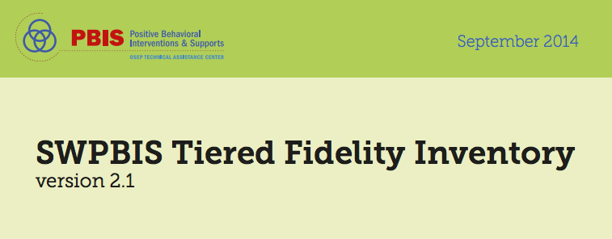
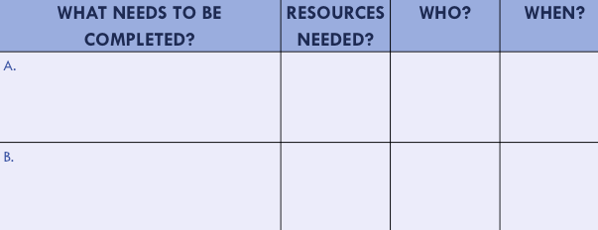
Organization of Modules
Content:
Aligned to TFI Items 1.1 – 1.15 and Classroom Management Practices
Activities/Team Time: Activities for Fluency
Self-Assessment:
Tiered Fidelity Inventory
Action Planning: Applying the core content to your school
Notes:
These are the icons that you will see throughout the training and will serve as a guide and a prompt to the content of each slide.

Slide 4
Tier 1: Professional Learning Roadmap
TFI Sub-Scale: Team
TFI 1.1 | Team Composition
TFI 1.2 | Team Operating Procedures
TFI Sub-Scale: Evaluation
TFI 1.12 | Discipline Data
TFI 1.13 | Data-based Decision Making
TFI 1.14 | Fidelity Data
TFI 1.15 | Annual Evaluation
TFI Sub-Scale: Implementation
TFI 1.3 | Behavioral Expectations
TFI 1.4 | Teaching Expectations
TFI 1.5 | Problem Behavior Definitions
TFI 1.6 | Discipline Policies
TFI 1.7 | Professional Development
TFI 1.8 | Classroom Procedures
TFI 1.9 | Feedback and Acknowledgement
TFI 1.10 | Faculty Involvement
TFI 1.11 | Student/Family/Community Involvement

Slide 5
TFI 1.9 Purpose & Outcomes
Purpose: Prepare and plan for facilitating implementation of acknowledging behavior
You should be able to:
Develop a school-wide and classroom-wide acknowledgement system for students and staff
Link acknowledgements to the expectations
Involve staff and students in developing acknowledgements

Slide 6
TFI 1.9: Feedback & Acknowledgement
CORE CONTENT: Definition, Rationale & Examples

Slide 7
What is Acknowledgement/Recognition?
Quick Write
Write for 1 minute whatever comes to your mind when you think about acknowledge also called recognition.
When you hear the signal stop writing.
Choose one thing you wrote in a round table fashion (one person at a time), with your team.
Notes:
Have participants connect to their understanding of recognition first.

Slide 8
Definition
Positive acknowledgement is the presentation of something pleasant or rewarding immediately following a behavior.
It makes that behavior more likely to occur in the future, and is one of the most powerful tools for shaping or changing behavior.
(SBCUSD Positive Behavior Support Initiative)
Notes:
Now come to a common definition for the training session. Explain that together we will explore the purpose rationale for using recognition in the PBIS framework.

Slide 9
Purposes & Rationale for using Acknowledgment
Reinforce the teaching of new behaviors
Strengthen and encourage the behaviors we want to occur again in the future
Every adult interaction with a student is an instructional moment that influences what happens next.
Research indicates that you
can improve behavior
by 80% just by pointing out
what someone is doing
correctly.
Laura Riffel, OSEP
Notes:
9
Use of acknowledgements to reinforce behavior is research based however, it is really about how we want to spend out time with students

Slide 10
What really matters
What really matters
is the positive social
acknowledgement
and interaction
Notes:
We all like to hear positive feedback – so what could possibly be wrong about saying to a student, “raising your hand, and waiting to be called upon is so respectful, thank you.” – (then we have to reinforce that behavior so that we can increase the likelihood that it will occur again in similar circumstances.

Slide 11
Research Recommendations for Providing Recognition
Recognize both effort and mastery
Make recognition specific and aligned with expected performance and behavior
More recognition than correction occurs
Pair recognition with a concrete symbol

Slide 12
Recognition both effort and mastery
Focus in on the positive
How this applies to the school setting?
Notes:
Give teams 3 minutes to talk about role of recognition in building a positive community where students are willing to fail, take risks and feel seen and valued for their worth as an individual who is learning and growing.

Slide 13
Recognition is Aligned and Specific
Example:
Step 1: Use the student’s name
Step 2: Name the behavior observed
Step 3: Tie back to school-wide expectations
Example: Nice job sitting in your seat Jay when the bell rang. Way to be there, be ready.
Non-example:
Giving ticket without saying anything
Giving ticket for non-school wide expectations
Only giving for “above and beyond” behavior
Notes:
Have teams pair up and practice recognition.

Slide 14
Choose an example and practice
Pair up at your table
Choose an example and practice using aligned and specific recognition
Student is on time for class
Student is helping clean up in the cafeteria
Student follows the morning routine
Student is walking in the hallway
Include:
student name • what you saw • how that aligns to your expectations
Notes:
Have teams practice in pairs

Slide 15
Recognition Occurs more Frequently than Correction (across ALL school settings, including the classroom)
Failure
(punishment)
Success (reinforcement)
5 : 1
(Scott, 2008)
Notes:
Studies show that in order to be successful the positives need to exceed the negatives by a ratio of more than 4 to 1 (family & marriage therapy research). The BOQ recommends at least 5:1.
If the consequence was access to technology and the behavior increased, then the access was a reinforcer.
If the consequence was sending the student to the office and the behavior increased, then the removal was a reinforcer.
If the consequence was a reprimand (which included adult attention), and the behavior increased, then the reprimand was a reinforcer.

Slide 16
How Does 5 to 1 Happen?
All Staff are expected to:
Interact in a friendly, supportive manner at all times---students, parents, guests and colleagues
Initiate positive interactions by:
Making eye contact
Welcoming
Offering a greeting
Asking if assistance is required
Providing positive feedback regarding appropriate student behavior
Maintaining an attitude of respect and support, even when correcting student behavior

Slide 17
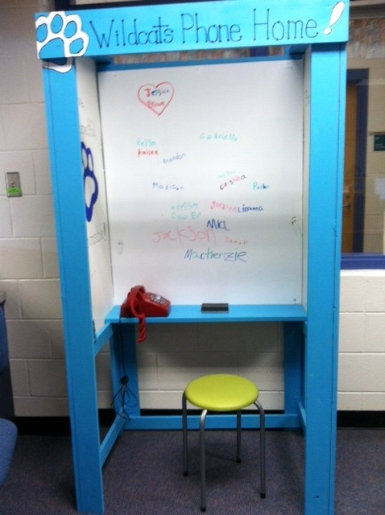
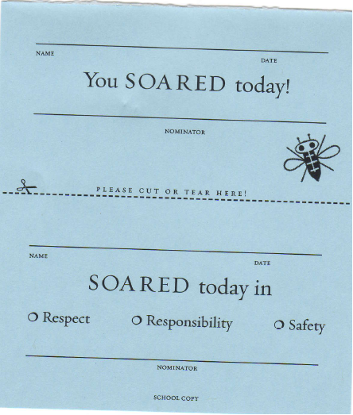
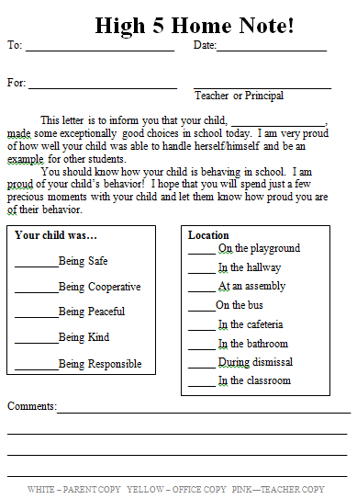
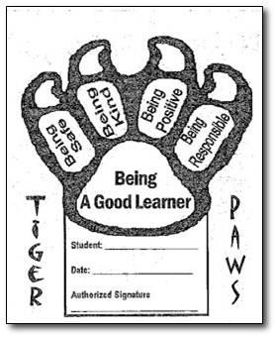
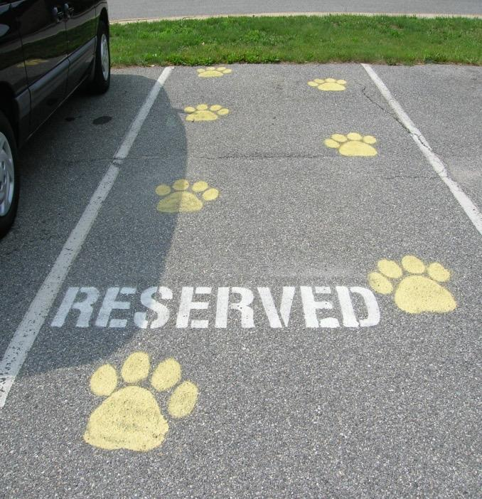
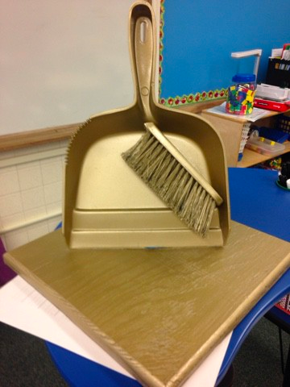
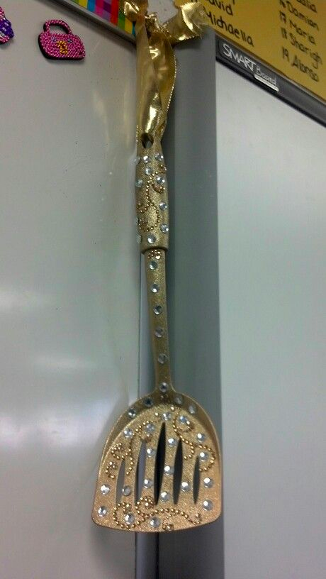
Pair Recognition with a Concrete Symbol
Notes:
Emphasize that the FEEDBACK is the most important piece, not the “thing” that you are handing out

Slide 18
Staff Recognition
Restaurant coupons for staff who gave winning student coupon
Auto detailing for staff member
Starbucks delivered to class
“Rock Star” (parking closest to school)
“Whale Done” Trophy - The principal presents it to the first winner at the first faculty meeting, modeling how it was to be presented. After that each winner looks for a colleague to whom the trophy can be given the next time
Extra planning period coupon
Thank you cards to teachers for support

Slide 19
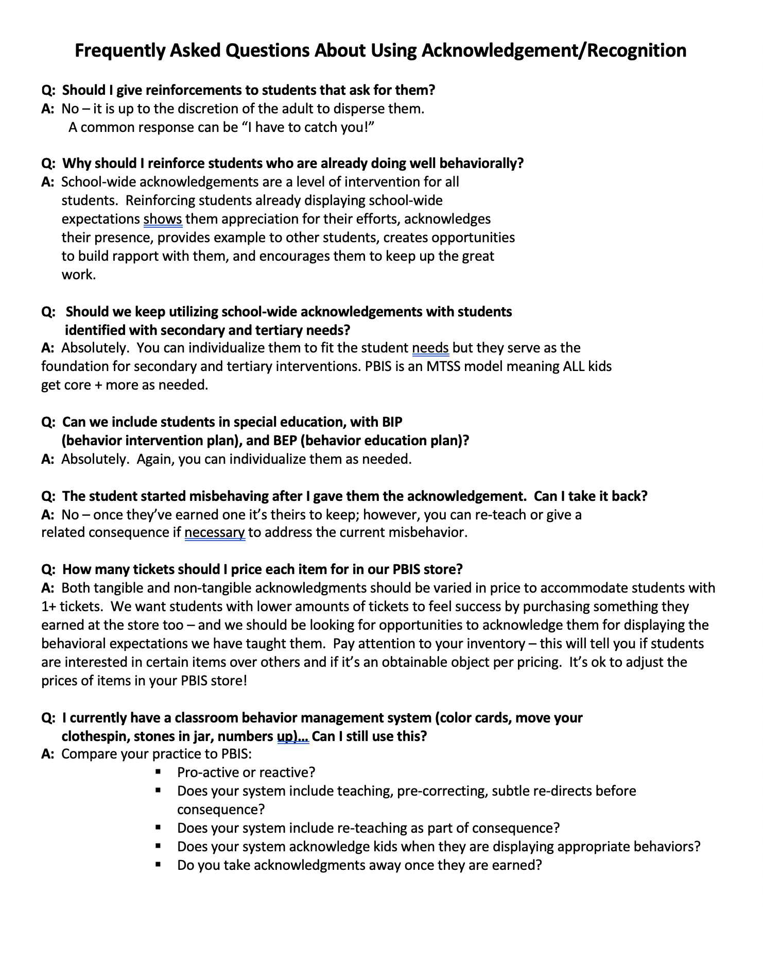
Frequently Asked Questions:
Read through the Frequently Asked Questions handout.
What thoughts or questions did you have as you read?
Talk with your team about it.
Notes:
Have teams read through the frequently asked questions handout. Give them time to talk about thoughts/questions that came up as they read. (10 minutes)

Slide 20
TFI 1.9: Feedback & Acknowledgement
Implementing With Fidelity: Guidelines for School Wide Recognition

Slide 21
Guidelines for School Wide Recognition
Recognition is for EVERY student
Recognize the behavior-connect to SW expectation
Recognition closely follows the desired behavior
Include the students in identifying possible recognitions
Create a system that is easy to implement consistently across the school campus
Create a communication plan
Notes:
Could be a handout or a link- showcase just a few

Slide 22
Planning with the Outcome in Mind
We have a system of recognition that is being implemented consistently across campus for students and staff
We use a variety of methods to recognition student effort and mastery
Staff provide immediate and specific recognition
Our concrete symbols are linked to our expectations and goals
Our concrete symbols are varied to maintain student interest
The ratio of recognition to correction is high
Students are involved in identifying/developing incentives
Notes:
In the end this is the desired outcome

Slide 23
Planning Tool for Designing Your Recognition Tool
TYPE | WHAT | WHEN | WHERE | WHO
Immediate/High Frequency In the moment, predictable, Delivered at a high rate for a short period (e.g., Gotchas, Paws, High Fives) | STUDENTS: ADULTS: | High frequency for a short time when first teaching desired behavior or re-teaching identified problem behavior from data |  | ALL STUDENTS, ALL ADULTS
Redemption of high frequency (e.g., school store, drawings) | STUDENTS: ADULTS: | At least monthly |  | ALL STUDENTS, ALL ADULTS
Intermittent/Unpredictable (e.g., surprise homework completion treat, random use of gotchas in hallway) | STUDENTS: ADULTS: | Maintaining a taught behavior (fading) |  | ALL STUDENTS, ALL ADULTS
Long-term School-wide Celebrations (school-wide not individually based) FOR: Ex: ODR reduction, school-wide target met for certain setting/behavior area ACTIVITY: (e.g., ice cream social, dance, game day) | BOTH TOGETHER: | At least quarterly |  | ALL STUDENTS, ALL ADULTS
The Acknowledgement Matrix
Notes:
23
Emphasize 3 different types/ 3 different purposes and when to use
Long term celebrations are for ALL students….referral free parties DO NOT count!!!!!
Information from George Sugai:
The discussion was about long-term celebrations that all kids attend vs. long term celebrations that have criteria (0-1 referrals for a semester) for attendance.
1. Contingencies that link reinforcer to whole group behavior performance (e.g., If more than 80% of students have perfect attendance, whole school gets special assembly).
2. For kids with challenges, I like having separate individualized criteria and reinforcers (e.g., If Steve attends school 70% of days, he can also sit with friends of his choice).
3. Students with 100% can get some additional acknowledgement beyond what whole group get.
Etc.
The general big idea is that all kids get what the collective earns. Some kids (100% AND specialized needs kids) get extra for exceptional performance

Slide 24
TFI Self-Assessment
Features | Possible Sources | Criteria
1.9 Feedback and Acknowledgement: A formal system (i.e., written set of procedures for specific behavior feedback that is [a] linked to school-wide expectations and [b] used across settings and within classrooms) is in place and used by at least 90% of a sample of staff and received by at least 50% of a sample of students | • TFI Walkthrough Tool or Staff Handbook | 0 = No formal system for acknowledging students 1 = Formal system is in place and is used by at least 90% of staff OR received by at least 50% of students 2 = Formal system for acknowledging student behavior is used by at least 90% of staff AND received by at least 50% of students
Notes:
Teams should complete this self assessment and use the results to determine action planning steps on Workbook page 11.

Slide 25
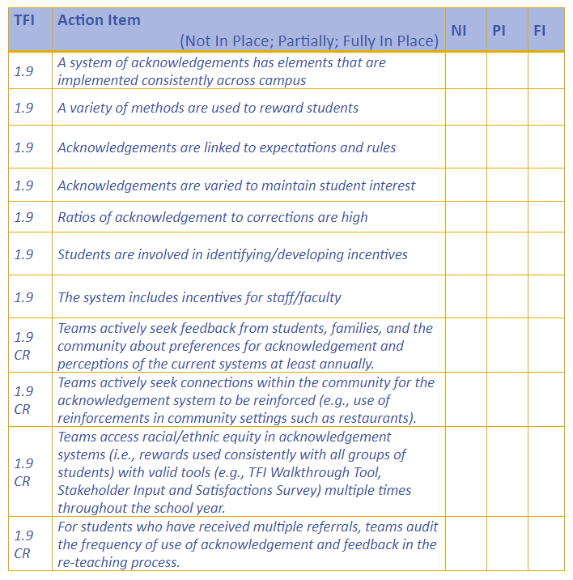
Dig Deeper into Feedback & Acknowledgement

Slide 26
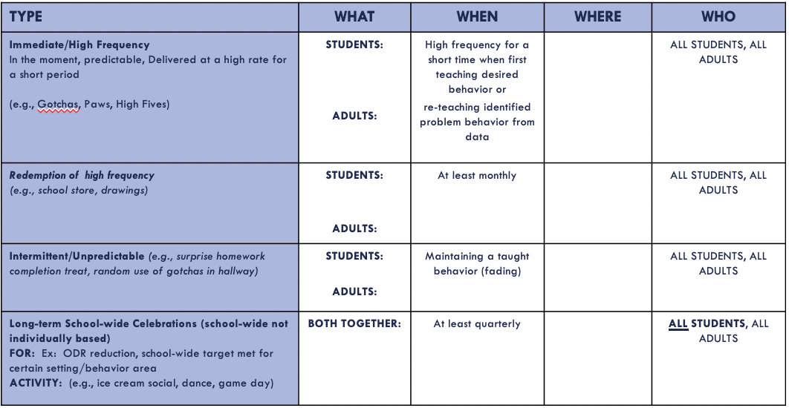
Team Time Task
Brainstorm Ideas for acknowledging both staff and students.
Complete the acknowledgement matrix for staff and students (high frequency, intermittent, long term).
Be ready to share your work here and back home.
Notes:
Have teams share their acknowledgement matrix in their template and then share one recognition idea for staff or student recognition they are going to propose to their colleagues.

Slide 27
Appreciation is given to the following for their contributions to this Professional Learning:

Slide 28
The following slides are example ideas. You can add them to your presentation if you are looking for ideas.
**If you are going to move these, please make a copy of the presentation and then make the changes.

Slide 29
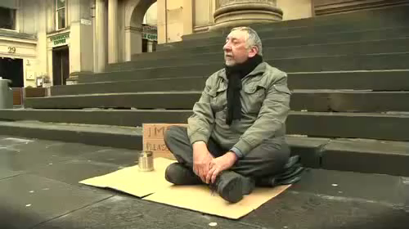
Change your words, change your world
http://youtu.be/Hzgzim5m7oU
Notes:
http://youtu.be/Hzgzim5m7oU

Slide 30
Activity: Changing our words
Negative
Positive
Workbook: TFI 1.9 Activity 1
Notes:
Each person draws a line down the middle of the card and writes 2-3 negative statements they have heard in their building, said by teachers to students; (e.g., Don’t run in the hallway! How many times do I have to tell you…) on the left side of the card.
Stand when completed.
Exchange card with a person from another school.
Re-write the statement to a positive direction. Return card to owner.
Share out with the large group.
Ask: Would this be a useful activity in your school?

Slide 31
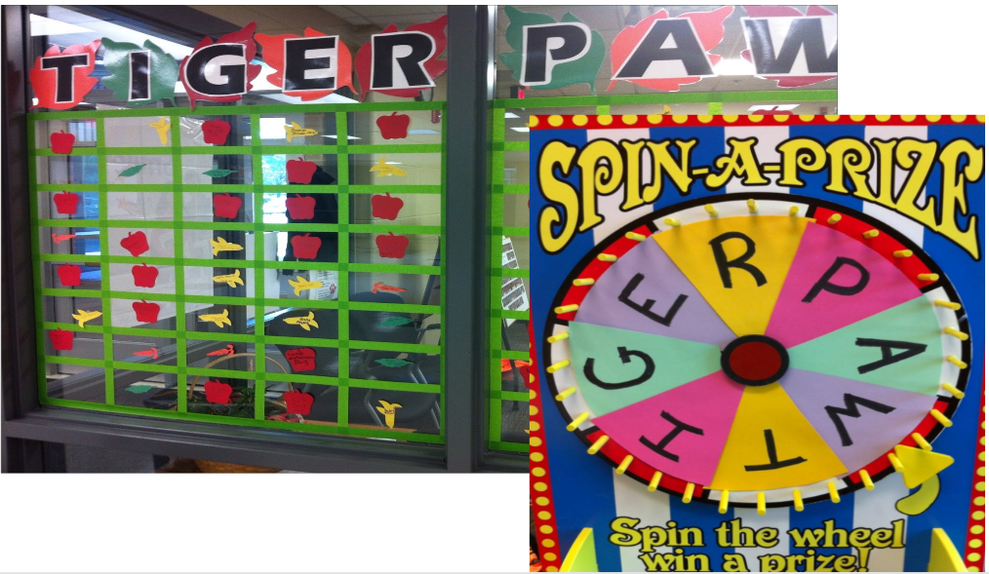
Make it Fun

Slide 32
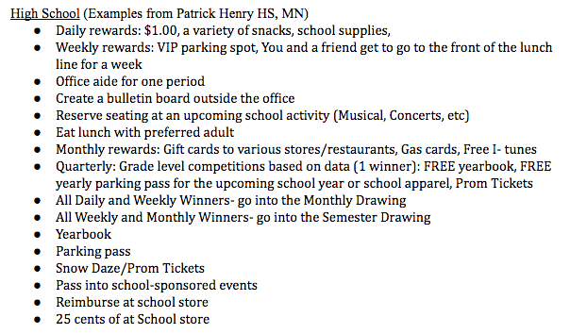
Social Reinforcements
Link to example menu
Notes:
Students collect tickets to spend on a menu of items. This menu could include tangible items or items that promote social connections. Some schools include things students may need such as school supplies, socks, beanie hats, or even blankets.

Slide 33
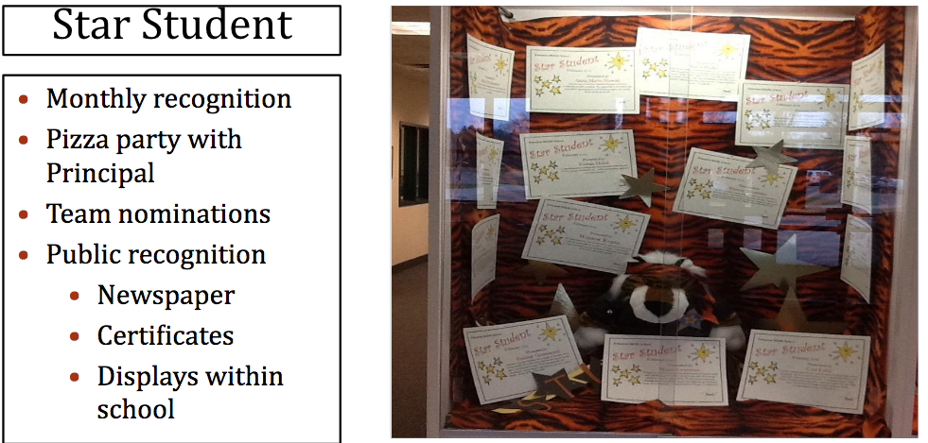
Monthly
Notes:
New examples

Slide 34
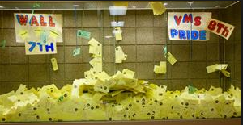
Quarterly
Notes:
School-wide celebrations after so many tickets are collected.

Slide 35
Make It Easy!

Slide 36
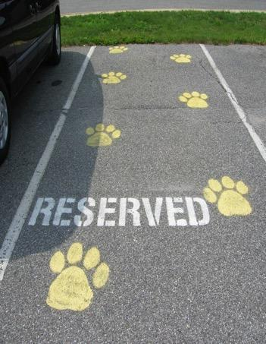
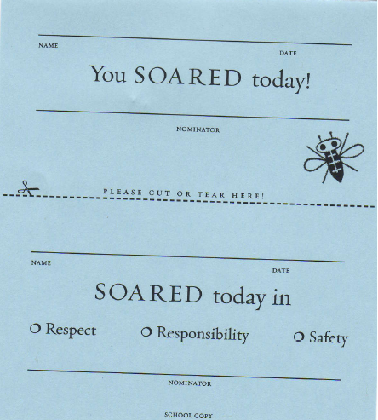
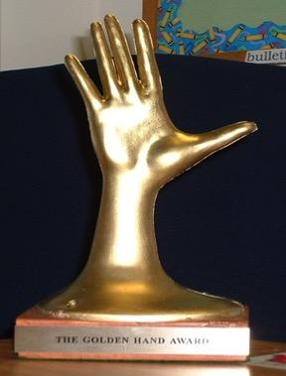
Recognizing Staff
Keep staff motivated and appreciated!
Use community resources and local businesses
Incentives for staff could include:
Tangibles
Tokens
Symbolic
Celebrations
Notes:
Incentives for staff: survey staff for ideas and suggestions
Tangibles: school spirit t-shirt, coffee mug with school name on it
Tokens: raffle ticket for chance to “win” a free gas card, meal from a restaurant, salon pass
Symbolic: thank you note from principal, golden hand award for catching kids being respectful,
Celebrations: ice cream social, dinner as a team, jeans day (the most popular!)
New examples

Slide 37
35 No or Low Cost Rewards for Staff
Source, Laura Riffel: https://usm.maine.edu/sites/default/files/smart/freerewards4studentsnstaff.pdf

