Slide 1
PBIS Team Training 4B
PBIS in the Classroom (TFI 1.8)
Notes:
Updated October 2019

Slide 2
Learning Expectations
EXPECTATION | BEHAVIOR
Be Responsible | Make yourself comfortable Take care of your needs (water, food, restroom, etc.) Action plan to implement what you are learning Follow through on your action items
Be Respectful | Turn cell phones off or to “vibrate” Listen attentively while others are speaking Have only the training materials up on your computer/tablet/phone
Be Engaged | Ask what you need to know to understand and contribute Contribute to the group by sharing relevant information and ideas
Notes:
2

Slide 3
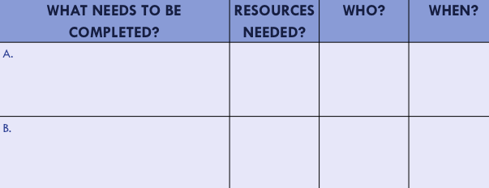
Organization of Modules
Content:
Aligned to TFI Items 1.1 – 1.15 and Classroom Management Practices
Activities/Team Time: Activities for Fluency
Self-Assessment:
Tiered Fidelity Inventory
Action Planning: Applying the core content to your school
Notes:
These are the icons that you will see throughout the training and will serve as a guide and a prompt to the content of each slide.

Slide 4
Purpose and Outcomes
Purpose:
Identify actions for a school-wide team to improve the quality of classroom management throughout the school
Outcomes:
Tier I features are implemented within classrooms and are consistent with school-wide systems. (TFI 1.8)

Slide 5
Tier 1: Professional Learning Roadmap
TFI Sub-Scale: Team
TFI 1.1 | Team Composition
TFI 1.2 | Team Operating Procedures
TFI Sub-Scale: Evaluation
TFI 1.12 | Discipline Data
TFI 1.13 | Data-based Decision Making
TFI 1.14 | Fidelity Data
TFI 1.15 | Annual Evaluation
TFI Sub-Scale: Implementation
TFI 1.3 | Behavioral Expectations
TFI 1.4 | Teaching Expectations
TFI 1.5 | Problem Behavior Definitions
TFI 1.6 | Discipline Policies
TFI 1.7 | Professional Development
TFI 1.8 | Classroom Procedures
TFI 1.9 | Feedback and Acknowledgement
TFI 1.10 | Faculty Involvement
TFI 1.11 | Student/Family/Community Involvement
6 Classroom Management Practices
1 | Physical Environment
2 | Classroom Teaching Matrix (Expectations, Routines and Procedures)
3 | Active Supervision
4 | Encouraging Appropriate Behavior
5 | Continuum of Response Strategies for Inappropriate Behaviors
6 | Engagement and Opportunities to Respond

Slide 6
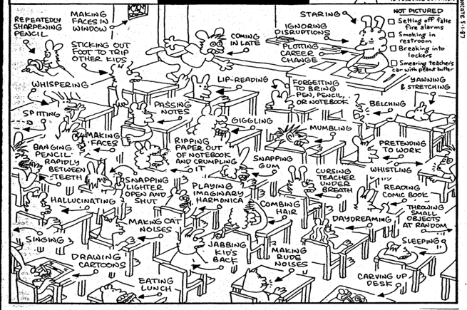
Look Familiar?
Notes:
This cartoon is meant to represent all those high frequency, but low intensity behaviors that teachers deal with everyday in their classrooms. These are not the big things that prompt pulling together the building behavior team, but they are those behaviors that drive us all crazy over time. I like to point out a few that are funny, like lip reading and playing an imaginary harmonica, and also the teacher plotting a career change. This slide is a nice lead in to set up the following discussion described on the next two slides.

Slide 7
It is important…
to have
both non-classroom
and classroom systems
in place in order
to support
all students

Slide 8
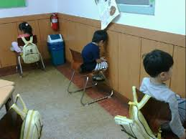
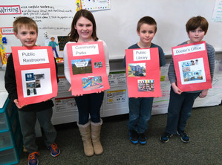
Traditional Discipline vs. PBIS
PBIS
Focuses on replacing undesired behavior with a new behavior or skill
Alters the environment, promotes systematic use of evidence-based prevention and response strategies
Traditional Discipline
Focuses on the student’s problem behavior
Goal is to stop undesirable behavior through the use of fear and punishment

Slide 9
Directly Teach Behavior
Behaviors are prerequisites for academics
Repetition is key to learning new skills:
For a child to learn something new, it needs to be repeated, on average, 8 times
For a child to unlearn an old behavior and replace with a new behavior, the new behavior must be repeated, on average, 28 times
(Wong, 2001)

Slide 10
Behaviors are Learned
We do know that our behaviors are learned and continue because they serve some
purpose or function.
That is, we engage in behavior because we have learned that certain desirable outcomes are likely.
MANTRA:
Behavior continues because the behavior works!!

Slide 11
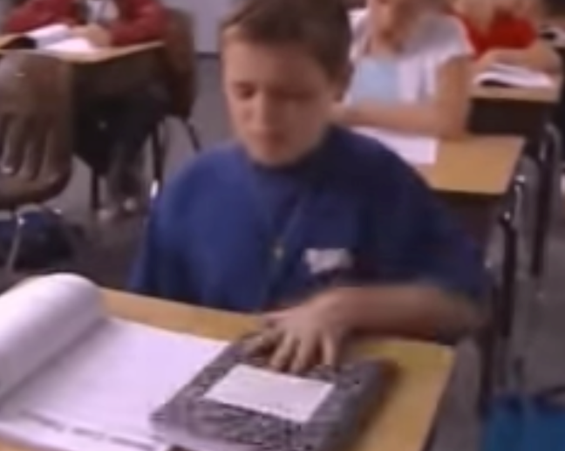
A Look at How Behavior Works
https://www.youtube.com/watch?v=yKJMpfxFjH8
Notes:
https://www.youtube.com/watch?v=yKJMpfxFjH8
36 seconds
This video will be played again after the ABC explanation.
First play - ask attendees to pay attention to the behavior and events surrounding.

Slide 12
Understanding the ABC’s
Looking at Mason

Slide 13
What ABC Could Look Like
Antecedent | Behavior | Consequence
Given assignment to write | If you see behavior continue | Provide more support
Modifications offered:
Graphic organizer
Write one sentence to start and then check back
Remind them how to get help appropriately
Review self calming strategies
Remind student to use graphic organizer
Review how to ask for help appropriately.
Offer choices
Stay calm and remind student to use self calming strategy and/or do with them
These responses all build skills!
How might the outcome be different using this approach?

Slide 14
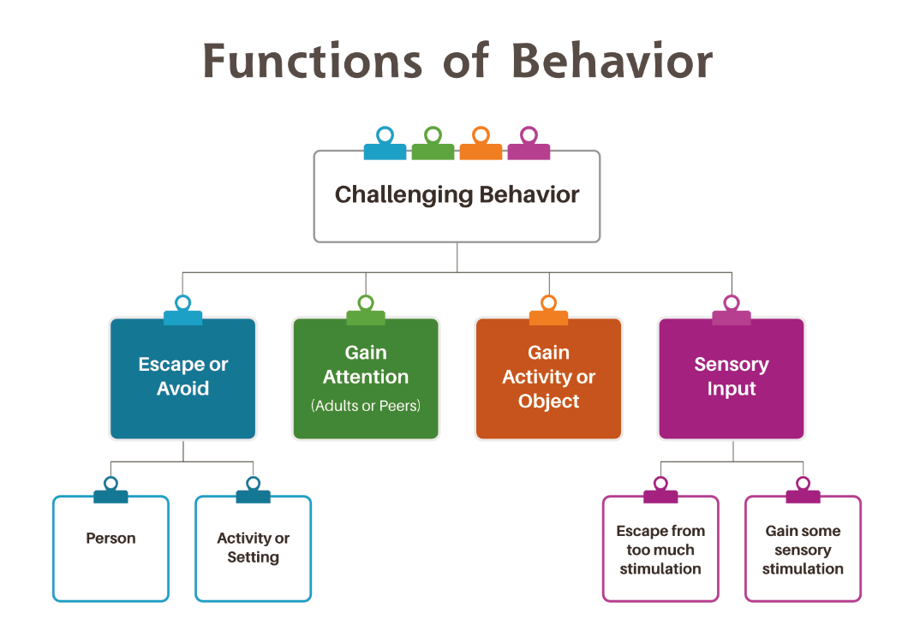
Behavior Has Purpose

Slide 15
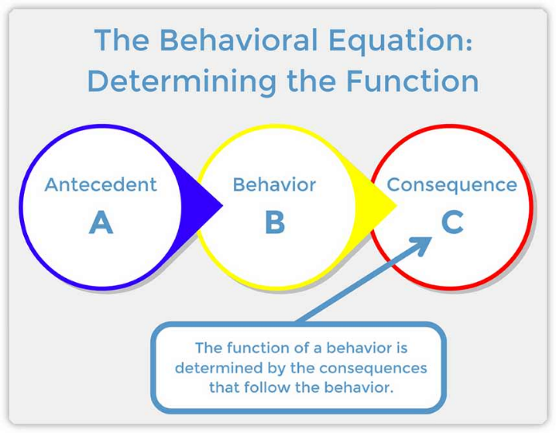
Behavior Continues When It Works
Students need our help to learn new ways of getting their needs met

Slide 16
Classroom PREVENTION Practices and ABC
Antecedent (Before) | Behavior | Consequence (Response)
Establish clear classroom expectations Increase predictability through clear procedures and routines Teach and review expected procedures and routines Use pre-corrects to prompt students about expectations Actively supervise-moving, scanning, and interacting Provide a high number of opportunities to respond to academic material with high rates | Increase student engagements with learning and task completion Increase display of expected social behaviors | Provide high rates of specific positive feedback Use of full continuum of positive consequences
Notes:
Each of the antecedent strategies will be talked about in following slides.

Slide 17
ABCs of Behavior - Turn & Talk
At your table, discuss what type of education and professional development your staff needs around the ABCs of behavior.

Slide 18
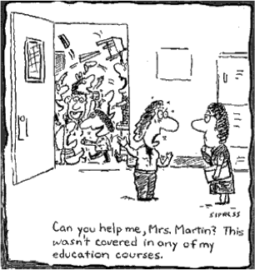
Can you help me?

Slide 19
Classroom Management Practices
6 Classroom Practices
Physical environment
Classroom Teaching Matrix (Expectations, Rules, Routines)
Active Supervision
Encouraging Appropriate Behavior
Direct instruction of expectations, rules, routines
Preventative Prompts
Specific Praise for Behavior
Individual Reinforcers
Class-Wide Group Contingency
Continuum of Response Strategies for Inappropriate Behaviors
Praise other students/groups
Specific Error Correction
Etc.
6. Engagement & Opportunities to Respond
Purpose:
Identify actions for a school-wide team to improve the quality of classroom management throughout the school
Outcomes:
Tier I features are implemented within classrooms and are consistent with school-wide systems. (TFI 1.8)
Rev 3-16-19. Midwest PBIS Network. Developed through the ongoing research and shared knowledge of many partners, including the National TA Center on PBIS, Midwest PBIS Network, Mid-Atlantic PBIS Network, Missouri PBIS, Lincoln Public Schools, Brandi Simonsen (UConn) & Diane Myers (Texas Women’s University).
Notes:
These are the 6 Classroom Management Practices that research has shown has a positive impact on students.
We want your teachers to have effective strategies that they are all using consistently. Tier I features are implemented within classrooms and are consistent with school-wide systems.
(The classroom is a critical aspect of Tier I training and includes 8 key components. These strategies maximize classroom management to allow for instructional time and less teacher stress!

Slide 20
Big Ideas of Classroom Systems
Positive classroom systems provide a felt sense of safety by maximizing predictability.
Positive classroom systems are designed to promote connection and a sense of belonging.
Positive classroom systems teach students how to demonstrate school wide expectations within the routines of the classroom.
Positive classroom systems provide recognition and celebrate success.
Positive classroom systems support behavioral growth that focuses on teaching replacement behaviors, skill building and providing practice opportunities.

Slide 21
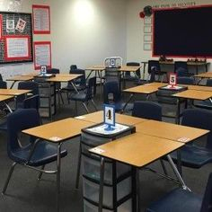
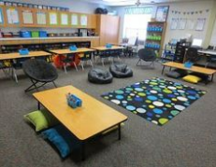
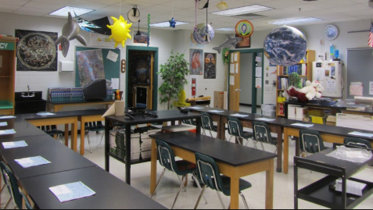
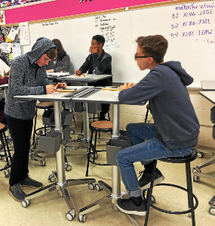
The Physical Environment
Teachers can prevent many instances of problem behavior and minimize disruptions by strategically planning the arrangement of the physical environment (Wong & Wong, 2009)
Does the room allow for traffic flow?
Are materials labeled and easy to access?
Is there a semi-private spot to process emotions and reset?
Does the arrangement promote different types of learning (solo, partner, whole class?)
Does the room offer choice? (i.e. standing, sitting)

Slide 22
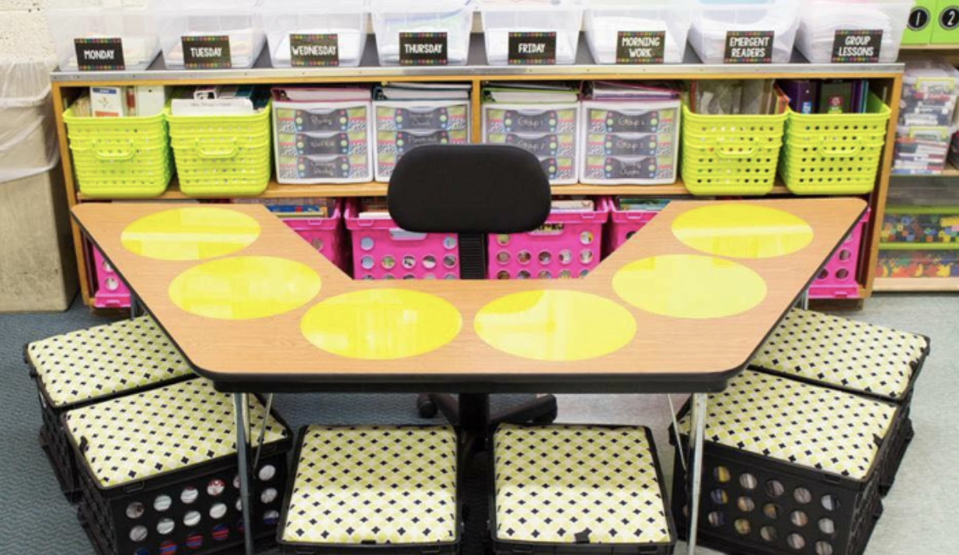
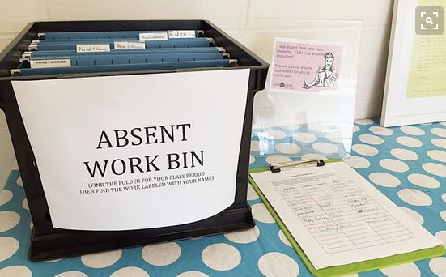
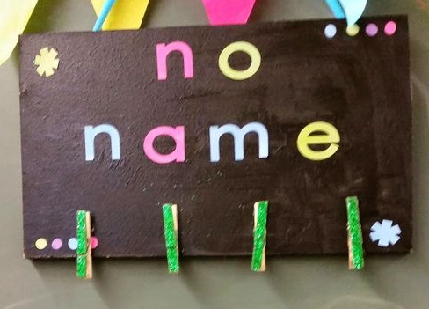
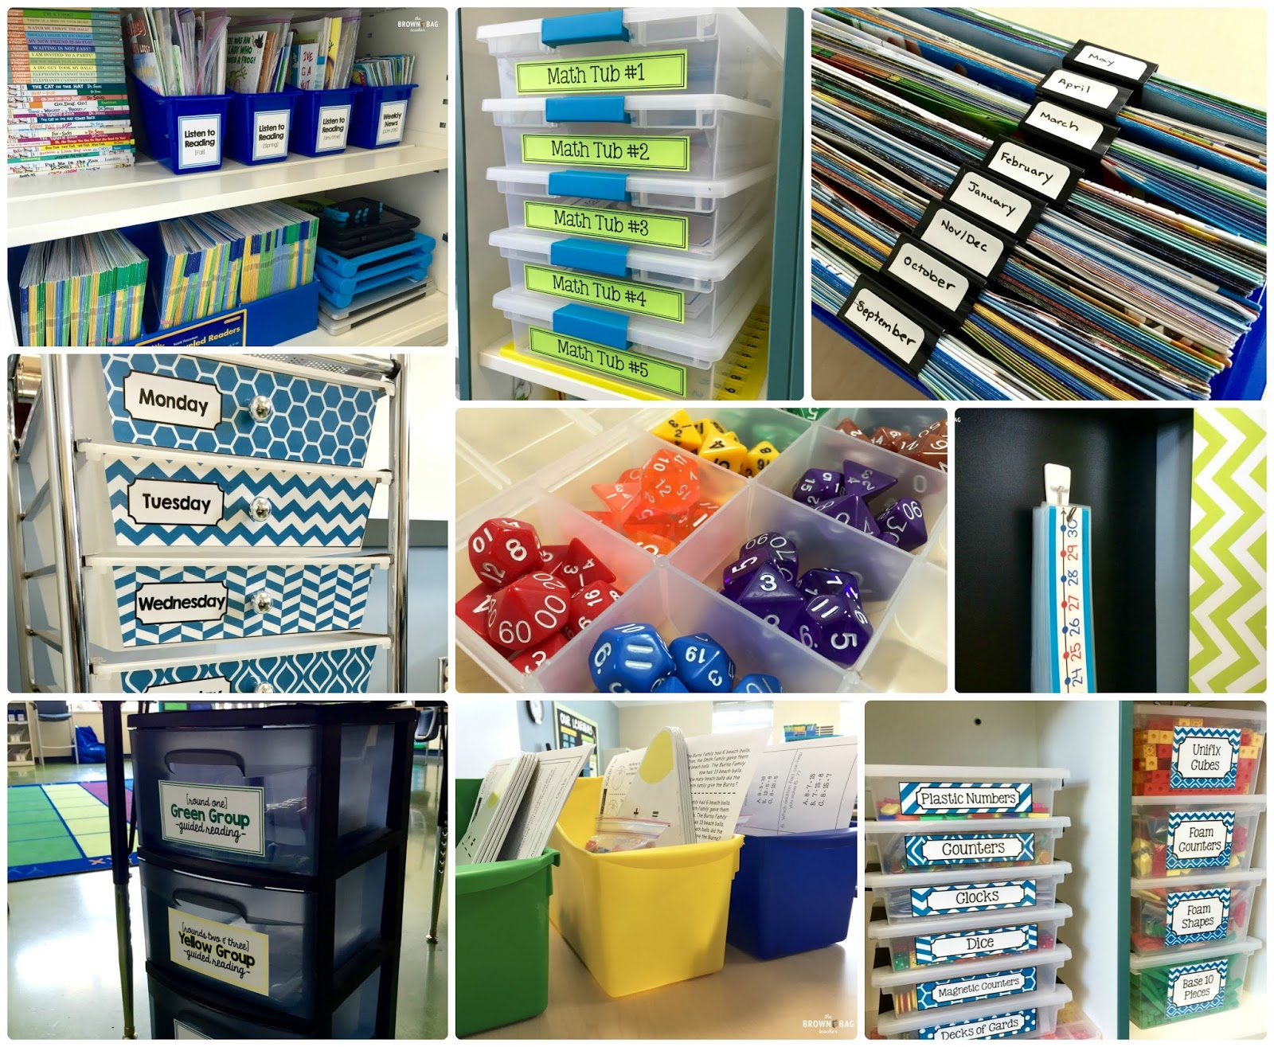
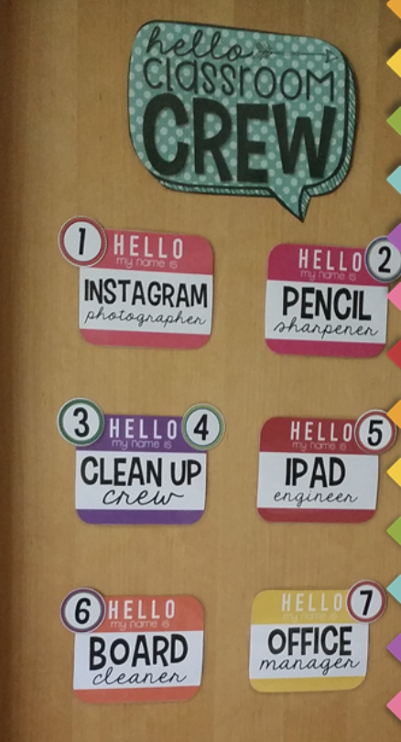
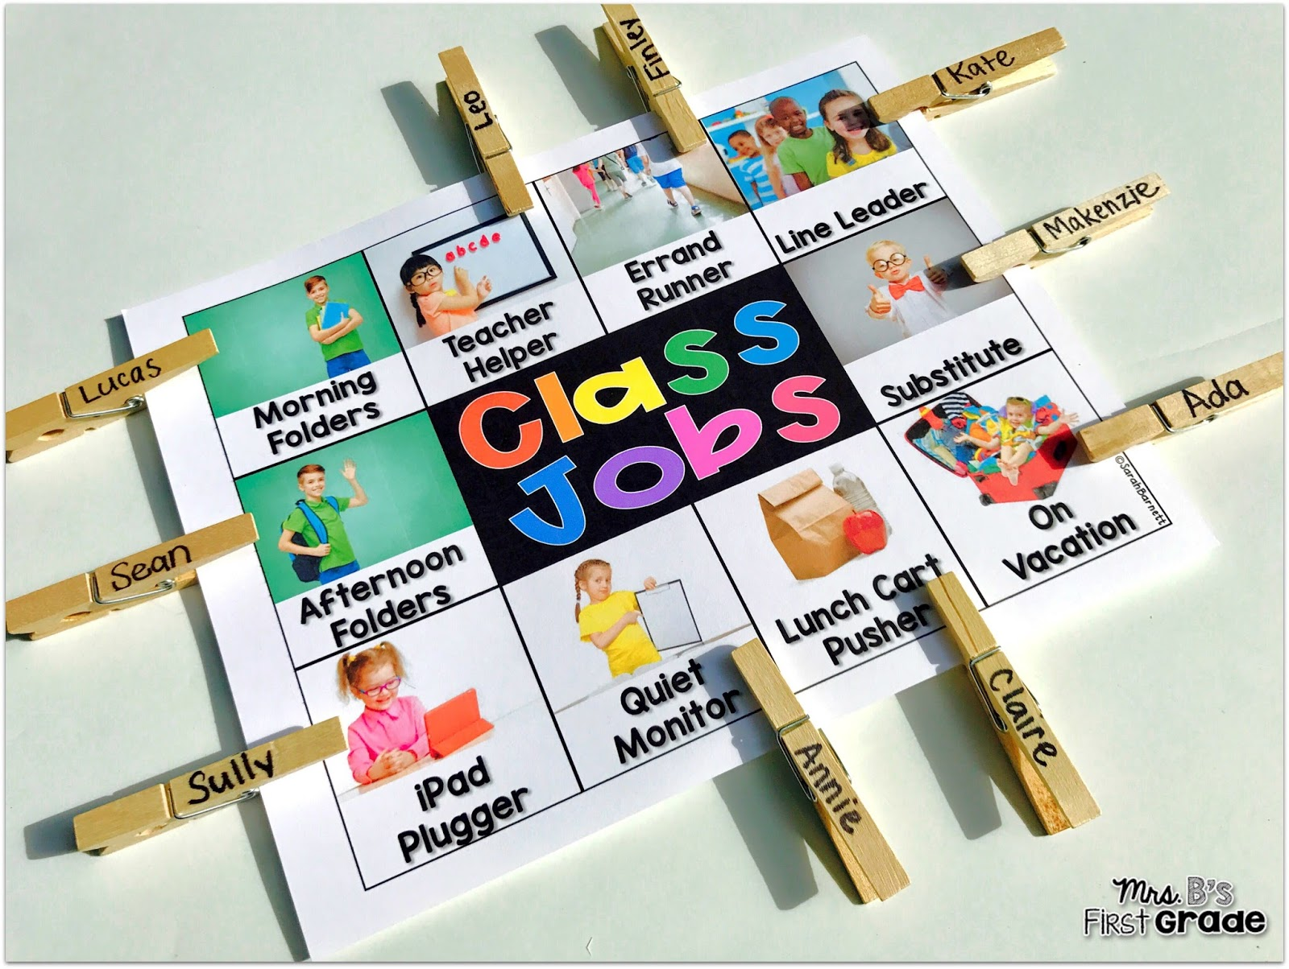
The Physical Environment
Easy Access to Doing & Fixing Things
Easy Access to Supplies

Slide 23
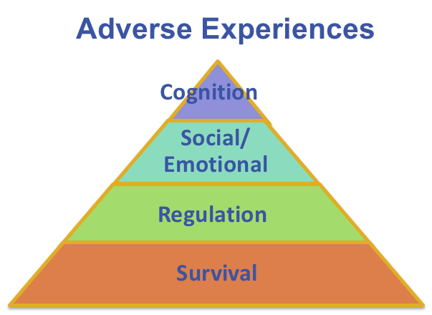
Arrange Orderly Physical Environment
is also trauma informed because
A well-designed classroom environment promotes of sense of safety and security for students impacted by trauma.
Notes:
As we explore the 6 classroom practices, we want to make a link to how each practices is trauma informed. In this strategy, a well designed environment promotes a sense of safety and security for students who have been impacted by trauma. It helps students be able to be less focused on survival and regulation and more focused on social emotional and cognitive learning.

Slide 24
The Physical Environment -
Turn & Talk
With your team, pinpoint 2 key learnings about the Physical Environment that need to be brought back to your entire staff.

Slide 25
Classroom Management Practices
6 Classroom Practices
Physical environment
Classroom Teaching Matrix (Expectations, Rules, Routines)
Active Supervision
Encouraging Appropriate Behavior
Direct instruction of expectations, rules, routines
Preventative Prompts
Specific Praise for Behavior
Individual Reinforcers
Class-Wide Group Contingency
Continuum of Response Strategies for Inappropriate Behaviors
Praise other students/groups
Specific Error Correction
Etc.
6. Engagement & Opportunities to Respond
Purpose:
Identify actions for a school-wide team to improve the quality of classroom management throughout the school
Outcomes:
Tier I features are implemented within classrooms and are consistent with school-wide systems. (TFI 1.8)
Rev 3-16-19. Midwest PBIS Network. Developed through the ongoing research and shared knowledge of many partners, including the National TA Center on PBIS, Midwest PBIS Network, Mid-Atlantic PBIS Network, Missouri PBIS, Lincoln Public Schools, Brandi Simonsen (UConn) & Diane Myers (Texas Women’s University).
Notes:
These are the 6 Classroom Management Practices that research has shown has a positive impact on students.
We want your teachers to have effective strategies that they are all using consistently. Tier I features are implemented within classrooms and are consistent with school-wide systems.
(The classroom is a critical aspect of Tier I training and includes 8 key components. These strategies maximize classroom management to allow for instructional time and less teacher stress!

Slide 26
By Teaching Procedures and Establishing Routines you will…
Increase instructional time by preventing problem behavior
Help students navigate the classroom more effectively
Reduce anxiety
Improve classroom climate
Create shared ownership of the classroom
Develop self-discipline
Make the classroom more equitable
(Evertson, Emmer, & Worsham, 2003; Good & Brophy, 2003)

Slide 27
What Are Procedures & Routines?
Procedures explain the accepted process for carrying out a specific activity such as
walking in the hallway
using lockers
sharpening pencils
going to the restroom
Procedures form routines when practiced and help students demonstrate school wide expectations more often
Notes:
Procedures are the steps we take to complete a task. Routines are the habits we form by repeating the same set of steps over and over.
Procedures are how we do something. Routines develop from consistent use of procedures.
Procedures and routines are important because they help students follow rules and meet expectations.
(Newcomer, 2008)

Slide 28
Having Procedures and Routines in Place Will:
Increase instructional time by preventing problem behavior
Help students navigate the classroom more effectively
Reduce anxiety
Improve classroom climate
Create shared ownership of the classroom
Develop self-discipline
Make the classroom more equitable
(Evertson, Emmer, & Worsham, 2003; Good & Brophy, 2003)

Slide 29
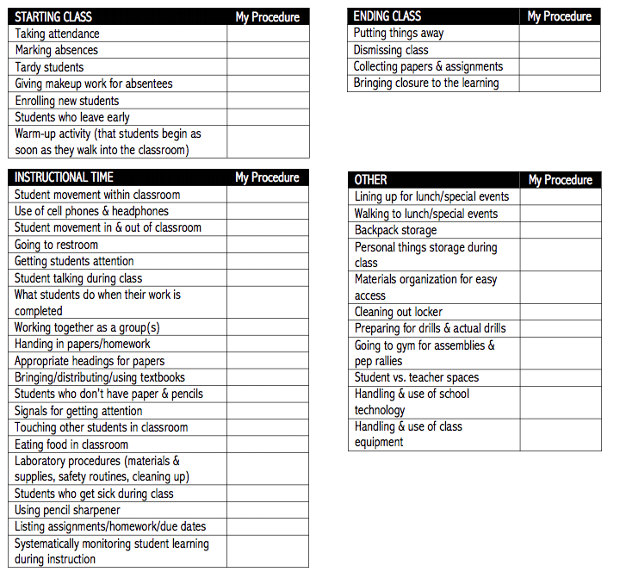
Team Activity
Refer to page(s) ________ in workbook
Link to Elem. Routines
Link to Secondary Routines
Identify Procedures to Teach
Follow the link to the checklist most relevant for you.
Explore the checklist.
Talk about how this tool or one like it could be helpful to teachers at your school?
Notes:
Elementary Routines https://www.stcloudstate.edu/ignite/_files/documents/classroom-management/procedures-elementary.pdf
Secondary Routines https://www.stcloudstate.edu/ignite/_files/documents/classroom-management/procedures-secondary.pdf

Slide 30
Identify the procedures that will become the common routines of the classroom
The classroom matrix is a tool that helps a teacher bring the school-wide expectations into the common routines of the classroom.
Notes:
From the list of procedures you will teach students, which one will occur every day and are core routines that prevent problem behaviors from happening. Develop a matrix with students if possible on how to demonstrate your expectations within the routines of the classroom. These are the ones that a teacher needs to include on the classroom procedures matrix and M.A.P. out for students.

Slide 31
How to Use the Classroom Matrix
The teacher identify the most important behaviors for students to use in order to demonstrate the school wide expectations within the common routines of the classroom.
Now teach, model and reinforce those behaviors.
Model
Add Visuals
Practice
M.A.P. it out for students

Slide 32
The Classroom Teaching Matrix is also trauma informed because
A well-designed teaching matrix creates consistency and predictability through clearly stated rules.
Routines support regulation, and can develop social-emotional competencies.
When teachers are consistent in expectations from class to class, it results in a predictable environment for students, helping them to regulate and operate in a state of calm.
Notes:
The classroom teaching matrix is trauma informed because it allows for consistency and predictability, offers routines to support regulation and can develop social emotional competencies, and when teachers are consistent, it results in a predictable environment and can allow students to operate in a state of calm.
For the recorder/webinar lead: You could go into the following in more detail. Resources are included.
Some regulation activities could include rhythmic and might be music, dance, drumming. Also note that not all students regulate at the same beat and it is actually based on their resting heart rate. Classical music may be regulating to one while a fast tempo may be more regulating to another.
Movement activities could be running/walking, dancing.
Relationship Development Activities might include
-Classroom professions such as being the giver, story teller, noticer, kindness keeper, resource manager, collaborator (Unwritten, The Story of a Living System: A Pathway to Enlivening and Transforming Education Dr. Lori Desautels)
-Copy Cat --- mirroring the actions of a partner
-Group drumming* --- hits both relationship and regulation
Emotional Development Activities
-Self-awareness exercises: S. Craig (Trauma Sensitive Schools, pg 82) refers to building student’s ‘resilience muscles’ or ‘rebound skills’ by responding to the 4 open-ended sentence stems often. This is an example, but there are other strategies that teachers’ may already be using that could have same intention.
-Emotion posters --- have a poster with emotions in your classroom that you reference it often for students to connect (i.e.: reading a story and ask how a character might be feeling, when debriefing a situation individually with a student, or a student is journaling).
-Connect through conflict (Whole Brain Child) --- view conflict as an opportunity to teach new skills

Slide 33
You can also use the Classroom Matrix to…
Communicate your routine expectations to families (send it home)
Communicate your routine expectations with the central office

Slide 34
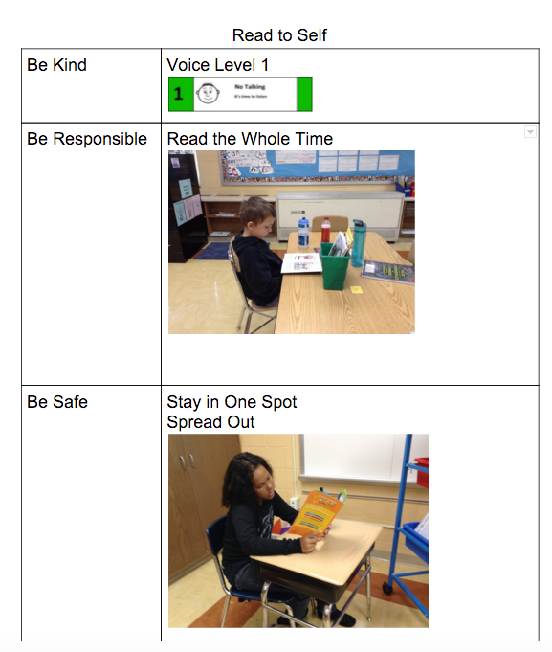
Use routine specific pre-correction to prompt use of school wide expectations for the routine
PRE-CORRECTION
A short period of time taken prior to a certain routine or event to focus student attention on expected behavior
Notes:
From the classroom matrix you can make behavioral anchor charts (Add Visuals) to use prior to starting a new routine to remind students how to demonstrate your SW Expectations within the context of the next routine

Slide 35
Classroom Matrix -
Turn & Talk
With your team, pinpoint 2 key learns about the Classroom Matrix that need to be brought back to your entire staff.

Slide 36
Classroom Management Practices
6 Classroom Practices
Physical environment
Classroom Teaching Matrix (Expectations, Rules, Routines)
Active Supervision
Encouraging Appropriate Behavior
Direct instruction of expectations, rules, routines
Preventative Prompts
Specific Praise for Behavior
Individual Reinforcers
Class-Wide Group Contingency
Continuum of Response Strategies for Inappropriate Behaviors
Praise other students/groups
Specific Error Correction
Etc.
6. Engagement & Opportunities to Respond
Purpose:
Identify actions for a school-wide team to improve the quality of classroom management throughout the school
Outcomes:
Tier I features are implemented within classrooms and are consistent with school-wide systems. (TFI 1.8)
Rev 3-16-19. Midwest PBIS Network. Developed through the ongoing research and shared knowledge of many partners, including the National TA Center on PBIS, Midwest PBIS Network, Mid-Atlantic PBIS Network, Missouri PBIS, Lincoln Public Schools, Brandi Simonsen (UConn) & Diane Myers (Texas Women’s University).
Notes:
These are the 6 Classroom Management Practices that research has shown has a positive impact on students.
We want your teachers to have effective strategies that they are all using consistently. Tier I features are implemented within classrooms and are consistent with school-wide systems.
(The classroom is a critical aspect of Tier I training and includes 8 key components. These strategies maximize classroom management to allow for instructional time and less teacher stress!

Slide 37
Components of Active Supervision
…a process for monitoring the classroom, or any school setting, that incorporates
Moving: Continuous, random teacher movement throughout all parts of classroom
Scanning: Frequent and intentional visual sweep of all parts of classroom
Interacting: Frequent and positive communication to encourage, reinforce, and correct
Notes:
Scanning
This involves frequently and intentionally look around at students and making eye contact with student. Teachers can visually sweep all areas of the room as well as look directly at students nearest you. Visual Scanning allows the teacher to watch for instances of appropriate and inappropriate behavior that he/she will want to respond to immediately or as soon as possible. It will also help a teacher to identify students who may need his/her assistance.
Interacting
While moving and scanning you should also frequently interact with students. This communicates care, trust, and respect and creates positive climate and increases likelihood of accepting correction if needed. Interacting includes proximity, listening, eye contact, smiles, pleasant voice tone, and use of student’s name

Slide 38
Active Supervision is also trauma informed because
Provides a sense of safety for students
More likely to identify trigger and prevent problem behavior
Creates frequent opportunities to interact with students for relationship development
Remember 15 seconds is long enough to have a meaningful connection with a student
Notes:
Active Supervision is trauma informed because it provides a sense of safety for students and allows the adult to be more likely to identify triggers in order to prevent problem behaviors. It also creates frequent opportunities to interact with students to develop relationships. It only takes 15 seconds to develop a meaningful connection with a student.

Slide 39
Video Activity & Discussion
What changes did you notice in the “Positive Examples of Supervision”?
Are there areas of our school that need increased supervision?
Where?
How do you know?
How will we make the changes?
Are there areas in our classrooms that need increased supervision?
Where?
How do you know?
How will we make the changes?
https://youtu.be/sxwl_TiB1xU
Notes:
Let’s watch this video. Think about this, the message students receive when a teacher is doing active supervision, either verbally and non-verbally, is that the teacher does inspect what he/she expects. In other words, the teacher means business and will do his/her part to ensure that his/her expectations are met as often as possible.
After the video: Encourage discussion on how to more actively supervise non-classroom and classroom areas of your school.

Slide 40
Team Time
Refer to pages ______ in workbook
Think about the 3 components of classroom PBIS we have discussed:
Physical Environment, Teaching Matrix, Active Supervision
Use the workbook to find activities to support your work of informing your staff:
Teaching Routines
Blank Classroom Matrices (examples in slides)
Active Supervision
Begin thinking about how you will implement this at your school.
Notes:
The following slides are EXAMPLES for teams to look at; trainers do not need to go through them but you can reference they are there for information/exploration.

Slide 41
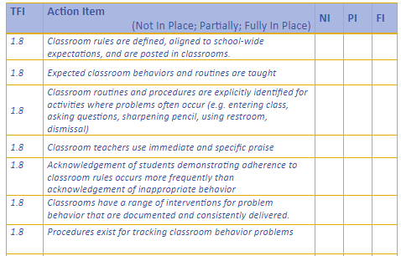
Reflection

Slide 42
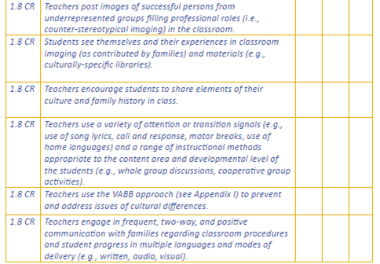
Reflection

Slide 43
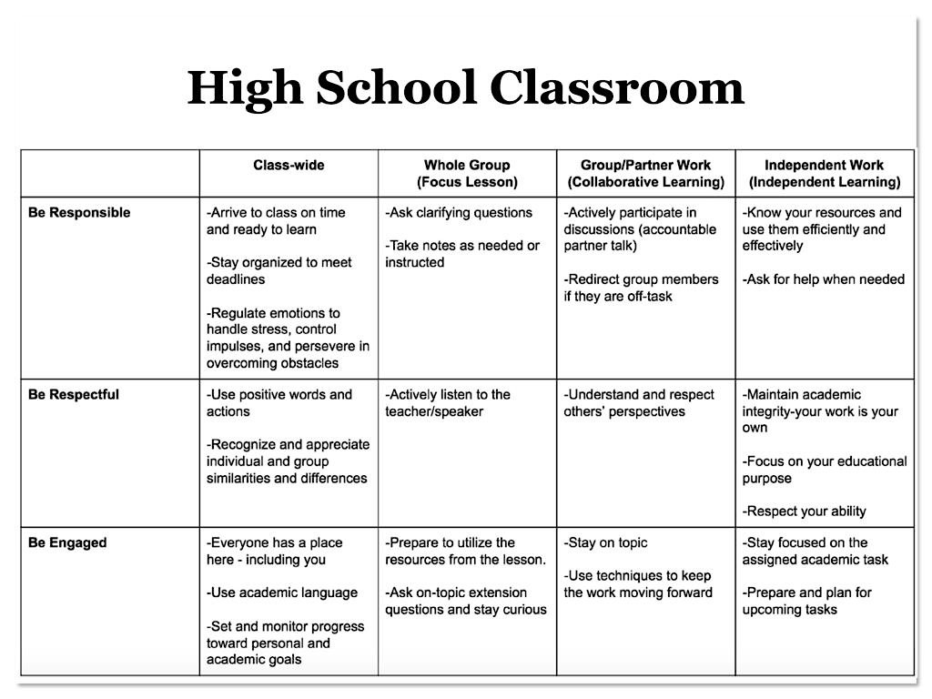
Classroom Matrix Example

Slide 44
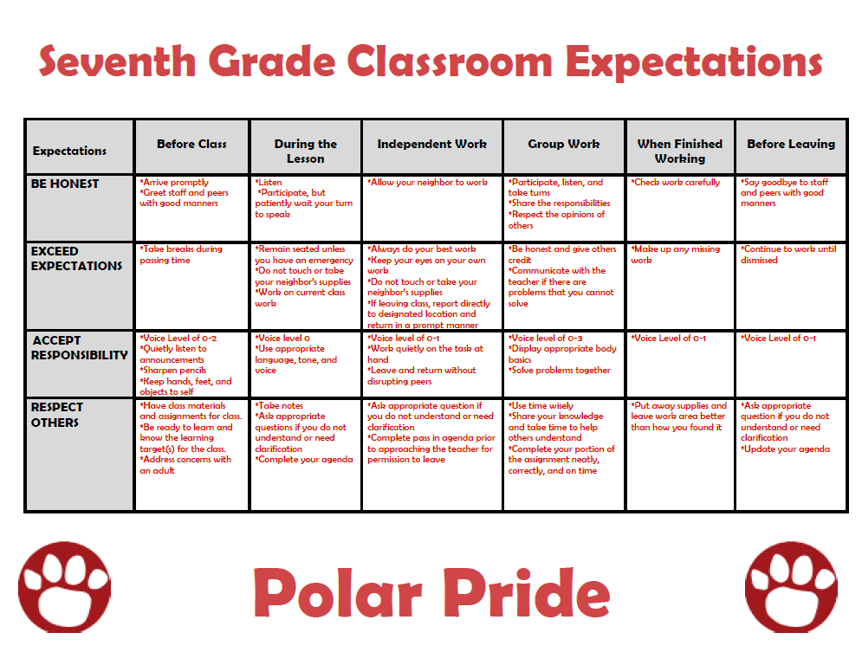
Classroom Matrix Example

Slide 45
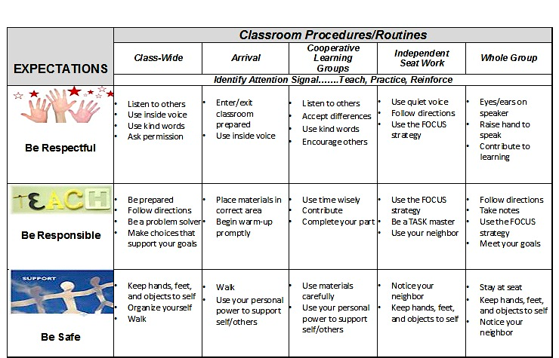
Classroom Matrix Example

Slide 46
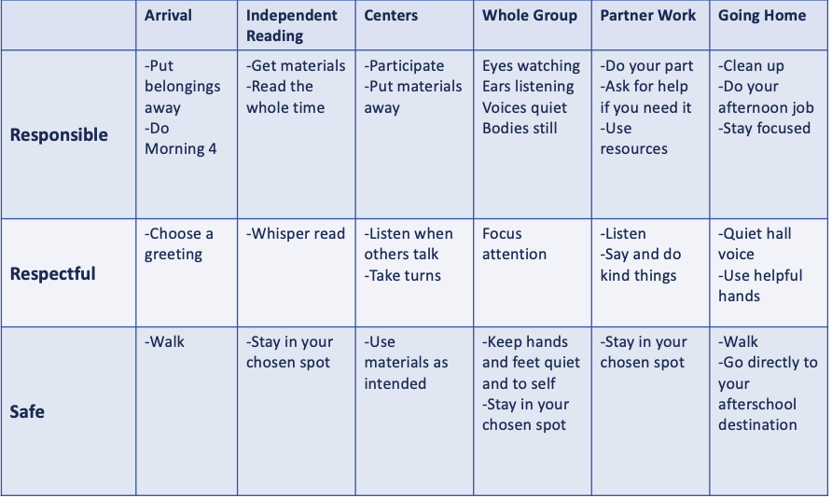
Classroom Matrix Example

Slide 47
Resources
National Website
http://www.pbis.org/school/pbis-in-the-classroom
Midwest PBIS – Classroom Modules
http://www.midwestpbis.org/materials/classroom-management
http://www.midwestpbis.org/materials/classroom-practices
Florida PBIS Classroom Coaching
http://www.livebinders.com/play/play?id=2295063
Mid-Atlantic PBIS http://www.midatlanticpbis.org/materials-1/classroom
Additional Classroom Resources – Tim Lewis
https://www.pbis.org/resource/192/classroom-checklists-effective-classroom-plan-environmental-inventory-checklist
Supporting and Responding to Classroom Behavior Tool
http://www.pbis.org/resource/1016/supporting-and-responding-to-behavior

Slide 48
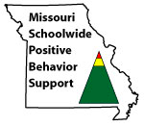
Appreciation is given to the following for their contributions to this Professional Learning:

