Slide 1
PBIS Team Training 3C
Discipline Data (TFI 1.12)
Data-based Decision Making (TFI 1.13)
Notes:
Updated October 2019

Slide 2
Learning Expectations
EXPECTATION | BEHAVIOR
Be Responsible | Make yourself comfortable Take care of your needs (water, food, restroom, etc.) Action plan to implement what you are learning Follow through on your action items
Be Respectful | Turn cell phones off or to “vibrate” Listen attentively while others are speaking Have only the training materials up on your computer/tablet/phone
Be Engaged | Ask what you need to know to understand and contribute Contribute to the group by sharing relevant information and ideas
Notes:
2

Slide 3
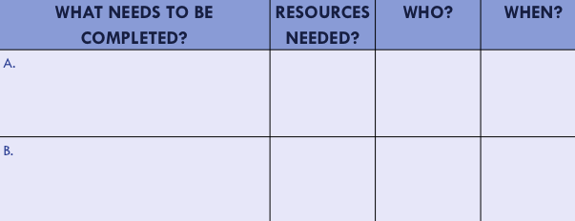
Organization of Modules
Content:
Aligned to TFI Items 1.1 – 1.15 and Classroom Management Practices
Activities/Team Time: Activities for Fluency
Self-Assessment:
Tiered Fidelity Inventory
Action Planning: Applying the core content to your school
Notes:
These are the icons that you will see throughout the training and will serve as a guide and a prompt to the content of each slide.

Slide 4
Tier 1: Professional Learning Roadmap
TFI Sub-Scale: Team
TFI 1.1 | Team Composition
TFI 1.2 | Team Operating Procedures
TFI Sub-Scale: Evaluation
TFI 1.12 | Discipline Data
TFI 1.13 | Data-based Decision Making
TFI 1.14 | Fidelity Data
TFI 1.15 | Annual Evaluation
TFI Sub-Scale: Implementation
TFI 1.3 | Behavioral Expectations
TFI 1.4 | Teaching Expectations
TFI 1.5 | Problem Behavior Definitions
TFI 1.6 | Discipline Policies
TFI 1.7 | Professional Development
TFI 1.8 | Classroom Procedures
TFI 1.9 | Feedback and Acknowledgement
TFI 1.10 | Faculty Involvement
TFI 1.11 | Student/Family/Community Involvement
8 Classroom Management Practices
1 | Arrange orderly physical environment
2 | Define, Teach, Acknowledge Rules and Expectations
3 | Define, Teach Classroom Routines
4 | Employ Active Supervision
5 | Provide Specific Praise for Behavior
6 | Continuum of Response Strategies for Inappropriate Behaviors
7 | Class-Wide Group Contingency
8 | Provide Multiple Opportunities to Respond

Slide 5
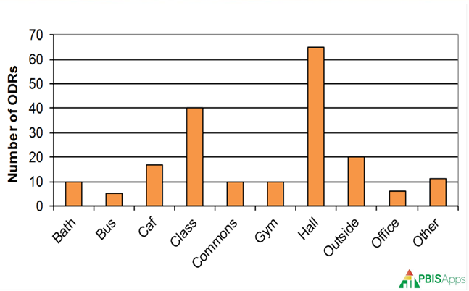
TFI 1.12 & 1.13 Purpose & Outcomes
Purpose: Prepare and plan for facilitating implementation of Data Analysis
Outcomes:
1.12 Discipline Data: Tier I team has instantaneous access to graphed reports summarizing discipline data organized by the frequency of problem behavior events by behavior, location, time of day, and by individual student.
1.13 Data-based Decision Making: Tier I team reviews and uses discipline data and academic outcome data (e.g., Curriculum-Based Measures, state tests) at least monthly for decision-making.

Slide 6
Definition
Data are the many sources of information we use to make decisions about how to allocate our resources of time and attention for teaching, redirecting, prompting, and reinforcing behaviors.
Data come in many forms such as office referrals, attendance records, grades, surveys, verbal feedback, and observations.
Data must be documented, and shared to be most effective in action planning.

Slide 7
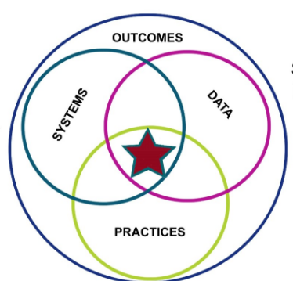
Review

Slide 8
Quote
“If we have data, let’s look at data.
If all we have are opinions,
let’s go with mine.”
–Jim Barksdale, former Netscape CEO

Slide 9
Rationale
Data allow us to look at a problem more objectively.
Without data, we are more likely to make ambiguous, or emotionally driven decisions.
Data can be used for identifying and planning to address problems, celebrating successes, and accountability.

Slide 10
Why Use Data For Decision Making?
Data helps us ask the right questions…it does not provide the answers.
Use data to:
Identify problems
Refine problems
Define the questions that lead to solutions
Data helps place the “problem” in the context rather than in the students.

Slide 11
Activity
Turn to your shoulder partner or discuss as a table:
What are difference sources of data you use in the classroom? School-wide?
How comfortable are you accessing, and interpreting these data?
Notes:
Let’s start buy talking about the data already available within the school and your comfort level with those data.
Activity: Turn to your shoulder partner or discuss round robin about different sources of data. Allow 5 min.

Slide 12
Types of Data
Effort: What is the current status of your systems?
School-wide Tiered Fidelity Inventory (TFI Progress Monitoring)
Self-Assessment Survey (SAS) – Staff
Opinion Survey
Fidelity: Are you doing what the framework outlines? Are you doing what you said you would?
School-wide Tiered Fidelity Inventory (TFI-Annual Assessment)
Self-Assessment Survey (SAS) – Staff
Outcome: Are your systems working?
Office Discipline Referrals (ODR’s)
Check-In Check-out (CICO)/Point Sheets
Suspensions/Expulsions
Attendance
Grades/Test Scores

Slide 13
Outcome Data

Slide 14
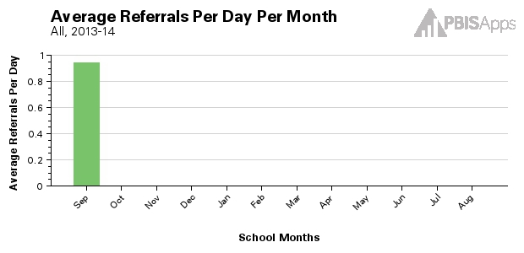
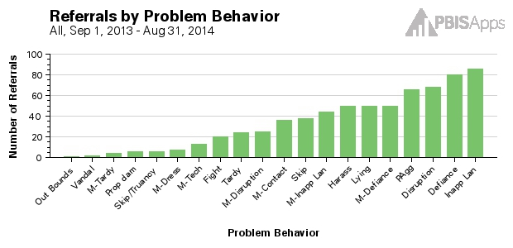
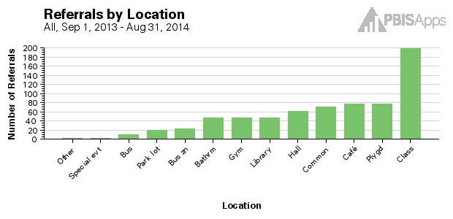
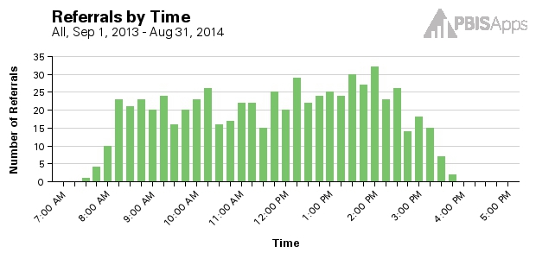
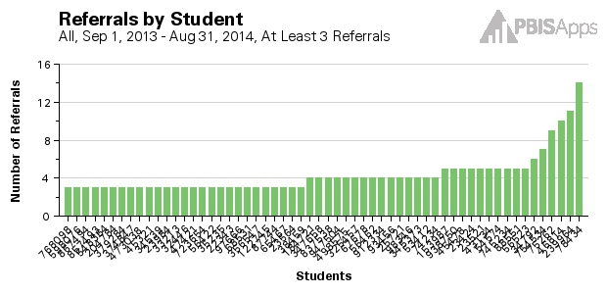
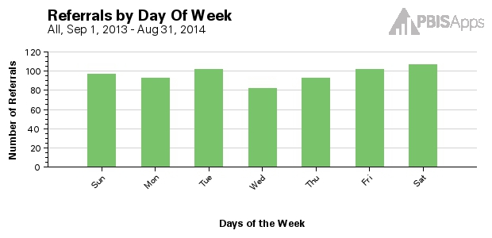
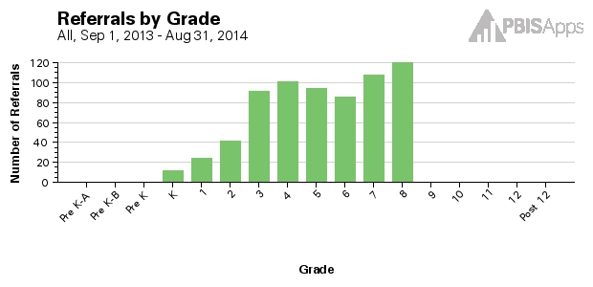
Core Reports – Data System
Avg Referrals/Day/Month
Referrals by Prob Behavior
Referrals by Location
Referrals by Time
Referrals by Student
Referrals by Day of Week
Referrals by Grade
Notes:
Trainer Notes: These examples come from SWIS- any system used should be able to produce these reports
Core Reports provide information at the school-wide level. These reports are presented on the main SWIS Dashboard and are also available in the reports dashboard (View Reports). The value of the Core Reports is they help schools quickly, visually identify “red flags” or potential problems that may need further inquiry. The Core Reports include: Average Referrals Per Day Per Month, Referrals By Location, Referrals By Problem Behavior, Referrals By Time, Referrals By Student, Referrals By Day of Week, and Referrals By Grade. Both the day of week and grade reports are new in SWIS 5.

Slide 15
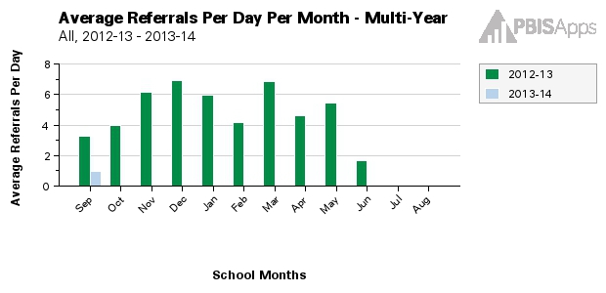
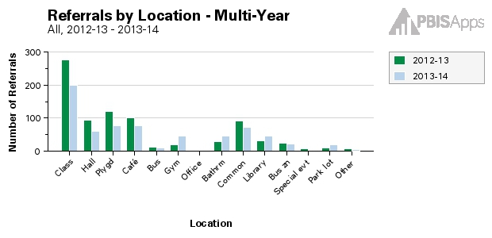
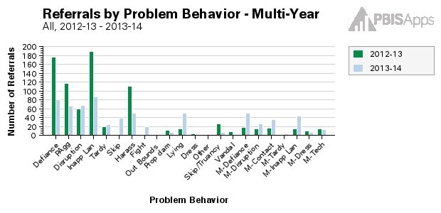
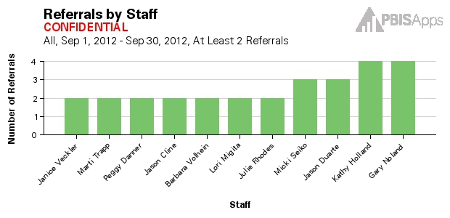
Additional Reports
Avg Referrals/Day/Month – Multi-Year
Referrals by Location – Multi-Year
Referrals by Prob Behavior – Multi-Year
Referrals by Staff: Confidential
Notes:
Trainer Notes: These examples come from SWIS- any system used should be able to produce these reports
Additional Reports provide some of the same information presented in the Core Reports and display it in a multi-year format so schools/facilities can see changes over time. For example, the Average Referrals Per Day Per Month report is represented in a multi-year format so users can see a specific month (e.g., March) and compare it to the previous year, the year before that, the year before that, etc. The same is true for the Location report presented in the multi-year format. This specific report allows users to see the number of referrals in various locations compared across years. The Problem Behavior report presented in the multi-year format allows users to see the number of referrals associated with individual problem behaviors compared across years. The Staff report is only accessible to certain users with appropriate access levels. The Staff report displays the number of referrals written by staff members within a designated time range.

Slide 16
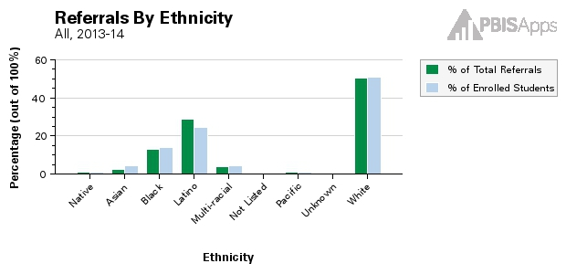
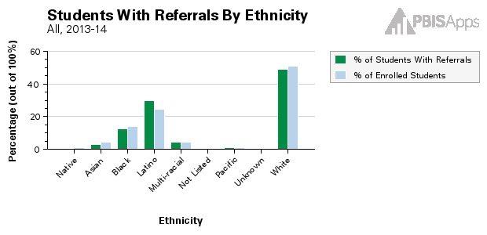
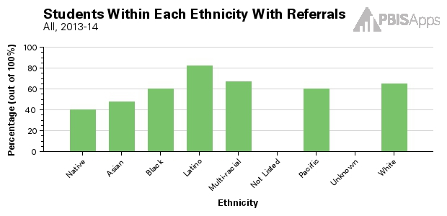
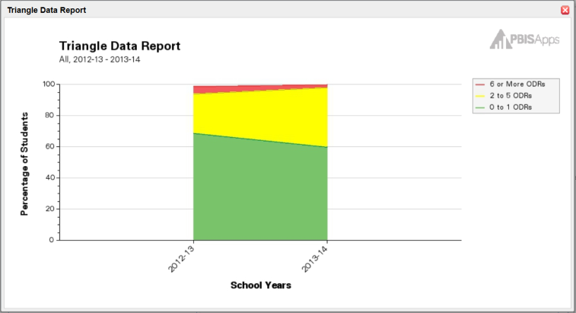
Additional Reports (cont.)
By Students with IEPs
Referrals by Ethnicity (three graphs)
Triangle Data Report
Notes:
Trainer Notes: These examples come from SWIS- any system used should be able to produce these reports
The Suspension/Expulsion Report displays the total number of days, total number of events, and total number of students contributing for in-school suspensions, out-of-school suspensions, and expulsions. This report will also display individual student information and note which specific students received a suspension or expulsion.
*******The Ethnicity report is presented using three different graphs and is used to monitor referral patterns across a school/facility’s various racial/ethnic groups. The Ethnicity report can assist schools in providing equity in education and taking actionable steps towards avoiding disproportionality in discipline practices. Reviewing this data is ESSENTIAL FOR ensuring EQUITABLE discipline practices******

Slide 17
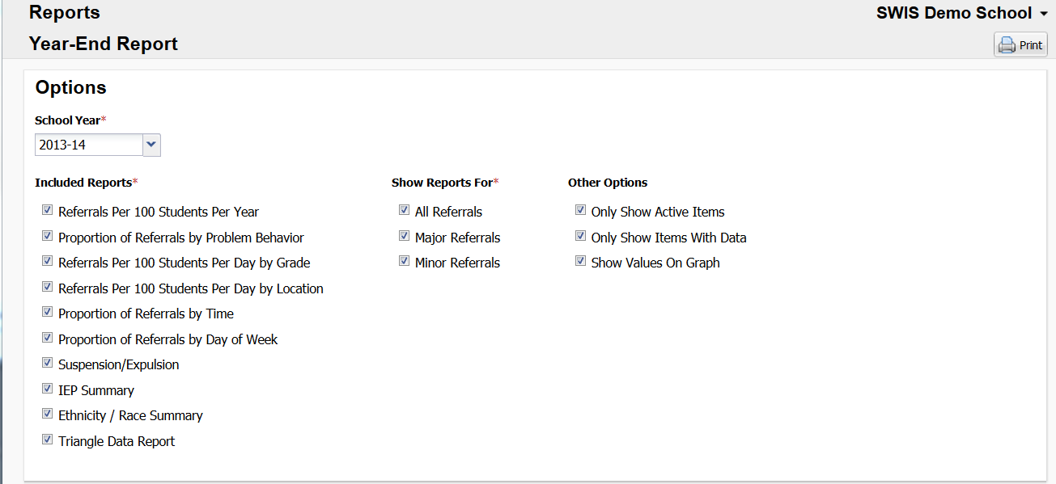
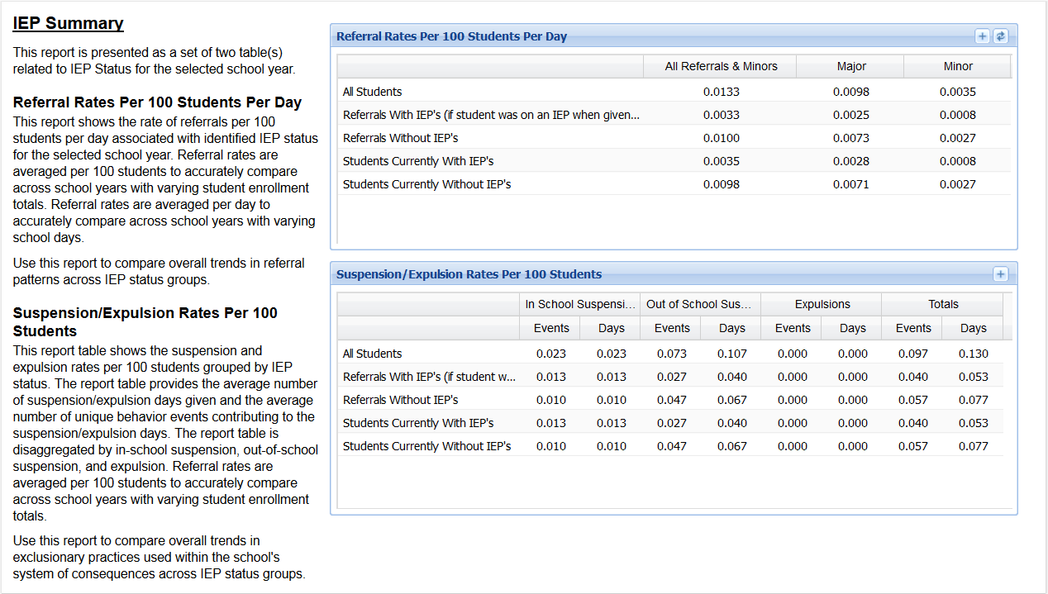
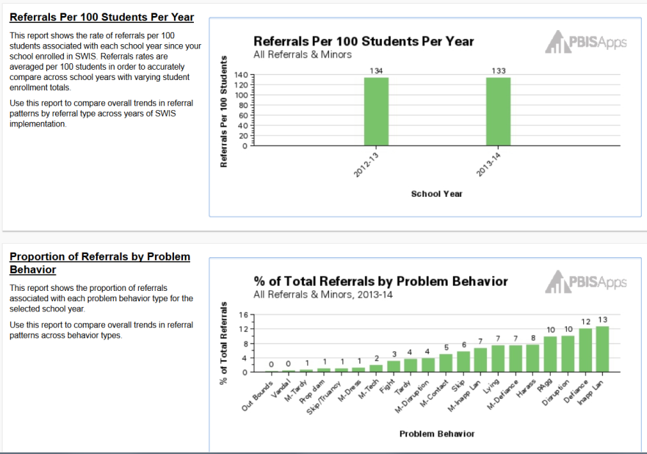
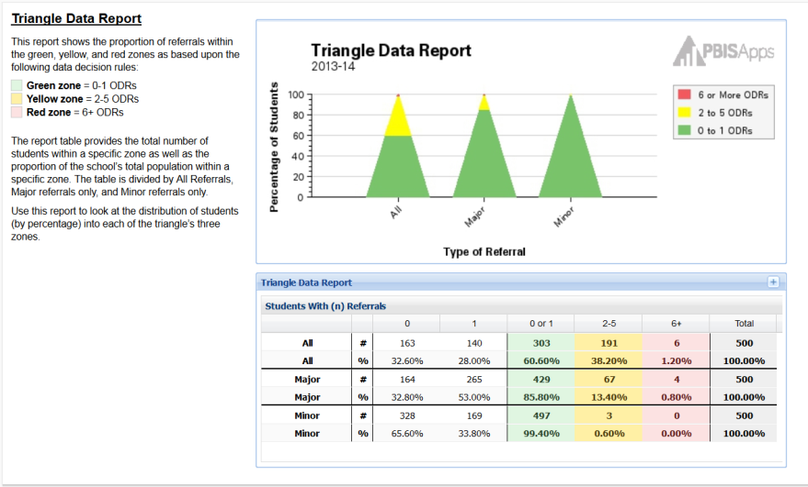
Additional Reports (cont.)
Year-End Report
IEP Summary
Referrals/100 Students/Year
Annual Triangle Data Report
% Total Referrals by Problem Behavior
Notes:
The Year-End Report contains several reports together to give an accurate representation of referral data across the school year. Only a sample of the reports are shown here. The table at the top of the report allows the report to be customized in terms of referral types and charts to include.
Each section of the Year-End Report includes a description to ensure that the information and/or purpose of the chart is clear.
SWIS provides us with tools to make decisions- have to use this as a template for other data sources

Slide 18
Data System Questions
Can I enter in referrals easily? 30 seconds/referral
Can I generate reports easily? 5 second rule!!
Do I have access to the Core Data Reports?
What other reports do I need on a regular basis?

Slide 19
Additional Data Sources
Other data can inform our behavioral supports:
Attendance
Student and teachers
Grades
Surveys
Perception
Notes:
We want to be able to answer these questions with our data to direct us to the last question: what is the most effective use of our resources?

Slide 20
Do We Have an Efficient Data System?
Are we collecting the right information? What, where, when, who, why
Is data collection efficient?
Less than 60 sec to fill out, less than 30 sec to enter
Do we get data in the right format?
Graphic format
Do we get the data at the right time?
Before and during meetings
Data no more than 24 hours old
Workbook: TFI 1.12. 1.13 Activity 2

Slide 21
Do We Have an Efficient Data System (cont.)
Does our Data-Analyst prepare in advance, and bring a draft Precision Problem Statement to our team meetings to present?
Are data used for decision-making by all?
Data presented to all faculty at least monthly
Data available for whole school, small group and individual student evaluation
Data collected on FIDELITY (what we do) as well as IMPACT (student behavior)

Slide 22
Data Entry
Consistent
Every 24-48 hours
Same people entering those data
OR simple online submission for all staff
Train at least 3 people (or all staff if online entering)
“Real time”
Real time entry allows for real time look at those data
Accountability
Decision-making
Notes:
We want to be able to answer these questions with our data to direct us to the last question: what is the most effective use of our resources?

Slide 23
Data Analysis
Is there a problem?
What areas/systems are involved?
Are there many students or a few involved?
What kinds of problem behaviors are occurring?
When are these problems likely to occur?
What is the most effective use of our resources to address this problem?
Notes:
We want to be able to answer these questions with our data to direct us to the last question: what is the most effective use of our resources?

Slide 24
Data-based Decision Making

Slide 25
Data-based Decision Making
Decisions are more likely to be effective and efficient when they are based on DATA.
The quality of decision making depends most on the first step—defining the problem to be solved.
Big Ideas:
Define problems with precision and clarity.
Data help place the “problem” in the context rather than on the students.

Slide 26
Old vs New Decision Making
Precision Problem Statement
Problem
Monitor Outcome vs Goal
Set Measurable Goal
Use Data
Monitor Fidelity of Plan
Develop Solution and Action Plan
Solution

Slide 27
Identifying the Problem
The statement of a problem is important
Everyone must be working on the same problem with the same assumptions.
Problems often are framed in “primary” form.
This raises awareness and concern, but is not useful for problem solving.
Use a more detailed review of the data to build precise problem statements which are solvable

Slide 28
Ask the Right Questions
What are the data we need for a decision?
Precise problem statements include information about the following:
What is the problem behavior?
How often is the problem happening?
Where is the problem happening?
Who is engaged in the behavior?
When is the problem most likely to occur?
Why is the problem sustaining?

Slide 29
Example Precision Statements
There are 25% more ODRs for aggression on the playground this month than last year. These are most likely to occur during first recess, with a large number of students, and the aggression is related to getting access to the new playground equipment.
What?
25% More ODRs for aggression
When?
First recess
Where?
On the playground
Why?
To get new playground equipment
Who?
A large number of students

Slide 30
Primary or Precision #1?
Too many referrals
Notes:
Primary

Slide 31
Primary or Precision #2?
Minor disrespect and disruption are increasing over time, and are most likely during the last 15 minutes of our block periods when students are engaged in independent seat work.
This pattern is most common in 7th and 8th grades, involves many students, and appears to be maintained by escape from work (but may also be maintained by peer attention… we are not sure).
Notes:
Primary

Slide 32
Primary or Precision #3?
Children are using inappropriate language with a high frequency in the presence of both adults and other children. This is creating a sense of disrespect and incivility in the school.
Notes:
Primary

Slide 33
Primary vs. Precision Statements
How do we go from here to here?
Primary Statements | Precision Statement
Too many referrals | There are 25% more ODRs for aggression on the playground this month than last year. These are most likely to occur during first recess, with a large number of students, and the aggression is related to getting access to the new playground equipment.
September has more suspensions than last year
Gang behavior is increasing
The cafeteria is out of control
Student disrespect is out of control

Slide 34
Use This Data to Become More Precise
What is the problem and how often is it happening?
Referrals by Problem Behavior
Where is it happening?
Referrals by Location
Who is engaged in the behavior?
Referrals by Grade
When the problem is most likely to occur?
Referrals by Time and referrals by Day of Week
Why the problem is sustained?
Drilldown Report – Referrals by Motivation

Slide 35
Problem Solving the Cafeteria Hallway
The Data
What? Physical altercations.
How often? Every day. 24 referrals in the last month in this location.
Where? In the hallway outside the cafeteria
Who? Many students (about 40%)
When is? During lunch, while entering and exiting
Why is the problem sustaining? Students want to access the lunch line first, especially on chicken nugget day!
Data also showed that students were getting sent out of class and placed in an alternative setting right outside the cafeteria. They were the first ones to be dismissed for lunch.
Write an example precision problem statement for hallway behavior in the entrance to the cafeteria entrance
Workbook: TFI 1.12., 1.13 Activity 4 (Step 1)
Notes:
Walk through this as a large group. They can write in their workbook if they choose. (Think I Do/We Do)
What is the problem behavior? Physical altercations.
How often is the problem happening? Every day. 24 referrals in the last month in this location.
Where is the problem happening? In the hallway outside the cafeteria
Who is engaged in the behavior? Many students (about 40%)
When is the problem most likely to occur? During lunch, while entering and exiting
Why is the problem sustaining? Students want to access the lunch line first (especially on chicken nugget day!)
Data also showed that students were getting sent out of class and placed in an alternative setting right outside the cafeteria. They were the first ones to be dismissed for lunch.
Solution:
Prevention: The principal put 2 lines down the middle of the hall (no one was allowed in the middle of the 2 lines). Students were taught to stay to the right of the stripes and keep moving. Also, the swinging doors at the cafeteria that were taken out to increase traffic flow in and out of the cafeteria and the lights were lowered.
Recognition: students were recognized as they entered the cafeteria peacefully and safely
Extinction: Students from the “Time Out” room were dismissed last.
Corrective Consequence: Administrators and teachers patrolled the area Data Collection: Referrals were collected and analyzed. Referrals to Time Out decreased.

Slide 36
Identify a Measurable Goal
Goals allow you to analyze, monitor, and adjust professional practice.
Reduce hallway ODRs by 50% per month for Feb through May. (currently 24 per month average)
Is it:
Specific?
Measurable?
Achievable?
Relevant?
Timely?
Notes:
Continue Walk through this as a large group. They can write in their workbook if they choose. (Think I Do/We Do)

Slide 37
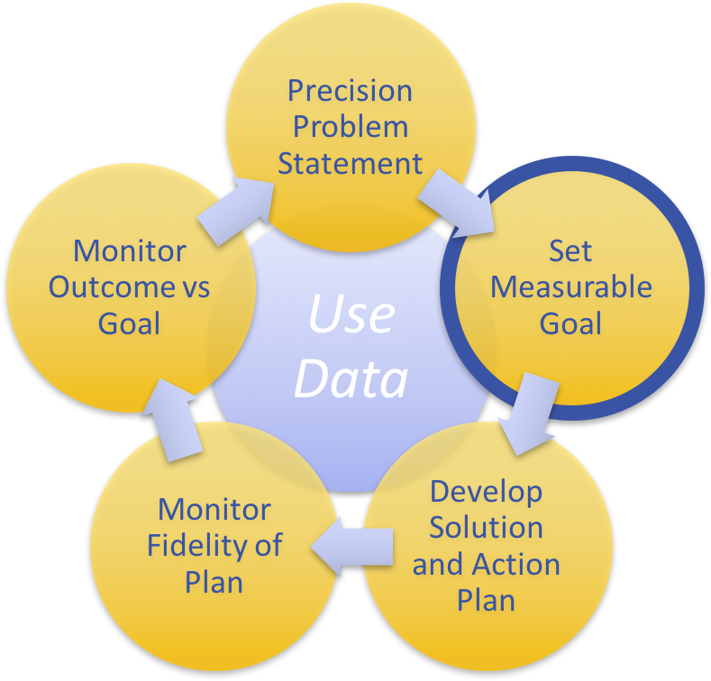
Activity: Write Example for a Measurable Goal
What measurable outcome do you want to achieve from your Precision Problem Statement on hallway behavior outside the cafeteria?
Specific
Measurable
Achievable
Relevant
Timely
Workbook: TFI 1.12., 1.13 Activity 4 (Step 2)
Notes:
Continue Walk through this as a large group. They can write in their workbook if they choose. (Think I Do/We Do)

Slide 38
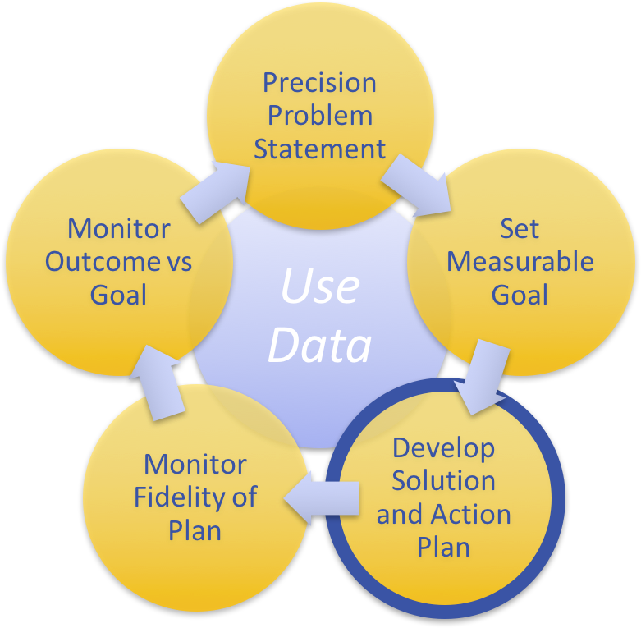
Building a Solution & Action Planning
Workbook: TFI 1.12., 1.13 Activities 4 (Step 3)
Solution component | Definition and Example | Cafeteria Hallway Solution…
Prevention | How can we avoid the problem context? e.g. schedule lunch times, change lighting
Teaching | How can we define, teach, and monitor what we want? e.g. build “Quiet” curriculum, teach hallway expectations, buy decibel meter
Recognition | How can we build in systematic rewards for positive behavior? e.g. 3 quiet days = 5 extra minutes of social time at lunch
Extinction | How can we prevent problem behavior by removing the reward? e.g. Do not respond to student who speaks out instead of raising hand
Consequence | What are efficient, consistent consequences for problem behavior? e.g: Error correction; practice appropriate behavior (document with Major/Minor ODR)
Data | How will we collect and use data for evaluating the fidelity of our solution (e.g. walkthrough reports, observations, self-assessments), and student outcomes (e.g. SWIS ODR data, time on task, etc.)?
Using one or more of the solution components, Write a solution addressing your Precision Problem Statement on hallway behavior outside the cafeteria.

Slide 39
Measure Fidelity of Implementation
How will you ensure the plan is being implemented as designed? Are you doing what you say you will do?
Team members will each take one passing period a day, and count the number of staff standing in doors to monitor hallways.
9th grade teachers rate implementation fidelity on scale of 1-5 (low to high), on the fidelity check board, at the end of each month.
1x per week, Social worker will randomly select two students in each class and interview if they used Stop, Walk, Talk. Will track on phone using Google Survey
All staff surveyed at weekly staff meeting:
Did you acknowledge 5 students, not in your classroom, daily?
1 - No 2 - Somewhat 3 - Yes
Notes:
Continue Walk through this as a large group. They can write in their workbook if they choose. (Think I Do/We Do)

Slide 40
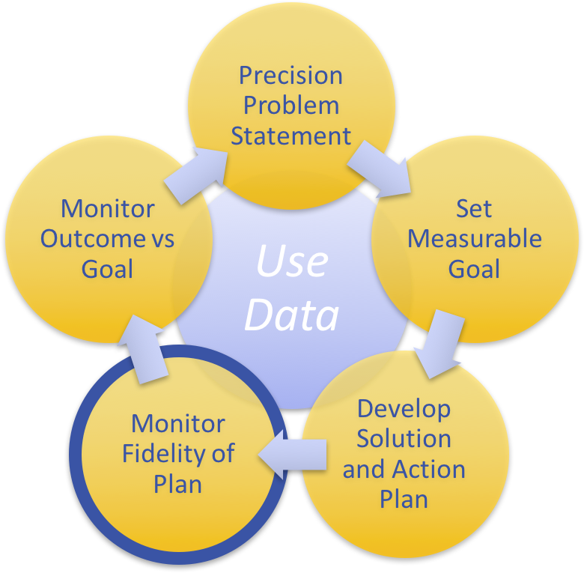
Activity: Measure the Fidelity of your Plan
Write a fidelity measure for your solution to addressing hallway behavior outside the cafeteria.
Workbook: TFI 1.12. 1.13 Activity 4 (Step 4)

Slide 41
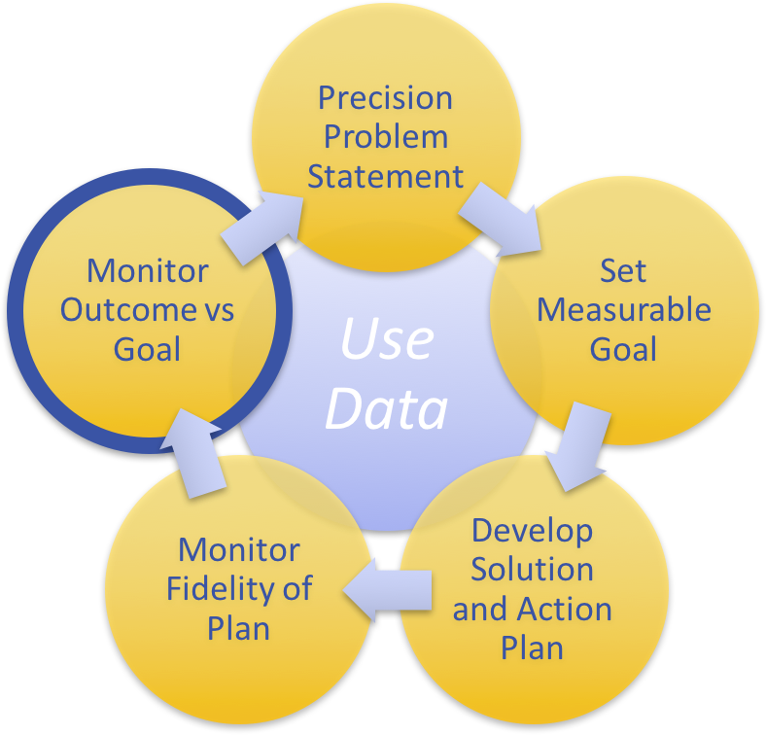
Was your problem-solving a success? Monitor Outcome Data vs Goal
Sample data categories:
Attendance
Tardies
Grades
Surveys
Perception (family, staff, students)
ODRs (Minor and Major)
Other?
Notes:
Continue Walk through this as a large group. They can write in their workbook if they choose. (Think I Do/We Do)
Trainer Notes:
Revisit the precision problem statement. Update the data used to create the precision problem statement and compare results. What other data sources can also inform the impact of the intervention?

Slide 42
Your Turn
Activity in handbook with data scenario
Precision Problem Statement
Monitor Outcome vs Goal
Set Measurable Goal
Use Data
Monitor Fidelity of Plan
Develop Solution and Action Plan

Slide 43
Report Out: Share your Problem Solving Process.

Slide 44
Six Things to Avoid
Define a solution before defining the problem
Build solutions from broadly defined, or fuzzy problem statements
Failure to use data to confirm/define problem
Agree on a solution without building a plan for how to implement or evaluate the solution
Agree on a solution but never assess if the solution was implemented
Serial problem solving without decisions

Slide 45
Data Sharing with Staff, Students, Community
SHARE monthly
How are we progressing toward our goal?
What are the results of our fidelity checks for our interventions?
Are these data accurate?
Are we over writing ODRs, under writing ODRs?
Are we being consistent in writing and definitions of behavior?
Get feedback
Communication is two way
Stress to staff the importance of accurate and consistent input
Notes:
We want to be able to answer these questions with our data to direct us to the last question: what is the most effective use of our resources?

Slide 46
Reflection
Identify action items below needed for full implementation
Add action items to the Action Plan in your workbook
Add completed items and artifacts to the PPT Overview for your school
TFI | Action Item (Not In Place; Partially; Fully In Place ->) | NI | PI | FI
1.12 | Data system is used to collect and analyze Office Discipline Referral (ODR) data
1.12 | Additional data are collected (attendance, grades, faculty attendance, surveys) and used by PBIS Team
1.13 | Data analyzed at least monthly
1.13 | Data shared with team and faculty monthly (minimum)
1.13 | Disaggregate data to inform and monitor equitable practices.
1.13 | Team Implements problem solving process including: precision problem statements, goal setting, action plan, fidelity measure, and monitoring student outcomes.

Slide 47
TFI Self-Assessment
Features | Possible Sources | Criteria
1.12 Discipline Data: Tier I team has instantaneous access to graphed reports summarizing discipline data organized by the frequency of problem behavior events by behavior, location, time of day, and by individual student. | • School policy • Team meeting minutes • Student outcome data | 0 = No centralized data system with ongoing decision making exists 1 = Data system exists but does not allow instantaneous access to full set of graphed reports 2 = Discipline data system exists that allows instantaneous access to graphs of frequency of problem behavior events by behavior, location, time of day, and student
1.13 Data-based Decision Making: Tier I team reviews and uses discipline data and academic outcome data (e.g., Curriculum-Based Measures, state tests) at least monthly for decision-making. | • Data decision rules • Staff professional development calendar • Staff handbook • Team meeting minutes | 0 = No process/protocol exists, or data are reviewed but not used 1 = Data reviewed and used for decision-making, but less than monthly 2 = Team reviews discipline data and uses data for decision-making at least monthly. If data indicate an academic or behavior problem, an action plan is developed to enhance or modify Tier I supports
Notes:
Teams should complete this self assessment and use the results to determine action planning steps

Slide 48
Appreciation is given to the following for their contributions to this Professional Learning:

