Slide 1
Day 3
PBIS Team Training SAS & TFI Results Action Planning
Notes:
UPDATED October 2019

Slide 2
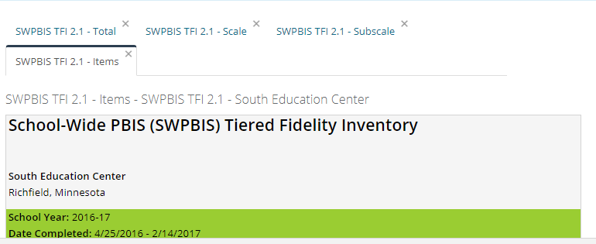
Pull All TFI Reports and Review
As a Team
Total
Scale
Subscale
Items

Slide 3
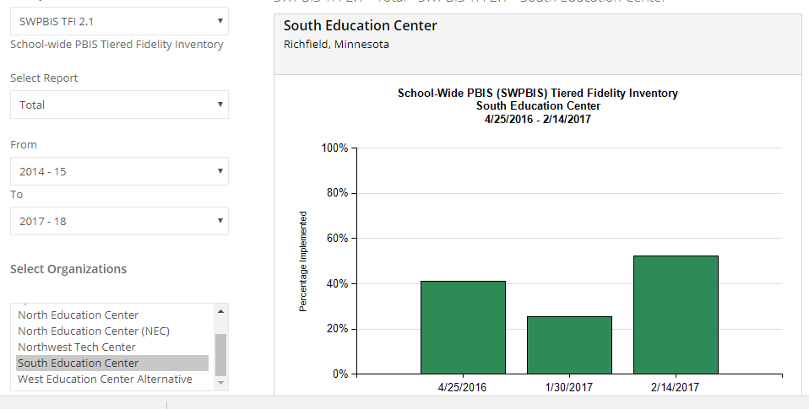
Total Report

Slide 4
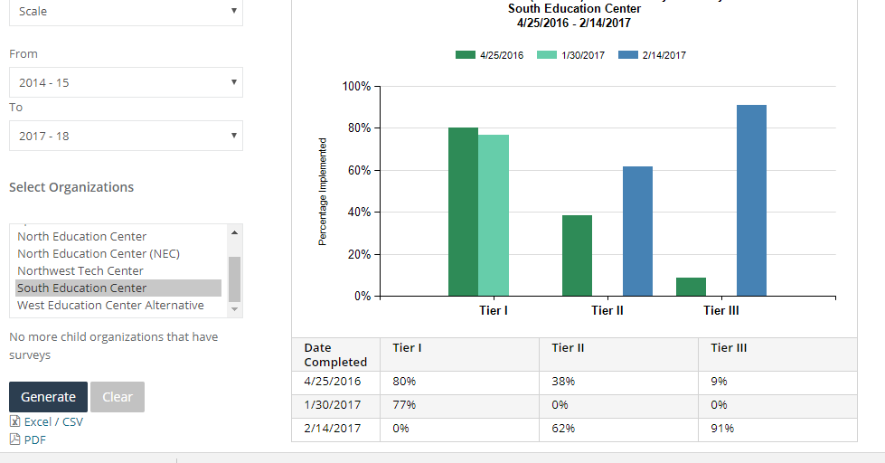
Scale Report

Slide 5
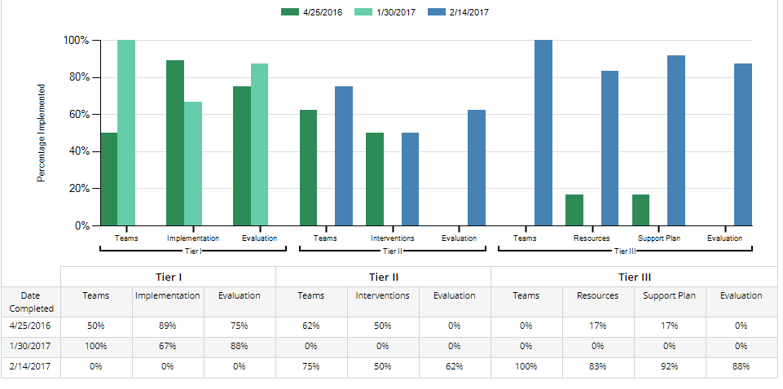
Subscale Report

Slide 6
Self-Assessment Survey (SAS)
WHAT: Annual assessment of staff perception of PBIS implementation
WHO: All school staff
WHEN: By November 1 and May 1
WHY: Shows how well adults understand and are implementing with PBIS

Slide 7
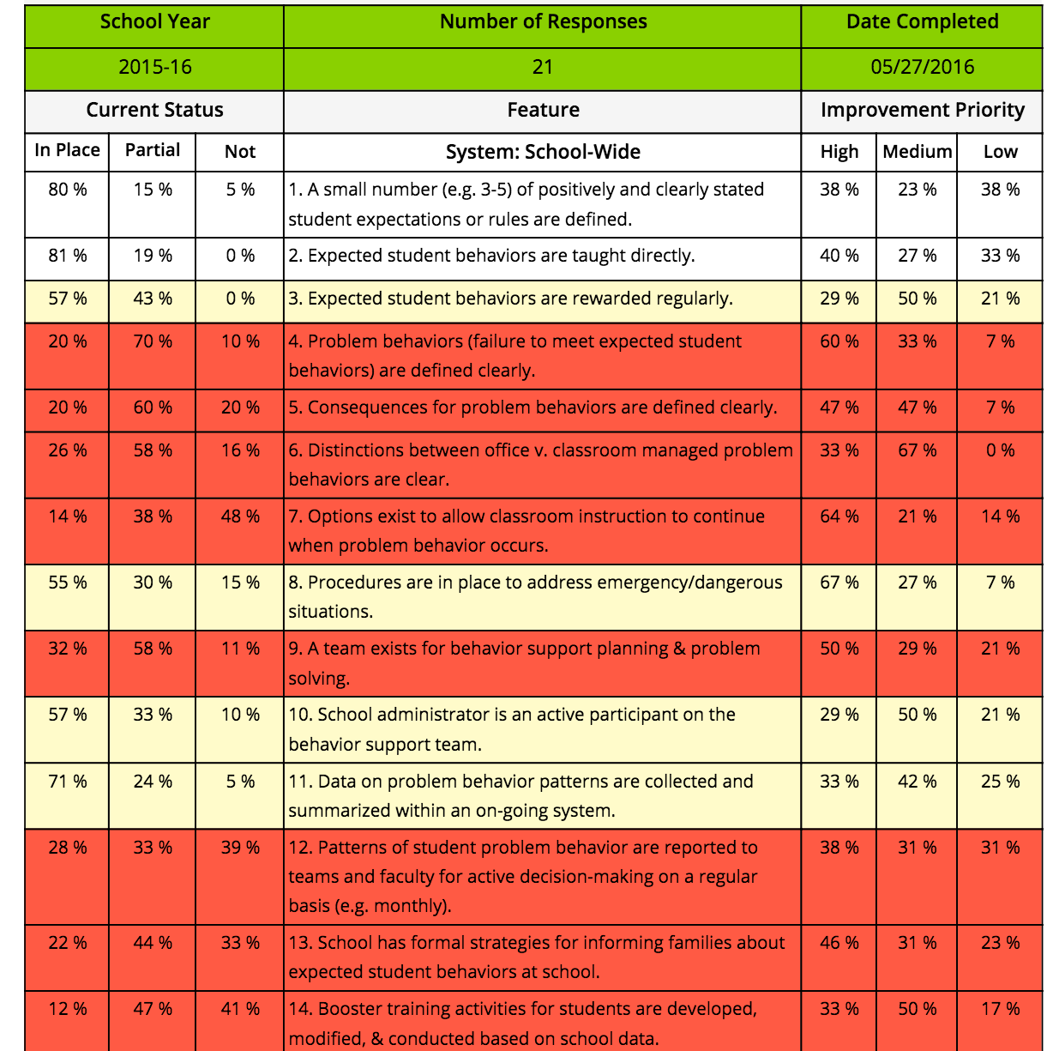
Sample SAS Item Analysis Report
What do you see? How is this helpful?

Slide 8
Self-Assessment Survey (SAS)
Annual fidelity measure that allows all staff to evaluate the status and need for improvement on the following systems:
School-wide
Non-Classroom
Classroom
Individual
Results can be used with the TFI results for a comprehensive view of Team and Staff implementation perception.

Slide 9
Self-Assessment Survey (SAS)
Action plan with the results. Once the survey has closed, the PBIS Team should view the results and make an action plan for continuous improvement.
Suggestions Include:
Compare results with the TFI and prioritizing action items (http://bit.ly/TFISASCrosswalk)
Summarize data and bringing back to staff to pick the top 3 areas of focus
Add priority items to your next meeting agenda

Slide 10
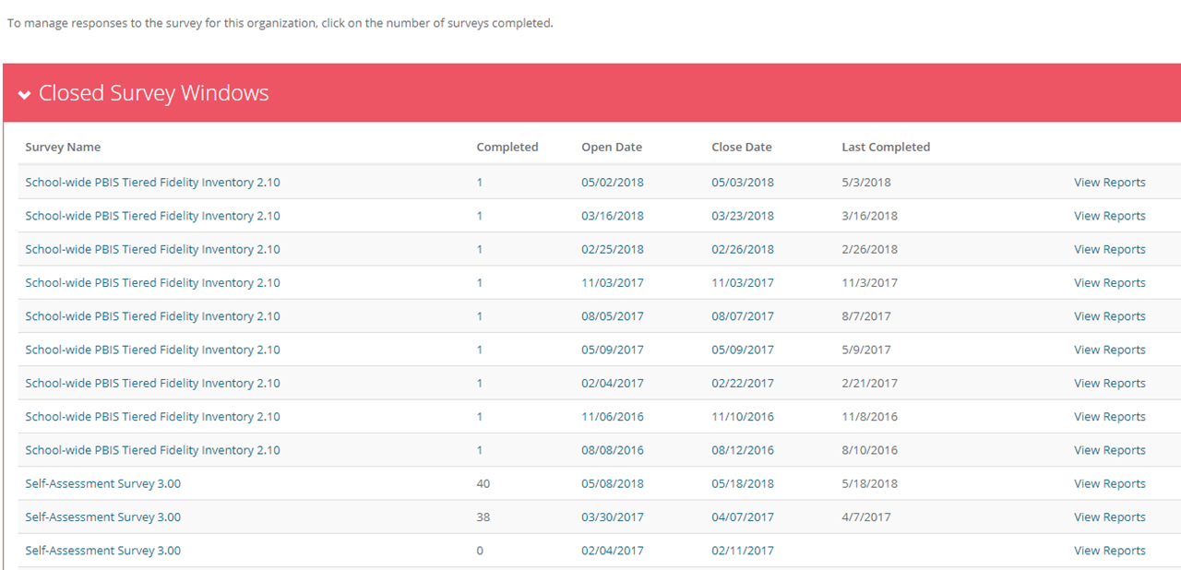
Pulling Up the Results

Slide 11
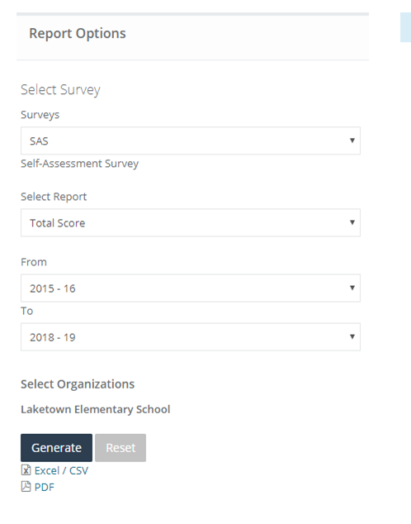
Report Options Menus

Slide 12
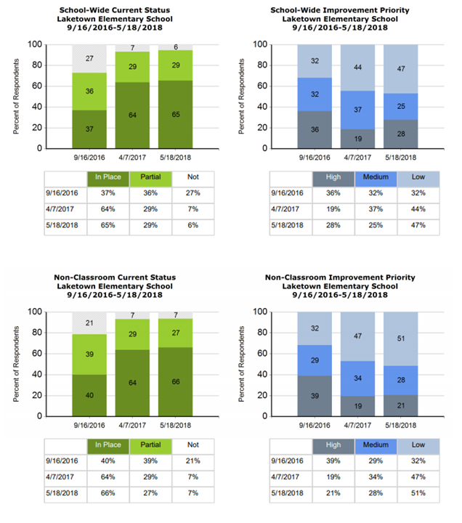
Total Score

Slide 13
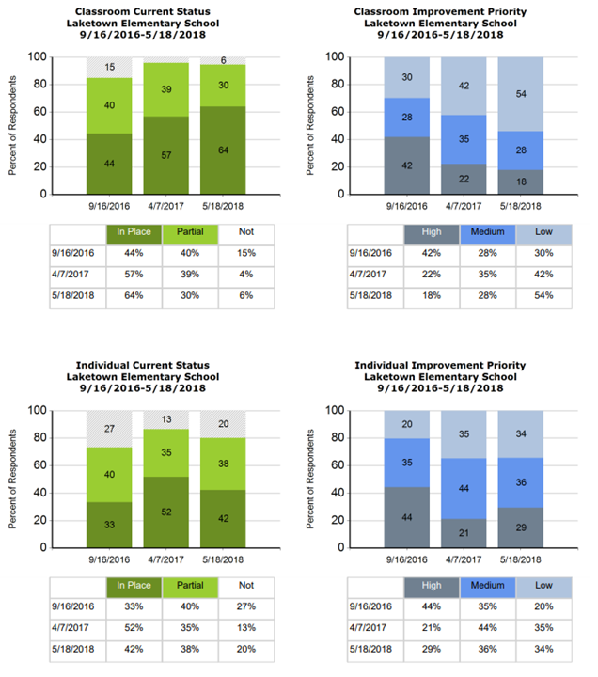
Total Score

Slide 14
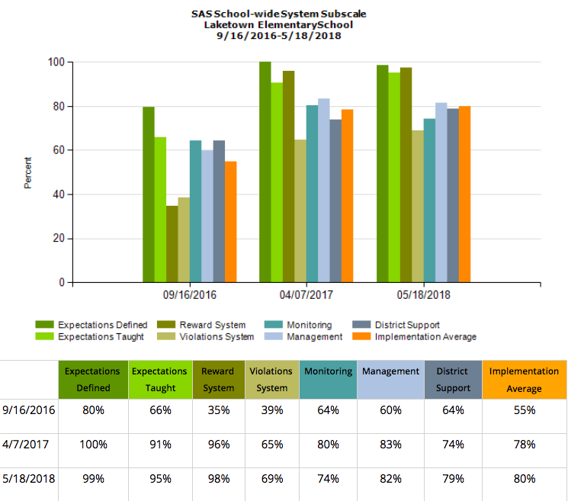
School-wide Systems Subscale

Slide 15
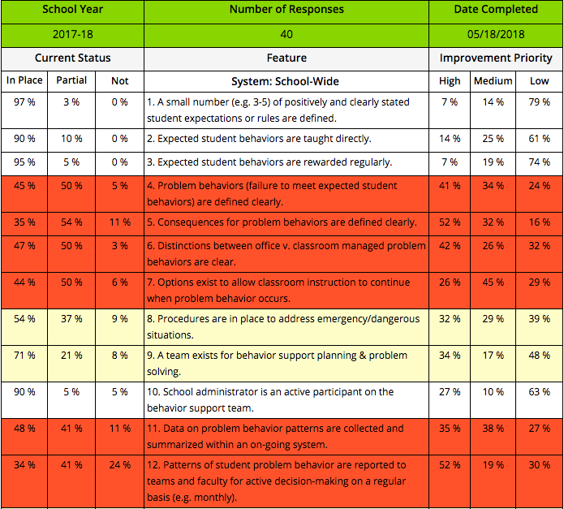
Items

Slide 16
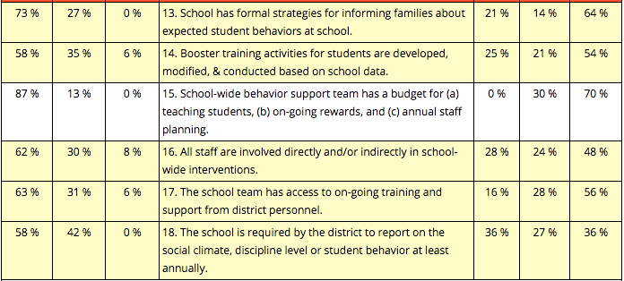
Items

Slide 17
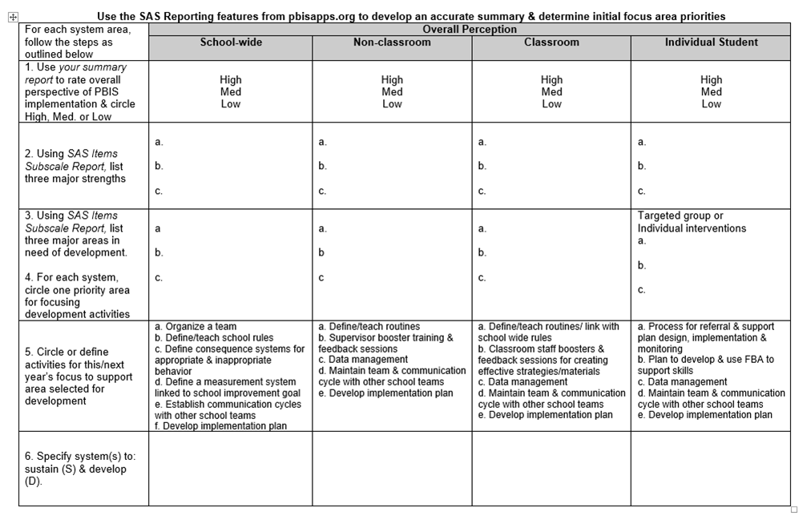
Action Planning
SAS Action Planning Document

Slide 18
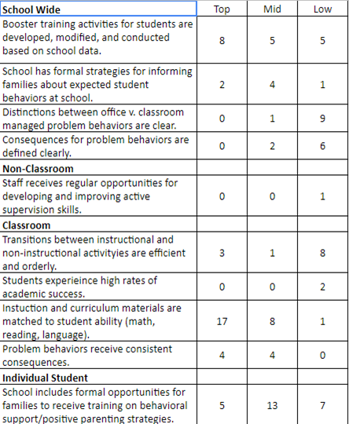
Additional Feedback/Narrow Goals
Bring your top 12 items for improvement (taken from the action planning doc) back to your staff.
List out the 12 items
Give each staff 3 colored dots
Have staff place their dots on items for improvement
Take this back to the team in a summary doc
Top
Middle
Low

Slide 19
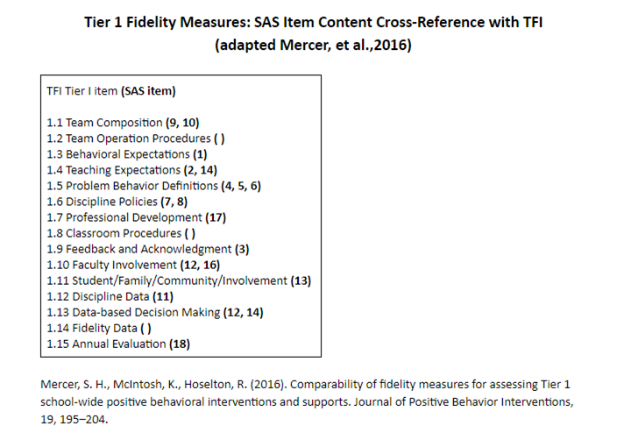
Using Both the SAS & TFI
SAS & TFI Crosswalk

Slide 20
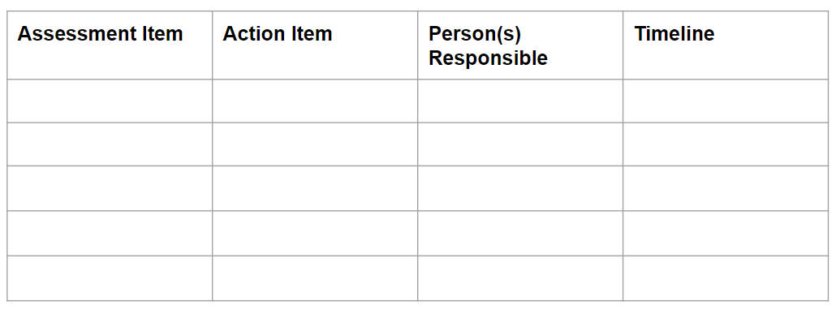
Using Both the SAS & TFI

Slide 21
Resources
How to Give the SAS
SAS Cheatsheet
SAS Action Planning Document
SAS & TFI Crosswalk
TFI Manual
TFI Action Planning Document
How-To-Navigate PBIS Assessment

