Slide 1
PBIS Team Training 2B
Teaching Expectations (TFI 1.4)
Notes:
UPDATED July 2019

Slide 2
Learning Expectations
EXPECTATION | BEHAVIOR
Be Responsible | Make yourself comfortable Take care of your needs (water, food, restroom, etc.) Action plan to implement what you are learning Follow through on your action items
Be Respectful | Turn cell phones off or to “vibrate” Listen attentively while others are speaking Have only the training materials up on your computer/tablet/phone
Be Engaged | Ask what you need to know to understand and contribute Contribute to the group by sharing relevant information and ideas
Notes:
2

Slide 3
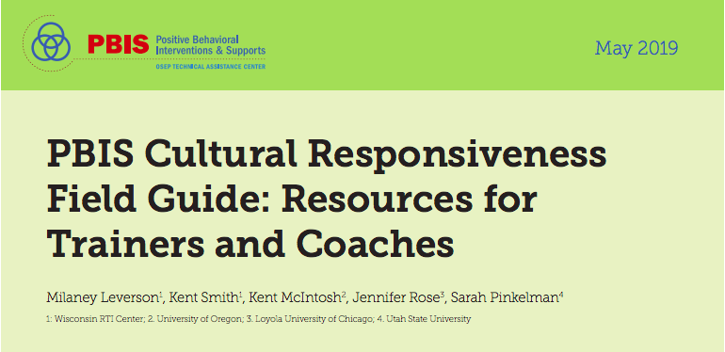
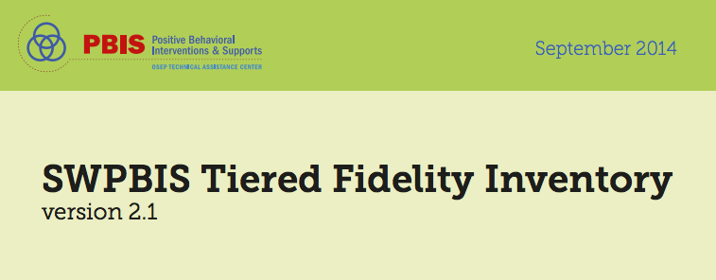
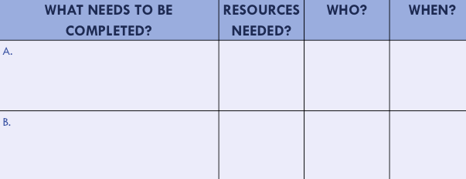
Organization of Modules
Content:
Aligned to TFI Items 1.1 – 1.15
Activities/Team Time: Activities for Fluency
Culturally Responsive:
Aligning culturally responsive practices to the core components of SWPBIS
Self-Assessment:
Tiered Fidelity Inventory
Action Planning: Applying the core content to your school
Notes:
MOVE UP
These are the icons that you will see throughout the training and will serve as a guide and a prompt to the content of each slide.
Change

Slide 4
Tier 1: Professional Learning Roadmap
TFI Sub-Scale: Team
TFI 1.1 | Team Composition
TFI 1.2 | Team Operating Procedures
TFI Sub-Scale: Evaluation
TFI 1.12 | Discipline Data
TFI 1.13 | Data-based Decision Making
TFI 1.14 | Fidelity Data
TFI 1.15 | Annual Evaluation
TFI Sub-Scale: Implementation
TFI 1.3 | Behavioral Expectations
TFI 1.4 | Teaching Expectations
TFI 1.5 | Problem Behavior Definitions
TFI 1.6 | Discipline Policies
TFI 1.7 | Professional Development
TFI 1.8 | Classroom Procedures
TFI 1.9 | Feedback and Acknowledgement
TFI 1.10 | Faculty Involvement
TFI 1.11 | Student/Family/Community Involvement
8 Classroom Management Practices
1 | Arrange orderly physical environment
2 | Define, Teach, Acknowledge Rules and Expectations
3 | Define, Teach Classroom Routines
4 | Employ Active Supervision
5 | Provide Specific Praise for Behavior
6 | Continuum of Response Strategies for Inappropriate Behaviors
7 | Class-Wide Group Contingency
8 | Provide Multiple Opportunities to Respond

Slide 5
TFI Self-Assessment
Feature | Possible Data Source | Scoring Criteria
1.4 Teaching Expectations: Expected academic and social behaviors are taught directly to all students in classrooms and across other campus settings/locations. | • Staff handbook • Student handbook • School policy • Discipline flowchart | 0 = Expected Behaviors are not taught 1 = Expected behaviors are taught informally or inconsistently 2 = Formal system with written schedules is used to teach expected behaviors directly to students across classroom and campus settings AND at least 70% of students can list at least 67% of the expectations.
Notes:
Teams should complete this self assessment and use the results to determine action planning steps on Workbook page 11.

Slide 6
TFI & Cultural Responsiveness
Features | Cultural Responsiveness
1.4 Teaching Expectations: Expected academic and social behaviors are taught directly to all students in classrooms and across other campus settings/locations. | Teams ensure that school staff understand that all students need explicit teaching about expected behavior at school. Teams have a process and procedures for staff to teach students the behaviors necessary to be successful in the school setting regardless of previous learning and without disrespecting families’ beliefs. When expectations differ between home or community and school, staff explicitly teach the differences (i.e., code-switching), the purpose of having the expectation at school, and provide additional practice until students demonstrate the behavior fluently.
Notes:
Teams should complete this self assessment and use the results to determine action planning steps on Workbook page 11.

Slide 7
Reflections
TFI | Action Item (Not In Place; Partially; Fully In Place ->) | NI | PI | FI
1.4 | A behavioral curriculum includes teaching expectations and rules for each location in the school
1.4 | Lesson include examples and non-examples (student/staff practice examples only)
1.4 | Lessons use a variety of teaching strategies
1.4 | Lessons are embedded into subject area curriculum
1.4 | Lessons will be taught and re-taught throughout the school year
1.4 | Staff and students are involved in development & delivery of behavioral curriculum
1.4 | Strategies to share key features of PBIS program with families/community are developed and implemented
1.4 | Identify dates on the school’s professional development calendar when the expectations will be formally taught to all students
1.7 | Identify dates on the school’s professional development calendar when the plans for teaching expectations will be shared with staff
1.8 | Expected classroom behaviors and routines are taught

Slide 8
Reflections
TFI | Action Item (Not In Place; Partially; Fully In Place ->) | NI | PI | FI
1.4 CR | Teams and school staff incorporate real life experiences or values of students into expectation lessons.
1.4 CR | Teams examine rules for reflection of dominant cultural values that may need explicit teaching and, if found, define the necessity of that skill and a plan for explicitly teaching it to all students.
1.4 CR | Teams provide opportunities for students to articulate their expectations at home and to discuss similarities and differences Staff actively teach and provide opportunities to practice code-switching to all students.
1.4 CR | Teams seek feedback on lesson plans from school staff, students, families, and community members.
1.4 CR | Teams include family and community members as teachers of behavior expectations.
1.4 CR | School staff use the Validate, Affirm, Build, and Bridge approach or other specific strategies to acknowledge students’ prior learning.
1.4 CR | Teams and school staff provide materials for families so that they can define and teach behavior expectations in the home in ways that fit their needs.
Notes:
There was discussion about the second reflection.
Suggested rewording or meaning is:
dea for Adjusted Language:
Teams examine positively stated expectations, rules, and lesson plans for reflection of dominant cultural values.
Teams determine how to adjust expectations, rules, and lesson plans to be culturally responsive.
Teams identify any necessary skills for success within existing dominant culture, define the necessity of these skills and create plans for teaching the skills to all students.

Slide 9
TFI 1.4 Purpose & Outcomes
Purpose:
Prepare and plan for facilitating implementation
of teaching the school-wide and classroom-wide
Expectations
Outcomes:
Expected academic and social behaviors are taught
directly to all students in classrooms and across other
campus settings/locations. (TFI 1.4)

Slide 10
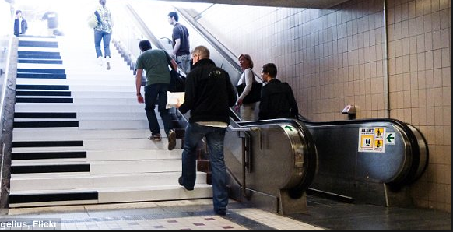
The Fun Theory
http://www.thefuntheory.com/piano-staircase
Notes:
Ask: what did you notice about changing behavior; did they measure outcomes? Did having fun make a difference? What was the reward?
1 minute 45 seconds
http://www.thefuntheory.com/piano-staircase

Slide 11
Developing a System for Teaching Appropriate School-wide & Classroom-wide Lesson Plans
Once you have developed school-wide expectations, it is not enough to just post the words on the walls…
YOU MUST TEACH (and RETEACH) THEM!
Notes:
We need to emphasize here that this is true for the classroom, in fact, classroom teachers may find that for most of the school year they must constantly and consistently teach the appropriate behaviors they want to see in their classroom. During the first couple weeks of school, teachers will spend more time teaching, re-teaching, pre-correcting, acknowledging and supporting implementation of classroom-wide rules for behavior, procedures and routines. Address behavior first and then teachers will find they have more time for teaching academics.
Can’t just put the expectations and rules on the wall and walk away..
If you emphasize “it” the students will see it’s importance
If you model “it” the students will learn how to do “it”.
Consistently provide students with feedback, emphasizing students who are doing “it”.

Slide 12
Why Develop a System for Teaching Behavior?
Behaviors are prerequisites for academics.
Procedures and routines create structure.
Repetition is key to learning new skills.
For a child to learn something new, it needs to be repeated on average ? times (Joyce and Showers, 2006)
Adults average ? (Joyce and Showers, 2006)
For a child to unlearn an old behavior and replace with a new behavior, the new behavior must be repeated on average ? times (Harry Wong)
8
25
28
Notes:
We can’t assume:
that students know the expectations/rules and appropriate ways to behave
That students will learn appropriate behaviors quickly and effectively without consistent practice and modeling
We must assume:
Students will require different curricula, instructional modalities supports, etc., to learn appropriate behavior
We need to teach expectations/rules and appropriate behaviors as effectively as we teach academic skills
Important for people to hear this information. Great slide.

Slide 13
Behavior Change
The change is an instructional process
We change STUDENT behavior
by changing
ADULT behavior
Interventions = changes in staff procedures & practices

Slide 14
Food for Thought…
If a child doesn’t know how to read, we teach.
If a child doesn’t know how to swim, we teach.
If a child doesn’t know how to multiply, we teach.
If a child doesn’t know how to drive, we teach.
If a child doesn’t know how to behave, we… teach? punish?
Why can’t we finish the last sentence as automatically as we do the others?
John Herner (NASDE Preent) Counterpoint 1998, page 2
Notes:
The following quote by Tom Herner expresses our difficulties with dealing with challenging behavior.
Read quote.
Do we regard behavior as a skill deficit that needs to be taught or do we perceive it as something that needs to be punished? If we perceive it as something to be punished then it is very clear that we regard it differently than any of the other behaviors or skills that we address at school. As a result, we tend to approach it in less-effective and less-professional ways. Appropriate behavior should be taught just like reading, swimming or driving.

Slide 15
Creating Behavior Lesson Plans
Teams and school staff incorporate real life experiences or values of students into expectation lessons.
Teams examine rules for reflection of dominant cultural values that may need explicit teaching and, if found, define the necessity of that skill and a plan for explicitly teaching it to all students.
Teachers create lesson plans for each desired behavior
Students are taught the expectations, rules and routines for both the school-wide system and the classroom-wide system.
Remember… If you are seeing problematic behavior, ask, “Have I taught the desired and acknowledged the behavior I want to see?”

Slide 16
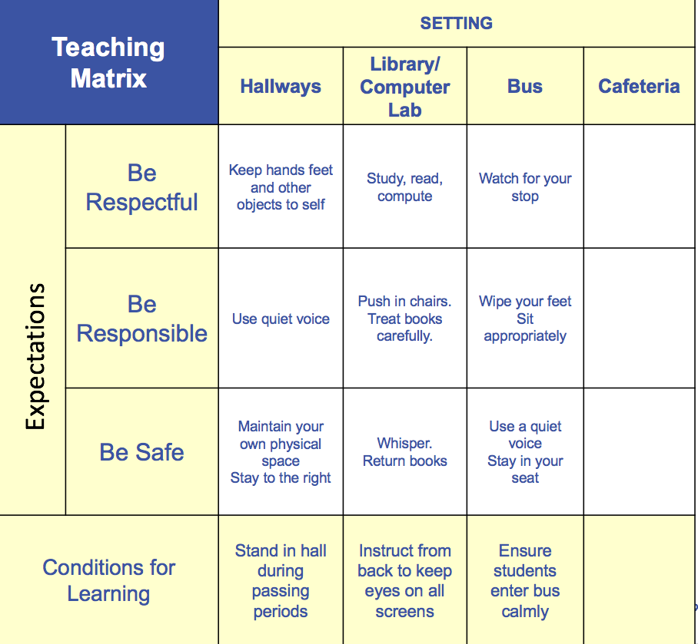
Develop an Efficient Teaching System
Provide initial lesson plans and/or lesson plan format to teach specific behaviors identified on the Matrix
CAFETERIA
Respectful | Be on time Keep my area clear Keep my place in line Say “Thank You”
Responsible | Dispose of food and trash in the proper manner Pay for my food
Safe | Listen to announcements Be prepared to leave on time
Conditions | Supervise student lines until they are fully in cafeteria
Notes:
Lesson plans should teach matrix behaviors explicitly
Behavioral instruction is infused into all instruction
Procedures are understood and practiced by administrators, staff, students, and families

Slide 17
Teaching Academics
DEFINE
(TELL)
Simplify
ADJUST
(RETEACH)
For
efficiency
MODEL
(SHOW)
BE CONSISTENT
MONITOR
PRACTICE
In setting
Notes:
Some teachers may say that they don't feel comfortable teaching behavior. they didn't receive any preparation in how to teach students behavior. They only received training on how to teach academic skills to students. Let’s elaborate on the similarities between teaching academic and teaching behaviors. When teaching a lesson you always start by defining whatever it is you're going to teach. You always have an objective; for example, “today class, I'm going to teach you how to do subtraction with regrouping.”
You're going to model it for your students and you're going to show them. You let the students practice with you and you do it together. We know that that's not enough to just teach it. They actually have to practice doing it for themselves. As they're practicing, you're going over and monitor and acknowledge how students are doing; so you're either providing useful corrections if they're misusing a strategy or you are providing positive feedback when they have it right, pointing out what they do right and then also giving them tips and prompts and redirecting them when they need it. And then as students go on we adjust for efficiency and effectiveness. Maybe you have some students who learn first time you modeled and practiced and monitor in they've got it. There's some other students that might need some different strategies. You may need to use manipulatives or another approach. That process for teaching a lesson is familiar with teachers.

Slide 18
Teaching Behavior
DEFINE
(TELL)
Simplify
ADJUST
(RETEACH)
For
efficiency
MODEL
(SHOW)
BE CONSISTENT
MONITOR
PRACTICE
In setting
Notes:
Teaching behavior is very similar to teaching academics. So if we were going to start with the defining a behavior, we'd have an objective that we're teaching, for example I'm going to teach you how to respectfully walk in the hallway and just like academics the teacher starts by modeling. So you see me walking on the right, I have a silent voice and my hands and feet are kept to myself. Just like with academics, it's not enough to just model it, we have to practice it and with behavior it's important to practice it in the setting. So we're not going to sit in the classroom and tell them about how to walk in the hallway. We're going to go to the hallway to practice walking together and the teacher is going to provide that feedback so it's either useful corrections or positive acknowledgment of students who are doing it right.
And then you would have to adjust for efficiency. So you're going to monitor for success and you're going to keep an eye on this skill as students go forward and continue to practice it daily. But there may be times when students might need a different strategy. Maybe there's some cluster areas where they come around a corner and we have to put tape on the floor, or maybe we have to put up some kind of physical barrier to keep students from running into each other. Just like with academics there might be a different strategy needed for teaching behavioral expectations. The main point is that teaching behavior and teaching academics are fundamentally the same. It doesn't matter if you're teaching reading, math, physics, music, etc., it's all the same process. With our role as behavior instructors, we need to be just as explicit as we are with academics. We may think we modeled it, and told the students what the expectation is, and think they should know it now. Our job as educators is to follow through, practice it with the students, monitor and acknowledge and realizing that teaching the skill once at the beginning of the year isn't going to be enough.

Slide 19
Example: Teaching hallway expectations Middle School Example
https://www.youtube.com/watch?v=M87dPtEJC_w
Notes:
About 1 minute 7 seconds – video is elementary example
MS example- https://www.youtube.com/watch?v=M87dPtEJC_w 3:35 (this video does contain non-examples)
Feel free to use a local example video

Slide 20
Let’s Build A Lesson Plan Together
Teams provide opportunities for students to articulate their expectations at home and to discuss similarities and differences. Staff actively teach and provide opportunities to practice code-switching to all students.
Teams seek feedback on lesson plans from school staff, students, families, and community members.
Expectation: Be Safe
Location: Hallway
Establish/Define Behavior/Procedure:
When in the hallway at anytime
Walk on the right, Hands and feet to self
Teach: (group shares ideas)
Practice: (group shared ideas)
Notes:
This is an excellent template teachers and teams can use to organize the instructional process for the desired behavioral skill and can be found on p. ___ in your workbook. This can be used for your lesson planning activity at the end of this module.

Slide 21
Lesson Plan Continued…
Monitor and Reinforce:
Pre-Correct/Remind: Anticipate and give students a reminder to perform behaviors
Supervise: Move, scan and interact with students.
Feedback: Observe student performance and give positive, specific feedback to students.
Reteach: Practice throughout the day and school year.

Slide 22
Lesson Plan Activity
Choose a location from your school-wide matrix –or– choose a specific rule (e.g. hands to self) or a Classroom routine.
Work with your team and complete the behavior lesson plan template found in your workbook.
Be ready to describe your lesson to the group, describe the non-example if needed, and role play the correct example.
Workbook: Teaching Expectations Activity 1
Notes:
This brings a focus to the need for teaching behaviors and provides immediate practice in creating lesson plans for teaching behavior in identified areas. Teams also have the opportunity to get ideas from other teams sharing their plans.

Slide 23
How will the Lesson Plan be delivered?
Take time to decide how the lessons will be taught, not only at the beginning of the year, but throughout the year. Consider who, when, and where.
Encourage all staff members to participate to build their fluency with the expectations, rules, and instruction of behavior.
Rationale:
Creating a delivery plan ensures that it will be followed.

Slide 24
When Will You Teach? Schedule for Teaching Classroom Rules
Beginning of school year
Teach rules for all areas of school, including individual classrooms, during first week of school
After first week, review rules 2 or 3 times/week
End of first grading period
Through second grading period
Review rules once per week
Remainder of the year
Review rules periodically as needed
Review rules immediately after a school break
When behavior data indicates a need
Notes:
Determine your schedule initially teaching the expectations to the students and also additional times throughout the school year.

Slide 25
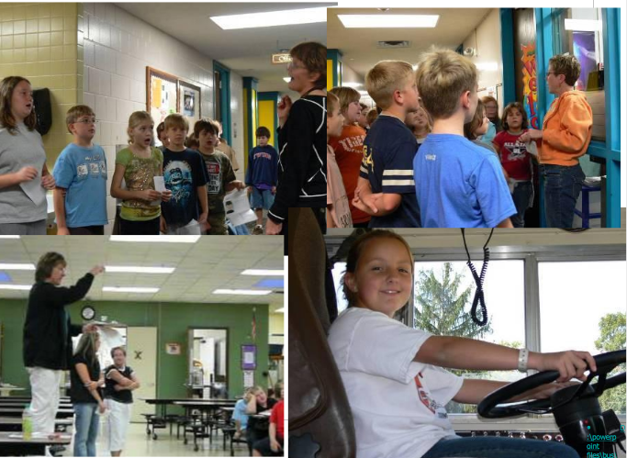
Teach in Context
Notes:
The first teacher took groups of students into the restrooms and explained the proper way to respect privacy, wash hands, exit quickly and quietly. The teacher on the right brought students into the cafeteria to share the new café routines and procedures. She explained what it looked like to be respectful to themselves, others and property during lunch. She also shared how students and their classes would be recognized for displaying Respectful behavior in the cafeteria; as this was one of the school’s target areas.

Slide 26
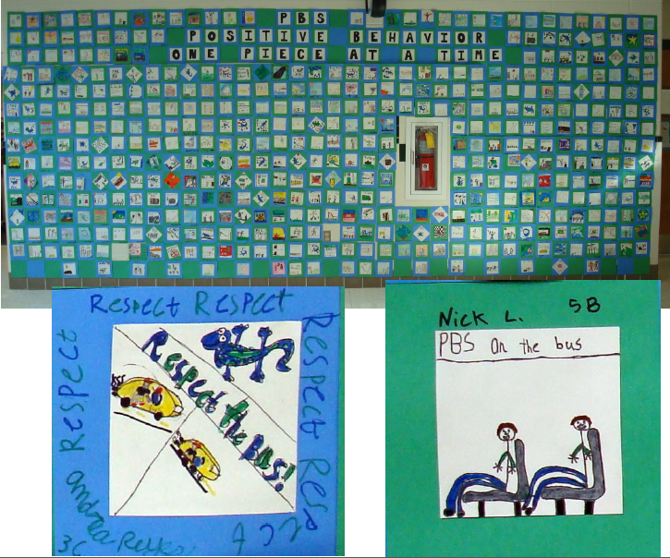
Embed Into the Curriculum
Notes:
The art teacher at this elementary school created an art lesson plan for visually showing respect in all areas of the school community. Each class was responsible for a different location; i.e., “draw a picture of what RESPECT looks like on the bus.” Each 6” X 6” paper square was added to another RESPECT square, until there was a huge RESPECT quilt prominently displayed in the major hallway in the school…between the cafeteria and the gym. It was a focal point in the school, easily seen as parents and others entered the front office.

Slide 27
Important Considerations When Making Teaching Videos
Matching the climate of your building
Making sure they are data driven
Pairing them with follow up activities (Discussion, etc.)
Do not role-play non-examples. Video’s should demonstrate the positive examples only.
Involve students in the process
Ensure students involved are representative of your student body

Slide 28
Using Instructional Videos- Transition Procedure
http://vimeo.com/20955727
Notes:
Trainer Notes:
Play “Dancing the Expectations” for elementary teams. Preface by saying, there is both an art and science to teaching. We have discussed the “science” of teaching through lesson plans, etc. Here is an example of the “Art” of teaching.
After the video, ask participants: What did you notice? How were students involved in this lesson? How could this video be used in their school?
This can also be found at http://vimeo.com/20955727 about 1 minute 30 seconds
Feel free to use a local example video

Slide 29
Using Instructional Videos- Arrive on Time
https://www.youtube.com/watch?v=r5JZ3yD2f14
Notes:
Trainer Notes:
Play “Dancing the Expectations” for elementary teams. Preface by saying, there is both an art and science to teaching. We have discussed the “science” of teaching through lesson plans, etc. Here is an example of the “Art” of teaching.
After the video, ask participants: What did you notice? How were students involved in this lesson? How could this video be used in their school?
https://youtu.be/5C-Wyy_lPNk – about 4 minutes 30 seconds
Feel free to add local example

Slide 30
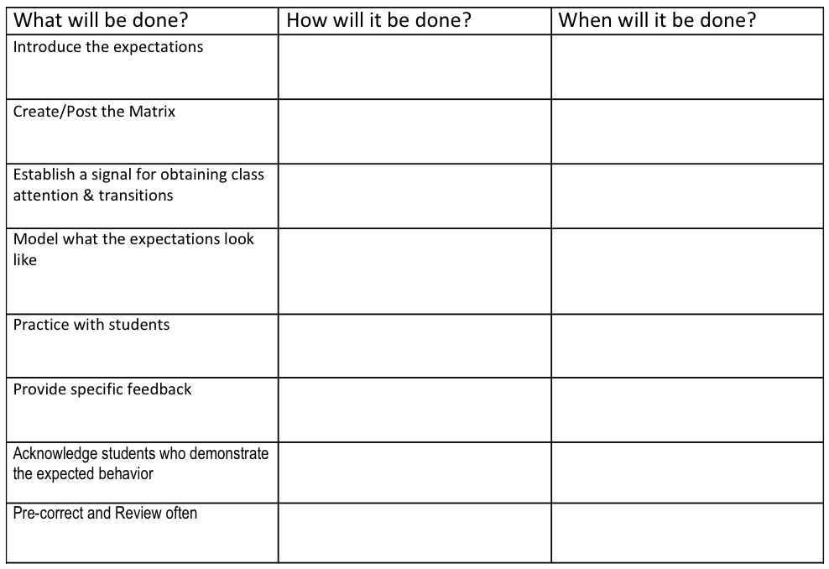
Plan for Teaching Expectations
Workbook: Teaching Expectations Activity 2
Notes:
Third line: signals used in library, cafeteria, gym, etc.

Slide 31
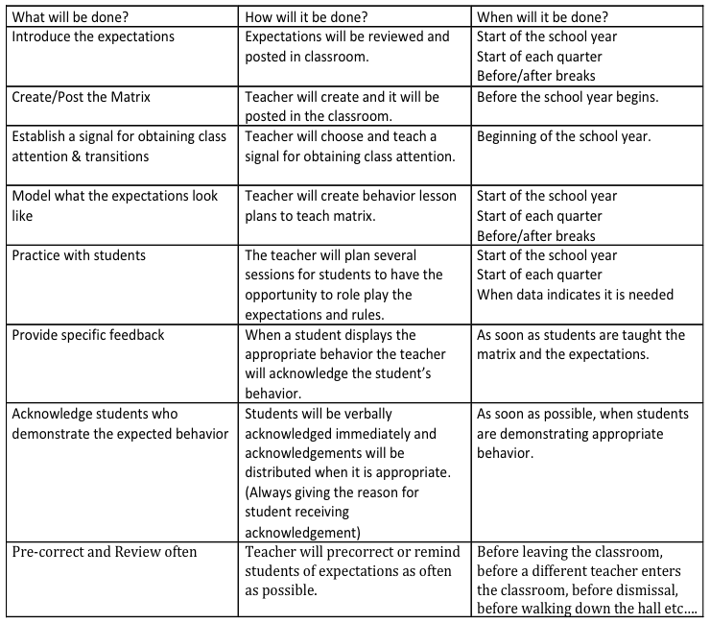
Plan for Teaching Expectations

Slide 32
More Culturally Responsive Considerations
Teams provide opportunities for students to articulate their expectations at home and to discuss similarities and differences. Staff actively teach and provide opportunities to practice code-switching to all students.
School staff use the Validate, Affirm, Build, and Bridge (VABB) approach or other specific strategies to acknowledge students’ prior learning.
Teams and school staff provide materials for families so that they can define and teach behavior expectations in the home in ways that fit their needs.

Slide 33
Lesson Plan Resources
http://www.pbis.org/training/student
http://pbiscompendium.ssd.k12.mo.us/elementary-lesson-plans
http://pbiscompendium.ssd.k12.mo.us/middle-school-lesson-plans
http://pbiscompendium.ssd.k12.mo.us/high-school-lesson-plans
Notes:
Each year check the links to ensure they are still active
If you know of local examples please add

Slide 34
TFI Self-Assessment
Feature | Possible Data Source | Scoring Criteria
1.4 Teaching Expectations: Expected academic and social behaviors are taught directly to all students in classrooms and across other campus settings/locations. | • Staff handbook • Student handbook • School policy • Discipline flowchart | 0 = Expected Behaviors are not taught 1 = Expected behaviors are taught informally or inconsistently 2 = Formal system with written schedules is used to teach expected behaviors directly to students across classroom and campus settings AND at least 70% of students can list at least 67% of the expectations.
Notes:
Teams should complete this self assessment and use the results to determine action planning steps on Workbook page 11.

Slide 35
TFI & Cultural Responsiveness
Features | Cultural Responsiveness
1.4 Teaching Expectations: Expected academic and social behaviors are taught directly to all students in classrooms and across other campus settings/locations. | Teams ensure that school staff understand that all students need explicit teaching about expected behavior at school. Teams have a process and procedures for staff to teach students the behaviors necessary to be successful in the school setting regardless of previous learning and without disrespecting families’ beliefs. When expectations differ between home or community and school, staff explicitly teach the differences (i.e., code-switching), the purpose of having the expectation at school, and provide additional practice until students demonstrate the behavior fluently.
Notes:
Teams should complete this self assessment and use the results to determine action planning steps on Workbook page 11.

Slide 36
Reflections
TFI | Action Item (Not In Place; Partially; Fully In Place ->) | NI | PI | FI
1.4 | A behavioral curriculum includes teaching expectations and rules for each location in the school
1.4 | Lesson include examples and non-examples (student/staff practice examples only)
1.4 | Lessons use a variety of teaching strategies
1.4 | Lessons are embedded into subject area curriculum
1.4 | Lessons will be taught and re-taught throughout the school year
1.4 | Staff and students are involved in development & delivery of behavioral curriculum
1.4 | Strategies to share key features of PBIS program with families/community are developed and implemented
1.4 | Identify dates on the school’s professional development calendar when the expectations will be formally taught to all students
1.7 | Identify dates on the school’s professional development calendar when the plans for teaching expectations will be shared with staff
1.8 | Expected classroom behaviors and routines are taught

Slide 37
Reflections
TFI | Action Item (Not In Place; Partially; Fully In Place ->) | NI | PI | FI
1.4 CR | Teams and school staff incorporate real life experiences or values of students into expectation lessons.
1.4 CR | Teams examine rules for reflection of dominant cultural values that may need explicit teaching and, if found, define the necessity of that skill and a plan for explicitly teaching it to all students.
1.4 CR | Teams provide opportunities for students to articulate their expectations at home and to discuss similarities and differences Staff actively teach and provide opportunities to practice code-switching to all students.
1.4 CR | Teams seek feedback on lesson plans from school staff, students, families, and community members.
1.4 CR | Teams include family and community members as teachers of behavior expectations.
1.4 CR | School staff use the Validate, Affirm, Build, and Bridge approach or other specific strategies to acknowledge students’ prior learning.
1.4 CR | Teams and school staff provide materials for families so that they can define and teach behavior expectations in the home in ways that fit their needs.

Slide 38
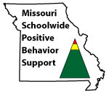
Appreciation is given to the following for their contributions to this Professional Learning:

