Slide 1
PBIS Team Training 2A
Behavioral Expectations (TFI 1.3)
Notes:
UPDATED July 2019
Updated 7/2018

Slide 2
Learning Expectations
EXPECTATION | BEHAVIOR
Be Responsible | Make yourself comfortable Take care of your needs (water, food, restroom, etc.) Action plan to implement what you are learning Follow through on your action items
Be Respectful | Turn cell phones off or to “vibrate” Listen attentively while others are speaking Have only the training materials up on your computer/tablet/phone
Be Engaged | Ask what you need to know to understand and contribute Contribute to the group by sharing relevant information and ideas
Notes:
2

Slide 3
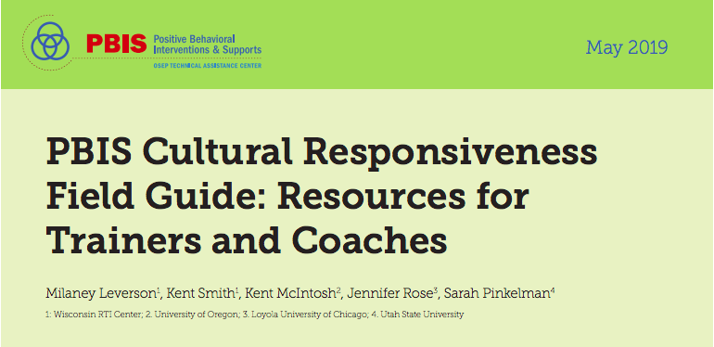
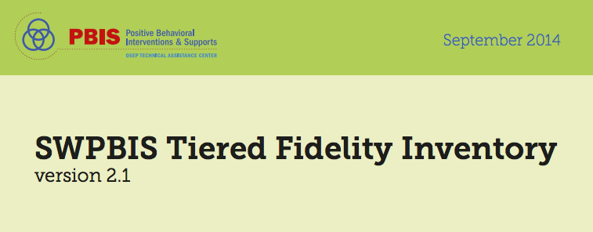
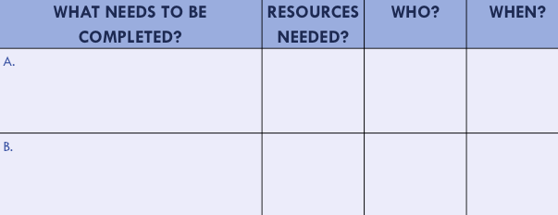
Organization of Modules
Content:
Aligned to TFI Items 1.1 – 1.15
Activities/Team Time: Activities for Fluency
Culturally Responsive:
Aligning culturally responsive practices to the core components of SWPBIS
Self-Assessment:
Tiered Fidelity Inventory
Action Planning: Applying the core content to your school
Notes:
MOVE UP
These are the icons that you will see throughout the training and will serve as a guide and a prompt to the content of each slide.
Change

Slide 4
Tier 1: Professional Learning Roadmap
TFI Sub-Scale: Team
TFI 1.1 | Team Composition
TFI 1.2 | Team Operating Procedures
TFI Sub-Scale: Evaluation
TFI 1.12 | Discipline Data
TFI 1.13 | Data-based Decision Making
TFI 1.14 | Fidelity Data
TFI 1.15 | Annual Evaluation
TFI Sub-Scale: Implementation
TFI 1.3 | Behavioral Expectations
TFI 1.4 | Teaching Expectations
TFI 1.5 | Problem Behavior Definitions
TFI 1.6 | Discipline Policies
TFI 1.7 | Professional Development
TFI 1.8 | Classroom Procedures
TFI 1.9 | Feedback and Acknowledgement
TFI 1.10 | Faculty Involvement
TFI 1.11 | Student/Family/Community Involvement
8 Classroom Management Practices
1 | Arrange orderly physical environment
2 | Define, Teach, Acknowledge Rules and Expectations
3 | Define, Teach Classroom Routines
4 | Employ Active Supervision
5 | Provide Specific Praise for Behavior
6 | Continuum of Response Strategies for Inappropriate Behaviors
7 | Class-Wide Group Contingency
8 | Provide Multiple Opportunities to Respond

Slide 5
TFI Self-Assessment
Feature | Possible Data Source | Scoring Criteria
1.3 Behavioral Expectations: School has five or fewer positively stated behavioral expectations and examples by setting/location for student and staff behaviors (i.e., school teaching matrix) defined and in place. | • TFI Walkthrough Tool • Staff handbook • Student handbook | 0 = Behavioral expectations have not been identified, are not all positive, or are more than 5 in number 1 = Behavioral expectations identified but may not include a matrix or be posted 2 = Five or fewer behavioral expectations exist that are positive, posted, and identified for specific settings (i.e., matrix) AND at least 90% of staff can list at least 67% of the expectations
Notes:
Teams should complete this self assessment and use the results to determine action planning steps on Workbook page 11.

Slide 6
TFI & Cultural Responsiveness
Features | Cultural Responsiveness
1.3 Behavioral Expectations: School has five or fewer positively stated behavioral expectations and examples by setting/location for student and staff behaviors (i.e., school teaching matrix) defined and in place. | Professional development processes and procedures focus on: (1) implementation of the SWPBIS framework, (2) the cultural responsiveness core components described in this guide, and (3) historic context and present-day issues specific to the school’s underserved populations.
Notes:
Teams should complete this self assessment and use the results to determine action planning steps on Workbook page 11.

Slide 7
Considerations
TFI | Action Item (Not In Place; Partially; Fully In Place ->) | NI | PI | FI
1.3 | Staff are involved in development of expectations and rules
1.3 | 3-5 positively stated school-wide expectations are posted around school
1.3 | Teaching matrix is developed to identify rules linked to expectations in various areas in the school
1.3 | Rules are posted in specific settings/locations
1.3 | Expectations apply to both students and staff
1.3 CR | Teams provide staff and community with periodic orientation and opportunities to examine and give input regarding school-wide expectations and rules to ensure that they reflect the values and norms of the community.
1.3 CR | Teams examine expectations and rules for implicit bias to ensure that expectations are truly universal.
1.3 CR | Families and students are given opportunities to examine and give feedback on the school-wide expectations and rules before implementing and at least annually after implementation.
1.3 CR | Expectations and rules are included in family and student orientation materials, including explicit statements on possible differences between school and home.
1.3 CR | School staff model expectations and refer to them regularly in daily interactions.

Slide 8
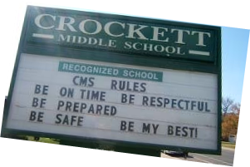
Purpose and Outcomes
Purpose:
Prepare and plan for facilitating implementation of development of School-wide Expectations & Rules
Outcomes:
School has five or fewer positively stated behavioral expectations and examples by setting/location for student and staff behaviors (e.g., school teaching matrix) defined and in place. (TFI 1.3)
Classroom rules and routines are defined, aligned to expectations, and in place. (TFI 1.8)

Slide 9
Why? … Consistency Matters
Common
Vision/Expectations
SCHOOL COMMUNITY
Common
Language
Common
Practices
(USDOE OSEP PBIS TA Center, 2010)
Notes:
9
When staff, students and families know the the school’s vision and 3-5 schoolwide expectation, as well as the practices and common language there is consistency among all stakeholders. Consistency matters in developing a safe and predictable environment.

Slide 10
Consistency with our language
Expectations | 3-5 overarching school-wide expectations
Behaviors | Specific tasks students are to do to achieve the school-wide expectations
Routines/ Procedures | Procedures are methods for accomplishing tasks in the classroom Procedures form routines that help students meet classroom expectations and rules/behaviors
Notes:
We have addressed the expectations; now we will be moving on to the Behaviors, Routines and Procedures
Expectations are outcomes
Rules are the specific criteria for meeting expectation outcomes
Rules identify and define concepts of acceptable behavior
Use of expectations and rules provides a guideline for students to monitor their own behavior and they remind and motivate students to meet certain standards

Slide 11
Common Language
Common Language: Expectations
Broadly stated and easy to remember
3-5 positively stated behaviors
Consistent with school’s mission statement
Expected of all staff/students
Notes:
what you want them to do, rather than what you don’t want them to do
positively stated
easy to remember
posted in the school and classroom
taught directly by the staff/students

Slide 12
A Non-Example
T H E DO NOTs
(A Non-Example)
Notes:
What is wrong with Ms. Mutner’s list? It’s a list of arbitrary rules; it doesn’t say what students should do instead. If you’re in Ms. Mutner’s class, what should you be doing? How do these rules make students more successful; they are more arbitrary than instructional. You can never teach everything a student should do by teaching the negatives. We should be telling them what we want instead. Could we teach academics like this? 2+2 is not 5; 2+2 is not 20, etc.

Slide 13
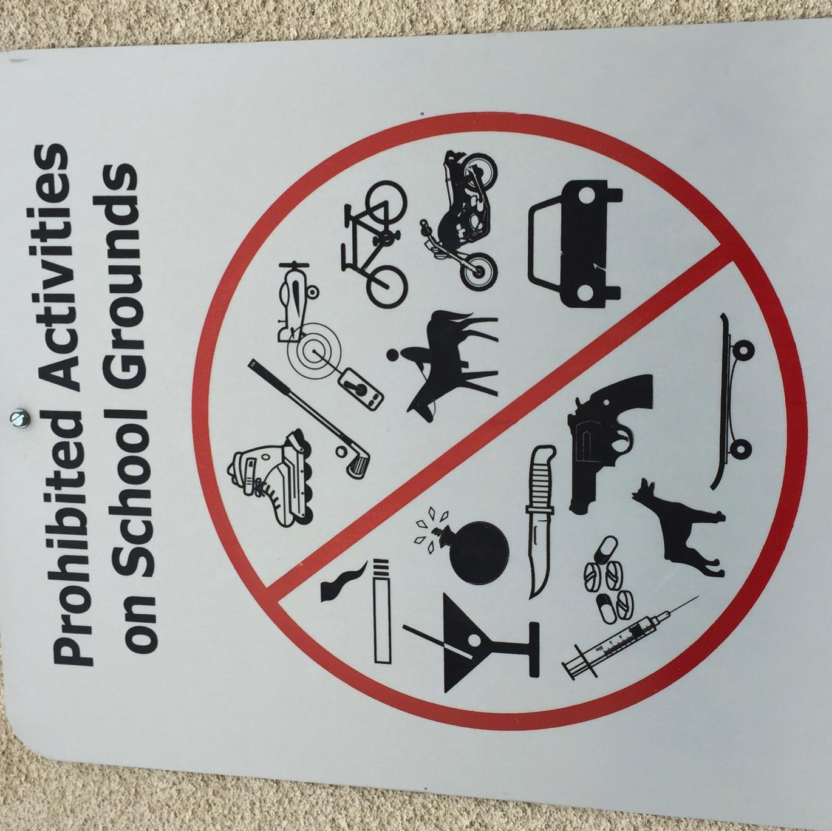
Prohibited activities on school grounds sign

Slide 14
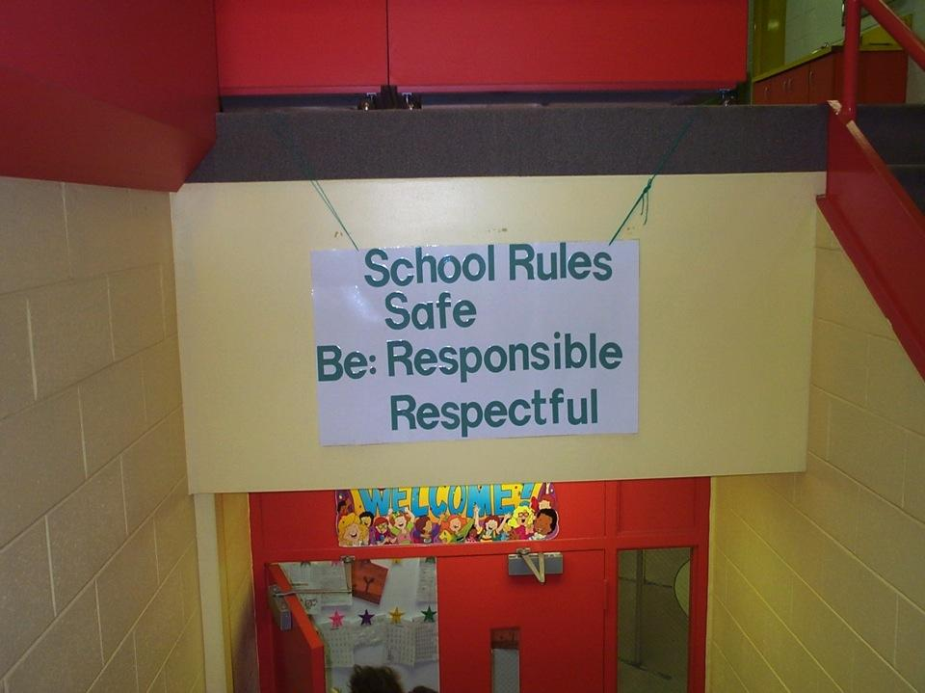
Redesign the Learning Environment
School Expectations
School Rules
NO Food
NO Weapons
NO Backpacks
NO Drugs/Smoking
NO Bullying
Notes:
14
Redesign Learning & Teaching Environment. Our mission is to create positive, preventative and predictable climates in schools. We want to change from a focus on the “no’s” and “don’ts” to what is expected behavior from students and staff.

Slide 15
Why Focus on Expectations and Behaviors?
This information has been found to be reliable whether we are talking about academics and/or behavior…
Clearly stated expectations and consistently supporting them lends credibility to a teacher’s authority. (Good & Brophy, 2000)
It has been found that what actually communicates expectations to students is teacher behavior. (Marzano, Education Leadership, September 2010)
Teaching rules, reviewing expectations and providing feedback is associated with an increase in academic engagement, leadership skills and conflict resolution. (Johnson & Stoner, 1996: Sharpe, Brown, & Cider, 1995; Rosenberg, 1986)

Slide 16
School-wide Behavior Expectations Non-example:
Exhibit respect for yourself and others.
Accept responsibility.
Give your best effort.
Look, listen, and learn to
Exceed expectations and
Soar to success.
Notes:
What is the problem with these school-wide expectations?
Too many
Not easy to remember
Too wordy

Slide 17
Elementary

Slide 18
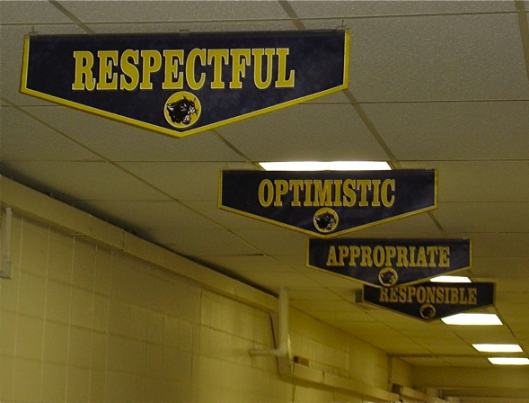
MS/HS Examples

Slide 19
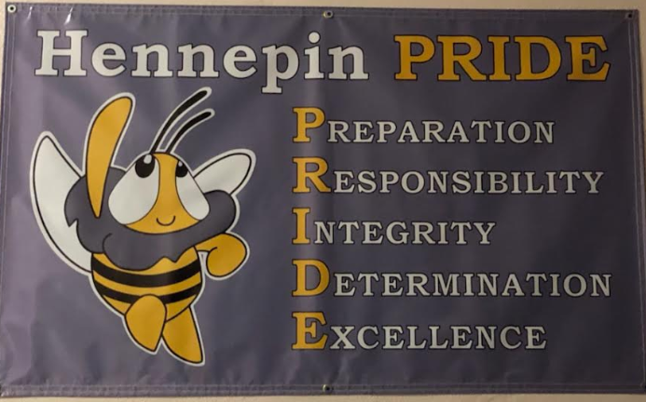
Expectations Examples

Slide 20
Residential School/Unit-wide Expectations
Be a STAR
Show respect
Take responsibility
Accept adult directions
Respond Appropriately

Slide 21
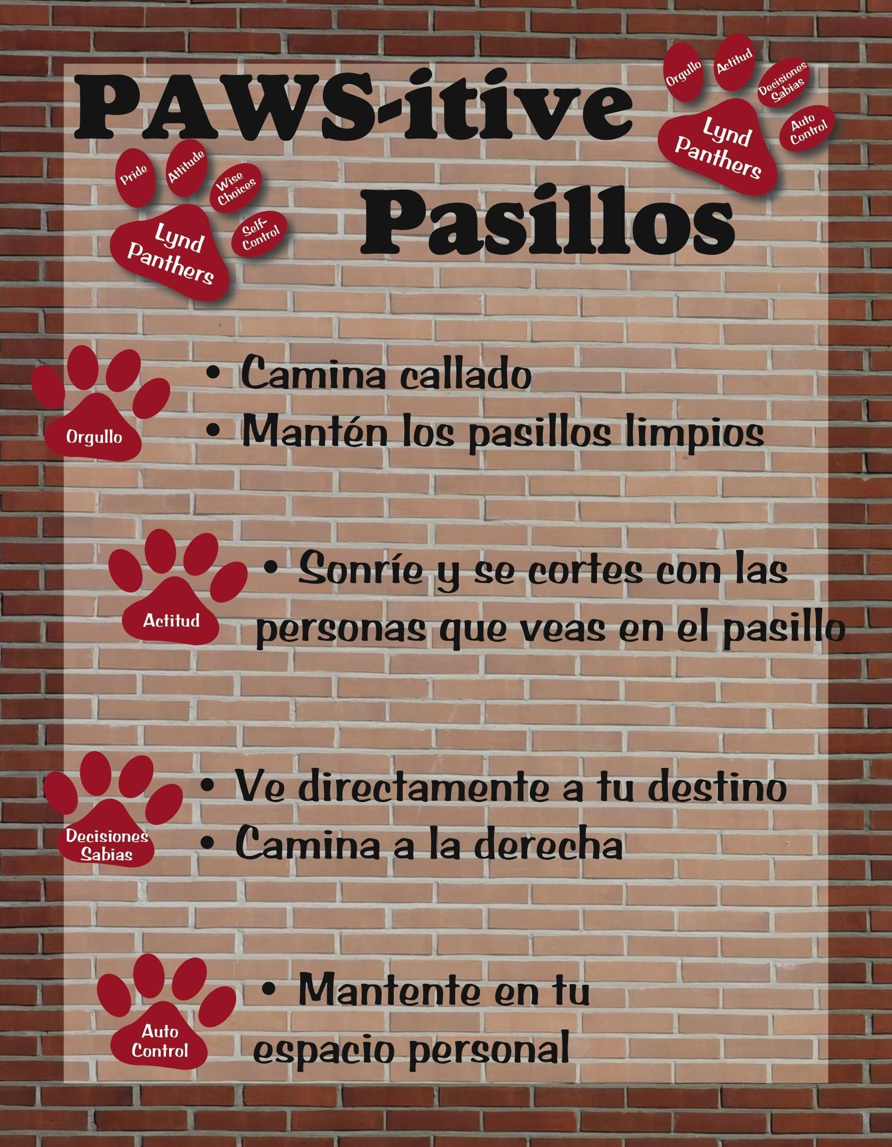
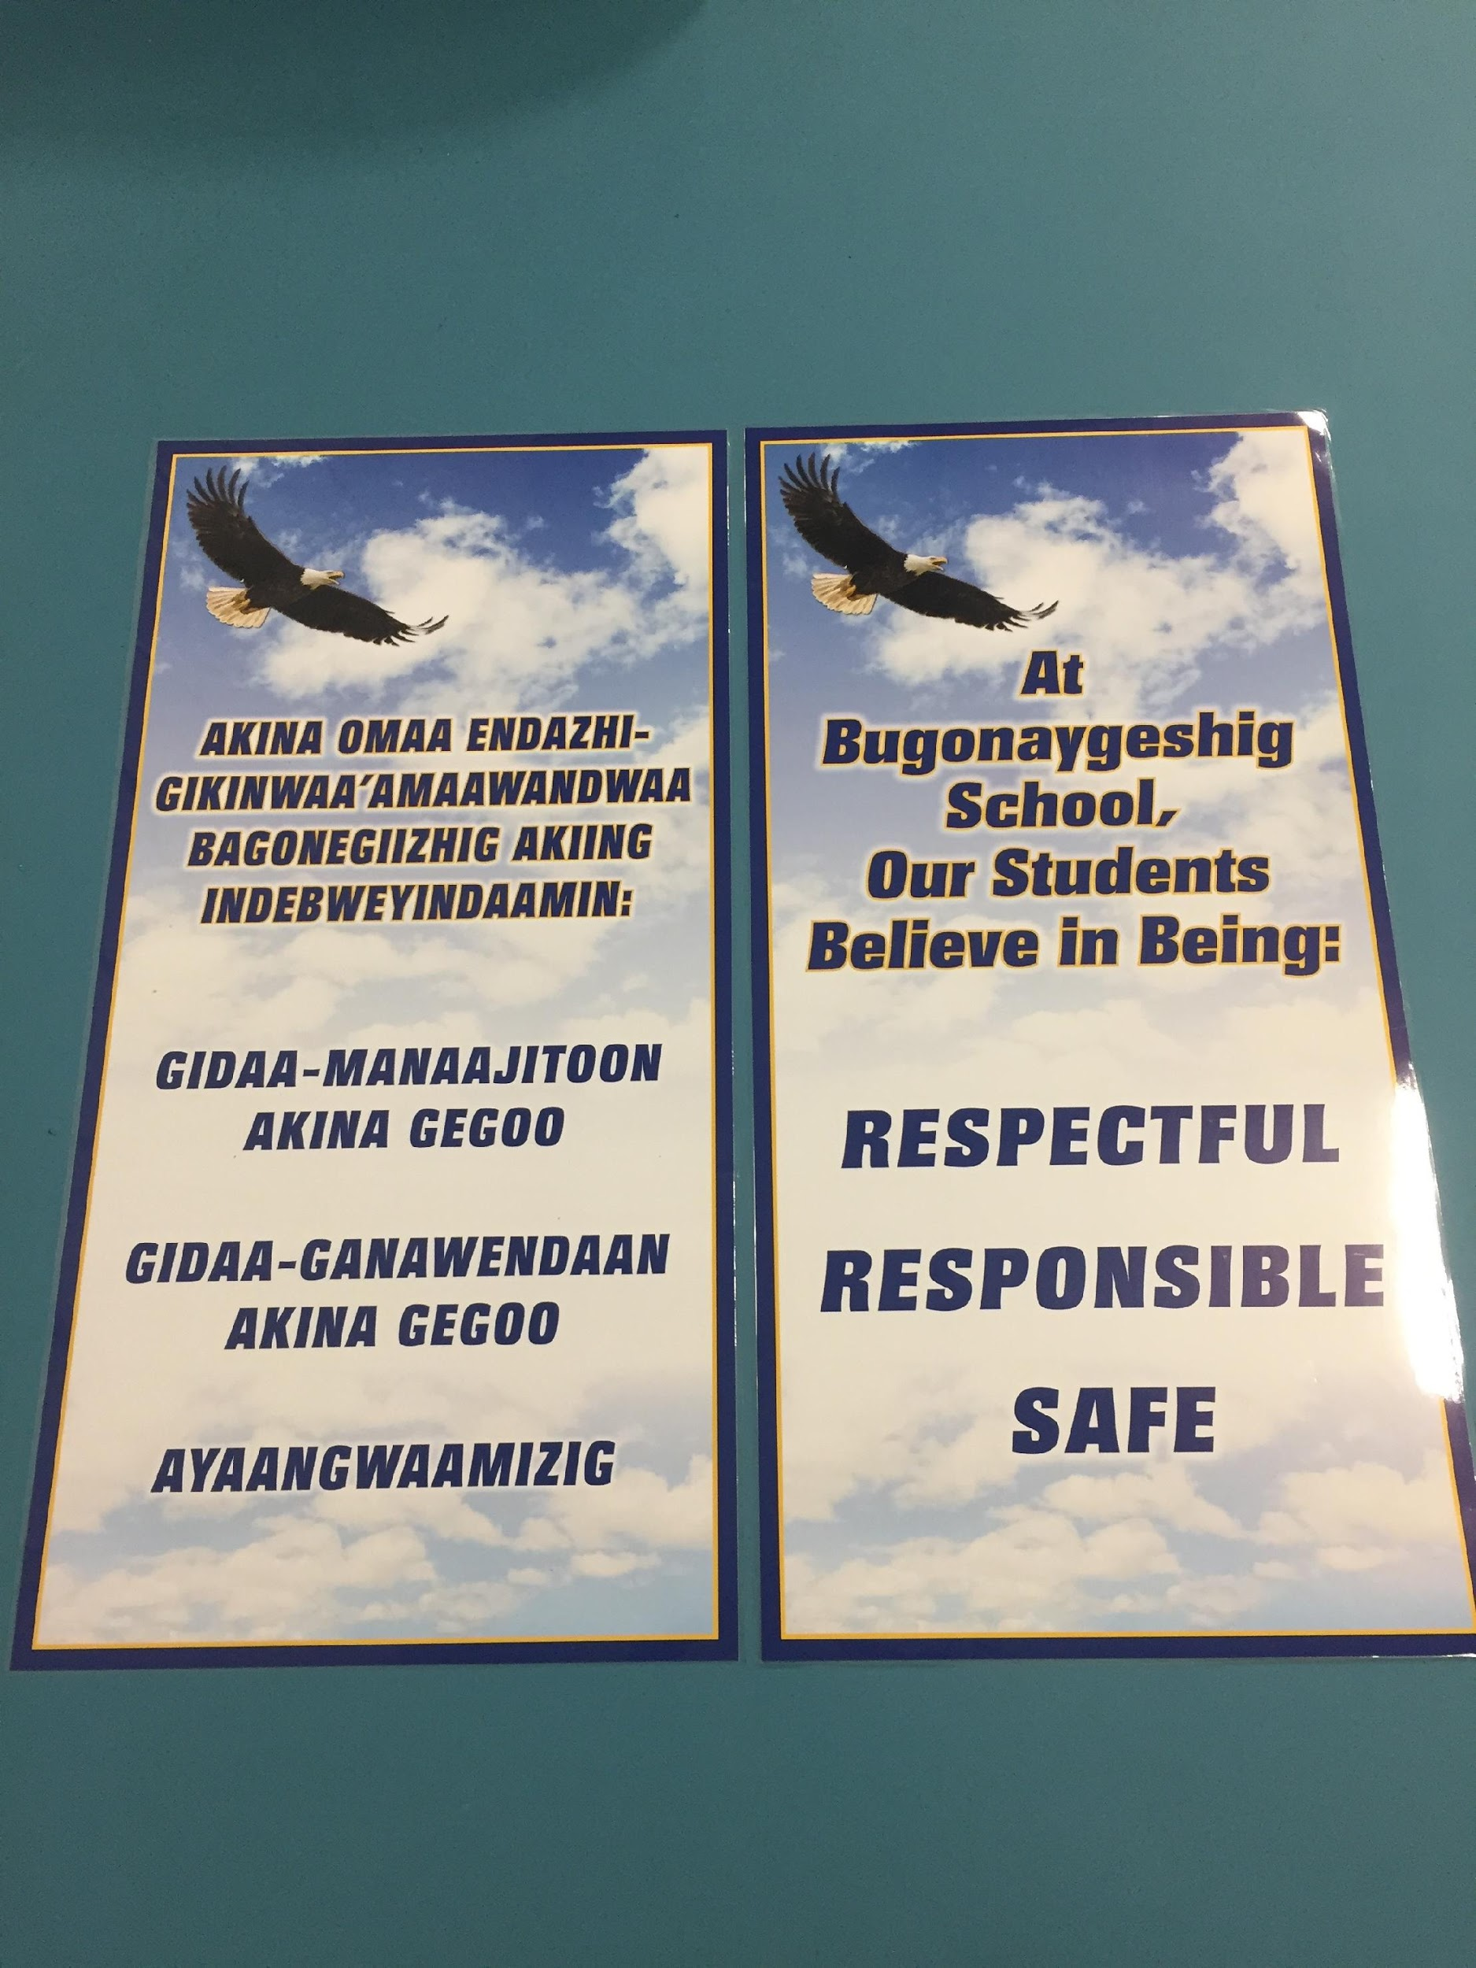
Cultural Connection

Slide 22
Build Your 3-5 School-wide Expectations
Think school vision statement
Think School Improvement Plan
Think data: what is showing up in your school?
Think about what you already have in your school
Get input from stakeholders
What words describe the culture you want in your school?
What social skills can you include?
Can you also come up with a name for your school-wide expectations?
The Wilson Way
Tiger ROAR
SOAR Expectations
Panther Pride
Bradley B’s
Workbook: Expectations Activity 1 (TFI 1.3)
Notes:
If your school system does not have school-wide expectations, proceed to developing expectations for your school.
Activity:
Each team member gets three sticky notes to record one expectation per sticky note.
Reach consensus as a team on three.
Take this activity back to staff.
Record these on a blank matrix

Slide 23
Locations of Behavior Problems
Where are the predictable problem behaviors you want to change at your school?
(Refer to YOUR data if you have any)
Notes:
Think of the earlier predictable problems you discussed

Slide 24
Teaching Matrix
Expectations | SETTINGS
?
?
?
Enter your expectations
3-5 positively stated behaviors
broadly stated
Workbook: Expectations Activity 2 (TFI 1.3)
Notes:
Provide teams with a blank teaching matrix.

Slide 25
School-wide Matrix
 | Hallway | Bathroom | Cafeteria | Bus
Be Respectful
Be Responsible
Be Safe
Add locations/settings
Workbook: Expectations Activity 4 (TFI 1.3)
Notes:
Identify the classroom and non-classroom areas in the schools.

Slide 26
Consistency with our language
Expectations | 3-5 overarching school-wide expectations
Behaviors | Specific tasks students are to do to achieve the school-wide expectations
Routines/ Procedures | Procedures are methods for accomplishing tasks in the classroom procedures form routines that help students meet classroom expectations and rules/behaviors
Notes:
We have addressed the expectations; now we will be moving on to the Rules, Routines and Procedures
Expectations are outcomes
Rules are the specific criteria for meeting expectation outcomes
Rules identify and define concepts of acceptable behavior
Use of expectations and rules provides a guideline for students to monitor their own behavior and they remind and motivate students to meet certain standards

Slide 27
What Is Gained By Identifying Behaviors?
Consistent instruction across multiple programs and settings within the school
Communication among staff members and students
Students know what to expect and what is expected in all areas
Consistent communication with parents
Notes:
It’s not enough to just identify the expectations and locations in the school, we need to clearly describe what the expectations look like. We do that by identifying the rules, using school’s data to determine what needs to be addressed in each area.

Slide 28
5 Guidelines for Developing Expected Behaviors
Guidelines | This Means | Example | Non-Example
Observable | I can see it. | Raise hand and wait to be called on. | Be your best.
Measurable | I can count it. | Bring materials. | Be ready to learn.
Positively Stated | I tell students what TO do. | Hands and feet to self. | No fighting.
Understandable | The vocabulary is age and grade appropriate. | Hands and feet to self. | Maintain personal space (K-1 rule)
Always Applicable | I am to consistently enforce. | Stay in assigned area. | Remain seated until given permission to leave.

Slide 29
Are They Expectations Or Behaviors?
Respect self and others
Walk in the hallways
Turn in completed assignment
Be Here, Be Ready
Keep hands and feet to self
Don’t run
Remember: Rules must be Observable, Measurable, Positively Stated, Understandable and Always Appropriate
Notes:
Could be done as a turn and talk

Slide 30
Including Pro-social Skills On Your Matrix
What modifications can be made to your matrix to increase the effectiveness of school-wide PBIS supports for students in your building who exhibit internalizing behaviors?
Not talking with other children
Being shy
Timid and/or unassertive
Avoiding or withdrawing from social situations
Not standing up for one’s self
Source: Walker and Severson, 1992
Quick table talk on this topic before learning more

Slide 31
Specific Behaviors + Pro-Social Skills
Specific Behaviors
Pro-Social Skills
Throw paper in the waste can
Use the right side of the stairway
Bring all materials to class
Keep hands, feet, and other objects to yourself
Do an act of kindness
Pick up trash even if it isn’t yours
Use encouraging words with others
Give positive feedback to a peer
Notes:
Consider incorporating pro-social skills within the teaching matrix. Specific behaviors are important and necessary, but we are also addressing social competency with all our students.
Because students spend more time in small cooperative, collaborative work groups, they rely on these prosocial skills for their academic work as well. You can increase content coverage when you pre-correct and teach prosocial skills (Anita Archer principle).

Slide 32
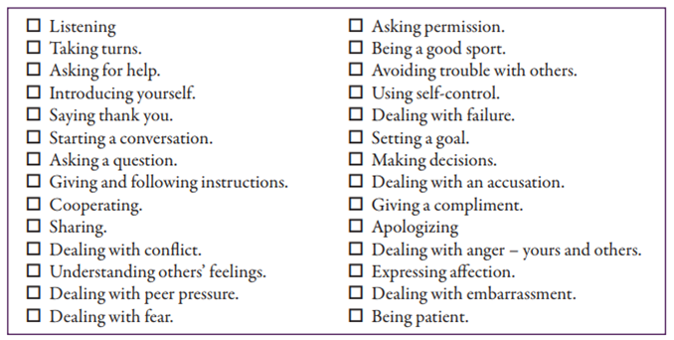
Example Pro-Social Skills

Slide 33
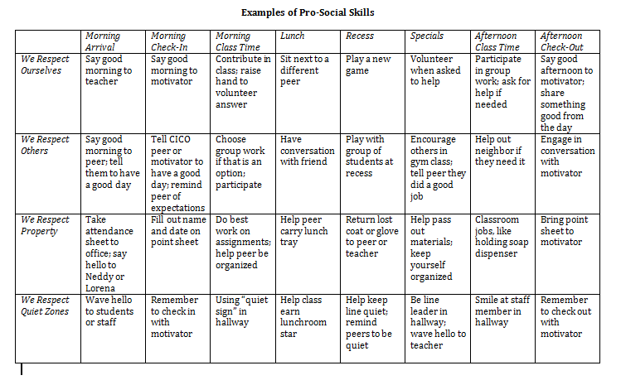
Examples of Pro-Social Skills
Notes:
Consider adding pro-social skills to your Matrix based on the needs of your students.

Slide 34
Create Developmentally Appropriate Rules
Notes:
Readability level of vocabulary need to be age appropriate

Slide 35
Teaching Matrix
 | Hallway | Bathroom | Cafeteria | Bus
Be Respectful
Be Responsible
Be Safe
How will you operationally define your expectations (rules/specific behaviors)?
Workbook: Expectations Activity 5 (TFI 1.3)
Notes:
How will your team and faculty complete the teaching matrix for your expectations in all areas of your school community?
Remind teams:
EXPECTATIONS on the left
RULES, Specific Behaviors, Pro Social Skills go in individual boxes

Slide 36
Teaching/Staff Matrix
Teaching/Staff Matrix |  | SETTING
 |  | Hallways | Cafeteria | Library/ Computer Lab | Bus | Classroom
 | Be Respectful | Keep hands feet and other objects to self | Eat only your food | Study, read, compute | Watch for your stop
 | Be Responsible | Use quiet voice | Replace trays & utensils | Push in chairs. Treat books carefully. | Wipe your feet Sit appropriately
 | Be Safe | Maintain your own physical space Stay to the right | Clean up your eating area | Whisper. Return books | Use a quiet voice Stay in your seat
 | Conditions for Learning | Stand in hall during passing periods | Supervise students until all enter cafeteria | Instruct from back to keep eyes on all screens | Ensure students enter bus calmly
Think About Teacher Supports
Expectations
Notes:
Talk about how schools have implemented classroom-individual teacher, grade level/core/dept level collaboration
Conditions for learning- what will staff do to create the conditions or increase the probability of students learning these behaviors?

Slide 37
Teaching/Staff Matrix
Teaching/Staff Matrix |  | SETTING
 |  | Hallways | Cafeteria | Library/ Computer Lab | Bus | Classroom
 | Be Respectful | Keep hands feet and other objects to self | Eat only your food | Study, read, compute | Watch for your stop
 | Be Responsible | Use quiet voice | Replace trays & utensils | Push in chairs. Treat books carefully. | Wipe your feet Stay seated
 | Be Safe | Maintain your own physical space Stay to the right | Clean up your eating area | Whisper. Return books | Use a quiet voice Stay in your seat
 | Conditions for Learning | Stand in hall during passing periods | Supervise students until all enter cafeteria | Instruct from back to keep eyes on all screens | Ensure students enter bus calmly
What about the classroom?
Expectations
Notes:
Talk about how schools have implemented classroom-individual teacher, grade level/core/dept level collaboration
Are there general rules for the classroom that you want all classrooms to use? What do we want to see in ALL classrooms?

Slide 38
Your Turn…
Workbook: Behavioral Expectations Activity 6
Activity:
Your School-Wide Matrix
Prepare to share one completed location with the group and add to Artifact Template when completed
Notes:
Do only one setting/location for sharing

Slide 39
Classroom
Day 5 will be dedicated to supporting PBIS in the classroom.

Slide 40
TFI Self-Assessment
Feature | Possible Data Source | Scoring Criteria
1.3 Behavioral Expectations: School has five or fewer positively stated behavioral expectations and examples by setting/location for student and staff behaviors (i.e., school teaching matrix) defined and in place. | • TFI Walkthrough Tool • Staff handbook • Student handbook | 0 = Behavioral expectations have not been identified, are not all positive, or are more than 5 in number 1 = Behavioral expectations identified but may not include a matrix or be posted 2 = Five or fewer behavioral expectations exist that are positive, posted, and identified for specific settings (i.e., matrix) AND at least 90% of staff can list at least 67% of the expectations
Notes:
Teams should complete this self assessment and use the results to determine action planning steps on Workbook page 11.

Slide 41
TFI & Cultural Responsiveness
Features | Cultural Responsiveness
1.3 Behavioral Expectations: School has five or fewer positively stated behavioral expectations and examples by setting/location for student and staff behaviors (i.e., school teaching matrix) defined and in place. | Teams adopt or revise expectations that are reflective of the cultural values of the surrounding community. Expectations and specific rules are identified based on a legitimate purpose within the setting, as opposed to simply school tradition or maintaining the status quo. Within a culturally responsive framework, behavior expectations should focus on high standards for all students, be able to be taught and learned, and be respectful of the students’ cultures.
Notes:
Teams should complete this self assessment and use the results to determine action planning steps on Workbook page 11.

Slide 42
Reflections
TFI | Action Item (Not In Place; Partially; Fully In Place ->) | NI | PI | FI
1.3 | Staff are involved in development of expectations and rules
1.3 | 3-5 positively stated school-wide expectations are posted around school
1.3 | Teaching matrix is developed to identify rules linked to expectations in various areas in the school
1.3 | Rules are posted in specific settings/locations
1.3 | Expectations apply to both students and staff
1.3 CR | Teams provide staff and community with periodic orientation and opportunities to examine and give input regarding school-wide expectations and rules to ensure that they reflect the values and norms of the community.
1.3 CR | Teams examine expectations and rules for implicit bias to ensure that expectations are truly universal.
1.3 CR | Families and students are given opportunities to examine and give feedback on the school-wide expectations and rules before implementing and at least annually after implementation.
1.3 CR | Expectations and rules are included in family and student orientation materials, including explicit statements on possible differences between school and home.
1.3 CR | School staff model expectations and refer to them regularly in daily interactions.

Slide 43
Appreciation is given to the following for their contributions to this Professional Learning:

