Slide 1
Tier 1
Training Day 6
Classroom Procedures & Practices
(TFI 1.8)
Updated April 2022
Notes:
This presentation will prepare teams for success in implementing classroom procedures and practices.
Updated 7/2018

Slide 2
Learning Expectations
EXPECTATION | BEHAVIOR
Be Responsible | Make yourself comfortable Take care of your needs (water, food, restroom, etc.) Action plan to implement what you are learning Follow through on your action items
Be Respectful | Turn cell phones off or to “vibrate” Listen attentively while others are speaking Have only the training materials up on your computer/tablet/phone
Be Engaged | Ask what you need to know to understand and contribute Contribute to the group by sharing relevant information and ideas
Notes:
‹#›
Have teams review training expectations

Slide 3
Tier 1: Implementation Fidelity
TFI Sub-Scale: Team
TFI 1.1 | Team Composition
TFI 1.2 | Team Operating Procedures
TFI Sub-Scale: Evaluation
TFI 1.12 | Discipline Data
TFI 1.13 | Data-based Decision Making
TFI 1.14 | Fidelity Data
TFI 1.15 | Annual Evaluation
TFI Sub-Scale: Implementation
TFI 1.3 | Behavioral Expectations
TFI 1.4 | Teaching Expectations
TFI 1.5 | Problem Behavior Definitions
TFI 1.6 | Discipline Policies
TFI 1.7 | Professional Development
TFI 1.8 | Classroom Procedures & Practices
TFI 1.9 | Feedback and Acknowledgement
TFI 1.10 | Faculty Involvement
TFI 1.11 | Student/Family/Community Involvement
Notes:
‹#›
Review the TFI Roadmap to orient teams on the content we are covering in this presentation.

Slide 4
TFI 1.8 Purpose & Outcome
Purpose:
Teams will develop a professional development plan for training staff on Tier 1 Core Classroom Practices.
Outcome:
All Classrooms are formally implementing all Tier 1 Core Features(SW Expectations, routines, acknowledgments, in-class continuum of response to behavior errors, consistent with school-wide expectations.)
Notes:
Read through the purpose and outcome emphasizing that teams will develop a written plan for professional development focused on the core classroom practices.

Slide 5
Culturally Responsive Implementation
SWPBIS Big Idea
SWPBIS classroom systems that are aligned with school-wide systems improve student outcomes.
Establishing Behavioral Expectations Focuses On…
Teams support classroom teachers in the implementation of SWPBIS in classrooms.
Classroom routines and expectations are taught explicitly and are connected to school-wide systems and students’ prior knowledge and home lives.
Classroom teachers ensure that all students in the class can see their lives, histories, cultures, and home languages incorporated into the classroom environment, curricula, and instructional practices on a daily basis.
Notes:
‹#›
Provide teams with the overall goal of implementing classroom procedures and practices.

Slide 6
How can we make Classroom Procedures & Practices more culturally responsive?
Teachers post images of successful persons from underrepresented groups filling professional roles (i.e., counter-stereotypical imaging) in the classroom.
Students see themselves and their experiences in classroom imaging (as contributed by families) and materials (e.g., culturally-specific libraries).
Teachers encourage students to share elements of their culture and family history in class.
Teachers use a variety of attention or transition signals (e.g., use of song lyrics, call and response, motor breaks, use of home languages) and a range of instructional methods appropriate to the content area and developmental level of the students (e.g., whole group discussions, cooperative group activities).
Teachers use the VABB approach (see Appendix I) to prevent and address issues of cultural differences.
Teachers engage in frequent, two-way, and positive communication with families regarding classroom procedures and student progress in multiple languages and modes of delivery (e.g., written, audio, visual).
Page 20
Notes:
‹#›
The main idea of this slide is to get teams thinking about how to make classroom procedures and practices more equitable for all stakeholders.

Slide 7
PBIS in the Classroom Tasks
Plan PD on Core Classroom Practices 4-6
Lead teachers to use identified response practices
Identify coaching for staff who need support
Notes:
This slide let’s teams know the implementation actions they will take to develop a system for implementing classroom practices with fidelity so they can achieve the outcomes just outlined.

Slide 8
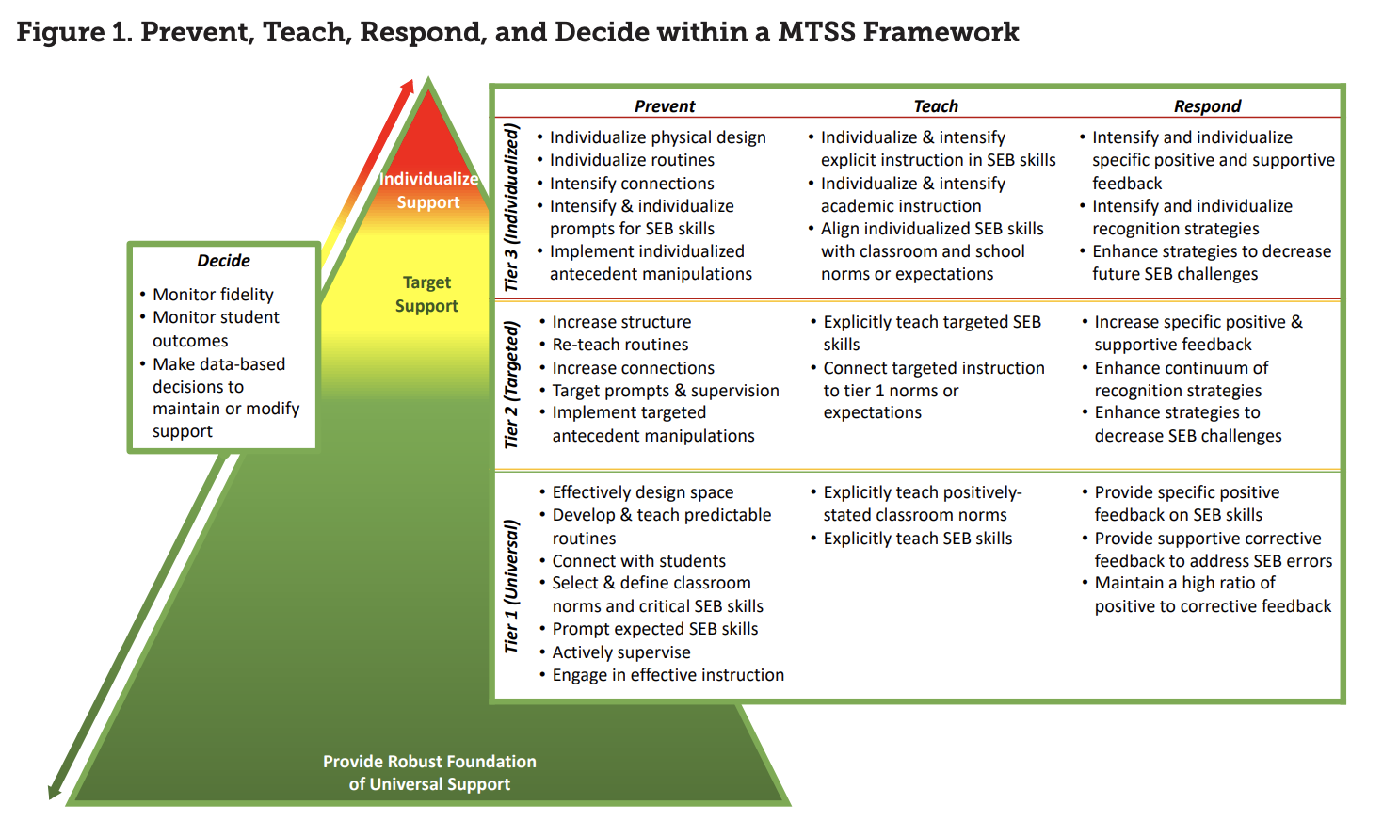
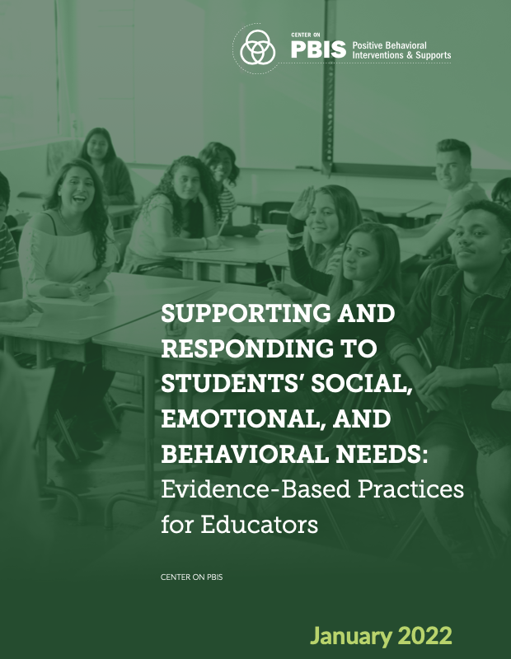
PBIS In The Classroom
Effective educator practices have their greatest impact when they are implemented within a schoolwide system of support for staff and students to promote equitable academic and social emotional behavior outcomes for each and every student. (Center on PBIS, 2021)
MTSS IN THE CLASSROOM
SEB Needs: Evidence-based Practices

Slide 9
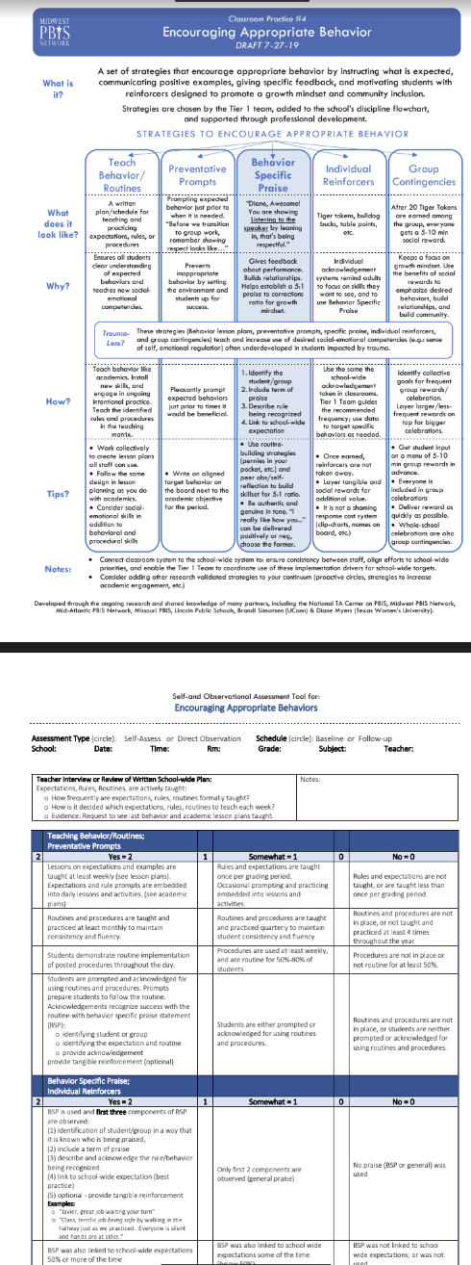
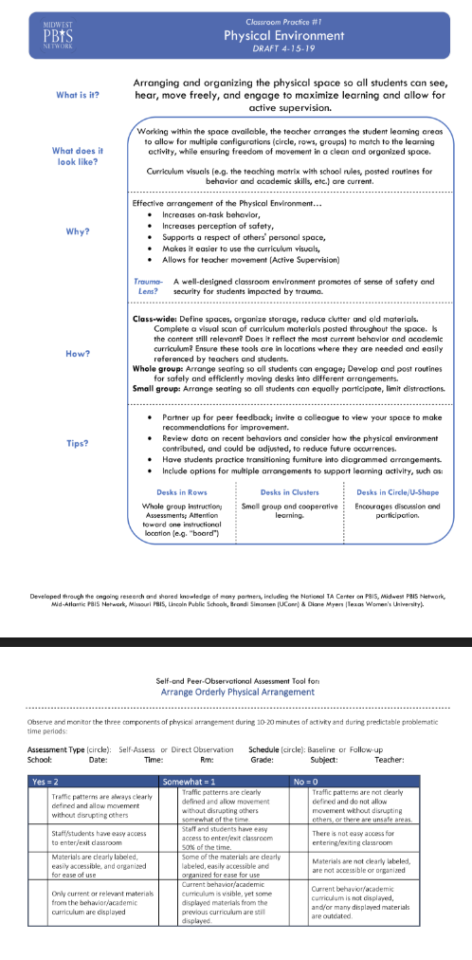
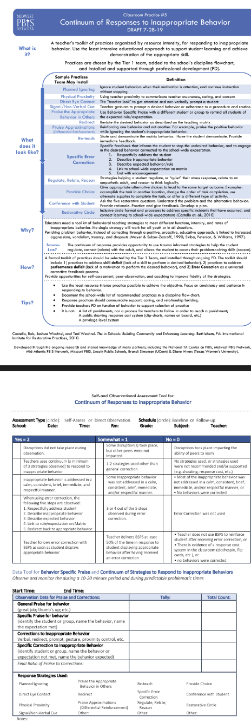
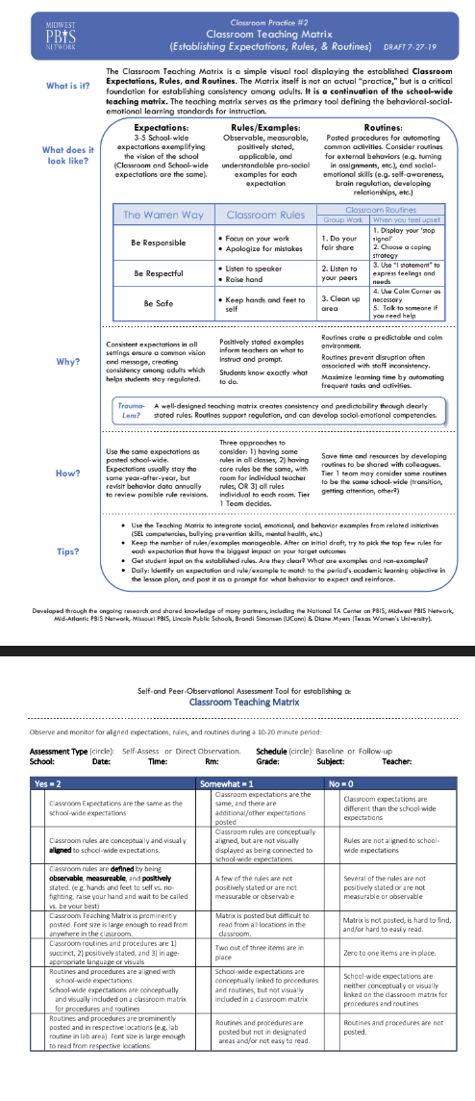
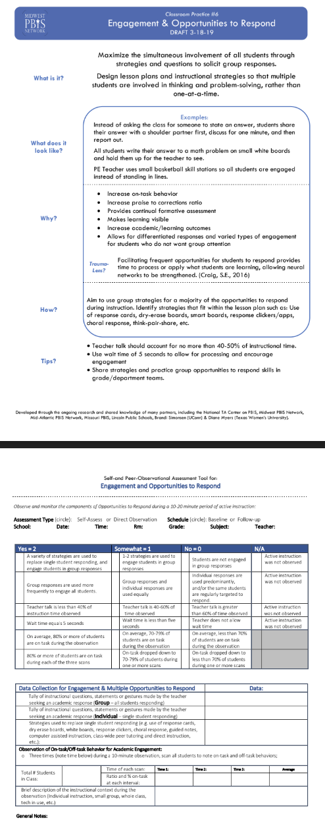
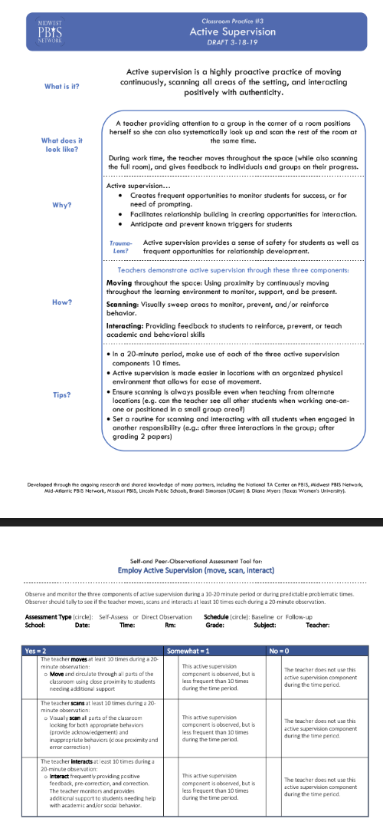
6 Core Classroom Practices
Core Classroom Practices

Slide 10
4 Critical Components of Social Emotional Behavioral Support In The Classroom
Prevent
Teach
Respond
Decide
Prevent
SEB challenges by setting students up for success
Teach
critical SEB skills
Respond
in ways that encourage SEB skills and decrease repeated SEB challenges
Decide
whether to maintain or adjust (e.g., intensify, adapt, or fade) support based on data.
Notes:
‹#›
The point of this slide remind teams that the 4 critical components of all social emotional behavioral (SEB) support and that these critical component apply to whatever tier of support schools is working to implement. Throughout the slides each of these components will be represented by the triangle next to the core classroom practices being introduced. Trainers should tie the critical component to the core practice as each is introduced. For example: “Preparing the Physical Environment in these ways will help PREVENT SEB challenges by setting students up for success.”

Slide 11
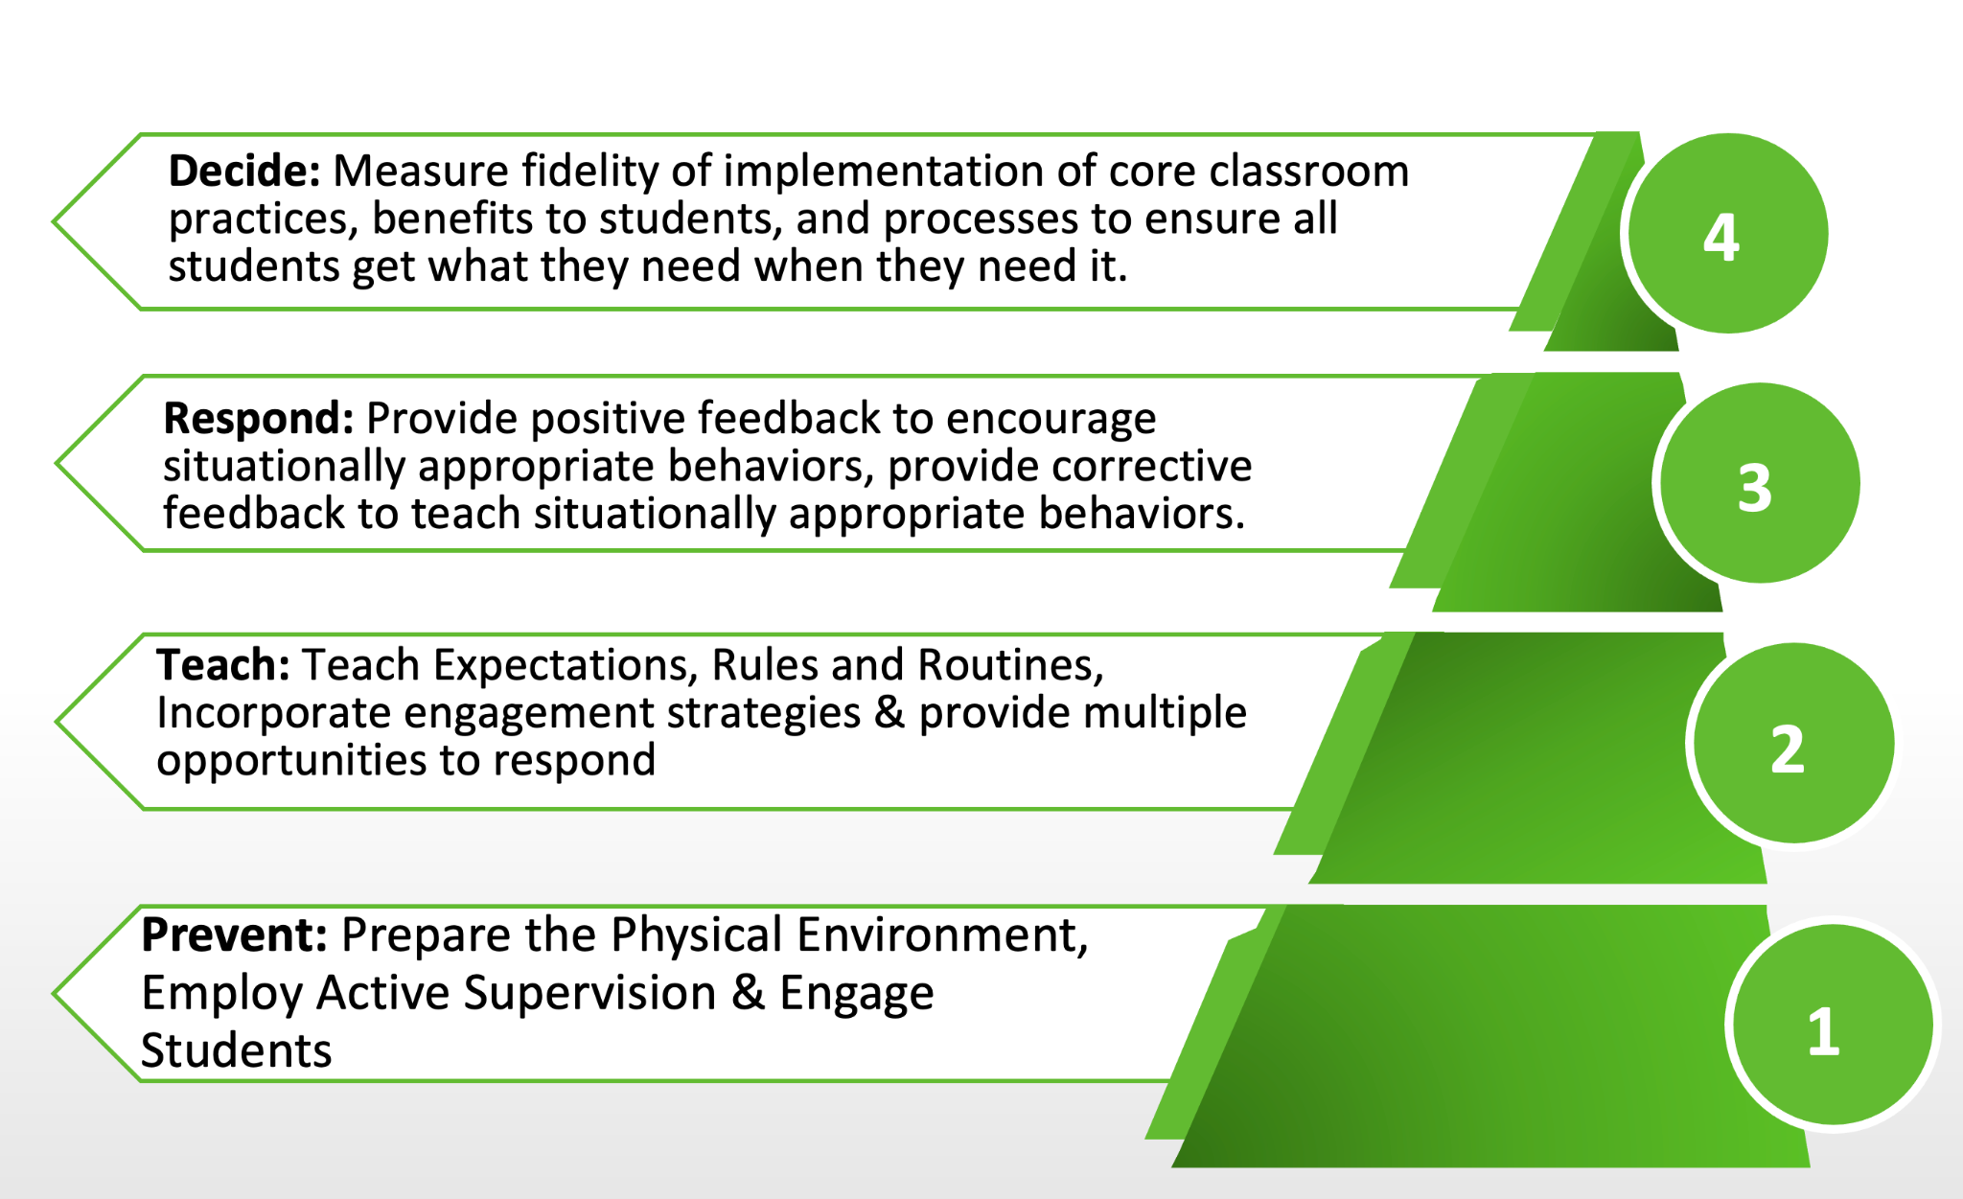
Tier 1 SW Behavioral Expectations Purpose
Notes:
Bring focus in to what we will cover in this presentation. Tier 1 Core practices of PBIS in the classroom.

Slide 12
Big Ideas of Classroom Systems
Positive classroom systems provide a felt sense of safety by maximizing predictability.
Positive classroom systems are designed to promote connection and a sense of belonging.
Positive classroom systems teach students how to demonstrate school wide expectations within the routines of the classroom.
Positive classroom systems build a bridge between home/community and school.
Positive classroom systems provide recognition and celebrate success.
Positive classroom systems support behavioral growth that focuses on teaching replacement behaviors, skill building and providing practice opportunities.
Notes:
‹#›
The main point of this slide is to provide a broad explanation of why the core classroom practices are so important to student success. When implemented with fidelity this is what they do!

Slide 13
Classroom Practices
6 Classroom Practices
Physical environment
Classroom Teaching Matrix (Expectations, Rules, Routines)
Active Supervision
Encouraging Appropriate Behavior
Direct instruction of expectations, rules, routines
Preventative Prompts
Specific Praise for Behavior
Individual Reinforcers
Class-Wide Group Contingency
Continuum of Response Strategies for Inappropriate Behaviors
Praise other students/groups
Specific Error Correction
Etc.
6. Engagement & Opportunities to
respond
Rev 3-16-19. Midwest PBIS Network. Developed through the ongoing research and shared knowledge of many partners, including the National TA Center on PBIS, Midwest PBIS Network, Mid-Atlantic PBIS Network, Missouri PBIS, Lincoln Public Schools, Brandi Simonsen (UConn) & Diane Myers (Texas Women’s University).
Notes:
‹#›
The main point of this slide is to provide teams with information that these core practices when implemented with fidelity have shown positive benefits for students. The goal is consistent adult use of the practice. (Tier I features are implemented within classrooms and are consistent with school-wide systems.)

Slide 14
PD Considerations for Implementing All Classroom Practices
How will staff be introduced to each practice?
When do you have secured time for training staff?
How much time will you give staff to implement each practice?
What kind of coaching support is available for staff who need Tier 2 and/or Tier 3 support?
Notes:
‹#›
The main point of this slide is for teams to have guiding questions for developing an implementation plan for this practice. Remind teams to consider these as they review each of the 6 core practices.

Slide 15
Encourage Appropriate Behavior
Respond
Provide behavior specific praise that labels specific SEB skill to acknowledge individuals and groups for engaging in SEB skills that are consistent with classroom norms.
Building positive sense of self for student
Reinforce new skills
Allows for sense of control
Promotes brain development
Establish and maintain expectations and positive climate
Strengthen sense of community in classroom
Recommended Ratios:
4:1 for neurotypical students
6:1 or higher for students impacted by trauma
9:1 or higher for students
with atypical neurodevelopment requiring additional support
Notes:
‹#›
The main point of this slide is for teams understand why encouraging appropriate behavior is prioritized and developing consistency in providing students with high rates of positive feedback will strengthen behaviors that help students learn. Remember that students need behavior specific praise at a rate of 4 to 1 and students who have experienced trauma need an even higher rate of 6 to 1.

Slide 16
Evidence-Based Practice
Behavior Specific Praise
Steps for Behavior Specific Praise:
1. Identify the student/group by name
2. Include term of praise
3. Describe skill being recognized
4. Link to classroom-wide expectation on your matrix
Example:
Hey Julie,
nice job
getting started on your work,
that shows responsibility

Slide 17
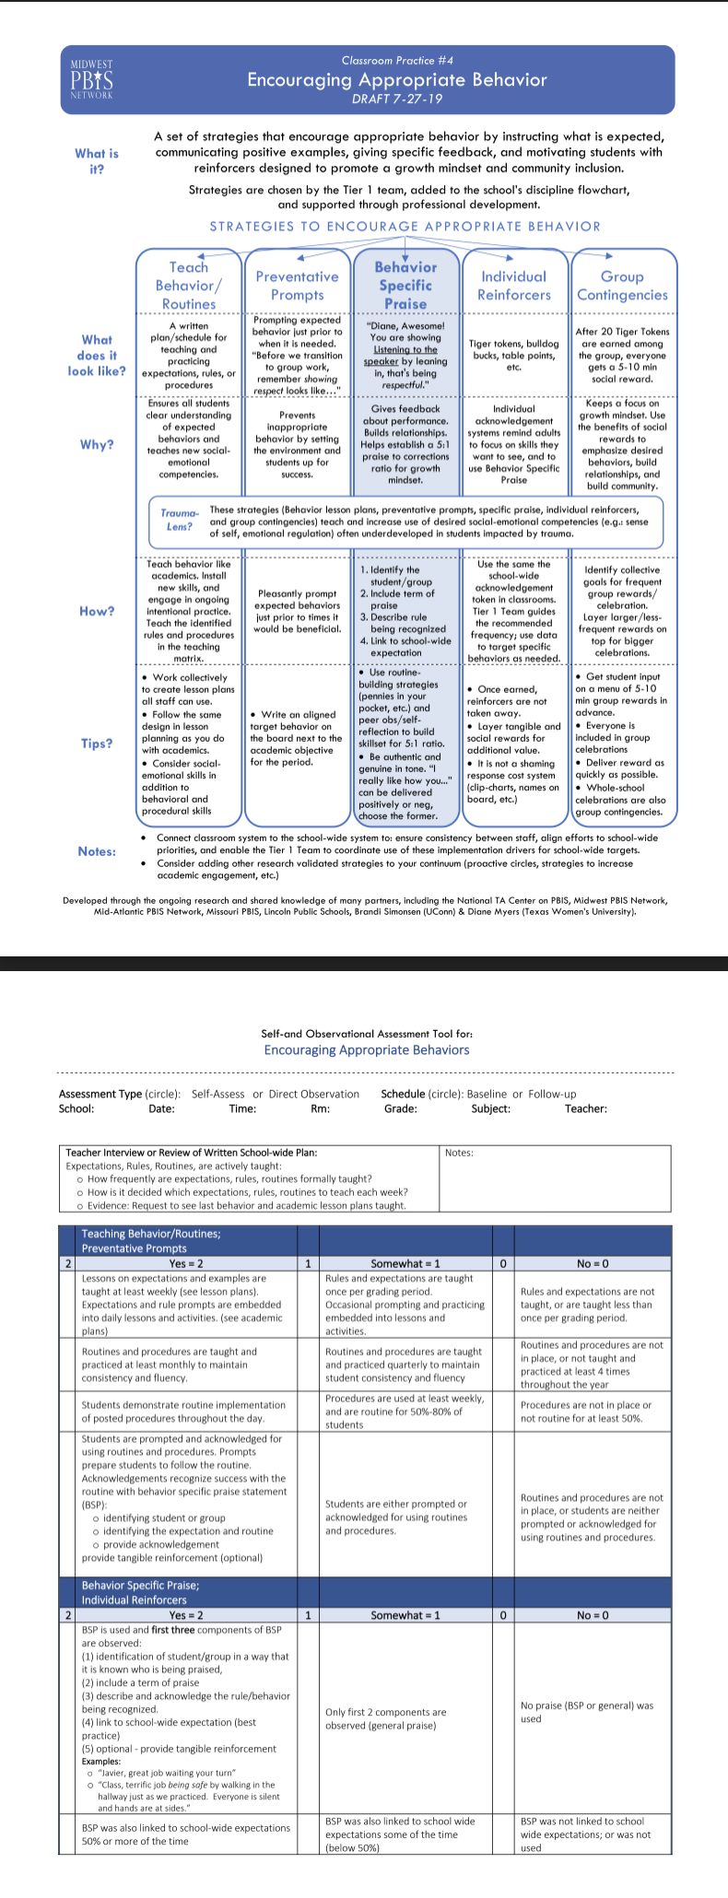
Team Implementation Planning
When you have work time:
Read The Snapshot and take the self-reflection.
Identify and include cultural connections for your students.
Consider what your students currently have access to and determine your next steps on the core PBIS classroom practice.
Encouraging Appropriate Behavior
Notes:
‹#›
The main point of this slide is for teams to be able to learn, consider current status of this practice at their school, determine gaps that exist around this practice and discuss how they will address those gaps through implementation of this practice and to consider PD for staff not at training.

Slide 18
Continuum of Response
Strategies for Behavioral Errors
Respond
Adults use a toolkit of respectful strategies that diminish the frequency, intensity, and/or duration of inappropriate behaviors.
Adults correct SEB errors in a supportive manner, similar to academic corrections.
Adults ensure corrections are brief, provide an opportunity for practice with praise, and redirect the student to the situationally appropriate skill.
Consistent Corrective Feedback from Adults provides SEB coaching that empowers students to replace learned responses with more appropriate behaviors and helps students regulate their emotions in stressful situations (demands outstrip my ability to adapt)
Notes:
‹#›
The main point of this slide is for teams understand why developing a continuum of response strategies for inappropriate behavior is prioritized and developing consistency in providing students with adult responses that recognize the function of the behavior, serve to be helpful to the situation, and work to help students develop more appropriate behavioral responses to environmental stressors is essential to school safety and skill development.

Slide 19
Coaching SEB Skills
T- Teach it
I- Imprint it by modeling
P- Practice it with them
P- Praise it when you see it with behavior specific praise

Slide 20
Specific Error Correction
SUPPORTIVE
Just like we would correct
an academic error
The message to the student is…
Oops! You made a mistake or you are off track with what is helpful to learning and/or expected. You can fix it and your school community can help.

Slide 21
Steps to Specific Error Correction
Steps for Specific Error Correction
1. Respectfully address the student
2. Describe inappropriate behavior
3. Describe expected behavior/rule
4. Link to expectation on the classroom matrix
5. End with encouragement
Example:
Hey Julie,
You haven’t started your work yet.
Starting your work will show responsibility.
Is there anything I can do to help you get started? (offer support)
Excellent Julie! Nice job being responsible.
GUIDELINES:
Calm • Consistent • Brief • Immediate • Respectful

Slide 22
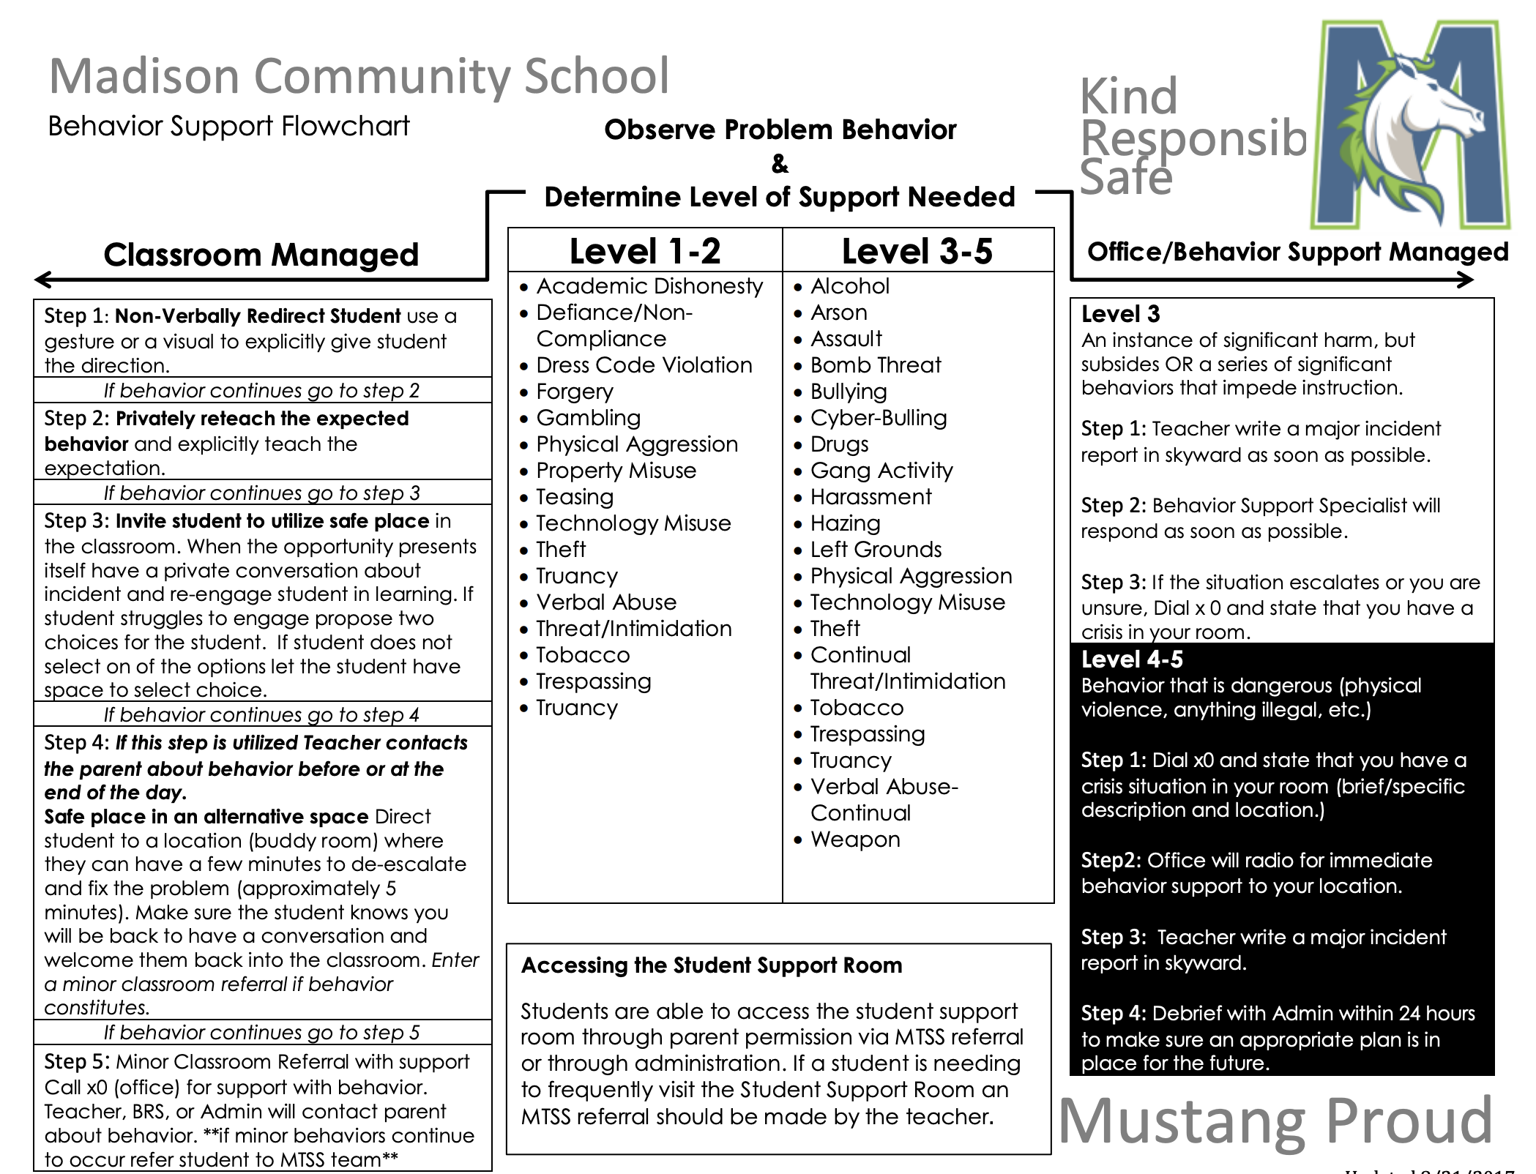
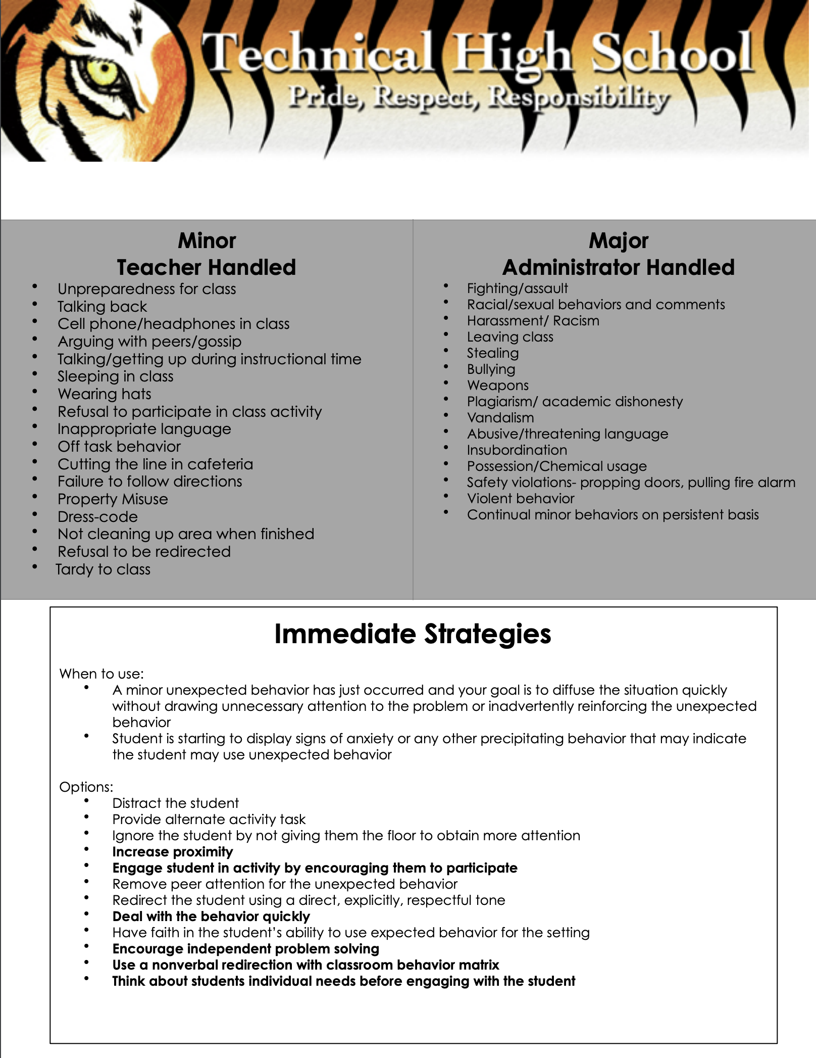
Follow Your School’s Flowchart
Notes:
‹#›
The main point of this slide is to remind teams that consistent response action from adults happens when all staff follow the strategies outlined on the flowchart which they worked on at winter training. Remind them that fidelity of implementation of the strategies on the flowchart are important so teams need to ask; does everyone know how to do the strategies on the flowchart? How do they know? If not, what is the plan to train staff on the strategies?

Slide 23
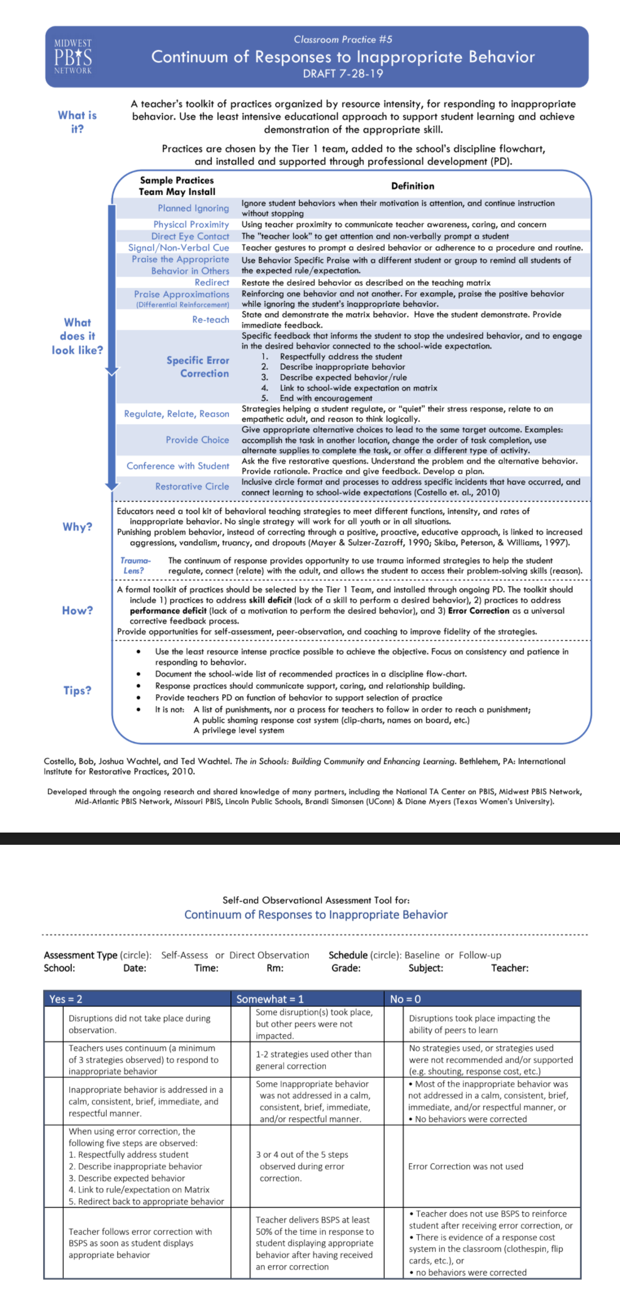
Team Implementation Planning
When you have work time:
Read The Snapshot and take the self-reflection.
Identify and include cultural connections for your students.
Consider what your students currently have access to and determine your next steps on the core PBIS classroom practice.
Continuum of Response Strategies
Notes:
‹#›
The main point of this slide is for teams to be able to learn, consider current status of this practice at their school, determine gaps that exist around this practice and discuss how they will address those gaps through implementation of this practice and to consider PD for staff not at training.

Slide 24
Engagement and
Opportunities to Respond
Prevent
Respond
Teach
Engaging instruction increases student on-task behavior to help prevent disruptive behavior.
Multiple opportunities to respond provides continual feedback on student learning and the effectiveness of teaching strategies.
Providing Multiple Opportunities To Respond (OTR) includes strategies to increase all students being engaged in the content simultaneously through various group engagement strategies.
Examples of group engagement strategies: think, pair, share; response boards; choral response, computer programs (e.g. Kahoot); small group work; etc.
Differentiated response supports all students to engage in ways comfortable
Facilitating frequent opportunities for students to respond provides time to process or apply what students are learning, allowing neural networks to be strengthened. (Craig, S.E., 2016)
Notes:
‹#›
The main point of this slide is for teams understand why engagement is prioritized and developing consistency in providing students with strategies that increase student engagement will decrease inappropriate behavior in the classroom. This practice falls into Prevent, Teach and Respond because when teachers take the time to teach students how to do more than raise their hand to respond they will increase engagement and prevent problem behaviors and in doing so they will be responding to student need to respond in multiple ways to show what they know.

Slide 25
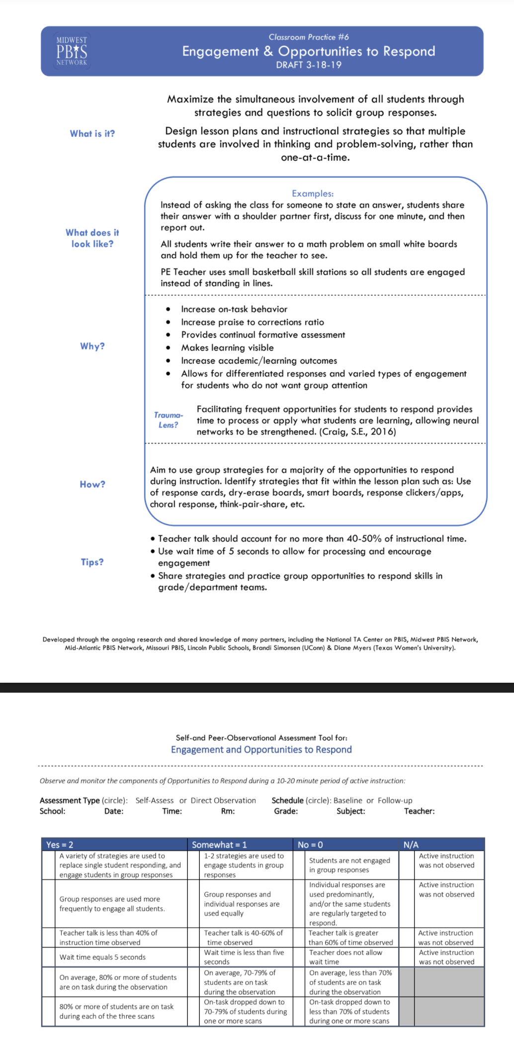
Team Implementation Planning
When you have work time:
Read The Snapshot and take the self-reflection.
Identify and include cultural connections for your students.
Consider what your students currently have access to and determine your next steps on the core PBIS classroom practice.
Engagement & Opportunities to Respond
Notes:
‹#›
The main point of this slide is for teams to be able to learn, consider current status of this practice at their school, determine gaps that exist around this practice and discuss how they will address those gaps through implementation of this practice and to consider PD for staff not at training.

Slide 26
Data-based Decisions-
Maintain or Modify Support
Decide
Monitor Fidelity
Monitor Student Outcomes
Collect fidelity data to self-assess the use of the core classroom practices.
Collect simple outcome data on students’ SEB skills to (a) guide implementation and differentiation of Tier 1 support for all students and (b) determine who is benefitting and who may need additional support (e.g., on/off-task, target skill demonstration).
Monitor outcomes for all student subgroups (i.e., race/ethnicity, gender, language status, disability status) to ensure equitable access and benefit.
Notes:
‹#›
The main point of this slide is for teams to think about how their school is measuring implementation of the core practices of the classroom (fidelity), the benefit students are experiencing from that implementation (impact), and the processes for all students to get what they need when they need it (equity).

Slide 27
Team Implementation Planning
When you have work time:
Reflect On:
How will your school monitor fidelity of implementation of classroom practices?
How will your school monitor the implementation benefits to ALL students and ALL staff?
What processes are in place for students to access the support they need when they need it?
Monitoring Fidelity of Classroom Practices
PBIS Technical Guide on Classroom Data
Notes:
‹#›
The main point of this slide is for teams to develop consistent effective data practices that allow them to answer the questions presented on the slide and be able to make data-based decisions and to consider PD for staff at training.

Slide 28
Resources for Implementing PBIS in The Classroom
PBIS Cultural Responsiveness Field Guide
MTSS in the Classroom-Tier 1
Creating Effective Classroom Environment Template
Monitoring Fidelity of Classroom Practices
PBIS Technical Guide on Classroom Data
Taking A Deeper Dive…
MTSS in the Classroom
Supporting and Responding to Student Behavior
Notes:
‹#›
The main point of this slide is for teams to have resources they can access on their own to take a deeper dive into PBIS in the classroom.

Slide 29
Team Implementation Planning
Use TFI 1.8 Activities 4 through 6 to guide your work.
Implementation Planning Workbook: TFI 1.8 Teaching Expectations Activities 4-6
Professional Development
How and when will you bring this information back to staff?
Update your action plan as needed for
1.9
Notes:
‹#›
Allow teams time to continuing working on implementation activities for PBIS in the classroom.

