Slide 1
Tier 1
Training Day 5
Classroom Procedures & Practices
(TFI 1.8)
Updated April 2022
Notes:
This presentation will prepare teams for success in implementing classroom procedures and practices.
Updated 7/2018

Slide 2
Learning Expectations
EXPECTATION | BEHAVIOR
Be Responsible | Make yourself comfortable Take care of your needs (water, food, restroom, etc.) Action plan to implement what you are learning Follow through on your action items
Be Respectful | Turn cell phones off or to “vibrate” Listen attentively while others are speaking Have only the training materials up on your computer/tablet/phone
Be Engaged | Ask what you need to know to understand and contribute Contribute to the group by sharing relevant information and ideas
Notes:
‹#›
Have teams review training expectations

Slide 3
Tier 1: Implementation Fidelity
TFI Sub-Scale: Team
TFI 1.1 | Team Composition
TFI 1.2 | Team Operating Procedures
TFI Sub-Scale: Evaluation
TFI 1.12 | Discipline Data
TFI 1.13 | Data-based Decision Making
TFI 1.14 | Fidelity Data
TFI 1.15 | Annual Evaluation
TFI Sub-Scale: Implementation
TFI 1.3 | Behavioral Expectations
TFI 1.4 | Teaching Expectations
TFI 1.5 | Problem Behavior Definitions
TFI 1.6 | Discipline Policies
TFI 1.7 | Professional Development
TFI 1.8 | Classroom Procedures & Practices
TFI 1.9 | Feedback and Acknowledgement
TFI 1.10 | Faculty Involvement
TFI 1.11 | Student/Family/Community Involvement
Notes:
‹#›
Review the TFI Roadmap to orient teams on the content we are covering in this presentation.

Slide 4
TFI 1.8 Purpose & Outcome
Purpose:
Teams will develop a professional development plan for training staff on Tier 1 Core Classroom Practices.
Outcome:
All Classrooms are formally implementing all Tier 1 Core Features(SW Expectations, routines, acknowledgments, in-class continuum of response to behavior errors, consistent with school-wide expectations.)
Notes:
Read through the purpose and outcome emphasizing that teams will develop a written plan for professional development focused on the core classroom practices.

Slide 5
Culturally Responsive Elaboration
SWPBIS Big Idea
SWPBIS classroom systems that are aligned with school-wide systems improve student outcomes.
Establishing Behavioral Expectations Focuses On…
Teams support classroom teachers in the implementation of SWPBIS in classrooms.
Classroom routines and expectations are taught explicitly and are connected to school-wide systems and students’ prior knowledge and home lives.
Classroom teachers ensure that all students in the class can see their lives, histories, cultures, and home languages incorporated into the classroom environment, curricula, and instructional practices on a daily basis.
Notes:
‹#›
Provide teams with the overall goal of implementing classroom procedures and practices.

Slide 6
How can we make Classroom Procedures & Practices more culturally responsive?
Teachers post images of successful persons from underrepresented groups filling professional roles (i.e., counter-stereotypical imaging) in the classroom.
Students see themselves and their experiences in classroom imaging (as contributed by families) and materials (e.g., culturally-specific libraries).
Teachers encourage students to share elements of their culture and family history in class.
Teachers use a variety of attention or transition signals (e.g., use of song lyrics, call and response, motor breaks, use of home languages) and a range of instructional methods appropriate to the content area and developmental level of the students (e.g., whole group discussions, cooperative group activities).
Teachers use the VABB approach (see Appendix I) to prevent and address issues of cultural differences.
Teachers engage in frequent, two-way, and positive communication with families regarding classroom procedures and student progress in multiple languages and modes of delivery (e.g., written, audio, visual).
Page 20
Notes:
‹#›
The main idea of this slide is to get teams thinking about how to make classroom procedures and practices more equitable for all stakeholders.

Slide 7
PBIS in the Classroom Tasks
Plan PD on the first 3 Core Classroom Practices
Lead teachers to develop Classroom Matrices
Identify coaching for staff who need support
Notes:
This slide let’s teams know the implementation actions they will take to develop a system for implementing classroom practices with fidelity so they can achieve the outcomes just outlined.

Slide 8
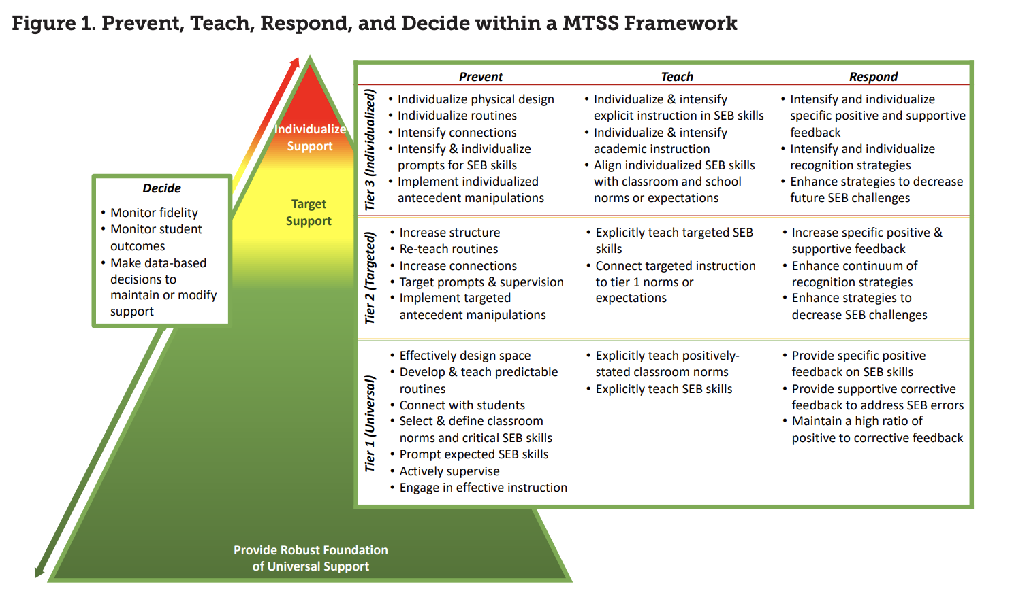
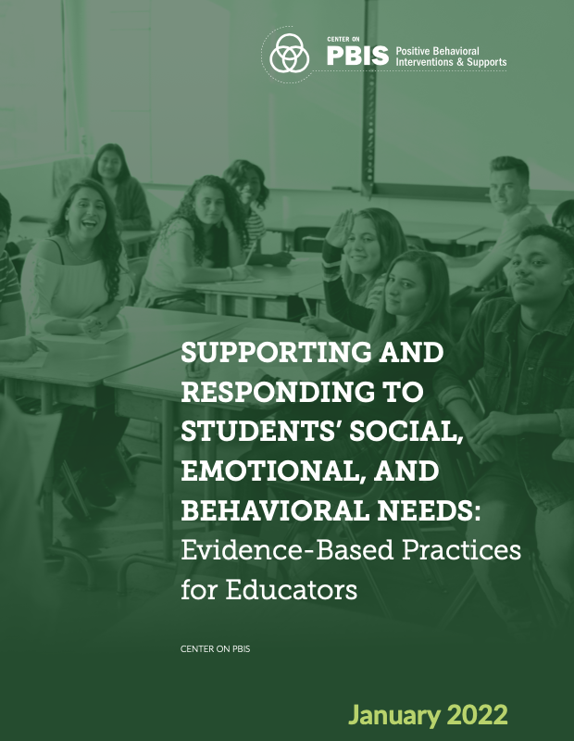
PBIS In The Classroom
Effective educator practices have their greatest impact when they are implemented within a schoolwide system of support for staff and students to promote equitable academic and social emotional behavior outcomes for each and every student. (Center on PBIS, 2021)
MTSS IN THE CLASSROOM
SEB Needs: Evidence-based Practices

Slide 9
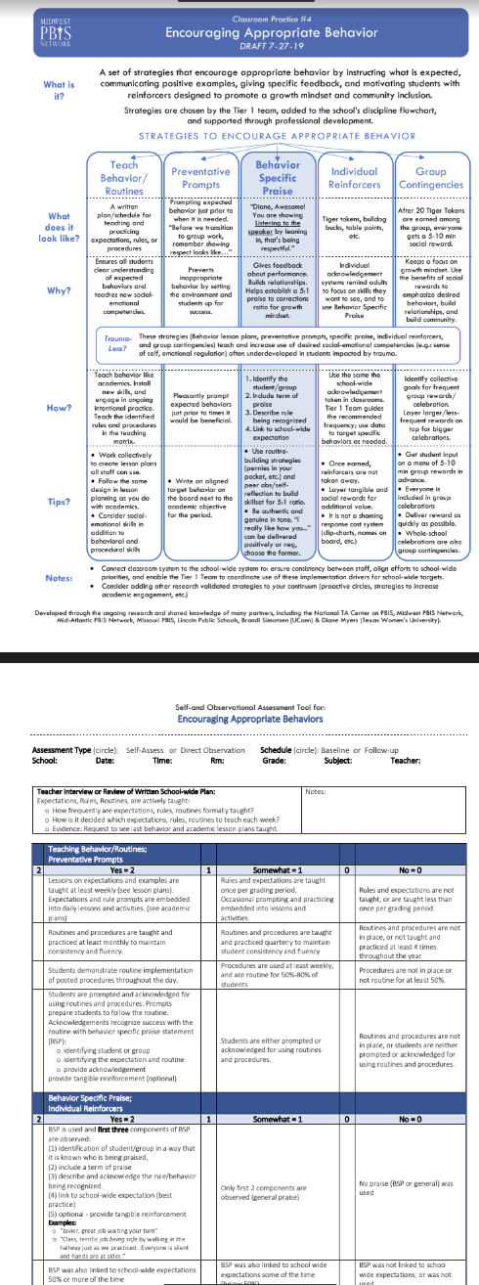
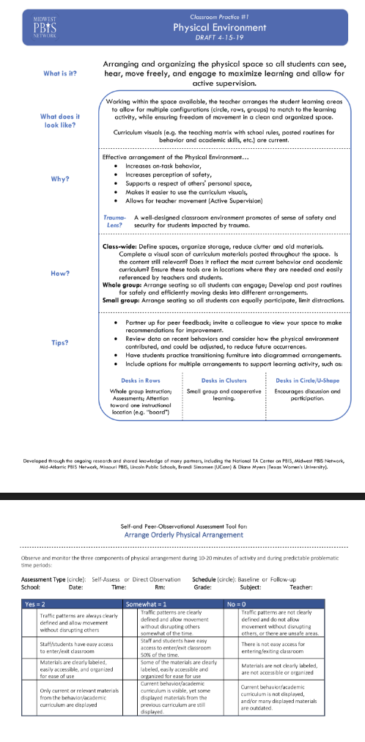
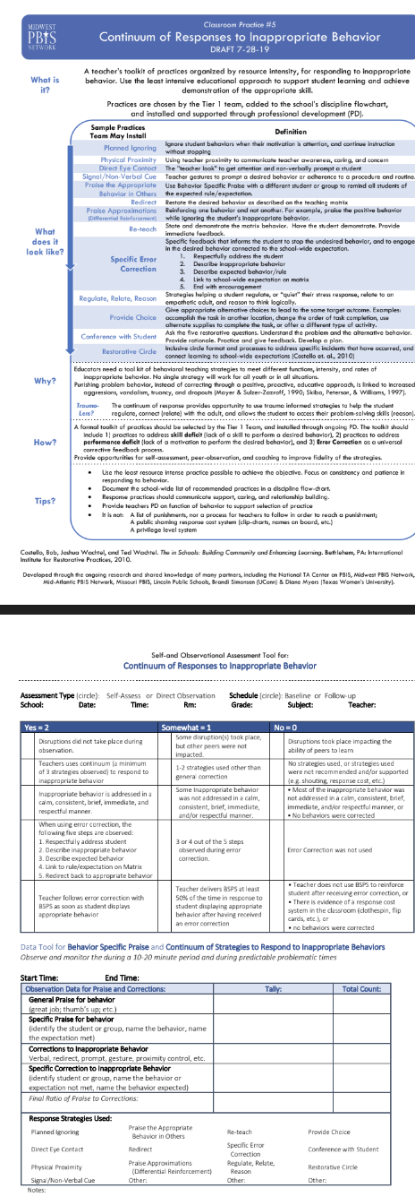
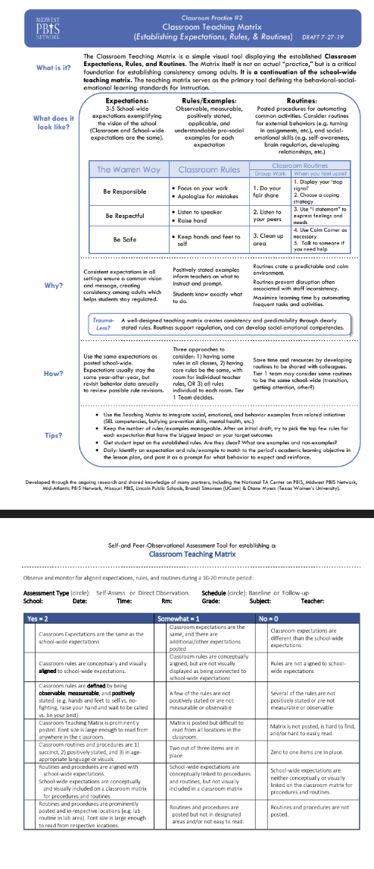
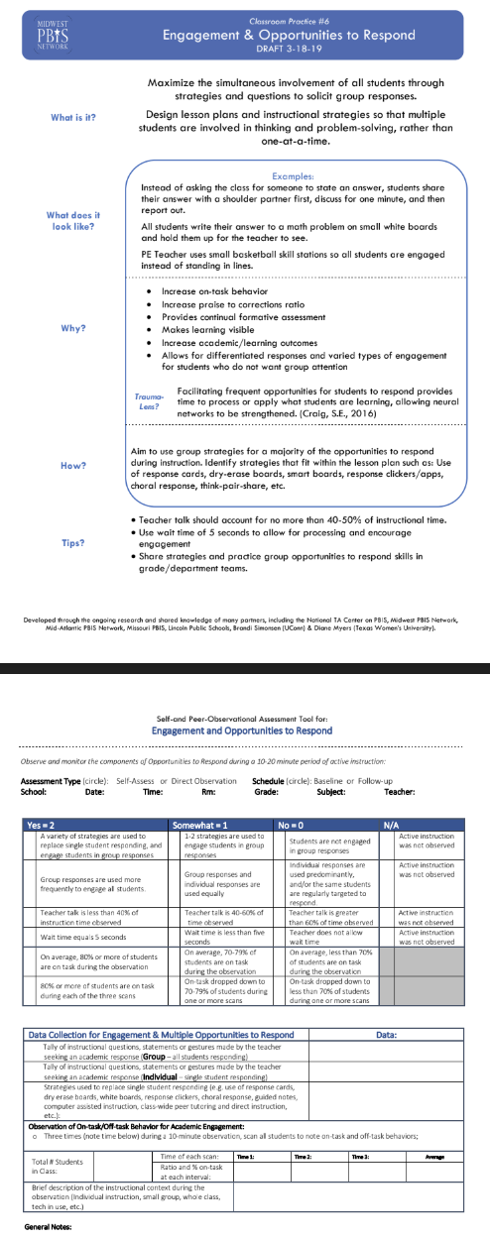
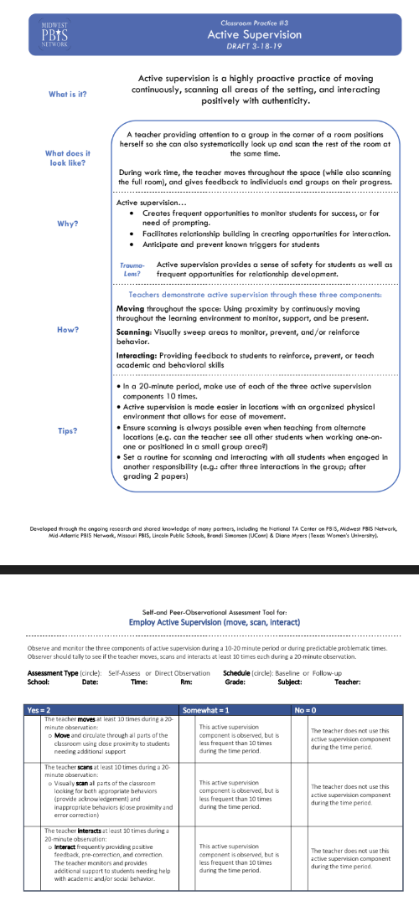
6 Core Classroom Practices
Core Classroom Practices

Slide 10
4 Critical Components of Social Emotional Behavioral Support In The Classroom
Prevent
Teach
Respond
Decide
Prevent
SEB challenges by setting students up for success
Teach
critical SEB skills
Respond
in ways that encourage SEB skills and decrease repeated SEB challenges
Decide
whether to maintain or adjust (e.g., intensify, adapt, or fade) support based on data.
Notes:
‹#›
The point of this slide remind teams that the 4 critical components of all social emotional behavioral (SEB) support and that these critical component apply to whatever tier of support schools is working to implement. Throughout the slides each of these components will be represented by the triangle next to the core classroom practices being introduced. Trainers should tie the critical component to the core practice as each is introduced. For example: “Preparing the Physical Environment in these ways will help PREVENT SEB challenges by setting students up for success.”

Slide 11
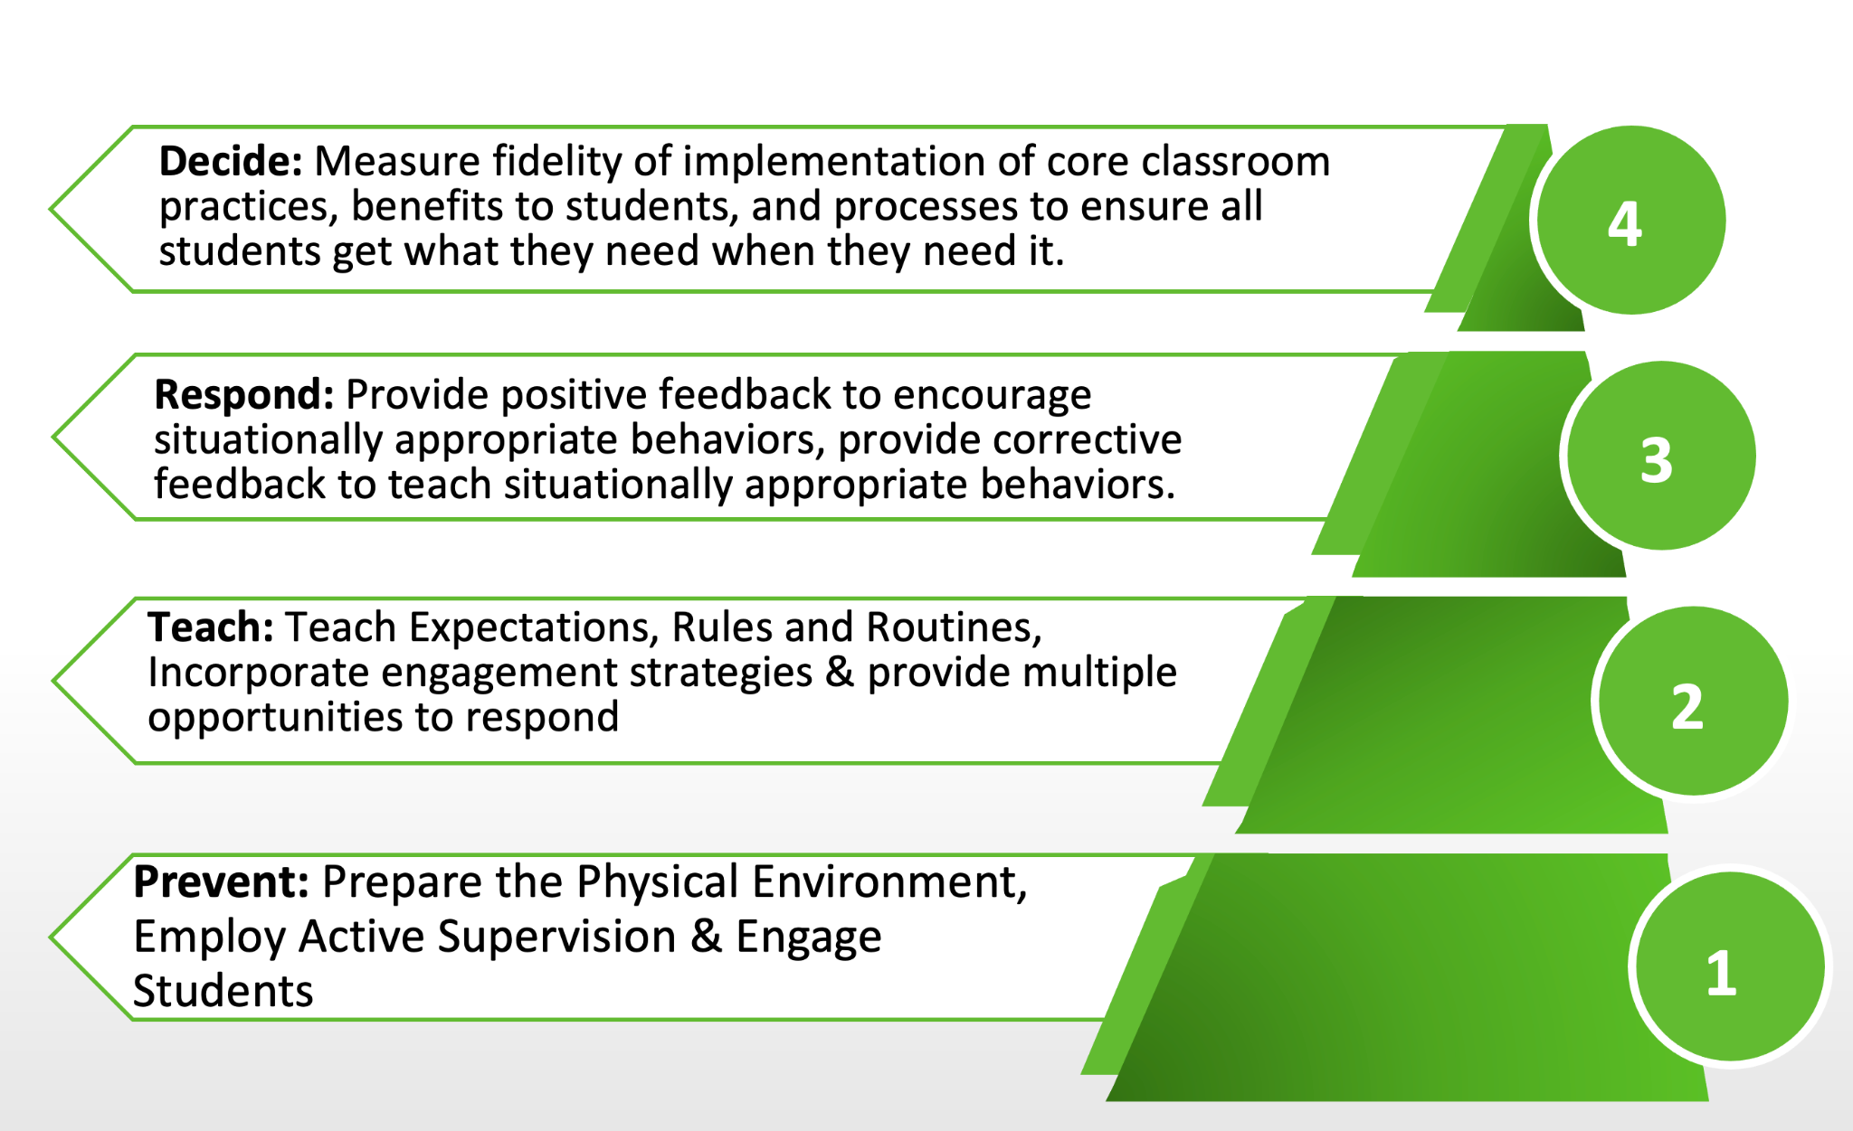
Tier 1 SW Behavioral Expectations Purpose
Notes:
Bring focus in to what we will cover in this presentation. Tier 1 Core practices of PBIS in the classroom.

Slide 12
Big Ideas of Classroom Systems
Positive classroom systems provide a felt sense of safety by maximizing predictability.
Positive classroom systems are designed to promote connection and a sense of belonging.
Positive classroom systems teach students how to demonstrate school wide expectations within the routines of the classroom.
Positive classroom systems build a bridge between home/community and school.
Positive classroom systems provide recognition and celebrate success.
Positive classroom systems support behavioral growth that focuses on teaching replacement behaviors, skill building and providing practice opportunities.
Notes:
‹#›
The main point of this slide is to provide a broad explanation of why the core classroom practices are so important to student success. When implemented with fidelity this is what they do!

Slide 13
Classroom Practices
6 Classroom Practices
Physical environment
Classroom Teaching Matrix (Expectations, Rules, Routines)
Active Supervision
Encouraging Appropriate Behavior
Direct instruction of expectations, rules, routines
Preventative Prompts
Specific Praise for Behavior
Individual Reinforcers
Class-Wide Group Contingency
Continuum of Response Strategies for Inappropriate Behaviors
Praise other students/groups
Specific Error Correction
Etc.
6. Engagement & Opportunities to
respond
Rev 3-16-19. Midwest PBIS Network. Developed through the ongoing research and shared knowledge of many partners, including the National TA Center on PBIS, Midwest PBIS Network, Mid-Atlantic PBIS Network, Missouri PBIS, Lincoln Public Schools, Brandi Simonsen (UConn) & Diane Myers (Texas Women’s University).
Notes:
‹#›
The main point of this slide is to provide teams with information that these core practices when implemented with fidelity have shown positive benefits for students. The goal is consistent adult use of the practice. (Tier I features are implemented within classrooms and are consistent with school-wide systems.)

Slide 14
PD Considerations for Implementing All Classroom Practices
How will staff be introduced to each practice?
When do you have secured time for training staff?
How much time will you give staff to implement each practice?
What kind of coaching support is available for staff who need Tier 2 and/or Tier 3 support?
Notes:
‹#›
The main point of this slide is for teams to have guiding questions for developing an implementation plan for this practice. Remind teams to consider these as they review each of the 6 core practices.

Slide 15
The Physical Environment
Prevent
The room allows for traffic flow
Materials labeled and easy to access
There’s a semi-private spot to process emotions and reset
The arrangement promotes different types of learning (solo, partner, whole class?)
The room offers choice? (i.e. standing, sitting, chair options)
A well designed classroom environment promotes a sense of safety and belonging and sets students up for success.
Notes:
‹#›
The main point of this slide is for teams to understand how to set students up for success through the physical design of classrooms, why it is prioritized and how developing consistency between classrooms will give students opportunity to navigate each classroom more successfully.

Slide 16
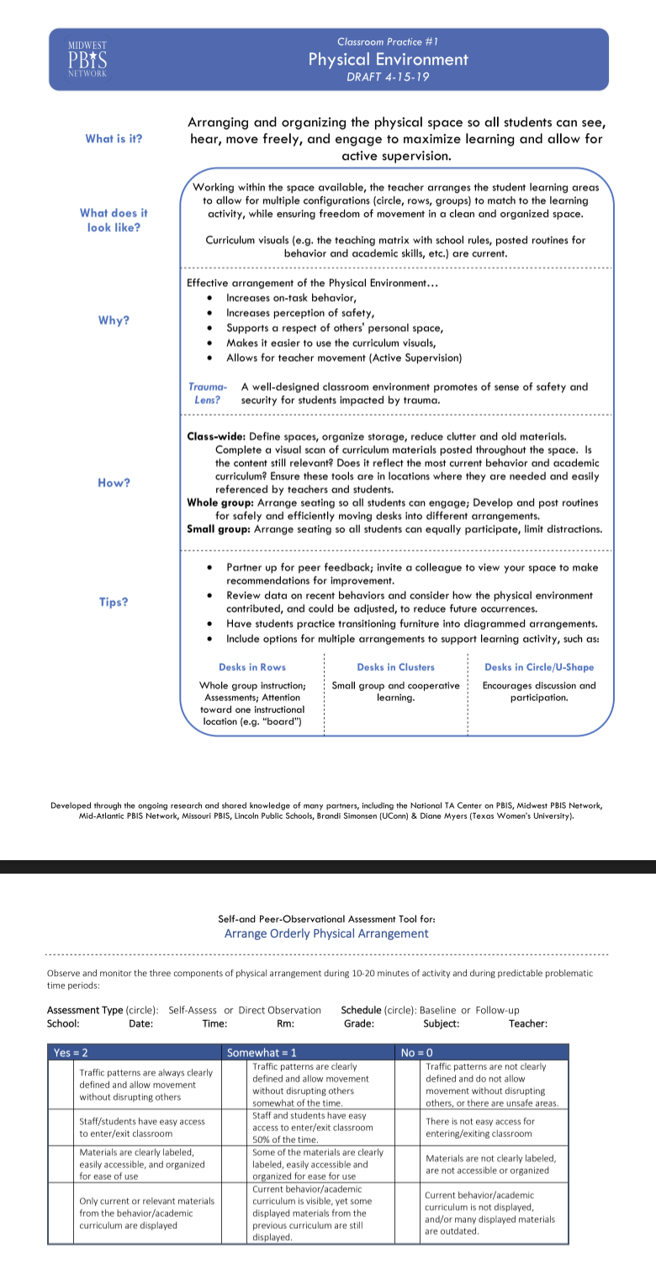
Team Implementation Planning
When you have work time:
Read The Snapshot and take the self-reflection.
Identify and include cultural connections for your students.
Consider what your students currently have access to and determine your next steps on the core PBIS classroom practice.
Physical Environment
Notes:
‹#›
The main point of this slide is for teams to be able to learn, consider current status of this practice at their school, determine gaps that exist around this practice and discuss how they will address those gaps through implementation of this practice and to consider PD for staff not at training.

Slide 17
Active Supervision
Prevent
Components of Active Supervision
Adult Presence provides a sense of safety for students
Adults are more likely to identify trigger and prevent problem behavior
Adults create frequent opportunities to connect with students to establish and maintain relationship
Remember 15 seconds is long enough to have a meaningful connection with a student
Moving: Continuous, random teacher movement throughout all parts of classroom
Scanning: Frequent and intentional visual sweep of all parts of classroom
Interacting: Frequent and positive communication to encourage, reinforce, and correct
Notes:
‹#›
The main point of this slide is for teams to understand why active supervision within the classroom setting is prioritized as a means promote safety and belonging through consistent connection and feedback within all classrooms.
Scanning
This involves frequently and intentionally look around at students and making eye contact with student. Teachers can visually sweep all areas of the room as well as look directly at students nearest you. Visual Scanning allows the teacher to watch for instances of appropriate and inappropriate behavior that he/she will want to respond to immediately or as soon as possible. It will also help a teacher to identify students who may need his/her assistance
Moving & Interacting
While moving and scanning you should also frequently interact with students. This communicates care, trust, and respect and creates positive climate and increases likelihood of accepting correction if needed. Interacting includes proximity, listening, eye contact, smiles, pleasant voice tone, and use of student’s name

Slide 18
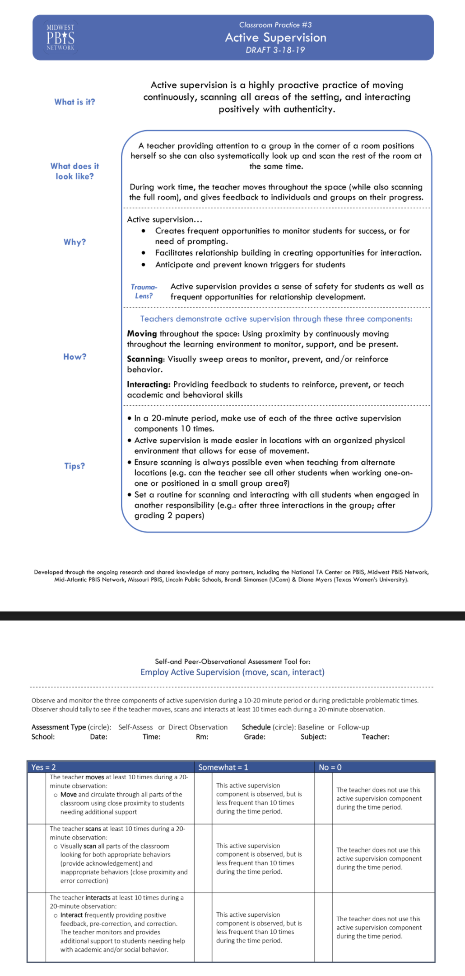
Team Implementation Planning
When you have work time:
Read The Snapshot and take the self-reflection.
Identify and include cultural connections for your students.
Consider what your students currently have access to and determine your next steps on the core PBIS classroom practice.
Active Supervision
Notes:
‹#›
The main point of this slide is for teams to be able to learn, consider current status of this practice at their school, determine gaps that exist around this practice and discuss how they will address those gaps through implementation of this practice and to consider PD for staff not at training.

Slide 19
Establishing & Teaching Expectations, Rules, Routines (The Classroom Teaching Matrix)
Teach
Intentionally bring the school-wide expectations into the common routines of the classroom through the Classroom Teaching Matrix.
Develop lesson plans and teach each routine
Model (I do)
Lead (We do)
Test (You do)
M.A.P out the classroom
Model
Add Visuals
Practice
A well-designed teaching matrix creates consistency and predictability through clearly stated rules.
Routines support regulation, and can develop social-emotional competencies.
When teachers are consistent in expectations from class to class, it results in a predictable environment for students, helping them to regulate and operate in a state of calm.
Notes:
‹#›
The main point of this slide is for teams to understand why establishing and teaching expectations, rules and routines is prioritized and developing consistency in teaching, modeling and practicing behaviors that demonstrate the school wide expectations within classroom routines will maximize predictability.

Slide 20
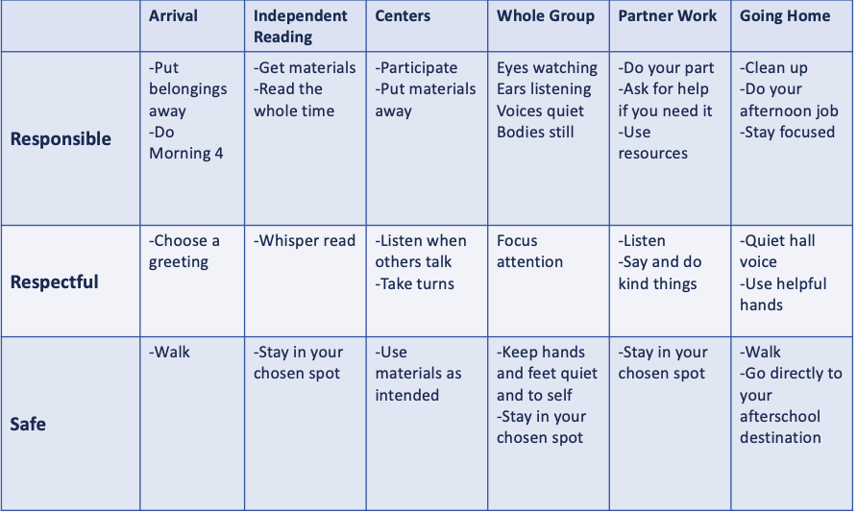
Using the Classroom Matrix
Identify and teach expected behavior for classroom routines.
Communicate your routine expectations to families (send it home)
Communicate your routine expectations with the central office
Create routine specific visuals and use to pre-correct
Notes:
‹#›
The main point of this slide is for teams to understand that the Classroom Teaching Matrix in a planning tool to prioritize behaviors that demonstrate SW Expectations within the routines of the classroom, and is also a communication tool for supporting staff, guest teachers and families.

Slide 21
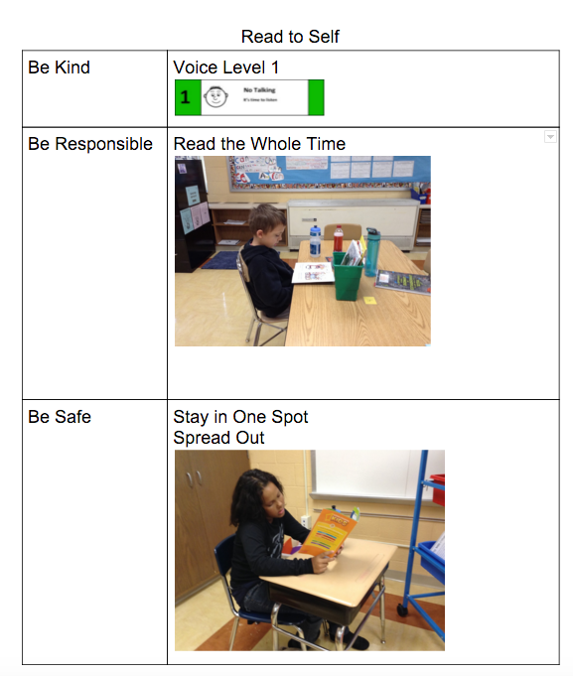
M.A.P. MODEL • ADD VISUALS • PRACTICE
PRE-CORRECTION
A short period of time taken prior to a certain routine or event to focus student attention on expected behavior.
Prompt Often!

Slide 22
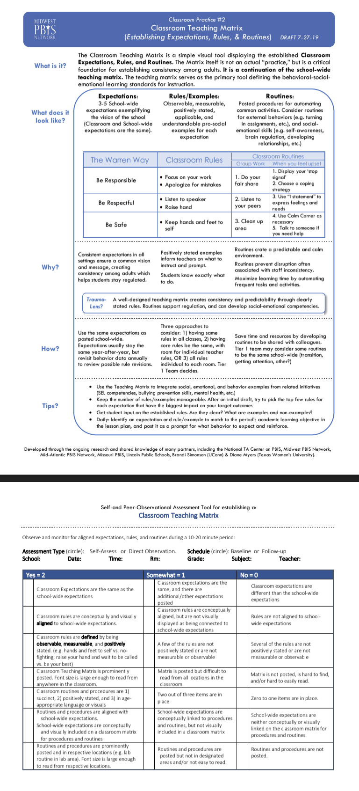
Team Implementation Planning
When you have work time:
Read The Snapshot and take the self-reflection.
Identify and include cultural connections for your students.
Consider what your students currently have access to and determine your next steps on the core PBIS classroom practice.
Classroom Teaching Matrix
Creating Effective Classroom Environment Template
Notes:
‹#›
The main point of this slide is for teams to be able to learn, consider current status of this practice at their school, determine gaps that exist around this practice and discuss how they will address those gaps through implementation of this practice and to consider PD for staff not at training.

Slide 23
Data-based Decisions-
Maintain or Modify Support
Decide
Monitor Fidelity
Monitor Student Outcomes
Collect fidelity data to self-assess the use of the core classroom practices.
Collect simple outcome data on students’ SEB skills to (a) guide implementation and differentiation of Tier 1 support for all students and (b) determine who is benefitting and who may need additional support (e.g., on/off-task, target skill demonstration).
Monitor outcomes for all student subgroups (i.e., race/ethnicity, gender, language status, disability status) to ensure equitable access and benefit.
Notes:
‹#›
The main point of this slide is for teams to think about how their school is measuring implementation of the core practices of the classroom (fidelity), the benefit students are experiencing from that implementation (impact), and the processes for all students to get what they need when they need it (equity).

Slide 24
Team Implementation Planning
When you have work time:
Reflect On:
How will your school monitor fidelity of implementation of classroom practices?
How will your school monitor the implementation benefits to ALL students and ALL staff?
What processes are in place for students to access the support they need when they need it?
Monitoring Fidelity of Classroom Practices
PBIS Technical Guide on Classroom Data
Notes:
‹#›
The main point of this slide is for teams to develop consistent effective data practices that allow them to answer the questions presented on the slide and be able to make data-based decisions and to consider PD for staff at training.

Slide 25
Resources for Implementing PBIS in The Classroom
PBIS Cultural Responsiveness Field Guide
MTSS in the Classroom-Tier 1
Creating Effective Classroom Environment Template
Monitoring Fidelity of Classroom Practices
PBIS Technical Guide on Classroom Data
Taking A Deeper Dive…
MTSS in the Classroom
Supporting and Responding to Student Behavior
Notes:
‹#›
The main point of this slide is for teams to have resources they can access on their own to take a deeper dive into PBIS in the classroom.

Slide 26
Team Implementation Planning
Use TFI 1.8 Activities 1 through 3 to guide your work.
Implementation Planning Workbook: TFI 1.8 Teaching Expectations Activities 1-3
Professional Development
How and when will you bring this information back to staff?
Update your action plan as needed for
1.9
Notes:
‹#›
Allow teams time to continuing working on implementation activities for PBIS in the classroom.

