Slide 1
Tier 1
Training Day 1
Teaching School Wide Expectations
(TFI 1.4)
Updated April 2022
Notes:
This presentation will prepare teams for success in teaching expectations in non-classroom context (settings).
Updated 7/2018

Slide 2
Learning Expectations
EXPECTATION | BEHAVIOR
Be Responsible | Make yourself comfortable Take care of your needs (water, food, restroom, etc.) Action plan to implement what you are learning Follow through on your action items
Be Respectful | Turn cell phones off or to “vibrate” Listen attentively while others are speaking Have only the training materials up on your computer/tablet/phone
Be Engaged | Ask what you need to know to understand and contribute Contribute to the group by sharing relevant information and ideas
Notes:
2
Have teams review training expectations

Slide 3
Tier 1: Implementation Fidelity
TFI Sub-Scale: Team
TFI 1.1 | Team Composition
TFI 1.2 | Team Operating Procedures
TFI Sub-Scale: Evaluation
TFI 1.12 | Discipline Data
TFI 1.13 | Data-based Decision Making
TFI 1.14 | Fidelity Data
TFI 1.15 | Annual Evaluation
TFI Sub-Scale: Implementation
TFI 1.3 | Behavioral Expectations
TFI 1.4 | Teaching Expectations
TFI 1.5 | Problem Behavior Definitions
TFI 1.6 | Discipline Policies
TFI 1.7 | Professional Development
TFI 1.8 | Classroom Procedures
TFI 1.9 | Feedback and Acknowledgement
TFI 1.10 | Faculty Involvement
TFI 1.11 | Student/Family/Community Involvement
Notes:
3
Review the TFI Roadmap to orient teams on the content we are covering in this presentation.

Slide 4
TFI 1.4 Purpose & Outcome
Purpose:
Teams will develop a formal system for teaching school wide behavioral expectations directly to students in classrooms and across other campus settings/locations.
Outcome:
A formal system with a written schedule is used to teach expected behaviors directly to students across classroom and campus settings/locations.
Notes:
Read through the purpose and outcome emphasizing that teams will develop a formal system for directly teaching students expected behavior across the school campus.

Slide 5
Culturally Responsive Elaboration
SWPBIS Big Idea
Active and explicit teaching of school-wide expectations clarifies concepts for students and adults, allows for practice and performance feedback, and reduces misunderstandings regarding what is appropriate at school.
Teaching Behavioral Expectations Focuses On…
All school staff understand that all students need explicit teaching about expected behavior at school.
Teams have a process and procedures for staff to teach students the behaviors necessary to be successful in the school setting regardless of previous learning and without disrespecting families’ beliefs.
When expectations differ between home or community and school, staff examine these differences critically, and if determined to be necessary, they explicitly teach the skills (including providing a clear rationale for having a different expectation at school and opportunities for practice and feedback until students demonstrate the skill fluently).
Notes:
5
Provide teams with the overall goal of Tier 1 Teaching Behavioral Expectations

Slide 6
How can we make Teaching SW Expectations more culturally responsive?
Expectations lesson plans incorporate students’ real-life experiences, cultural strengths, and values of students.
Teams examine expectations for reflection of dominant cultural values that may need explicit teaching and, if found, define the logical rationale for those expectations and a plan for explicitly teaching it to all students.
Teams provide opportunities for students to articulate their expectations at home and discuss similarities and differences (e.g., personal matrix, see Appendix G).
Staff include students actively in lesson plan design and delivery.
Teams seek regular feedback on lesson plans from school staff, students, families, and community members.
Teams include family and community members as teachers of behavior expectations.
School staff use the Validate, Affirm, Build, and Bridge approach (VABB, see Appendix I) or other specific strategies to build from students’ learning histories.
Teams and school staff provide materials for families so that they can define and teach behavior expectations in the home in ways that fit their needs.
page 16
Notes:
6
The main idea of this slide is to get teams thinking about how to make Teaching SW behavioral expectations more equitable for all stakeholders.

Slide 7
Teaching Expectations Tasks
Develop lesson plans for All Non-Classroom Locations
Create a yearly schedule for teaching SW Expectations
Communicate plan with staff to gain feedback
Notes:
This slide let’s teams know the implementation actions they will take to develop a teaching expected behavior system with fidelity so they can achieve the outcomes just outlined.

Slide 8
Point to Ponder
If a child doesn’t know how to read, we teach.
If a child doesn’t know how to swim, we teach.
If a child doesn’t know how to multiply, we teach.
If a child doesn’t know how to drive, we teach.
If a child doesn’t know how to behave, we… teach? punish?
Why can’t we finish the last sentence as automatically as we do the others?
John Herner (NASDE Preent) Counterpoint 1998, page 2
Notes:
8
The following quote by Tom Herner expresses our difficulties with dealing with challenging behavior.
Read quote.
Do we regard behavior as a skill deficit that needs to be taught or do we perceive it as something that needs to be punished? If we perceive it as something to be punished then it is very clear that we regard it differently than any of the other skills that we address at school. As a result, we tend to approach it in less-effective and less-professional ways. Behavior that is important for learning must be explicitly taught just like reading, swimming or driving.

Slide 9
Why Develop a System for Teaching Behavior?
Behaviors are prerequisites for academics.
Procedures and routines create structure.
Repetition is key to learning new skills.
For a child to learn something new, it needs to be repeated on average ? times (Joyce and Showers, 2006)
Adults average ? (Joyce and Showers, 2006)
For a child to unlearn an old behavior and replace with a new behavior, the new behavior must be repeated on average ? times (Harry Wong)
8
25
28
Notes:
9
We can’t assume:
that students know the expectations/rules and appropriate ways to behave
That students will learn appropriate behaviors quickly and effectively without consistent practice and modeling
We must assume:
Students will require different curricula, instructional modalities supports, etc., to learn appropriate behavior
We need to teach expectations/rules and appropriate behaviors as effectively as we teach academic skills
Important for people to hear this information. Great slide.

Slide 10
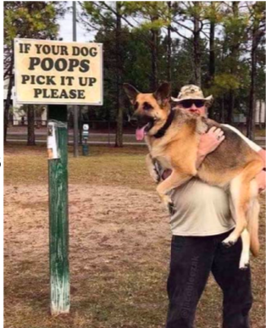
Posting Expectations is Not Enough
YOU MUST TEACH (and RETEACH) THEM!
Notes:
10
This is true campus wide. Remember one teaching is not enough. The part of the brain that governs behavior does not fully mature until an average of age 26. This means our students will need us to help them be successful and help their brain mature through teaching, reteaching, modeling, prompting, reinforcing, and providing corrective feedback frequently!
Can’t just put the expectations and rules on the wall and walk away..
If you emphasize “it” the students will see it’s importance
If you model “it” the students will learn how to do “it”.
Consistently provide students with feedback, emphasizing students who are doing “it”.

Slide 11
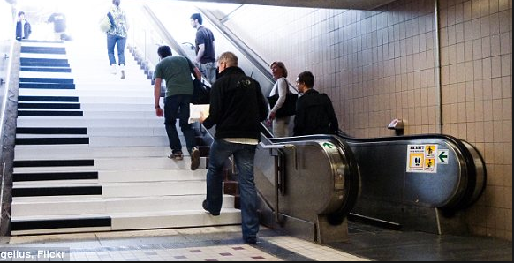
The Fun Theory
http://www.thefuntheory.com/piano-staircase
Notes:
11
Ask: what did you notice about changing behavior; did they measure outcomes? Did having fun make a difference? What was the reward?
1 minute 45 seconds https://www.youtube.com/watch?v=SByymar3bds
Alternate version Fun Theory video #2 https://www.youtube.com/watch?v=qRgWttqFKu8 1:26
Alternate version Fun Theory video #3 https://www.youtube.com/watch?v=bHLgSfxz6bQ 1:36

Slide 12
Instructional Approach
The change is an instructional process
We change STUDENT behavior
by changing
ADULT behavior
Interventions = changes in staff procedures & practices
Notes:
12
PBIS schools teach behavior using the same process as we do for academic instruction. It is a clear departure from punishment.

Slide 13
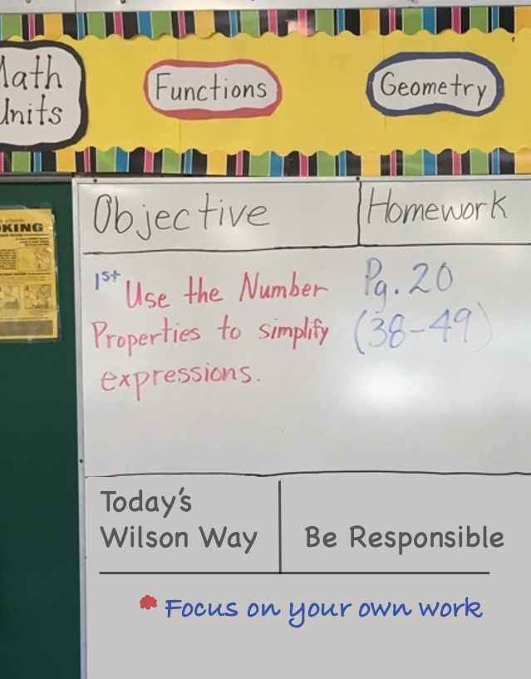
So How Can We Teach Behaviors School Wide?
Embed into Daily Curriculum
Objective for the Subject Matter Lesson
Objective for a paired Behavioral/Social/emotional skill (taken from the school’s teaching matrix)
Notes:
13
Systematize Teachers’ identifying and writing behavioral/social/emotional objectives to match with each lesson plan objective throughout their day. Write the behavior objectives on the board the same as you would do for academic lessons. This helps the teacher prompt for the behavior, and give specific praise and feedback for that behavior during the academic lesson.

Slide 14
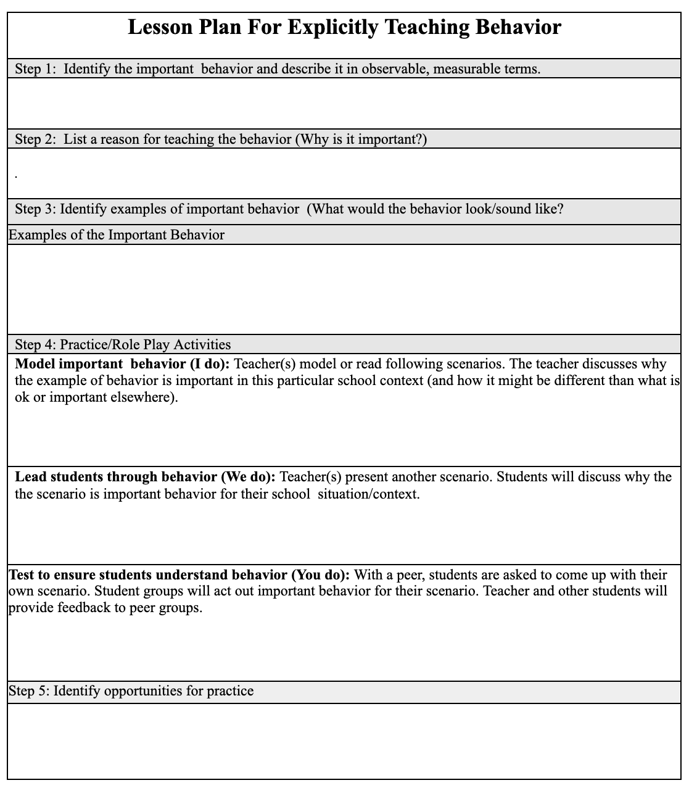
So How Can We Teach Behaviors School Wide?
Creating Behavior Lesson Plans
Create lesson plans for each context you have identified on your school wide matrix
Explicitly teach the behaviors you identified as important for that context
If you are seeing problematic behavior, ask, “Have I taught the important behaviors for this context?”
Lesson Plan Template
Notes:
14
The PBIS team creates draft lessons for each non-classroom area on their matrix.

Slide 15
Video Lesson Considerations
Matching the climate of your building
Pairing them with follow up activities (Discussion, etc.)
Do not role-play non-examples. Video’s should demonstrate the positive examples only.
Involve students in the process
Ensure students involved are representative of your student body
Notes:
15
Some schools especially high schools use video lessons to teach the SW expectations. This slide provides some things to remember if a school is choosing this format.

Slide 16
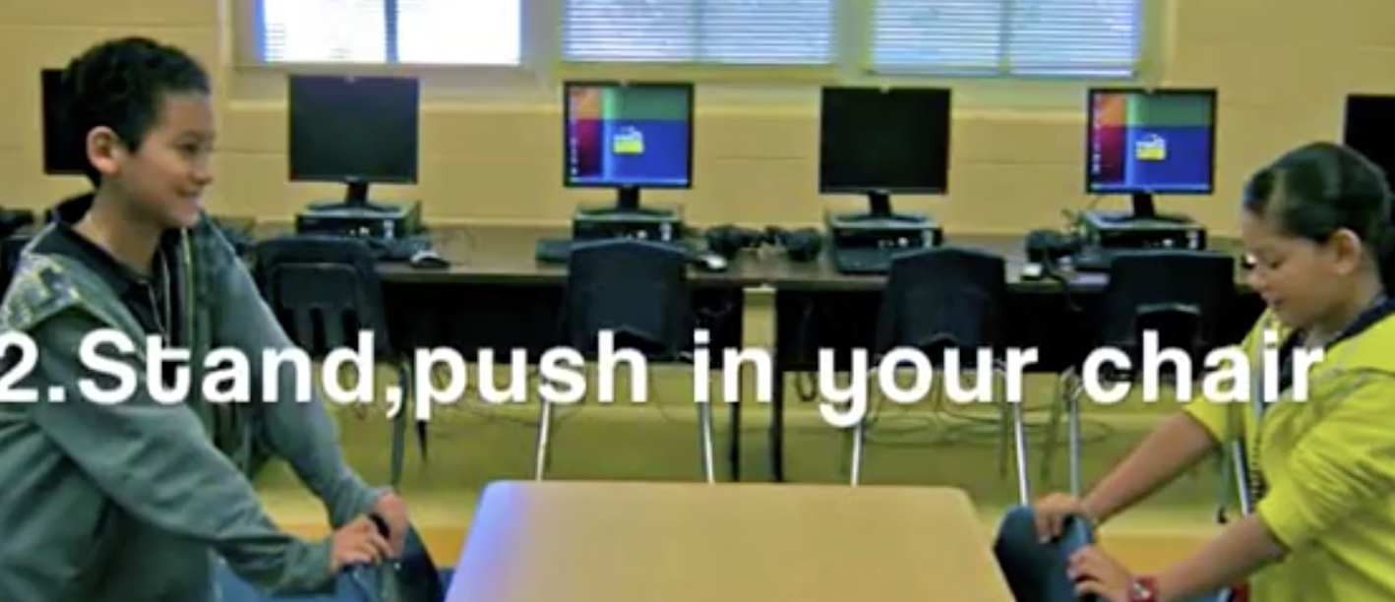
Example-Using Videos to Teach Behavior
Transition Procedures
https://www.youtube.com/watch?v=uUKh3_kaTww
Notes:
16
CHOOSE 1 video to play from slide 12 and 13
Feel free to use a local example video - remember it should have closed captioning.
This can also be found athttps://www.youtube.com/watch?v=uUKh3_kaTww 1 minute 32 seconds. This has closed captioning.
Trainer Notes:
Play “Dancing the Expectations” for elementary teams. Preface by saying, there is both an art and science to teaching. We have discussed the “science” of teaching through lesson plans, etc. Here is an example of the “Art” of teaching.
After the video, ask participants: What did you notice? How were students involved in this lesson? How could this video be used in their school?

Slide 17
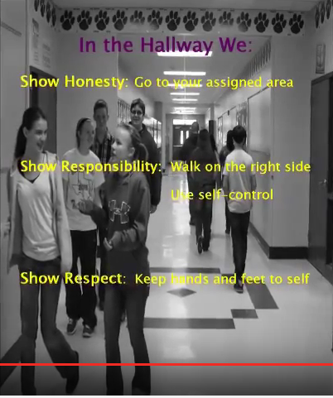
Example-Using Videos to Teach Behavior
Hallway Expectations
https://www.youtube.com/watch?v=M87dPtEJC_w
Notes:
17
CHOOSE 1 video to play from slide 12 and 13
Feel free to use a local example video - remember it should have closed captioning.
MS example- https://www.youtube.com/watch?v=M87dPtEJC_w 3:35 (this video does contain non-examples) This does not have closed captioning. There is no talking only music.

Slide 18
You have some ideas for how to teach
Now decide when to teach
Beginning of school year
Teach expectations for all areas of school, including individual classrooms, during first week of school
After first week, review expectations 2 or 3 times/week
Pre-correct expectations prior to transitions
Remainder of the year
Reteach expectations immediately after a school break
Reteach when behavior data indicates a need
Yearly Schedule For Teaching Expectations
Notes:
18
Determine your schedule for teaching SW expectations throughout the school year.

Slide 19
Planning To Teach SW Expectations
Action Planning to Teach SW Expectations
As a Team Consider
Will your plan create important consistent staff actions?
Is your plan user-friendly?
Who will answer questions staff might have?
How will you measure impact?
Who will create the lesson plan or this setting and gather the materials needed? | Who will teach it? | When will we teach it? | How will we communicate this plan to staff and get their feedback?
Notes:
19
This slide is meant to get teams thinking about action planning to help staff be successful with teaching SW Expectations.

Slide 20
Sample Teaching Lessons
Hastings Middle School
Ann Bremer Education Center
Notes:
20
The links provide two examples of what two mn schools have done to help staff be successful with teaching SW Expectations
Hastings provides a gen. ed. middle school setting example
Ann Bremer Education Center (ABEC) provide a high school through transition federal level 4 setting example

Slide 21
Team Implementation Planning
Use TFI 1.4 Teaching Expectations Activities 1 and 2 to guide your work.
Implementation Planning Workbook: TFI 1.4 Teaching Expectations Activities 1 & 2
Notes:
21
Allow teams at least 30 min. for teams to begin developing their teaching expectations system with facilitation from coaches and trainers.
Have them prepare to share their progress back to the whole group.

