Slide 1
Tier 1
Training Day 1
Team Composition & Team Operating Procedures
(TFI 1.1 & 1.2)
Updated April 2022
Notes:
This presentation will prepare teams for teaming success.
Updated 7/2018

Slide 2
Learning Expectations
EXPECTATION | BEHAVIOR
Be Responsible | Make yourself comfortable Take care of your needs (water, food, restroom, etc.) Action plan to implement what you are learning Follow through on your action items
Be Respectful | Turn cell phones off or to “vibrate” Listen attentively while others are speaking Have only the training materials up on your computer/tablet/phone
Be Engaged | Ask what you need to know to understand and contribute Contribute to the group by sharing relevant information and ideas
Notes:
Review Training Expectations

Slide 3
Tier 1: Implementation Fidelity
TFI Sub-Scale: Team
TFI 1.1 | Team Composition
TFI 1.2 | Team Operating Procedures
TFI Sub-Scale: Evaluation
TFI 1.12 | Discipline Data
TFI 1.13 | Data-based Decision Making
TFI 1.14 | Fidelity Data
TFI 1.15 | Annual Evaluation
TFI Sub-Scale: Implementation
TFI 1.3 | Behavioral Expectations
TFI 1.4 | Teaching Expectations
TFI 1.5 | Problem Behavior Definitions
TFI 1.6 | Discipline Policies
TFI 1.7 | Professional Development
TFI 1.8 | Classroom Procedures
TFI 1.9 | Feedback and Acknowledgement
TFI 1.10 | Faculty Involvement
TFI 1.11 | Student/Family/Community Involvement
Notes:
Orient teams into what Implementation items we will be covering and teams will be working on

Slide 4
TFI 1.2 Purpose & Outcome
Purpose:
Tier I team includes a Tier I systems coordinator, a school administrator, a family member, and individuals able to provide (a) applied behavioral expertise, (b) coaching expertise, (c) knowledge of student academic and behavior patterns, (d) knowledge about the operations of the school across grade levels and programs, and for high schools, (e) student representation.
Outcome:
Tier I team exists with coordinator, administrator, and all identified roles represented, AND attendance of all roles is at or above 80%.
Notes:
Read through the purpose and outcome emphasizing that teams will develop a formal system for implementing feedback & acknowledgement.

Slide 5
Culturally Responsive Elaboration
SWPBIS Big Idea
Effective SWPBIS teams are knowledgeable, representative of stakeholders (e.g., students, families, community, staff), and have administrative authority.
Team Composition Focuses On…
School SWPBIS leadership teams include stakeholders as team members but also actively elicit ownership, voice, and broad representation of their families and communities, especially underserved families and cultures.
Family voice is critical.
Consider the use of subcommittee structures and have families represented on the subcommittees.
Notes:
Provide teams with the overall goal of Tier 1 Teaming

Slide 6
How can we make our team composition more equitable?
Examples
School teams include family/student subcommittees or access to grade-level family subcommittees.
Family/student participation and role is clearly outlined, defined, and understood by the family/student representatives and the team.
Families have ownership of system components (e.g., celebrations, acknowledgments).
Families assist in reporting team meeting discussions and data to stakeholders.
Family feedback is sought regarding school processes such as hiring and policies.
PBIS Cultural Responsiveness Field Guide-page 14
Notes:
The main idea of this slide is to get teams thinking about how to make their team composition more equitable for all stakeholders.

Slide 7
TFI 1.2 Purpose & Outcome
Purpose:
Tier I team meets at least monthly and has (a) regular meeting format/agenda, (b) minutes, (c) defined meeting roles, and (d) a current action plan.
Outcome:
Tier I team meets at least monthly and uses regular meeting format/agenda, minutes, defined roles, AND has a current action plan.
Notes:
Read through the purpose and outcome emphasizing that teams will develop a formal system for implementing feedback & acknowledgement.

Slide 8
Culturally Responsive Elaboration
SWPBIS Big Idea
Teams with defined roles, consistent procedures, and an ongoing action plan make effective and efficient decisions.
Team Operating Procedures Focus On…
Include structures and practices that prompt the use of data for decision making and communication to ensure transparency of the system and to enable all stakeholders to have a voice and agency in the process and outcomes.
Examine the system and policies for potential changes, rather than placing the responsibility for change on families and students.
Procedures hold the team responsible for ensuring equitable SWPBIS implementation and assessing student data for equitable impact.
Notes:
Goal of this slide is to review the goal of effective team operating procedures

Slide 9
How can we make our team operating procedures more equitable?
Examples
Teams focus on changing the system rather than the students and engage in explicit conversations around ethnicity/race and effects of practices on all student enrollment groups.
Teams ensure that meeting minutes, goals, data, and decisions are shared with stakeholders and are readily accessible.
Teams have ongoing, timely procedures for families, students, and community members to communicate questions, concerns, or needs.
Teams regularly review procedures for utilization and effectiveness with stakeholders
PBIS Cultural Responsiveness Field Guide-page 15
Notes:
The main idea of this slide is to get teams thinking about how to make their team operating procedures more equitable for all stakeholders.

Slide 10
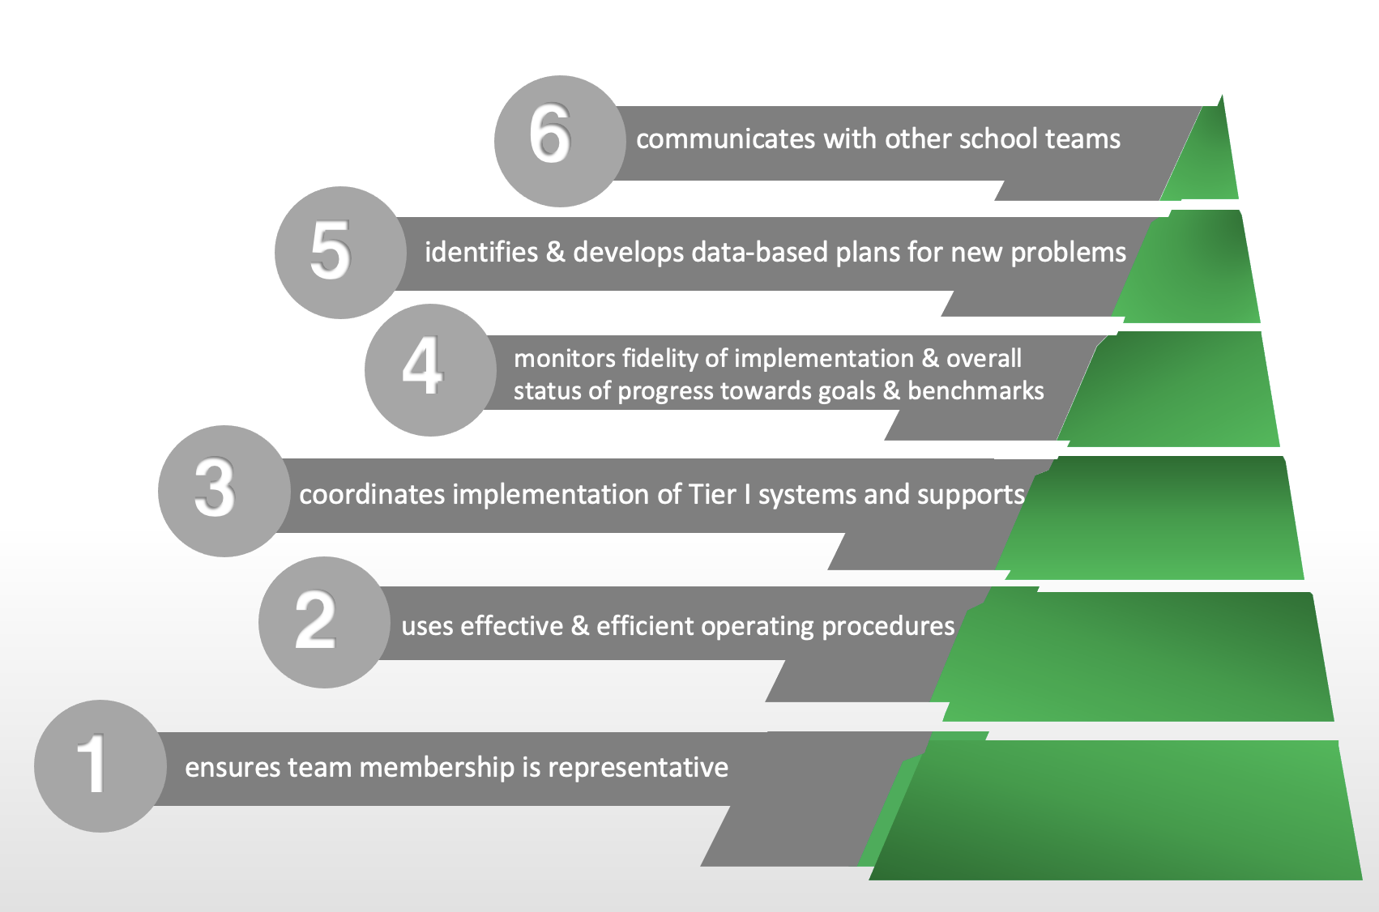
Tier 1 PBIS School Team Purpose
Notes:
10
Bring focus in to what we will cover which is Tier 1 Teaming

Slide 11
Teaming Implementation Tasks
Inventory current implementation teams
Review team membership and define team roles
Select regular meeting (agenda & notes), and action planning format
Define working agreements/norms
Begin work on artifact keeping
Notes:
This slide let’s teams know the implementation actions they will take to implement team composition and operating procedures with fidelity so they can achieve the outcomes just outlined.

Slide 12
The Challenge
Whenever a new initiative is introduced to a school, district/region, or state, the general approach is to “form a team/committee” to develop a plan for implementation.
Notes:
This slide introduces the first task teams will take. It is about helping them think about initiative overload vs. initiative integration

Slide 13
Task 1-Inventory current implementation teams
Take an inventory of your school’s current implementation teams. Look for integration opportunities and make enhancements that would improve the:
Effectiveness
Efficiency
Relevance
Workbook TFI 1.1 & 1.2
Teaming Activity 1
Notes:
This slide will guide teams into the first task. This task is to help teams see if they have teams that can be combined, eliminated, etc.

Slide 14
Team Composition-Broad Representation
Team members:
Administrator(s)
Broad representation from
ALL grade levels/Departments
Special education
Paraprofessionals
Art, music, P.E.
Family and Student representation
Other Suggestions?
Notes:
14
Notes:
SWPBIS Big Idea
What does broad representation mean? KEY STAKEHOLDERS-Does your faculty reflect your students? Are both genders represented on the team? How do you ensure student voice? How do you include family and community representation?

Slide 15
Team Roles/Responsibilities
ROLE (note some roles can be combined and/or different) | Responsibilities
Internal Coach | Starts meeting, reviews purpose, facilitates meeting keeping team focused on each step. Participates in external PD around PBIS and is the school’s main cheerleader for PBIS.
Note Taker | Taking notes and ensuring they are accessible after the meeting
Timekeeper | Monitors the amount of time available and keeps team aware of time limits by giving “warning” such as “5 minutes left on this topic”
Administrator | Actively encourages team efforts, provides planning time, feedback and publicly supports the plan
External PBIS Coach | District-level and/or regional individual that facilitates the team through the process, facilitates external PD around PBIS helps teams implement with fidelity
Data Analyst | Can access data system, pulls reports as needed and brings data to meeting
Team Member | Active participant in meetings, shares the workload and communicates plan to representative staff as needed
Assign backup for each role
One person serve multiple roles if needed
Notes:
The goal of this slide is to review roles and responsibilities to help teams move into the next activity. The big idea is that by having assigned roles and tasks teams ensure that things get done and no one person is overloaded with work.

Slide 16
The Role of a PBIS Administrator
Administrators Ensure:
Members are able to attend meetings (including themselves!)
Implementation process is supported
Communication is encouraged
Vision is established
Policy & procedure changes that produce more equitable outcomes are promoted
Team has access to data for decision making
Team has funding source for implementation
Notes:
16
Although this slide has been presented in Readiness section, it is important for all audiences to realize the importance of administrator support and leadership.

Slide 17
The Role of The Internal Coach
The Coach Ensures:
Team is meeting regularly
Facilitates team meetings
Prepares team agenda
Team is using data for decision making
Evaluation data are collected/entered on PBISApps.org
Helps Team monitor critical elements of PBIS are being implemented with fidelity
Notes:
17
Although this slide has been presented in Readiness section, it is important for all audiences to realize the importance of a internal coach.

Slide 18
Task 2-Review Team Membership & Define Roles
Name | Stakeholder Group (e.g. 6th grade, families, Specials, etc.) | Role on Tier 1 Team (e.g. Internal Coach, Note Taker, Data-Analyst, Administrator, Active Team Member) | Back-Up Role | Email | Phone #
Day to meet: |  |  |  | Time:
Location:
Dates to present to faculty:
Workbook TFI 1.1 & 1.2
Teaming Activity 2
Notes:
18
This slide will guide teams into their second task. Determine who will assume the which roles. Identify back-ups for each role.

Slide 19
Team Operating Procedures-Effective Team Meetings
Honor working agreements
Roles and responsibilities are:
defined
assigned
backup personnel are in place
Team members present and on time
Agenda/Minutes are reviewed, visible during meeting (projector/computer), and distributed afterward
Data is available and reviewed
Problems are defined with precision
Solutions are documented, and include:
goal defined, including a student outcome measure
action plan
fidelity measure for the solution
schedule to gather fidelity and outcome data
Team-Initiated Problem-Solving (TIPS) Foundations
(Rob Horner, Steve Newton, & Anne Todd: University of Oregon; Bob Algozzine & Kate Algozzine: University of North Carolina at Charlotte)
Notes:
19
The main idea of this slide is that effective PBIS teams do certain things well as a team. These things are outlined on this slide.

Slide 20
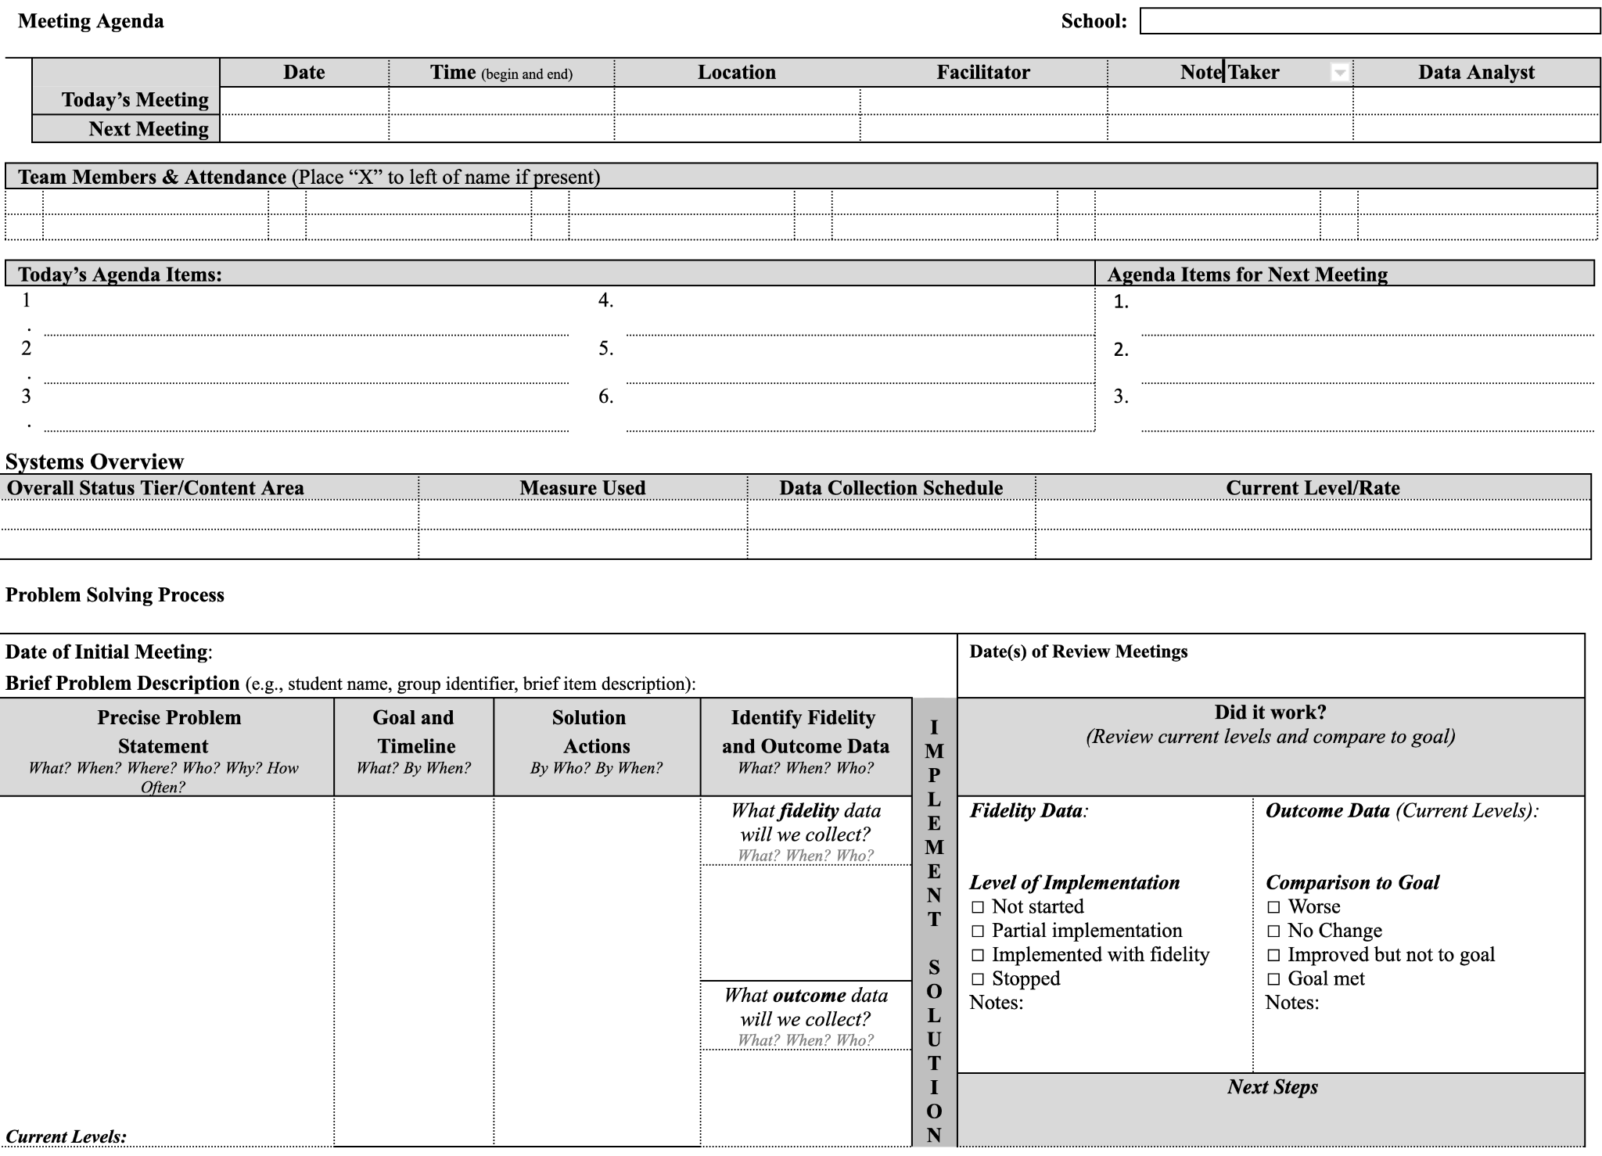
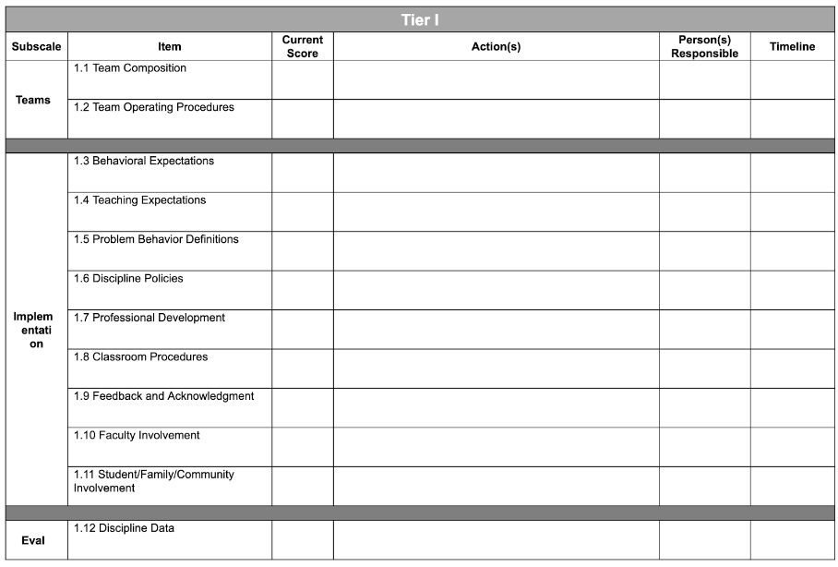
Task 3-Select Agenda & Action Planning Format
Workbook TFI 1.1 & 1.2
Teaming Activity 3
Notes:
This slide introduces Task 3-making sure that the team has an agenda and action plan.

Slide 21
Task 4-Create Agreements/Norms for Team Meetings
Sample Agreements/Norms:
Start on time, end on time
Listen to understand, not reply
Use the team meeting process
Actively participate
Assume best intentions
Reflect on the professional behaviors that characterize efficient and effective meetings you have attended.
What working agreements will support your team’s work and heighten your productivity?
Set your meeting schedule for the school year.
Workbook TFI 1.1 & 1.2
Teaming Activity 4
Notes:
This slide introduces task 4 Creating norms, and working agreements.

Slide 22
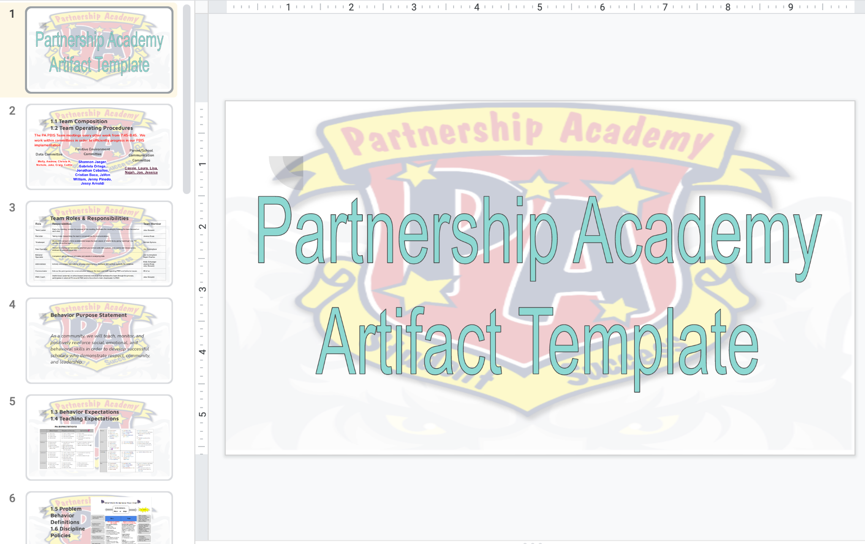
Task 5-Begin documenting your team’s artifacts
http://bit.ly/PBISArtifactsFolders
The Artifact Template is a comprehensive document that will be used to organize your PBIS products, share your PBIS implementation with stakeholders and train staff.
Workbook TFI 1.1 & 1.2
Teaming Activity 5
Notes:
This slide introduces task 5 - Understanding, finding and beginning their artifact template

Slide 23
References
Colvin, G. (2007). 7 Steps for developing a proactive school-wide discipline plan
Newton, J.S., Horner, R., Algozzine, B., Todd, A., & Algozzine, K.M. (2009). Using a problem-solving model for data-based decision-making in schools. In W. Sailor, G. Dunlap, G. Sugai, & R. Horner (eds.). Handbook of positive behavior support. New York: Springer
TIPS Training Manual (2013).
Todd, A., Horner, R., Newton, J.S., Algozzine, B, & Algozzine, K. (in press). Effects of Team-Initiated Problem-solving on Practices of School-wide Behavior Support Teams. Journal of Applied School Psychology.
Notes:
Reference Review

Slide 24
Team Implementation Planning
MN Implementation Workbook
Notes:
This slide reminds teams to work on implementation tasks during their work time.

