Slide 1
Welcome New Teams!
Minnesota PBIS Cohort 17 Fall Training – Days 1&2
MDE PBIS Management Team
MDE.PBIS@state.mn.us

Slide 2
Welcome to Minnesota PBIS Cohort Training!

Slide 3
Ten Minnesota Commitments to Equity
Notes:
Value people-George Floyd and others that have gone before him, schools, districts and the collective community that impact student lives.
Conditions for learning-not in building just yet but making ways for students, staff and families to received better educational circumstances.

Slide 4
Welcome New Teams! PBIS Minnesota Cohort Training
Takeaways
2020 in Review
PBIS Growth in Minnesota
Supports for PBIS Across Learning Environments

Slide 5
2020 in Review

Slide 6
March – May 2020
March 2020: Emergency Executive Order 20-02 authorized and directed the Commissioner of Education to temporarily close schools to plan for a safe educational environment.
March 2020: Emergency Executive Order 20-19 authorized and directed the Commissioner of Education to implement a Distance Learning Period and continue to provide a safe learning environment for Minnesota’s students.
May 2020: Emergency Executive Order 20-41 authorized and directed the Commissioner of Education to extend the Distance Learning Period and continue to provide a safe learning environment for Minnesota’s students.

Slide 7
Thanks from Commissioner to Exemplar Schools
“In education, our students are the heart of everything we do. It is critical that they feel supported, especially as they encounter challenging and traumatic issues…”
“I congratulate and thank these schools and districts for reimagining and transforming the way they care for and support our students. Your work not only benefits our schools, but it benefits our communities as a whole.”
- MDE Commissioner Mary Cathryn Ricker

Slide 8
Honoring the Life of George Floyd, and Lives of Every Person That Were Cut Short Due to Racism
Local, national and international mourning for George Floyd is about more than one tragic incident
Result of generations of systemic racism that threaten the dignity of our state’s Black communities, Indigenous communities, and communities of color
“We will not wake up one day and have the disease of systemic racism cured; we must do everything in our power to come together to deconstruct generations of systemic racism in our state so that every Minnesotan – Black, Indigenous, Brown, or White – can be safe and thrive.”
- State of Minnesota Proclamation, Tuesday, June 9, 2020

Slide 9
July 2020
July 2020: Emergency Executive Order 20-82 authorized and directed the Commissioner of Education to require school districts and charter schools to provide a safe and effective learning environment for Minnesota’s students during the 2020-21 school year
The Safe Learning Plan uses a localized, data-driven approach that allows public schools to operate in a learning model that is responsive and prioritizes the health and safety of students, educators and school communities
Families can learn more about the announcement here.

Slide 10
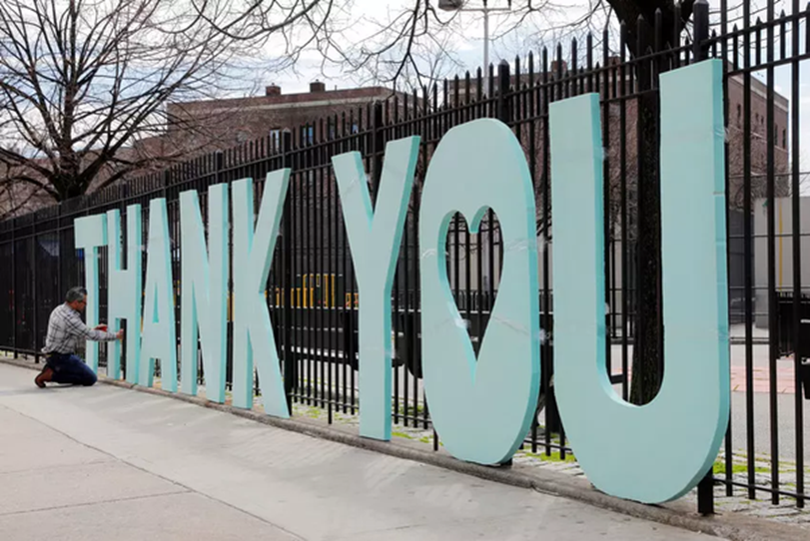
Education in 2020
As educators you are being asked to do the impossible under unprecedented circumstances

Slide 11
PBIS Growth in Minnesota

Slide 12
Growth of PBIS in Minnesota 2005-2020
Cohort 15
You are here!
803

Slide 13
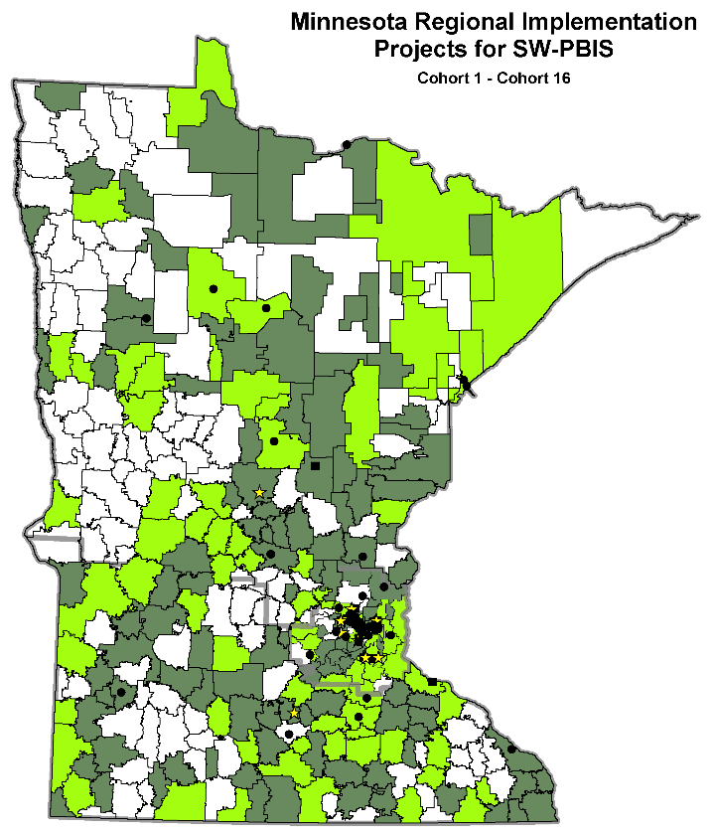
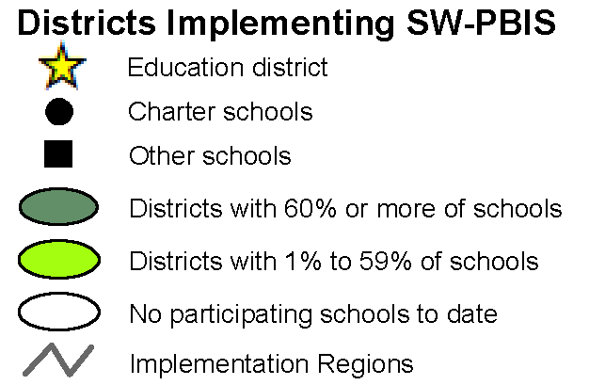
PBIS Scale-Up in Minnesota As of 2020
274 districts/charters
55% of districts/charters in MN
803 schools
39% of schools in Minnesota
378,097 of students
43% of students in Minnesota

Slide 14
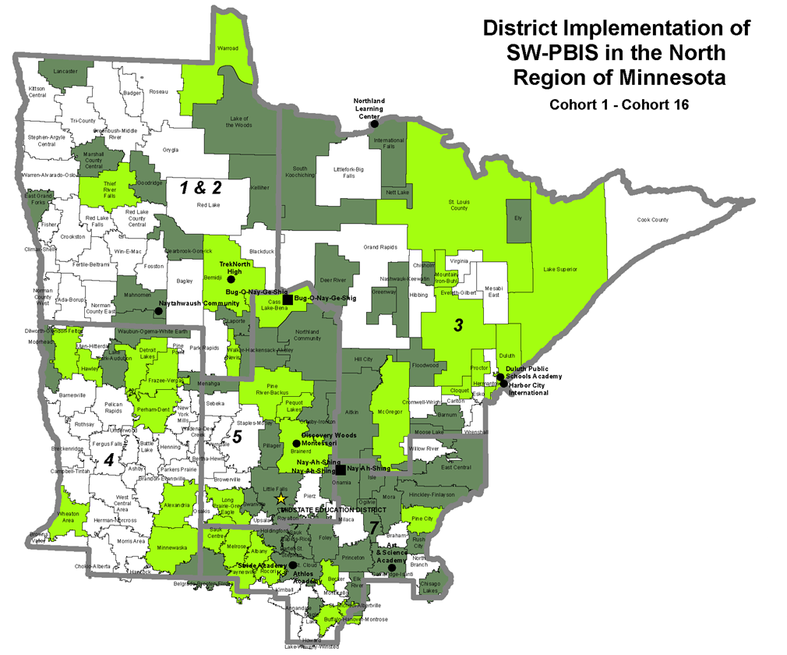
North Regional Implementation Project As of 2020
The impact of schools from
NRIP Cohorts 1-16:
105 districts / charters
47% of NRIP districts
254 schools
28% of NRIP schools
≈ 113,221 students

Slide 15
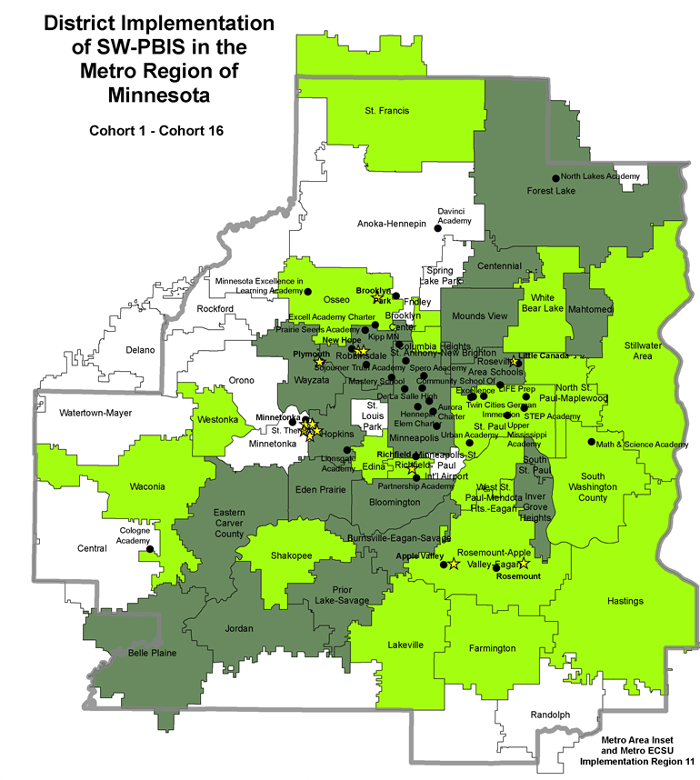
Metro Regional Implementation Project As of 2020
The impact of schools from
MRIP Cohorts 1-16:
78 districts / charters
45% of MRIP districts
343 schools
25% of MRIP schools
≈ 196,271 students

Slide 16
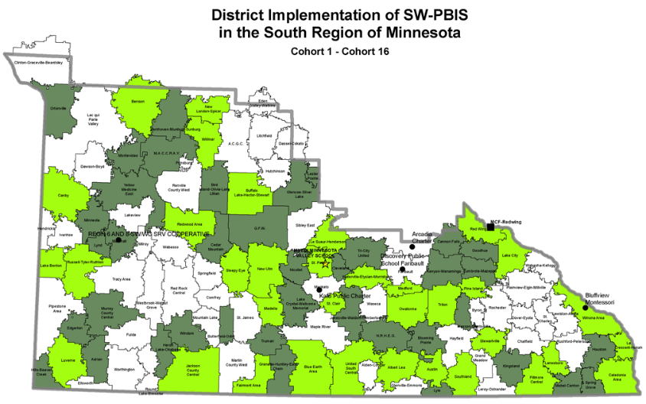
South Regional Implementation Project As of 2020
The impact of schools from
SRIP Cohorts 1-16:
93 districts / charters
58% of SRIP districts
201 schools
30% of SRIP schools
≈ 68,615 students

Slide 17
Top 10 Aligned Initiatives Implemented: Statewide Cohort 16

Slide 18
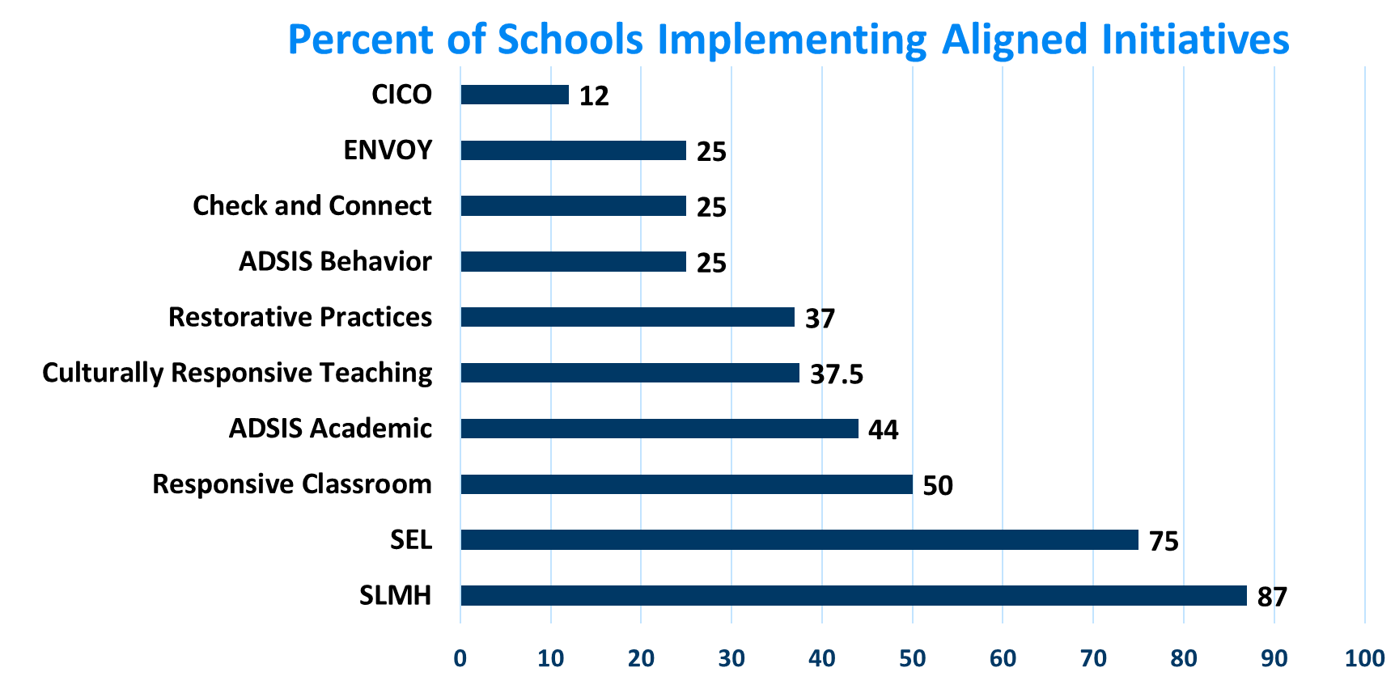
Top 10 Aligned Initiatives Implemented: North Regional Implementation Project Cohort 16

Slide 19
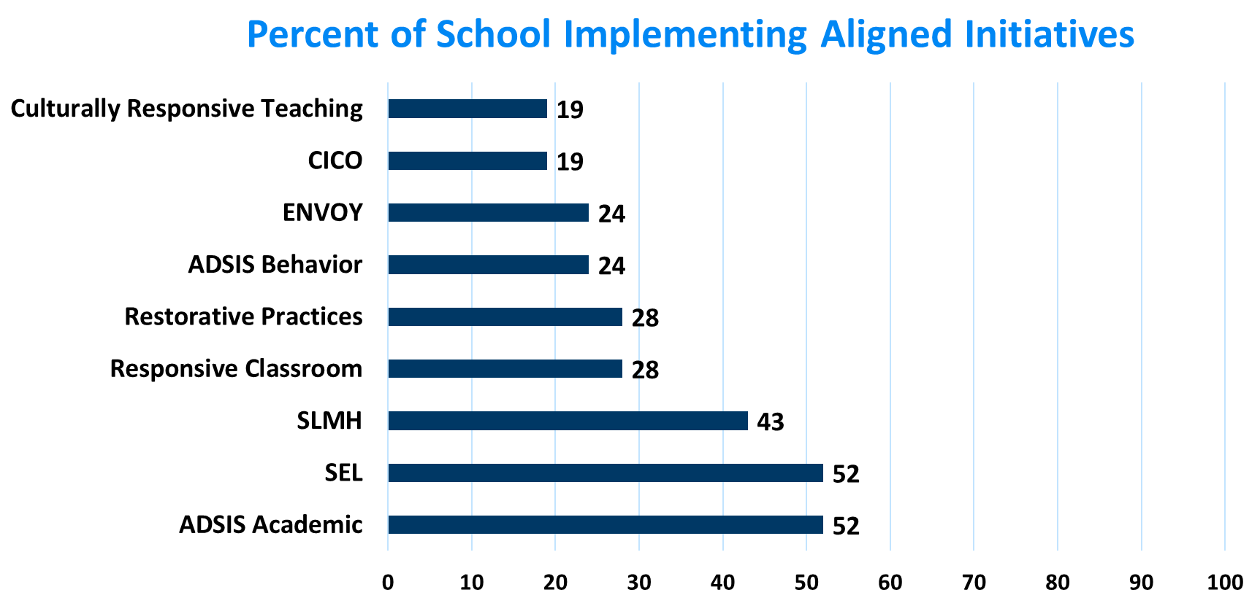
Top 10 Aligned Initiatives Implemented: Metro Regional Implementation Project Cohort 16

Slide 20
Top 10 Aligned Initiatives Implemented: South Regional Implementation Project Cohort 16

Slide 21
Supports for PBIS Across Learning Environments

Slide 22
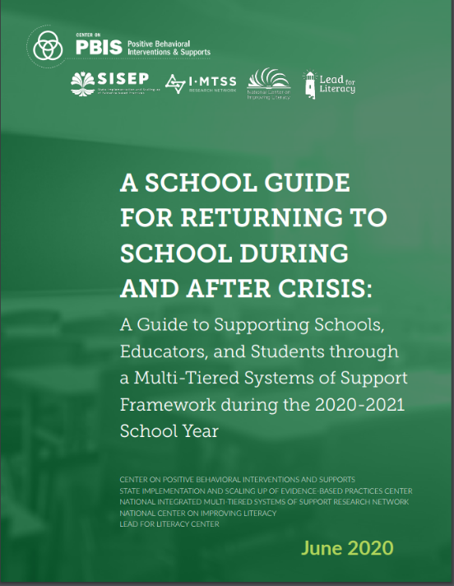
Collective National Centers’ Guidance: Returning to School During and After Crisis
Link to "Returning To School During and After Crisis"

Slide 23
Tips to Make Distance Learning and the Transition Safe, Predictable and Positive
First, be kind to yourself and everyone else who is trying something new, or returning to something less familiar.
Then continue to consider these strategies:
Use the same language.
Define online expectations.
Practice expected behaviors.
Continue positive, familiar routines.
Notes:
Use the same language. If your school already had a PBIS framework in place, your teachers should continue using the same consistent language and expectations. This will help students and teachers feel connected to familiar practices. For example, if your school had a motto that was displayed around the school building, put that motto on the banner of your online learning portal or at the bottom of email messages.
Define online expectations. Teachers will need to demonstrate what expected behaviors look and sound like in the virtual classroom with large-group and small-group online live classes, as well as independent work. "Many of us make assumptions that students know how to act in an online school environment," McIntosh said. Specific online practices, such as the use of chat boxes and raising a virtual hand to be acknowledged, should be taught.
Practice expected behaviors. Give students a chance to practice the online expectations you've taught. For example, set aside time to have students send positive notes to classmates in the chat box or to practice muting and unmuting their audio. Teachers should connect individually with students to see if they have any questions or concerns about videoconferencing.
Continue positive, familiar routines. Do your teachers individually greet students at the door before classes began? They can still individually greet students as they are welcomed into videoconferencing sessions. Teachers should also continue looking for opportunities to praise students who are working on task and who demonstrate positive behaviors.

Slide 24
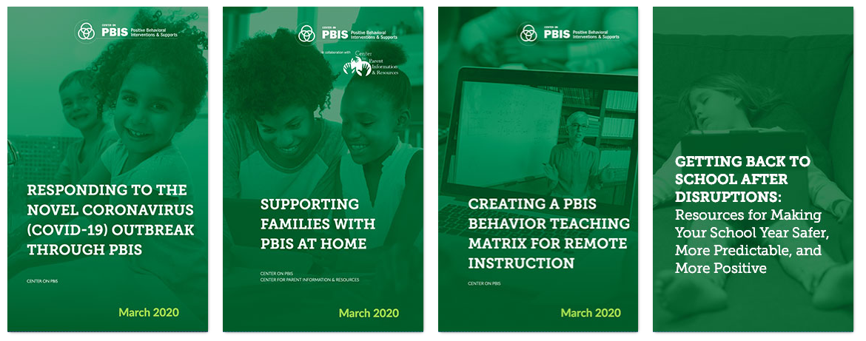
Resources to Support Students During the Pandemic
Source: https://www.pbis.org

Slide 25
Considerations During Transition to In-Person and Contingency Planning
Focus “prior to return, initial return, and post-initial return” with your action items
Capacity and fidelity are vulnerable during times of transition or disruption
If you have had a lot of staff changes since the spring, may want fidelity assessment in early fall to assess impact and action plan if needed to strengthen implementation
Incorporate lessons learned during distance learning (e.g., expanded expectation matrices, use of technology for connecting with students, etc.)
MTSS structures can be an important tool during times of transition and should be used to identify and address issues related to equity

Slide 26
Virtual PBIS Leadership Forum 2020
Virtual PBIS Leadership Forum – October 21, 22 & 23
George Sugai will present the Keynote
Session Descriptions
Registration Opens August 15th
$50.00 Registration Fee
http://www.pbisforum.org/

Slide 27
Virtual Minnesota PBIS Summer Institute
The links to the Presentations and Recordings can be found at the Summer Institute Webpage
Topics Included
PBIS 101
Implementing a Trauma Informed School Wide Support System
SWIS Update
Scaling up PBIS in an Urban School District
Transition to Adult Life
Positive & Responsive behavior Tools for Educators
Implementing PBIS with a Native Voice
How to Measure PBIS Implementation Fidelity When Interruptions Occur.

Slide 28
Upcoming Webinars
August 5th, 12:30-2:00, 5 Practically Good Ideas for Any Reality, Dr. Clayton Cook, University of Minnesota
Register at: http://sgiz.mobi/s3/5-Practically-Good-Ideas-for-Any-Reality
August 14th, 9:00-10:15, Returning to School During and After Crisis: A Guide to Supporting States, Districts, Schools, Educators, and Students through a Multi-Tiered Systems of Support Framework during the 2020-2021 School Year, Dr. Brandi Simonsen, University of Connecticut
August 24th, 1:00-2:30, Check-In/Check-Out as a Tier 2 Support: What Does Like and How Can It Be Adapted During Distance or Hybrid Learning Environments, Dr. Kevin Filter, MSU-Mankato
August 25th, 8:30-10:00, The Interconnected Systems Framework (ISF), Kelly Perales and Brian Meyer from the Midwest PBIS Center

Slide 29
Distance Learning Resources – pbisMN.org
pbisMN.org

Slide 30
Share your #pbisMN work!
facebook.com/pbisMN
twitter.com/pbisMN

Slide 31
North Regional Contacts
North Regional Implementation Project
Erin Engness NRIP Coordinator pbis.erin@gmail.com
PBIS Management - Regional Contacts
Erin Farrell
Erin.Farrell@state.mn.us
Mary Hunt
Mary.Hunt@state.mn.us
Eric Kloos Eric.Kloos@state.mn.us
PBIS Evaluation Contact
Wilder Research pbisevalmn@wilder.org
Find other PBIS Minnesota contacts at: http://pbismn.org/contact-us.php

Slide 32
Metro Regional Contacts
Metro Regional Implementation Project
Lauren Sparr MRIP Coordinator Lauren.Sparr@metroecsu.org
PBIS Management - Regional Contacts
Ellen Nacik Ellen.Nacik@state.mn.us
Daniel Torrez
Daniel.Torrez@state.mn.us
Eric Kloos Eric.Kloos@state.mn.us
PBIS Evaluation Contact
Wilder Research pbisevalmn@wilder.org
Find other PBIS Minnesota contacts at: http://pbismn.org/contact-us.php
Notes:
Dan the ADIS man

Slide 33
South Regional Contacts
South Regional Implementation Project
Liz Deen
Lead SRIP Coordinator
Liz.Deen@swwc.org
Hazel Ashbeck
SRIP Coordinator – SWWC
Hazel.Ashbeck@swwc.org
Erin Toninato SRIP Coordinator – South Central Service Cooperative EToninato@mnscsc.org
Amber Bruns Southwest West Central Service Cooperative Amber.Bruns@swwc.org
PBIS Management - Regional Contacts
Garrett Petrie
Garrett.Petrie@state.mn.us
Janet Christensen
Janet.Christensen@state.mn.us
Eric Kloos Eric.Kloos@state.mn.us
PBIS Evaluation Contact
Wilder Research pbisevalmn@wilder.org
Find other PBIS Minnesota contacts at: http://pbismn.org/contact-us.php

Slide 34
Thank You!
Minnesota Department of Education – PBIS Management Team
MDE.PBIS@state.mn.us

